Slide 1
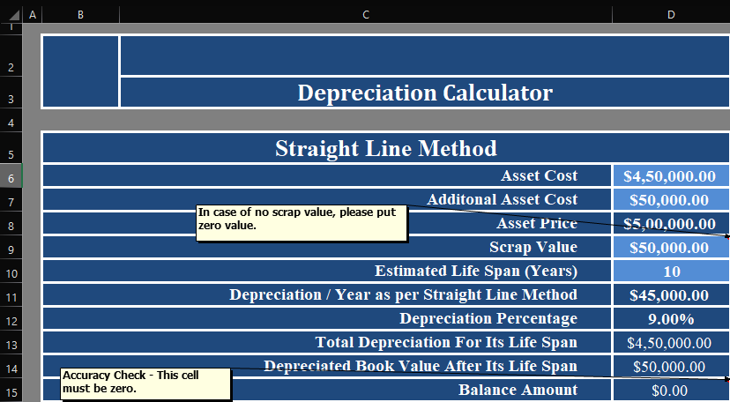
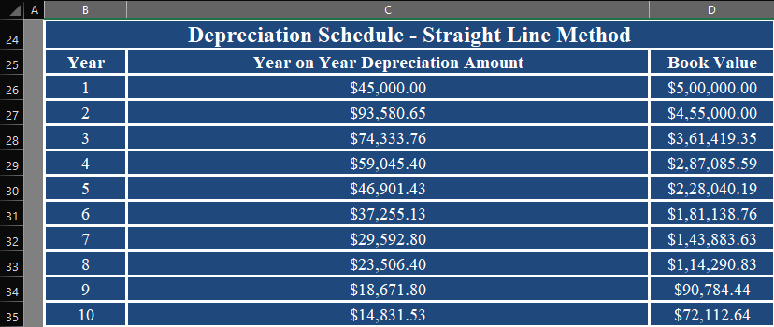
Calculate the annual depreciation amount using the straight-line method for the given asset.
Below is the given Depreciation Calculator wherein depreciation is to be calculated with a Straight-line method.
In order to find out the depreciation, we need to apply the following formula: =(D8-D9)/D10 This formula is Depreciation per year = (Asset Price - Scrap Value) / Estimated Life Span. We get the following result for 10 years:

Slide 2
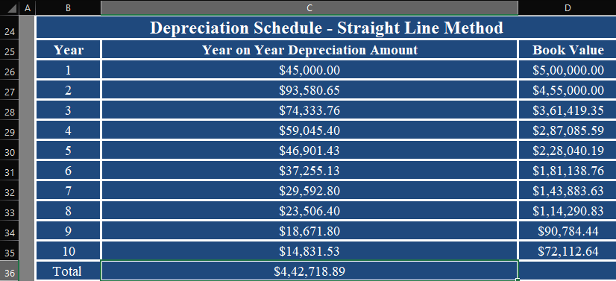
Calculate the total depreciation for the asset's entire life span using the straight-line method.
Below is the given Depreciation Calculator wherein depreciation is to be calculated with a Straight-line method.
In order to find out the depreciation, we need to apply the following formula: =SUM(C26:C35) We get the following result for 10 years:

Slide 3
What is the depreciated book value of the asset after its life span using the straight-line method?
Below is the given Depreciation Calculator wherein depreciation is to be calculated with a Straight-line method.
Depreciated book value can be found in the cell “D35” with a value of $72,112.64 which is calculated after depreciation of the asset value for 10 years using a straight line method

Slide 4
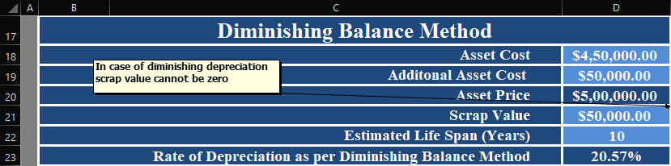
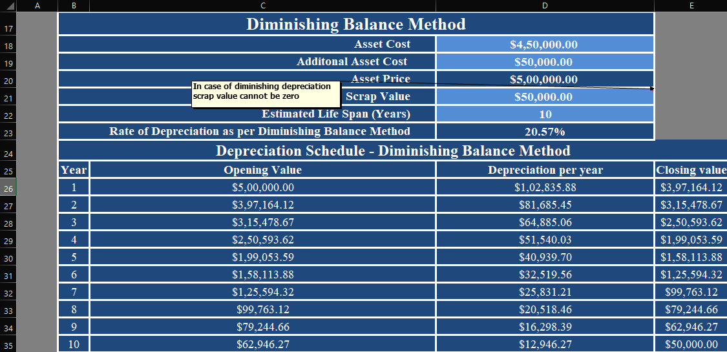
Calculate the rate of depreciation per year as per the diminishing balance method.
Below is the given Depreciation Calculator wherein depreciation is to be calculated with a diminishing balance method.
In order to find out the depreciation, we need to first find out “Depreciation per year”. This can be found out by the formula: Depreciation per year = Book Value at Beginning of Year *Depreciation Rate. So applying this in the workbook, we use the formula: =C26*$D$23. This results in the value of $1,02,835.88 for 1st year.

Slide 5
What is the depreciation amount for the asset in the second year according to the diminishing balance method?
Below is the given Depreciation Calculator wherein depreciation is to be calculated with a diminishing balance method.
In order to find out the depreciation amount for the 2nd year, we need to first find out the closing value of the asset after 1st year. As we already know the depreciation amount for the 1st year, we can deduct the same from the Opening value. Using the closing value as the Opening value for the 2nd year, we can use the formula: =C27*$D$23 to find out the depreciation amount for the 2nd year. This comes to the value of $81,685.45

Slide 6
What is the book value of the asset in the fourth year using the diminishing balance method?
Below is the given Depreciation Calculator wherein depreciation is to be calculated with a diminishing balance method.
In order to find out the book value of the asset for the 4th year, we need to first find out the closing value of the asset after 3rd year. As we already know the depreciation amount for the 3rd year, we can deduct the same from the Opening value. Using the closing value as the Opening value for the 4th year, we get the book value of the asset for the 4th year. This comes to $2,50,53.62

Slide 7
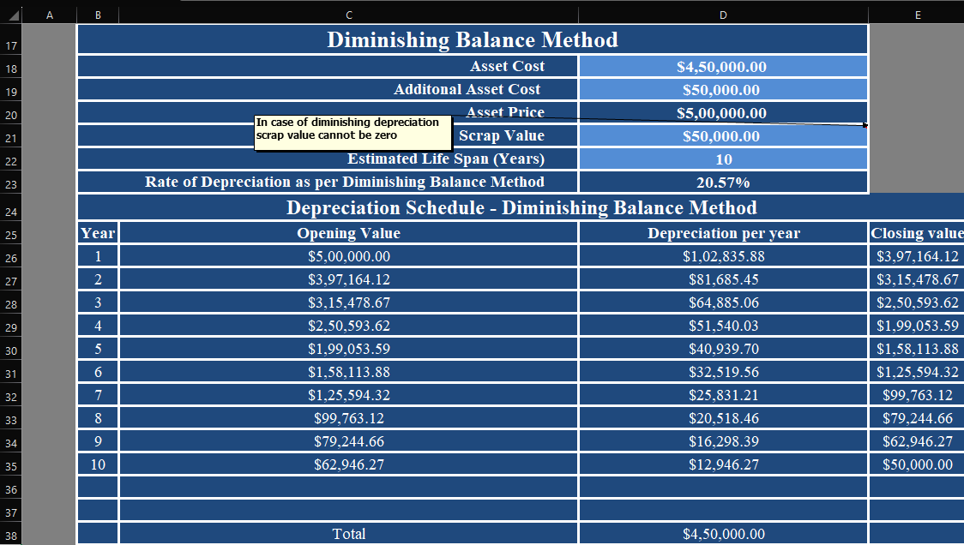
Calculate the total depreciation for the asset's entire life span using the diminishing balance method.
Below is the given Depreciation Calculator wherein depreciation is to be calculated with a diminishing balance method.
In order to find out the total depreciation amount for the asset’s entire life span, we can add all the amount in the “Depreciation per year” column with the formula: =SUM(D26:D35). The total comes to $4,50,000.00

Slide 8
What is the book value of the asset after its life span using the diminishing balance method?
Below is the given Depreciation Calculator wherein depreciation is to be calculated with a diminishing balance method.
In order to find out the book value of the asset after its life span (10 years) we need to look at the closing value for the 10th year. This amount is $50,000.00

Slide 9
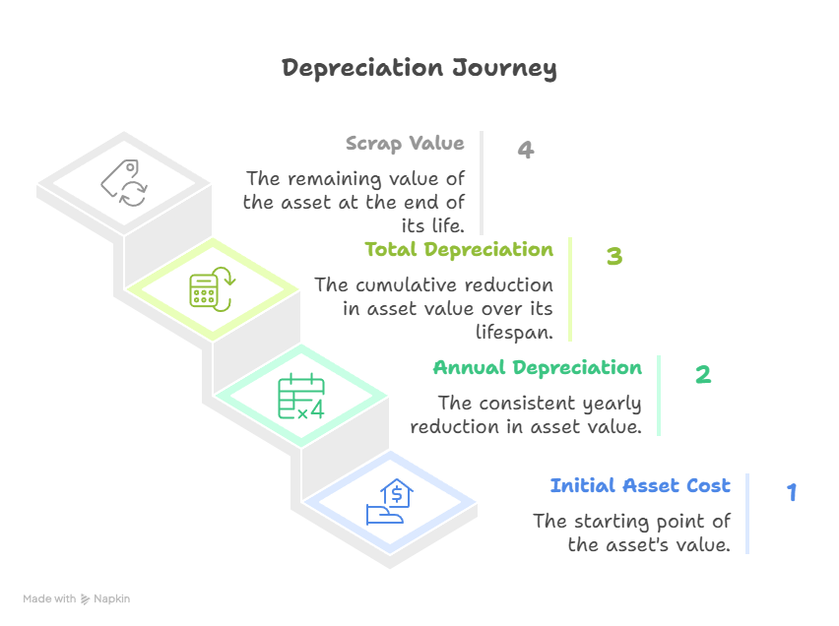
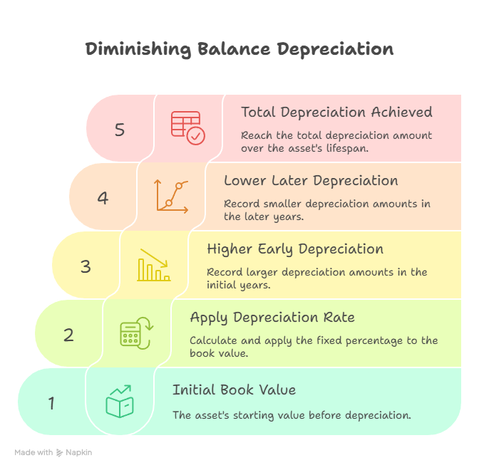
Compare the total depreciation amounts obtained from the straight-line method and the diminishing balance method. Which method results in higher total depreciation?
Particulars | Straight-Line Method | Diminishing Balance Method
Asset Cost | ₹5,00,000 | ₹5,00,000
Scrap Value | ₹50,000 | ₹50,000
Estimated Life (Years) | 10 | 10
Depreciation Rate | 9% | 20.57%
Annual Depreciation Pattern | Fixed every year (₹45,000 per year) | Reduces each year based on book value
Total Depreciation Over Life Span | ₹4,42,718.89 | ₹4,50,000.00
Book Value at End of Life | ₹50,000 | ₹50,000
Depreciation Trend | Equal expense throughout | Higher in early years, lower in later years
Complexity | Simple to calculate and apply | Requires recalculating each year’s value
Best Suited For | Assets that provide uniform benefit over time | Assets that lose value faster in initial years (e.g., machinery, equipment)

Slide 10
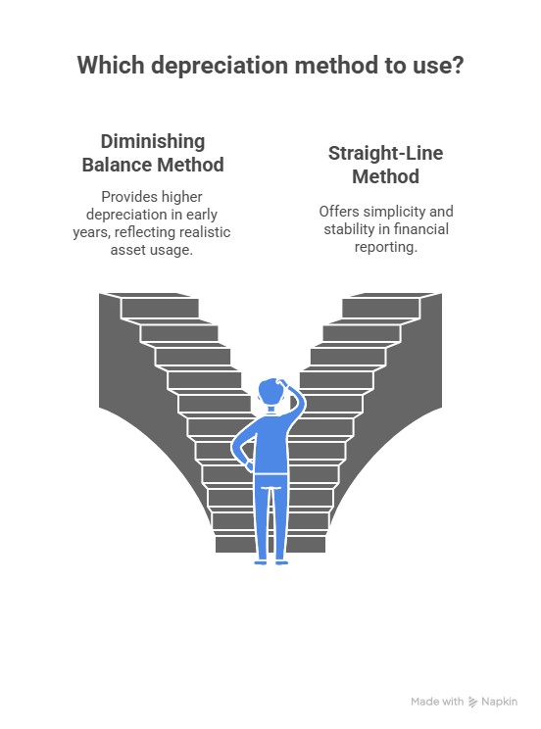
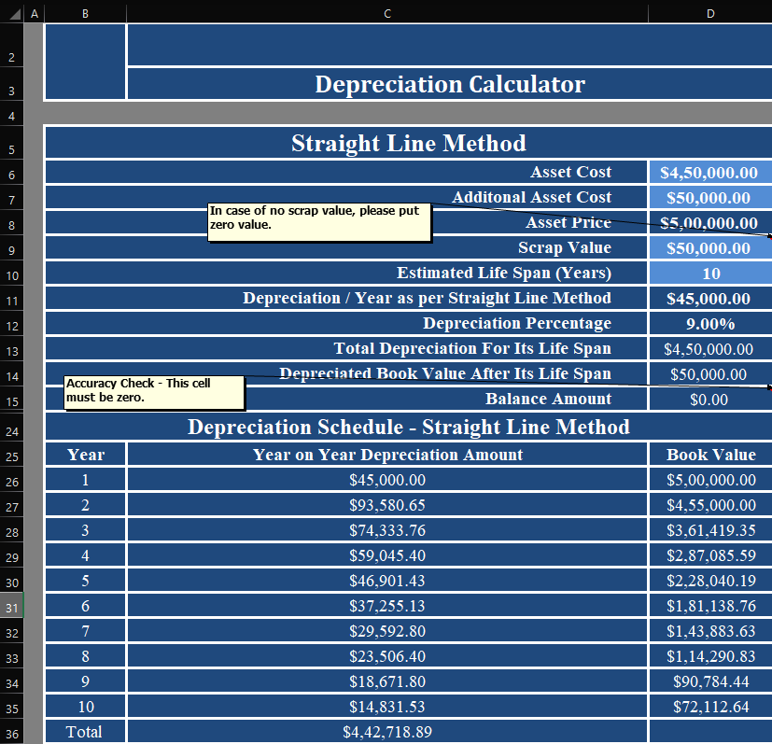
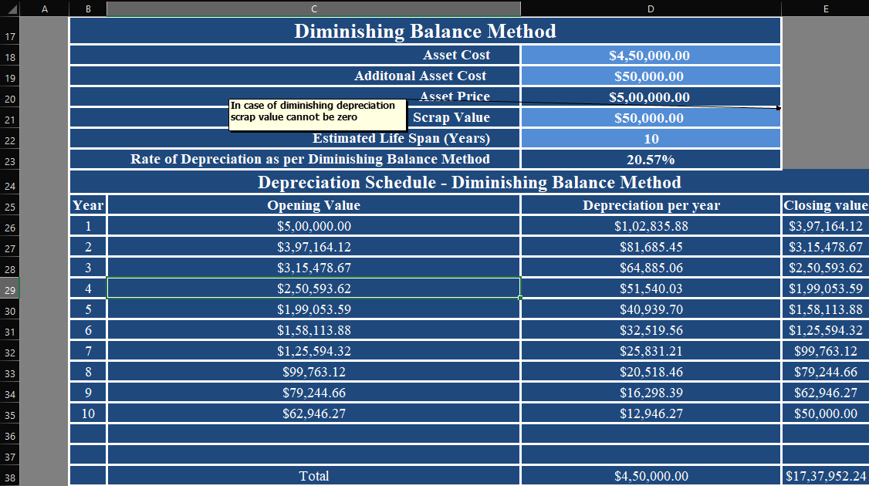
Conclusion
Comparing the two methods, the Diminishing Balance Method results in slightly higher total depreciation than the Straight-Line Method.
This approach provides a more realistic reflection of an asset’s usage and wear in the initial years.
The Straight-Line Method, on the other hand, offers simplicity and stability in financial reporting.

