Slide 1
Team 11 – Final Project
Sentiment Analysis on Amazon fine food reviews
INFO 7390 Advances in Data Science and Architecture

Slide 2

AMAZON FINE FOOD REVIEWS SENTIMENT ANALYSIS

Slide 3
Introduction
The focus of this project is, to do sentiment analysis on amazon fine food reviews data which contains more than 5 million reviews. As a part of project, we are performing below tasks:
Data Extraction and Conversion
Cleaning and pre-processing
Data Exploratory analysis (using python and Power BI)
Sentiment classification and analysis
Luigi Pipeline
Dockerization
Creation of Rest API using Microsoft Azure ML Studio
UI deployment

Slide 4
Columns in Data Set
ProductId - unique identifier for the product
UserId - unique identifier for the user
ProfileName- Name of the user
Helpfulness Numerator - number of users who found the review helpful
Helpfulness Denominator - number of users who indicated whether they found the review helpful
Score - rating between 1 and 5
Time - timestamp for the review
Summary - summary of the review
Text - text of the review

Slide 5
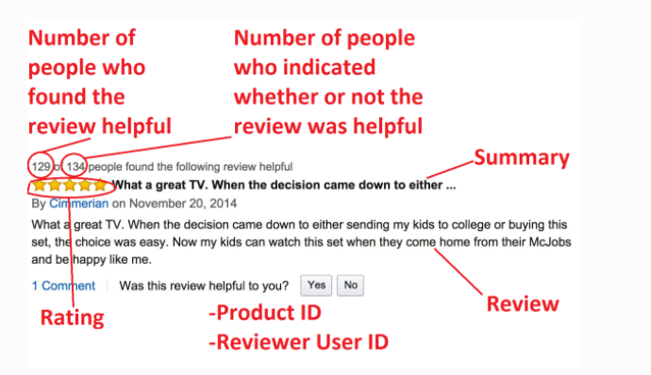
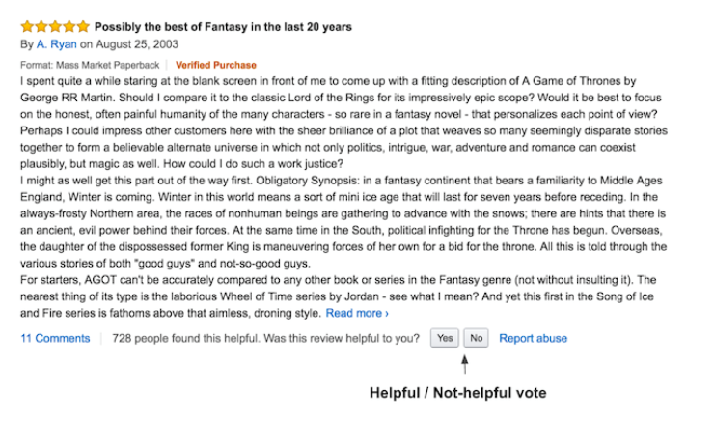
Columns in Data Set

Slide 6
Data Extraction and Conversion
Automated process to download data from https://snap.stanford.edu/data/finefoods.txt.gz
As data is present in .gz format, decompressed it to get .txt file present
Then .txt file converted it into .csv file
To achieve above steps defined several functions like download_data, decompress_data, convert_data,Prepare_Data
Also, helpfulness column divided it into helpfulness numerator and helpfulness denominator before saving it in .csv format
Added date column as well based on time column
Saved it into Reviews.csv

Slide 7
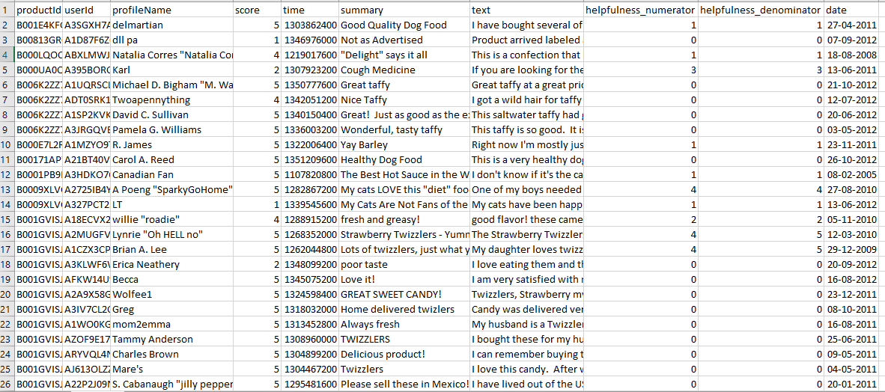
Preview of Reviews.csv

Slide 8
Pre-Processing Data
Tokenization:
Removing punctuation, removing stopwords and converting text to lower case using NLTK’s Porter Stemmer and word tokenize
Stemming:
The process of reducing inflected (or sometimes derived) words to their word stem, base or root form—generally a written word form. It takes morphologically complex words and reduces them to their root morphemes.
For example, the input contains the words "tasty", "tastier", and "tastiest", the suffixes would be stripped off and these forms would be treated as a single stem, "tasti"
Lemmatization:
removes inflectional endings only and to return the base or dictionary form of a word, which is known as the lemma
e.g. if support there is word better then it will give me its base form as good or plural form line cats become singular like cat
but if word is “best” it returns best
As lemmatization provides more accurate results over stemming, we have chosen it

Slide 9
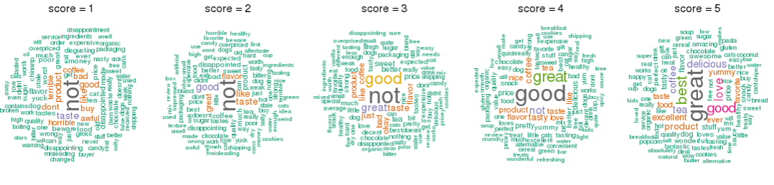
Exploratory Data Analysis (using python)
Word Cloud of Reviews sorted by Score

Slide 10
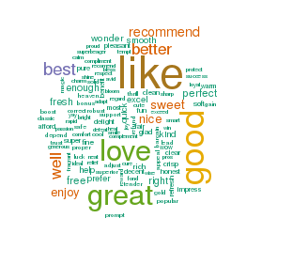
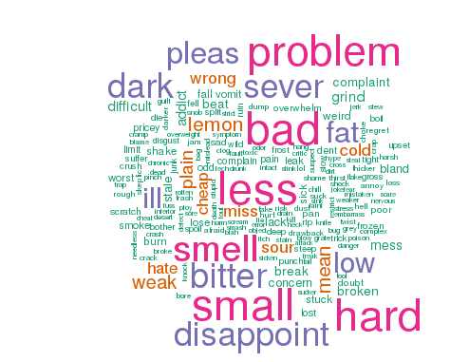
Exploratory Data Analysis (using python) Word Cloud
Positive Word Cloud
Negative Word cloud

Slide 11
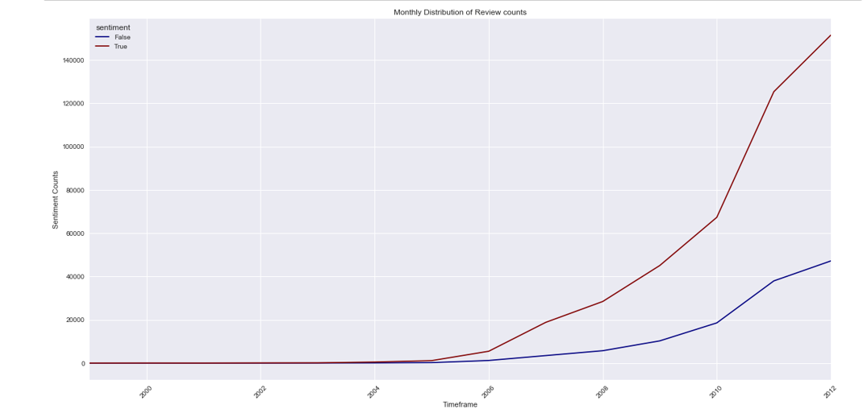
Exploratory Data Analysis Time series for yearly sentiment counts

Slide 12
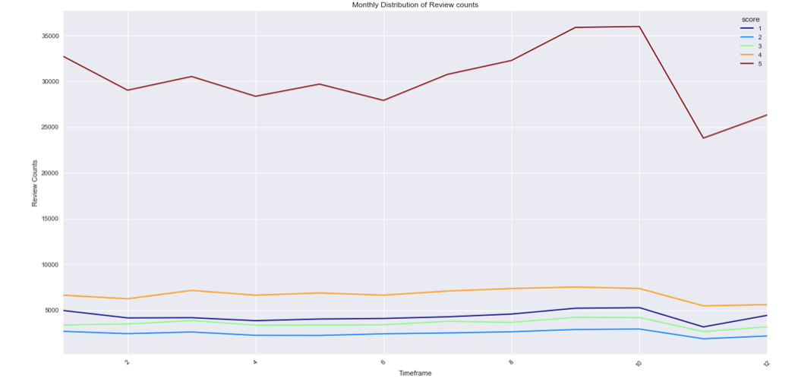
Exploratory Data Analysis Time series for monthly review counts

Slide 13
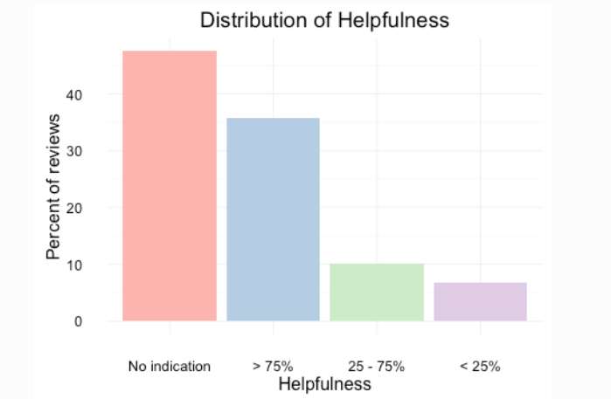
Exploratory Data Analysis (using python) contd..
Analysis 3: How many reviews are helpful?

Slide 14
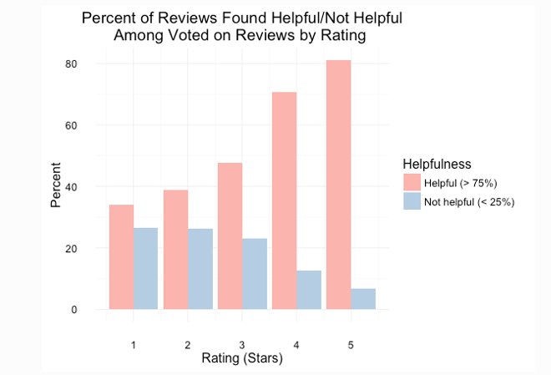
Exploratory Data Analysis (using python) contd..
Analysis 4: How ratings affect helpfulness

Slide 15
Exploratory Data Analysis (using python) contd..
Conclusions for data exploratory analysis:
Positive reviews are very common
Positive reviews are shorter
Longer reviews are more helpful
Despite being more common and shorter, positive reviews are found more helpful
Frequent reviewers are more discerning in their ratings, write longer reviews, and write more helpful reviews

Slide 16
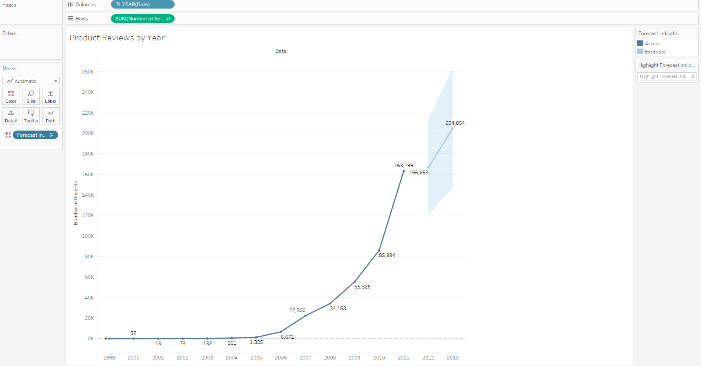
Power BI – Exploratory analysis
Product Reviews by Year

Slide 17
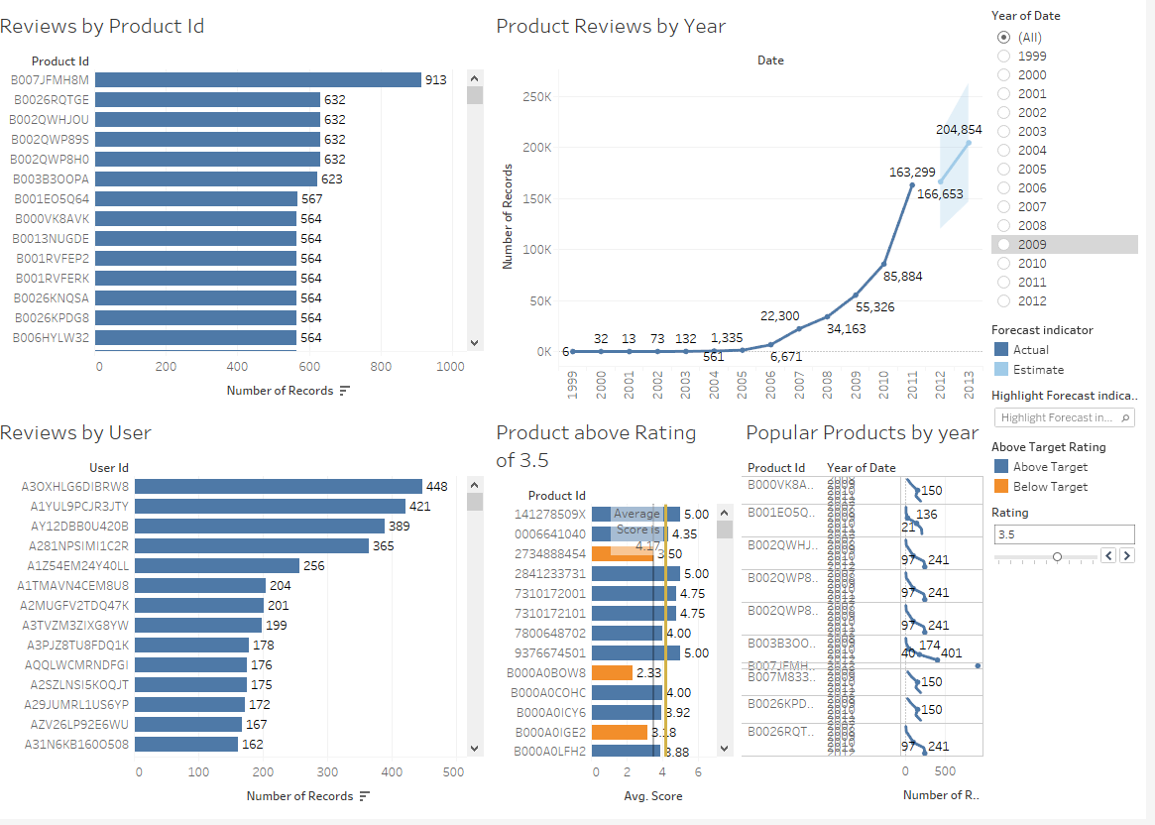
Power BI – Exploratory analysis

Slide 18
Sentiment classification and analysis
Approximately 4.44 million reviews having score i.e. ratings 5 and 4
Rest approximately 1.25 million reviews fall under review score 1, 2, and 3
So, in percentage,
Percentage for reviews with score 1, 2 or 3 are 21.93 %
Percentage for reviews with score 5 and 4 are 78.07 %

Slide 19
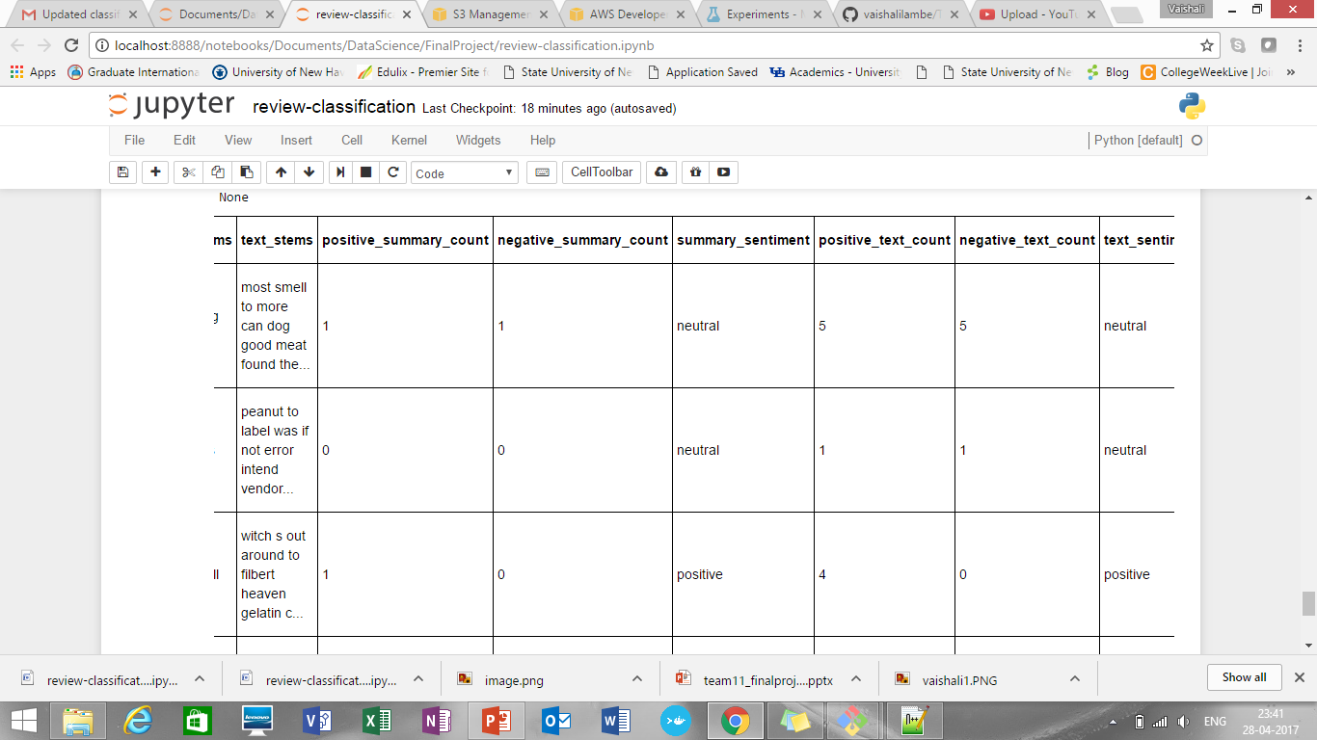
Sentiment classification and analysis contd..
Approach1 for sentiment classification:
Classify summary and text of a product
Stem and give positive and negative count for it
Creates new sentiment lable as “positive”, “negative”, “neutral” based on that count

Slide 20
Sentiment classification and analysis
There are 3 inputs: - a list of positive words (text file, one per line) - a list of negative words (text file, one per line) - a CSV file for the processed reviews (only the ‘summary’ and ‘text’ columns are used) First the positive and negative word files are read to give lists of positive and negative words. Each of these lists is stemmed and reduced to a list of unique stems. Next the summary and text columns from each row are read and processed: - the entry is tokenized using NLTK’s wordpunct_tokenize() function. - undesirable tokens, e.g. those that are numbers or consist entirely of punctuation, are removed. - the tokens are converted to lowercase. - the tokens are stemmed, and reduced to a list of unique stems. The summary stems are added to a ‘summary_stems’ column, and the text stems are added to a ‘text_stems’ column. To determine whether a review is positive, neutral or negative the stems for the review are compared to those in the positive and negative stem sets: - the positive count is the number of stems from the review that appear in the positive stem set - the negative count is the number of stems from the review that appear in the negative stem set If the positive count is greater than the negative count, the review is considered positive. If the positive count is less than the negative count, the review is considered negative. If the positive count is equal to the negative count, the review is considered neutral. This determination is done for both the summary stems and the text stems. Finally the following values are added back to the dataframe as additional columns: - the positive count for the summary stems - the negative count for the summary stems - the sentiment for the summary (positive, neutral or negative) - the positive count for the text stems - the negative count for the text stems - the sentiment for the text (positive, neutral or negative)

Slide 21
Sentiment classification and analysis contd..
Approach2 for sentiment classification:
First we divided reviews as positive and negative on the basis on score value.
Score value > 3 are considered as positive while rest considered as negative
After tokenizing the training data to find frequency of words we found that total “2708” unique words are present in review text
When doing text classification, the vocabulary of the data set becomes the feature set
So, we followed feature selection option to reduce the features
Used most frequent 5000 features/words as feature set
When we tried to print top most frequent words found that:

Slide 22
Sentiment classification and analysis contd..
Then split data into train in test dataset (train = 0.5 and test =0.25)
Ran three classification algorithms on it:
Naïve Bayes
Logistic regression
Decision trees
Ran only for 5000 feature set
Model | Accuracy
Naïve Bayes | 87.01%
Logistic Regression | 88.79%
Decision Trees | 91.41%

Slide 23
Sentiment classification and analysis contd..
Finally, we can try by running it on our entire feature set. One can guess it will take a lot of time with Decision Tree Classifier.
We can make use of group of words to get better results. Sometimes sequence of words might have different effect on the prediction. Sequences like "not good" or "not bad" affect the prediction in way different than when used individually
So, we will use bigrams for it
First added one more column sentiment label as true and false for positive and negative sentiments
Plotted it against graph

Slide 24
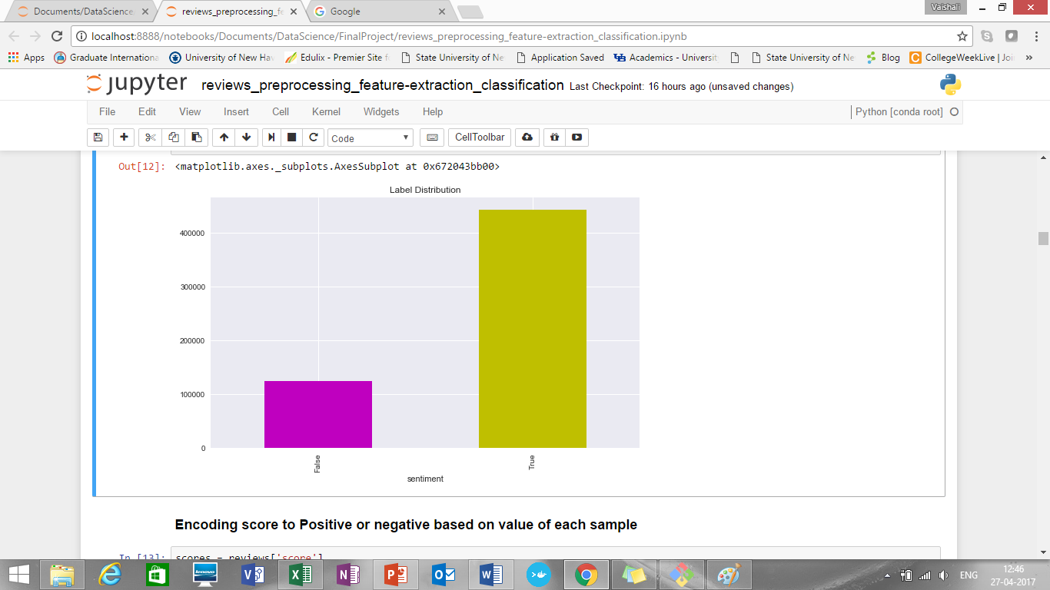
Sentiment classification and analysis contd..

Slide 25
Sentiment classification and analysis contd..
sentiment
Number of positive and negative reviews getting were:
False 124646 (negative)
True 443766 (positive)
Ran all three algorithms Naïve Bayes, Logistic Regression and Decision Tree
Summary for accuracy of each model:
Model | Accuracy
Naïve Bayes | 88.65%
Logistic Regression | 92.87%
Decision Trees | 91.64%

Slide 26
Sentiment classification and analysis contd..
Further we are populating top Best and top Worst reviews:
Top best reviews by sentiment score
[1] these cookies were fun to paint but not too tasty to eat the kids did not care much but it might have been more fun if they could have eaten them they really had fun coloring them
[2] i ordered this for a friend at south carolina for christmas i want her to try some italian chocolates lol the item was arrived earlier than expected but nevertheless it was well packed and only melts on her mouth she totally loves itthree different taste and flavors of ferreros guarantees to give three different yummy joy mmmmm
[3] i'm on my first jar of this and am enjoying what it adds to my concoctions vegetarian one pan mix ups of onions garlic vegetables usually tofu rice or pasta or quinoa sometimes olives or capersi may have purchased it at uwajimaya when on salei will be buying many more jars of this mixed spice paste it’s not a paste more liquid with easily identifiable basil leaves i highly recommend this chili paste
[4] excellent shipment and product as well looking forward to purchase again thanks excellent shipment and product as well looking forward to purchase again thanks excellent shipment and product as well looking forward to purchase again thanks
..."

Slide 27
Sentiment classification and analysis contd..
Top worst reviews by sentiment score:
[1] my husband and i were very disappointed in this coffee very weak
[2] i am a true seattle coffee addict and i have never had a better
[3] no doubt about it this is just the right combination of lobster scampi prawns with a hint of dry white wine & a dash of brandy finish this soup to perfection ingredients water lobster (4%) cod (35%) scampi (25%) concentrated tomato paste modified cornflour white wine prawns (15%) skimmed milk powder butterfat double cream salt yeast extract sugar shrimp powder fish powder vegetable oil vegetable extracts stabiliser (polyphosphates) brandy concentrated lemon juice spices herb and spice extracts with celery*no artificial colours*no artificial flavours*no artificial preservatives information gluten free contains
[4] i will first say that i have only tried making pancakes with gf bisquick my family's experience with these pancakes however was very disappointing and i will not be trying any other recipe i have tried betty crocker's gf brownies and loved them so when i decided to spend a little extra and try gf bisquick i was greatly let down by the result we couldn't even finish them we just threw them out if you can tolerate tree nuts and milk products i recommend trying pamela's pancake mix otherwise if you are looking for great gf pancakes look elsewhere gf bisquick is not worth it in our opinion

Slide 28
Luigi Pipeline
Download data
Decompress Data
Convert Data
Pre process Data
Upload Data to S3

Slide 29
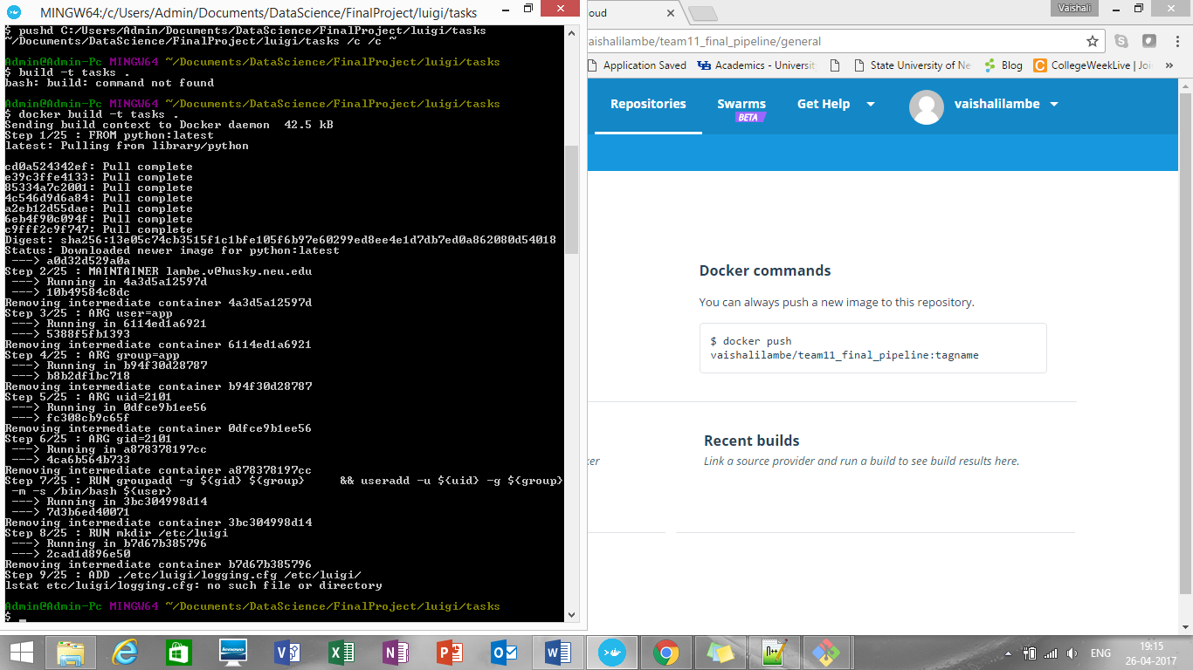
Dockerizing Luigi Pipeline

Slide 30
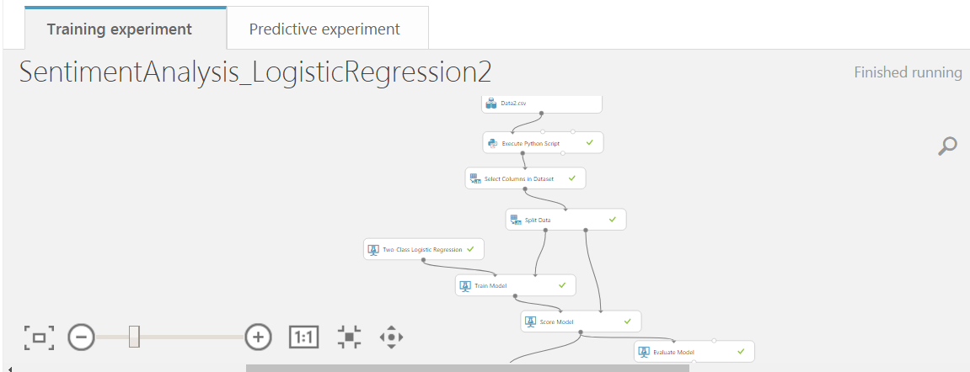
Microsoft Azure Rest API

Slide 31
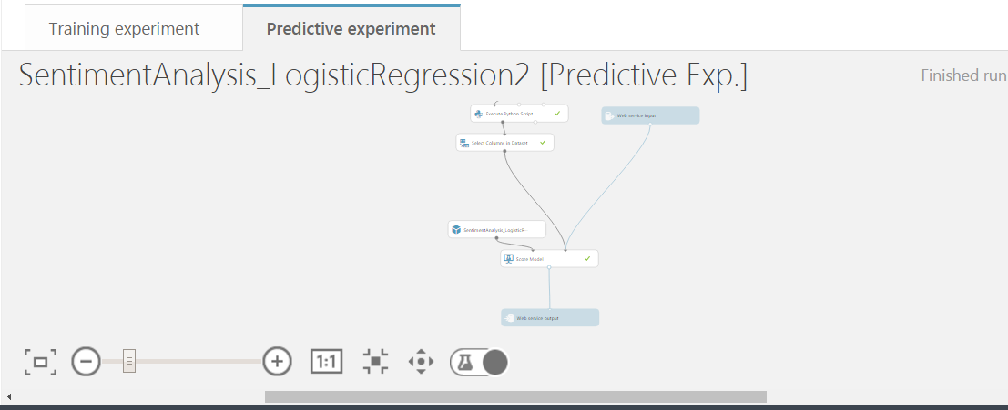
Microsoft Azure Rest API

Slide 32
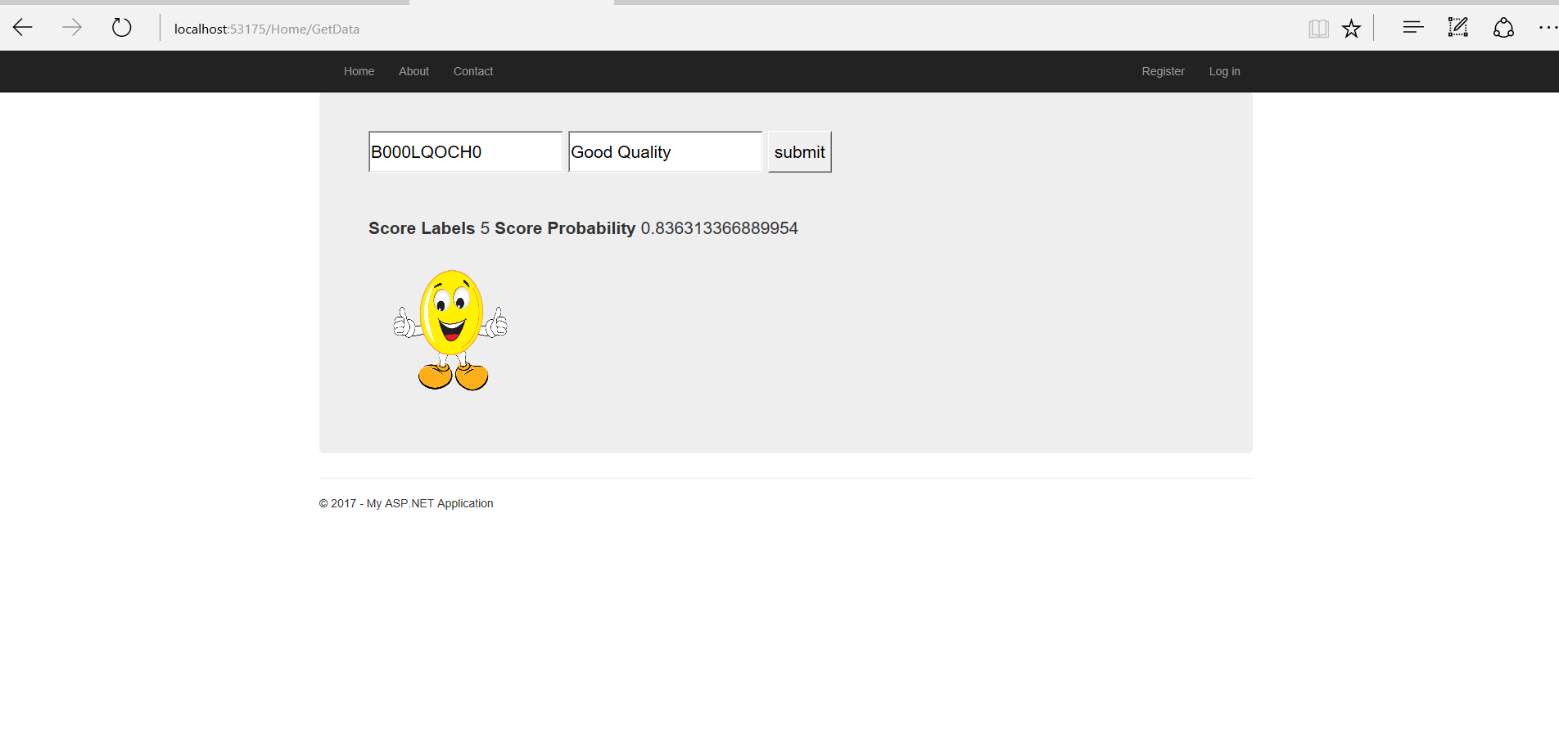
UI – check for positive sentiment

Slide 33
References
https://nlp.stanford.edu/IR-book/html/htmledition/stemming-and-lemmatization-1.html
https://en.wikipedia.org/wiki/Tf%E2%80%93idf
https://docs.microsoft.com/en-us/azure/machine-learning/machine-learning-text-analytics-module-tutorial
https://www.coursera.org/learn/ml-foundations/lecture/P6DXU/defining-which-reviews-have-positive-or-negative-sentiment
https://forums.aws.amazon.com/thread.jspa?messageID=713676

Slide 35
Tasks done:
Vaishali and Rijuta: Rest API, Classification and sentiment analysis, Report documentation, Power Point presentation
Rijuta: Data exploratory analysis using python and R, UI, K means clustering
Vaishali: Data Download, pre-processing, Conversion to .csv, Luigi pipeline, Dockerzing pipeline
Ankur: Data exploratory analysis using Power BI

Slide 36
Thank you!

