Slide 1
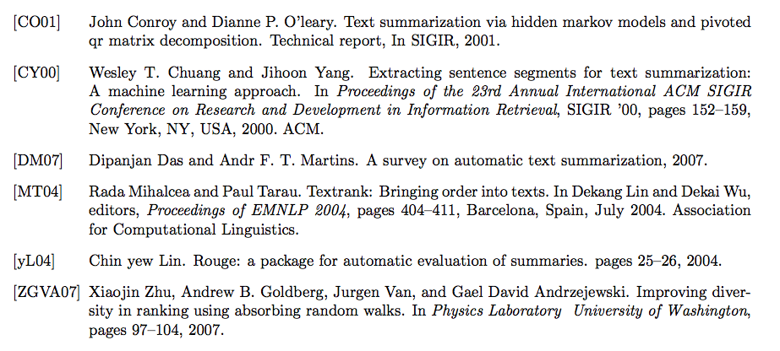
Multi-Document Extractive Summarization Techniques
Kevin Eskici, Luis A. Perez
CS182: Artificial Intelligence, Harvard University
Abstract
Methodology
Results
TODO
We implemented two algorithms for constructing summaries: TextRank and GRASSHOPPER
GRASSHOPPER
TextRan
k
Corpus
GRASSHOPPER
Future Work
Baseline
Synonyms
New Comparison functions for textrank
There
References
TODO
TODO
TODO

