Slide 1
Digital Portfolio
STUDENT NAME: Abiraji.k
REGISTER NO AND NMID: 32324u18001&astvu32332324u18001
DEPARTMENT:Bsc.computer science
COLLEGE: voorhees college

Slide 2
PROJECT TITLE
Student portfolio by using frontend development

Slide 3


AGENDA
Problem Statement
Project Overview
End Users
Tools and Technologies
Portfolio design and Layout
Features and Functionality
Results and Screenshots
Conclusion
Github Link
3/21/2024 Annual Review

Slide 4

PROBLEM STATEMENT
Many students and professionals lack an attractive personal portfolio to showcase their skills, projects, and achievements online. This reduces their visibility torecruiters, clients, and collaborators

Slide 5

PROJECT OVERVIEW
The project is a personal portfolio websitebuilt with HTML, CSS, and JavaScriptIt highlights key sections such as About Me, Projects, and Contact. The design ismodern, responsive, and styled with cursive fonts and attractive colors.

Slide 6

WHO ARE THE END USERS?
• Students showcasing academic andtechnical projects.
• Job seekers applying for internships orfull-time roles
• Freelancers and developers presentingtheir services

Slide 7

TOOLS AND TECHNIQUES
· HTML → Structure of the portfolio
·CSS → Styling, colors, cursive fonts.responsive design
• JavaScript → Interactive elements (e.g.contact form alert)
• Google Fonts (Great Vibes, Poppins)→Stylish typography

Slide 8
POTFOLIO DESIGN AND LAYOUT
• Header: Navigation menu (About Projects, Contact).
About Section: Circular profile image +introduction.
· Projects Section: Cards showcasing project details.
Contact Section: Form with name, email and message fields.
• Footer: Copyright with heart icon
8

Slide 9
FEATURES AND FUNCTIONALITY
Circular profile image with shadow &border
Gradient background with attractive colors.
Responsive design for all devices
Hover effects on project cards
Contact form with JavaScript alertmessage

Slide 10

RESULTS AND SCREENSHOTS
· A professional, visually appealingpersonal website.
User-friendly navigation
Attractive color scheme and fonts(Screenshots of your running portfoliocan be added here in PPT.)
3/21/2024 Annual Review
10

Slide 11
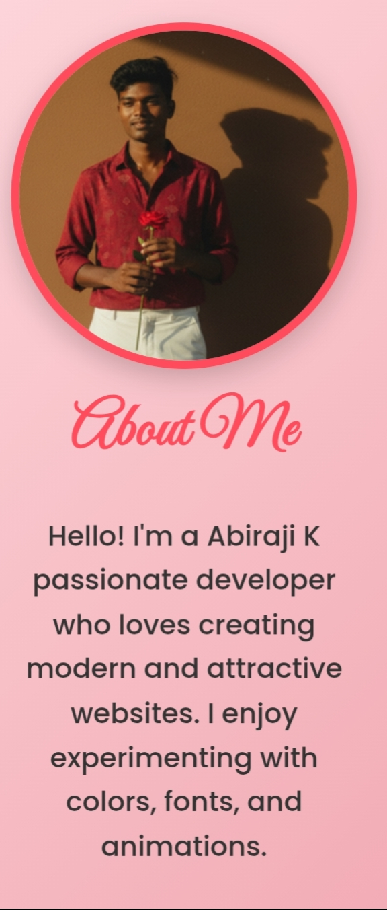
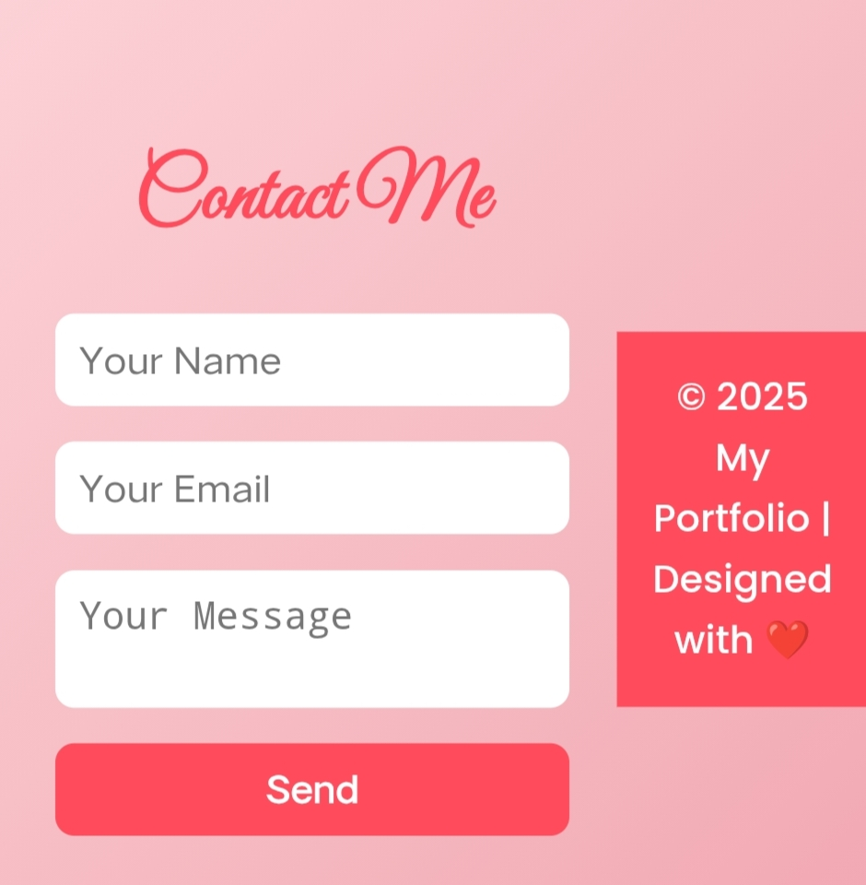
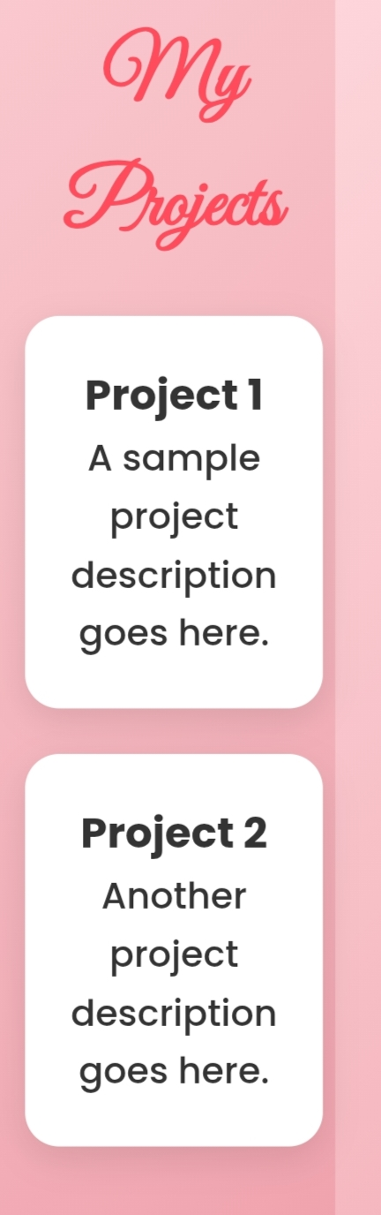

Slide 12
CONCLUSION
The project successfully delivers a modern portfolio website that is simple, stylish, and functional. It improves personal branding and serves as a digital resume.
12

