Slide 1
Computer Graphics (L11) EG678EX
3-D Viewing

Slide 2
Some Background Concepts

Slide 3
3-D Object Representation
Many kinds of objects in graphics scene. E.g. flowers, trees, clouds, rocks, bricks, marble, steel etc
All characteristics can’t be described with single way of representation of objects
Two broad categories to represent Euclidean (geometric) solid objects:
Boundary Representation (B-reps)🡪 object is assumed as set of surfaces that separate object from surroundings. E.g. surface polygons
Space-Partitioning Representations🡪 represented by set of non overlapping contiguous solids. E.g. Octree representation (with cubes)
Natural objects (Non-Euclidean i.e. non-geometrical shape) 🡪 Represented by Fractal Geometry.

Slide 4
3-D Object Representation
Polygon Surfaces
Approximate representation 3-D objects by set of surface polygons
Advantage:- speeds up rendering; since all surfaces are represented with linear equations
More accurate representation for polyhedron
Curved surface approximation can be improved with increase in number of polygons
Polygon Tables:- To specify polygon surfaces
Geometric Tables
Consist of parameters that specify polygon vertices and spatial orientation of polygons
Attribute Tables
Consist of parameters that specify transparency, surface texture, color etc.
Polygon Surface Approximation of Cylinder

Slide 5
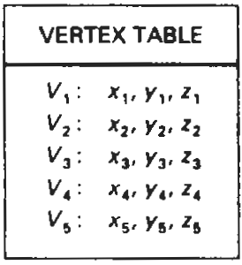
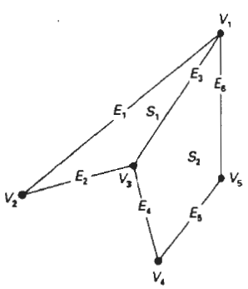
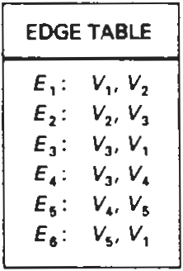
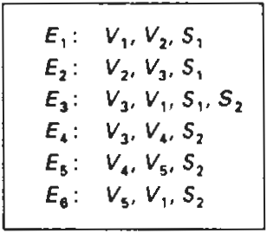
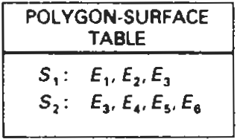
3-D Object Representation
Geometric Tables
Specified by three lists (each successive tables consists of pointers back to previous table
Vertex Table
Edge Table
Polygon Surface Table
Only Edge Tables or (Vertex table + Polygon Table) is sufficient ?
Yes but redundancy (repeated) in drawing
Alternate representation:- we add extra information for quick identification of redundancy. E.g. as in figure (Alternate Representation), pointers to polygon table are added to edge table so as to notice common edges quickly.
Alternate Representation

Slide 6

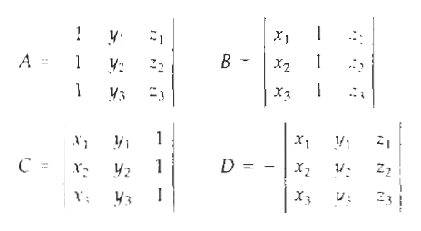
3-D Object Representation
Spatial Orientation of Surface
Orientation of surface normal
How to find surface normal if surface vertices (x₁,y₁,z₁), (x₂,y₂,z₂) and (x₃,y₃,z₃) are given ?
Plane equation:
Put the vertex coordinates to get
One of the surface normals is: N = (A,B,C)
(Note: Remember plane equation of form lx + my +nz = p
i.e. N = (l,m,n) )
N = (A,B,C)
y
x
z

Slide 7

3-D Object Representation
Two sides of a surface
For right handed cartesian system (i.e if vertices are taken in C-Clockwise order to evaluate A,B,C and D then)
y
x
z

Slide 8
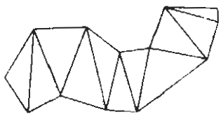
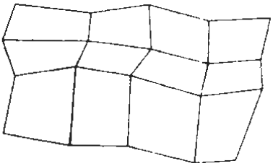
3-D Object Representation
Polygon Meshes:- object represented as:
Triangle Strip
Given n vertices co-ordinates, n-2 trangles are tiled to produce strip
Quadrilateral Mesh
Given n by m array of vertices co-ordinates, (n-1) by (m-1) quadrilaterals produce mesh

Slide 9
3-D Viewing

Slide 10
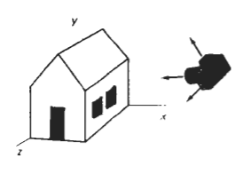
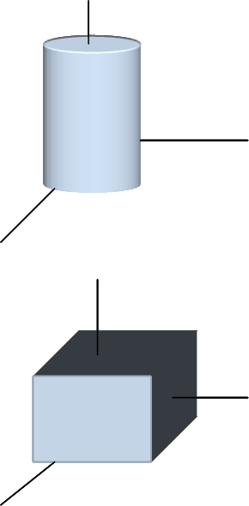
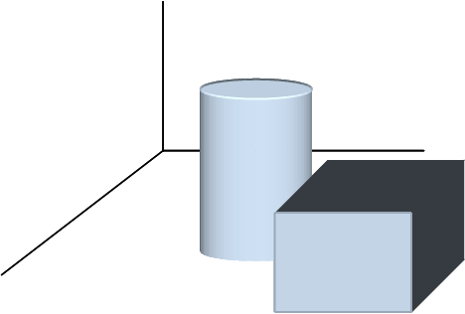
3-D Viewing Pipeline
Analogous to 2-D scene generation
3-D scene generation process analogous to taking photographs with camera
More flexible method than camera analogy in graphics to generate 3-D scene
MC
WC
MC
Modeling Transformations
WC
Viewing Transformation
VC
Projection Transformation
PC
Workstation Transformation
DC

Slide 11
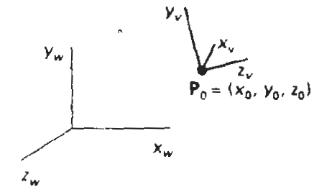
Viewing Coordinates
Specifying Viewing Plane similar to camera orientation
Steps:
Setup viewing Coordinate Reference 🡪 how?
Setup a view plane (projection plane) perpendicular to a viewing z_{v} axis
Note: plane could be assumed to be similar to camera film
Transform world co-ordinate scene to viewing coordinate scene
Viewing co-ordinates are projected unto the view plane

Slide 12
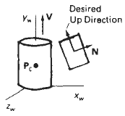
Setting Viewing Coordinates Reference
y_{w}
Pick a point in world coordinate as view reference point (origin of viewing coordinate system)
view reference point often chosen closed to or on the surface of some object or at center of a group of objects.
If it is near to object🡪 we aim camera to that object
If it is some distance away from scene🡪 camera position
Specify view plane orientation with Normal vector N i.e. z_{v} axis direction. How?
Chose a point in world coordinate
Vector from world origin to that point or vector from that point to view reference point is direction of Normal Vector N
Specify view-up vector V to establish positive direction for y_{v} axis
Specifying V that is perpendicular to N is difficult so V is specified in any convenient direction and establish y_{v} direction by projecting N to View plane
In some packages V is specified as the twist angle θ_{t} about the z_{v} axis and adjusted by projecting to view plane. The projection specifies the desired direction of y_{v} axis.
In some packages view reference point P₀ is at the center of the object, V is specified by world vector (0,1,0) and this vector is projected to the plane perpendicular to N to establish y_{v} axis as shown in figure
Establish third vector U perpendicular to both the vectors y_{v} and z_{v} to specify vector x_{v}
N
P₀
z_{v}
P
x_{w}
z_{v}
z_{w}
y_{w}
P₀
P₀
P
N
x_{w}
z_{w}
V
N
y_{w}
θ_{t}
z_{v}
y_{v}
P₀
Adjusted V
x_{w}
z_{w}

Slide 13
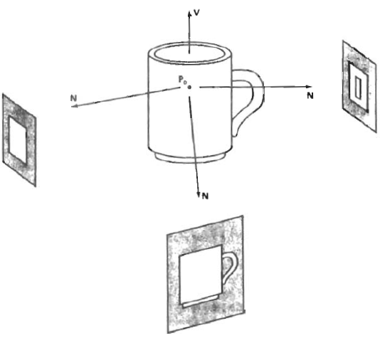
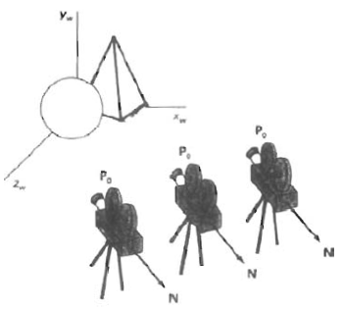
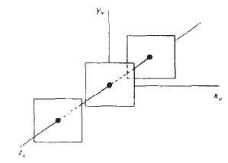
Setting Viewing Coordinates Reference (contd…)
Normalized viewing reference axis
Specified by unit vectors u, v and n (uvn system) along viewing axes
View plane position
Specified by view-plane-distance from viewing origin
View plane is always parallel to x_{v}y_{v} plane
Series of view is obtained by changing direction of N and keeping view reference point fixed. (How to obtain view along the line of v?)
To simulate camera motion through a scene keep the direction of N fixed and change the view reference point
y_{v}
v
u
x_{v}
n
z_{v}

Slide 14
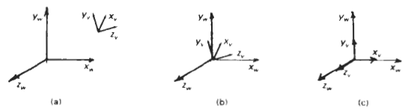

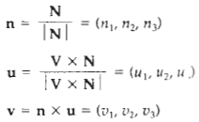

Transformation From World To Viewing Coordinates
Translate the view reference point to world origin
Rotate the view reference axis x_{v}, y_{v}, z_{v} to align with world axes x_{w}, y_{w}, z_{w} respectively
Thus the rotation matrix aligns vector u to x-axis
Similarly it alligns vectors v and n to y and z axis of world
Thus the rotation matrix is the desired matrix to align view reference frame to world coordinate frame
u₁ 1
u₂ ₌ 0
u₃ 0
1 1
R.

Slide 15
Projections
p₂
View Plane
Converts 3-D viewing co-ordinates to 2-D projection co-ordinates
Two types of projection
Parallel Projection
Coordinate positions are transformed to view plane along parallel lines (projection lines)
Orthographic and Oblique Projection
Perspective Projection
Coordinate positions are transformed to view plane along lines (projection lines) that converges to a point called projection reference point (center of projection)
Equal sized object appears in different size according as distance from view plane
Intersection of projection lines and view plane gives the projected view of the object
p₁
P₂’
P₁’
P₂
View Plane
P₁
P₂’
P₁’
Projection
Reference Point
View Plane
Projection
Reference Point

Slide 16
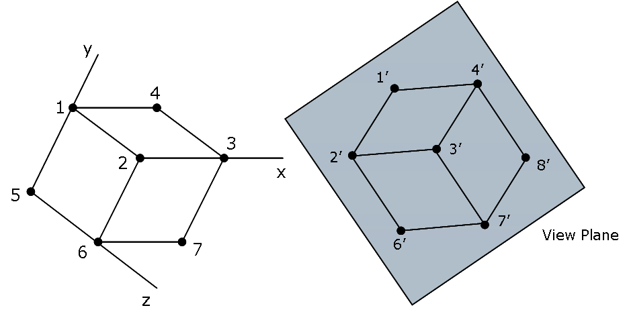
Parallel Projection
Orthographic projection:
Projection lines are perpendicular to view plane
Used to produce Front, Side and Top view of an object
Axonometric Orthographic Projection:
To display more than one face
Isometric Projection is commonly used orthographic projection
Generated by aligning the projection plane so that it intersect each coordinate axis in which object is defined at same distance from origin
Oblique projection: Projection lines are not perpendicular to view plane
Orthographic Projection
Oblique Projection
y_{v}
(x,y,z)
(x,y)
x_{v}
z_{v}

Slide 17
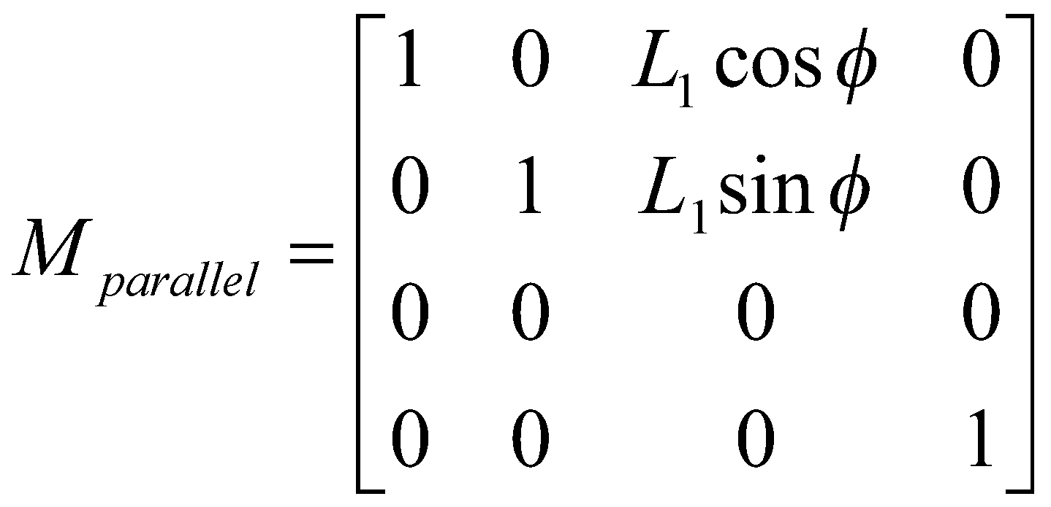
Oblique Projection
Oblique projection vectors are specified by two angles α and Ø
(x,y) are also the orthographic co-ordinates on view plane
Projection Matrix Calculation
x_{p} = x + L.cosØ
y_{p} = y + L.sinØ
tanα = z/L
L = z/tanα = z.L₁ where, L₁ = 1/tanα
x_{p} = x + z(L₁cosØ)
y_{p} = y + z(L₁sinØ)
Final projection matrix will be
y_{v}
(x_{p},y_{p})
α
L
Coordinates (x,y,z) are viewing coordinates
(x,y,z)
Ø
x_{v}
(x,y)
View
Plane
Orthographic projection: When L₁ = 0
xp = x
y_{p} = y
Cavalier projection: when tanα = 1 (i.e α = 45⁰)
Ø = 30⁰ or 45⁰
Cabinet Projection: when tanα = 2 (i.e α = 63.4⁰)
Ø = 30⁰ or 45⁰
z_{v}

Slide 18
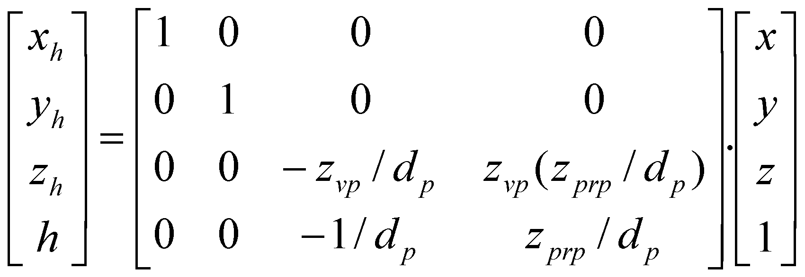
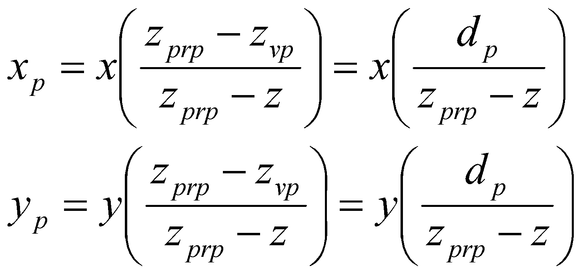
Perspective Projection
Projection vectors meet at projection reference point z_{prp} along the z_{v} axis
x’ = x – xu
y’ = y – yu
z’ = z – (z-z_{prp})u
On view plane
z’ = z_{vp}; therefore
u = (z_{vp} - z)/(z_{prp} – z)
thus projection transformation equations are
Projection Equation in homogeneous coordinates
Where, h = (z_{prp} –z)/d_{p}
and x_{p}= x_{h}/h, y_{p} = y_{h}/h
P = (x,y,z)
(x_{p},y_{p},z_{vp})
Special cases
uv plane as view plane (i.e z_{vp} = 0)
Viewing coordinate origin as projection reference point (i.e z_{prp} = 0)
z_{v}
z_{vp}
z_{prp}
View
Plane

Slide 19
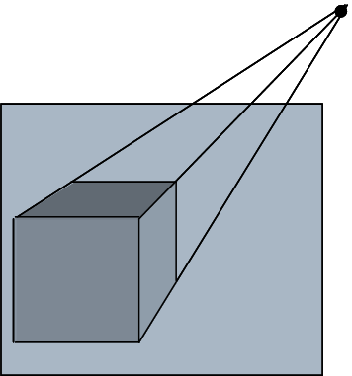
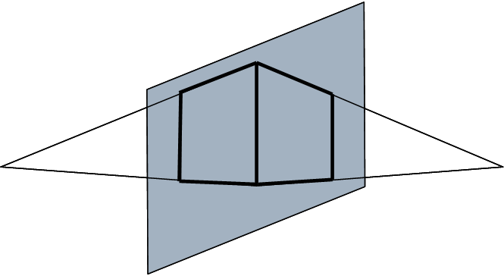
Perspective projection
y
Vanishing Point: a set of parallel lines that are not parallel to view plane are projected as converging lines that appear to converge at a point called vanishing point
a set of parallel lines that are parallel to view plane are projected as parallel lines
More than one set of parallel lines form more than one vanishing points in the scene
Principal Vanishing point: Vanishing point for a set of parallel lines parallel to one of the principal axis of object
We can control the number of principal vanishing point to one, two or three with the orientation of projection plane and classify as one, two or three point perspective projection
x
z
Vanishing
Point
X-axis
vanishing
Point
z-axis
vanishing
Point

