Slide 1
CHAPTER TWO
Software Metric
Measures
Metric
Indicators
Software Management
Metric for software quality
Statistical Quality Control
Metric for small Organizations

Slide 2
Software Metrics
Measure : A measure provides a quantitative indication of the extent, amount, dimension, capacity , or size of some attribute of a product or process
Metric : Metric as “ a quantitative measure of the degree to which a system, component, or process possesses a given attribute.
Indicator: An indicator is a metric or condition of the metrics that provides insight into the software process, a software project, or the product itself.

Slide 3
Software Metrics
Metrics strongly support software project management activities
They relate to the four functions of management as follows:
Planning
Organizing
Controlling
Improving

Slide 4
Size Estimation Metrics
Size of a program is not the number of bytes that the source code occupies
It is not the size of the executable code
It is an indicator of the effort and time required to develop the program.
Size of program indicates development complexity
Estimating the problem size is fundamental to estimating the effort, time, and cost of planned software.

Slide 5
Software Measurement
Direct measure and indirect measure.
Direct measures of the software include how many lines of code (LOC) produced, execution speed, memory size, and defects reported.
Indirect measures include functionality, quality, complexity, efficiency, reliability, and maintainability of the software.

Slide 6
Lines of Code
The simplest among all metrics available to estimate project size
Project size estimated by counting the number of source instructions
Lines used for commenting, header lines ignored
To find LOC at the beginning of a project divide module into sub modules and so on until size of each module can be predicted

Slide 7
Disadvantages of LOC
Gives a numerical value of problem size that vary
widely with individual coding style
If( x>y ) x > y ? x++ : y++;
then x++;
else
y++;
Effort needed for analysis, design , coding, testing etc (not just coding)

Slide 8
Disadvantages of LOC
# Larger Code size 🡺 Better Quality?
# Logical Complexity?
Complex Logic -> More Effort
Simple Logic -> Less Effort
while(i<4) { printf(“testing”);
printf(“testing”); printf(“testing”);
} printf(“testing”); printf(“testing”);

Slide 9
Disadvantage of LOC
Accurate computation of LOC only after
project completion!!

Slide 10
Lines of code
1. Cost per line of code = Labor rate / Productivity
2. Estimated project cost = Estimated line of code/cost per line of code
3. Estimate labor effort = Estimated line of code / Productivity

Slide 11
Example Of LOC
Estimated line of code = 33,200
Productivity = 620 LOC/PM
Labor Rate = $ 8000/PM
Cost per line of code = ?
Estimated Project cost = ?
Estimate Labor Effort = ?

Slide 12
Example of LOC
Cost per line of code = $8000/620
= $13
Estimated project cost = 33,200 * 13
= $431,600
Estimated Labor effort = LOC / productivity
= 33,200/620
= 54 PM

Slide 13
Function Point Metric
Size of software product computed directly from problem specification
Size of software = number of different functions/ features it supports
Input Output
Many features Larger size
Apart from that size depends on
- number of files
- number of interfaces
- number of enquiries
Function

Slide 14
Functional Point
Size of Function Point (FP)= Weighted sum of these five problem characteristics
1.Number of inputs: Data items input by user
(Group of user inputs taken together)
Employee Account
Name - Account Name
Age - Account Number
Sex - Account Open Date
Address

Slide 15
Functional Point Metric
2.Number of Outputs: Reports, Screen outputs,
Error Messages
3. Number of inquiries: Interactive queries made
by users
4. Number of Files: Logical files e.g. data
structures, physical files
5. Number of interfaces: Interfaces for
exchanging information e.g. disk, tapes,
communication links

Slide 16
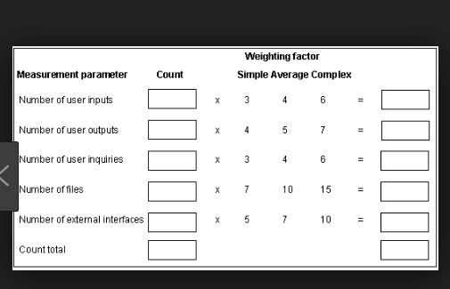
Functional Point

Slide 17
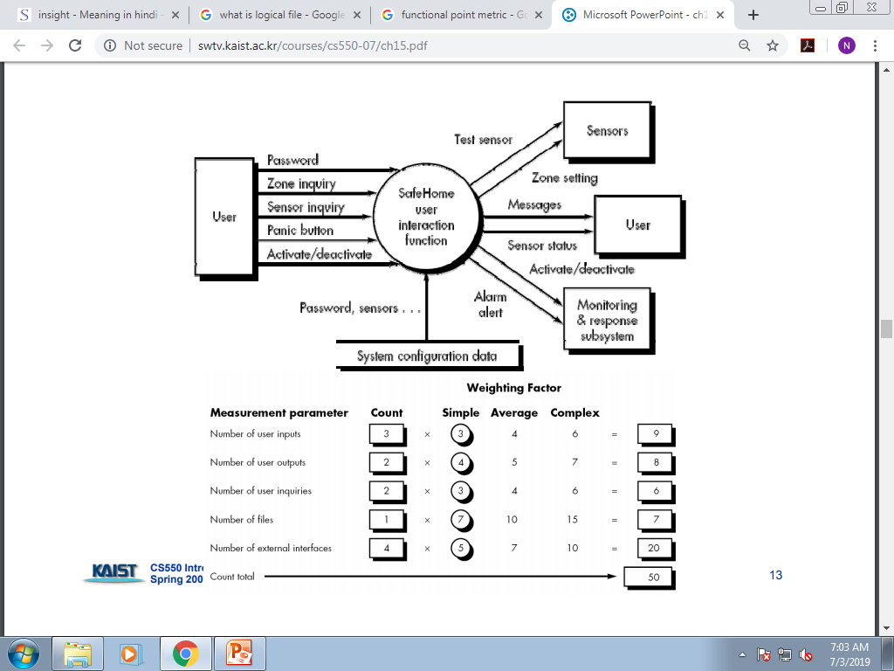
Functional Point Metric

Slide 18
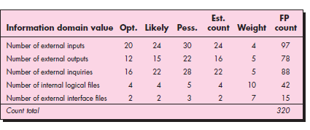
Functional point

Slide 19
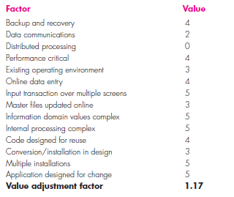
Functional Point (FP)

Slide 20

Functional Point
Expected Value for estimate variable size (s) = ?
Make optimistic , most likely, pessimistic , estimate for each item, then compute expected value .

Slide 21
Functional Point
Consider a project with the following functional units :
Number of user inputs = 50
Number of user outputs = 40
Number of user enquiries = 35
Number of user files = 06
Number of external interfaces = 04
Assuming all complexity adjustment factors and weighing factors as average, the function points for the project will be;

Slide 22
Functional Point
Characteristics for weights are
0 = No influence, 1= Incidental, 2= moderate,3= Average, 4 = Significant, 5 = Essential

Slide 23
Functional Point
Function point ( FP )= UFP x VAF
Where ,UFP = Unadjusted function point ,
VAF =Value Adjustment Factor

Slide 24
FP

Slide 25
FP
FP_{estimated} = 672
Organizational productivity = 6.5 FP/PM
Labor Rate = $8000 /PM
Cost per FP = $8000/6.5 = $1230
Effort = Fp_{estimated/}Productivity = 672/6.5 =103 PM
Total project cost = (672*1230) = $826560

Slide 26
Categories of Metrics
Product Metrics
Process Metrics
Project Metrics

Slide 27
Characteristics of Metrics
Product Metrics : Product metric describes the characteristics of the product, such as size, complexity, performance, efficiency.

Slide 28
Characteristics of Metrics
Process Metrics: Process metric describe effectiveness and quality of the process. E.g
Effort required in the process
Time to produce the product
Number of defects found during testing

Slide 29
Categories of Metrics
Project Metrics: Project metrics describe the project characteristics and execution. E.g
Number of software developer
Staffing pattern over the life cycle of the software
Cost and schedule
Productivity

Slide 30
Attribute of Effective Software Metrics
Simple and computable
Empirically and Intuitively Persuasive (satisfy Engineers’ intuitive)
Consistent and Objective
Consistent in the use of units and dimensions
Programming Language Independent
An Effective Mechanism for High Quality Feedback

Slide 31
Metric for Software Quality
Software quality can be measured through the software Engineering process, before release to customer and after release to the customer
The main goal of software engineering is to produce a high-quality system.
A good software Engineer and good software engineering must measure if high quality is to be realized .

Slide 32
Metric for software quality
Measuring Quality
Indicators to measure the quality
Correctness
Maintainability
Integrity (loyally functioning or not )
Usability (user friendly or not)

Slide 33
Defect Removal Efficiency
A quality metric that provides benefit at both the project and process level is defect removal efficiency (DRE)
DRE is computed as
DRE = E/E+D
Where E = Errors found before delivery of the software
D = Defects found after the delivery

Slide 34
Metric for small Organization
Organization might select the following set of easily collected measures:
Time (hours or days) elapsed from the time a request is made until evaluation is complete, tqueue.
Effort (person-hours) to perform the evaluation, Weval.
Time (hours or days) elapsed from completion of evaluation to assignment of

Slide 35
Metric for small Organization
comprehensive software metrics programs
software organizations of all sizes measure
use the resultant metrics to help improve their local software.

Slide 36
Metric for small Organization
change order to personnel, teval.
Effort (person-hours) required to make the change, Wchange.
Time required (hours or days) to make the change, tchange.
Errors uncovered during work to make change, Echange.
Defects uncovered after change is released to the customer base, Dchange.

Slide 37

Metric for Small organization
Defect removal efficiency

Slide 38
Project Estimation Technique
Empirical estimation technique
Heuristic Technique
Analytic estimation technique

Slide 39
Project Estimation Technique
Empirical Estimation : making an educated guess of the project using past experience e.g Delphi and Expert judges
Heuristic Techniques: Project parameter can be modeled by the mathematical expression.
Analytic Estimation : Like Heuristic Technique but supports scientific facts .

Slide 40
COCOMO II MODEL
The constructive cost model (COCOMO) is an algorithmic software cost estimation model developed by Barry Boehm
The model uses a basic regression formula, with some parameters that are derived from historical project data and current project characteristic

Slide 41
COCOMO II MODEL
COCOMO II is actually a hierarchy of estimation models that address the following areas:
Application composition model: Used during the early stages of software engineering, when prototyping of user interfaces, consideration of software and system interaction, assessment of performance, and evaluation of technology maturity are paramount.
Early design stage model: Used once requirements have been stabilized and basic software architecture has been established.
Post-architecture-stage model: Used during the construction of the software.

Slide 42
Basic COCOMO-II Model
COCOMO applies to three classes of software projects: ▪ Organic: Developing well understood application programs, small experienced team ▪ Semi Detached: mix of experienced and non-experienced team ▪ Embedded: strongly coupled to computer hardware

Slide 43
Basic COCOMO
▪ Effort = a (KLOC)b PM ▪ Time = c (Effort)d Months ▪ Number of people required = (Effort applied) / (Development time)

Slide 44
Example: The size of organic software is estimated to be 32,000 LOC. The average salary for software engineering is Rs. 15000/- per month. What will be effort and time for the completion of the project?
Solution:
▪ Effort applied = 2.4 x (32)^{1.05} PM = 91.33 PM (Since: 32000 LOC = 32KLOC) ▪ Time = 2.5 x (91.33)^{0.38} Month = 13.899 Months ▪ Cost = Time x Average salary per month = 13.899 x 1 5000 = Rs. 208480.85 ▪ People required = (Effort applied) / (development time) = 6.57 = 7 persons

