Slide 1
CHAPTER TWO

Slide 2
Software Metrics
Measure : A measure provides a quantitative indication of the extent, amount, dimension, capacity , or size of some attribute of a product or process
Metric : Metric as “ a quantitative measure of the degree to which a system, component, or process possesses a given attribute.
Indicator: An indicator is a metric or condition of the metrics that provides insight into the software process, a software project, or the product itself

Slide 3
Software Metrics
Metrics strongly support software project management activities
They relate to the four functions of management as follows:
Planning
Organizing
Controlling
Improving

Slide 4
Size Estimation Metrics
Size of a program is not the number of bytes that the source code occupies
It is an indicator of the effort and time required to develop the program.
Estimating the problem size is fundamental to estimating the effort, time, and cost of planned software.

Slide 5
Software Measurement
Direct measure and indirect measure.
Direct measures of the software include how many lines of code (LOC) produced, execution speed, memory size, and defects reported.
Indirect measures include functionality, quality, complexity, efficiency, reliability, and maintainability of the software.

Slide 6
Lines of Code
The simplest among all metrics available to estimate project size
Project size estimated by counting the number of source instructions
Lines used for commenting, header lines ignored
To find LOC at the beginning of a project divide module into sub modules and so on until size of each module can be predicted

Slide 7
Disadvantages of LOC
Gives a numerical value of problem size that vary
widely with individual coding style
If( x>y ) x > y ? x++ : y++;
then x++;
else
y++;
Effort needed for analysis, design , coding, testing etc (not just coding)

Slide 8
Disadvantages of LOC
# Larger Code size 🡺 Better Quality?
# Logical Complexity?
Complex Logic -> More Effort
Simple Logic -> Less Effort

Slide 9
Disadvantage of LOC
Accurate computation of LOC only after
project completion!!

Slide 10
LOC Calculation
Cost per line of code = Labor rate/ productivity
Estimated project cost = cost per line of code * estimated line of code
Estimated labor effort = LOC/productivity

Slide 11
Example Of LOC
Estimated line of code = 33,200
Productivity = 620 LOC/pm
Labor Rate per month = $ 8000
Cost per line of code = ?
Estimated Project cost = ?
Estimate Labor Effort = ?

Slide 12
Example of LOC
Cost per line of code = $8000/620
= $13
Estimated project cost = 33,200 * 13
= $431,600
Estimated effort = LOC / productivity
= 33,200/620
= 54 pm

Slide 13
Function Point Metric
Size of software product computed directly from problem specification
Size of software = number of different functions/ features it supports
Input Output
Many features Larger size
Apart from that size depends on
- number of files
- number of interfaces
- number of enquiries
Function

Slide 14
Function Point
Size of Function Point (FP)= Weighted sum of these five problem characteristics
1.Number of inputs:
2.Number of Outputs:
3. Number of inquiries
4. Number of Files
5. Number of interfaces

Slide 15
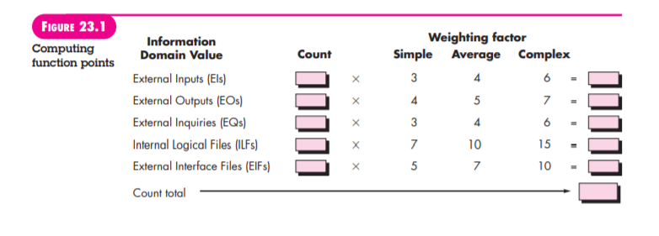
Function Point

Slide 16
Function point
Limitation of function point metric
The weight of items on metric is fixed which may not sufficient for all cases.

Slide 17
Function Point
To compute function points (FP), the following relationship is used:
FP = count total * [0.65 + 0.01 *∑(Fi )]
The Fi (i 1 to 14) are value adjustment factors (VAF) based on responses to the following questions

Slide 18
Function Point
These 14 questions are scaled to 0 to 5 where,
0 = No influence or No importance, 1= Incidental, 2= moderate, 3= Average, 4 = Significant, 5 = Essential

Slide 19
Function Point
1. Does the system require reliable backup and recovery?
2. Are specialized data communications required to transfer information to or from the application?
3. Are there distributed processing functions?
4. Is performance critical?
5. Will the system run in an existing, heavily utilized operational environment?
6. Does the system require online data entry?
7. Does the online data entry require the input transaction to be built over multiple screens or operations?
8. Are the ILFs updated online?

Slide 20
Function Point
9. Are the inputs, outputs, files, or inquiries complex?
10. Is the internal processing complex?
11. Is the code designed to be reusable?
12. Are conversion and installation included in the design?
13. Is the system designed for multiple installations in different organizations?
14. Is the application designed to facilitate change and ease of use by the user?

Slide 21
Function Point
Example : With the given data for an online shopping site developed by ABC software developers
Number of user input = 98
Numbers of user Output = 51
Number of User Inquires = 47
Number of External Interfaces = 32
Number of Logical Files = 61
Assuming that the complexity of the given website development is average, compute the function point if the productivity of the ABC S/W developers is 35 FP/PM and their salary structure is Rs. 1500 per month on average, estimate total cost of the software .

Slide 22
Function Point
Formula for Function Point
Cost per FP = labor rate/productivity
Estimated project cost = estimated fP* cost per Fp
Estimated Labor effort = Estimated FP/Productivity

Slide 23
Function Point
FP = 672
Organizational productivity = 6.5 FP/pm
Labor Rate per month = $8000
Cost per FP = $8000/6.5 = $1230
Effort = FP/Productivity = 672/6.5 =103 PM
Total project cost = (672*1230) = $826560

Slide 24
FP Problem (Class Work )
Assuming that the complexity of the NCIT MIS software development is average, compute the function point for it with the given data:
Number of User Input : 95
Number of User Output : 55
Number of Inquiries : 4
Number of logical Files : 66
Number of External Interfaces:27
If the productivity of the software developers is 30 FP/PM and their salary structure is RS.18000 per month on average, estimate the total cost of the software.

Slide 25
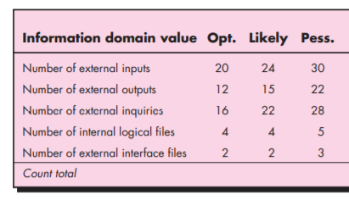
Function point
Fp Count
S*4
97

Slide 26

Function Point
Expected Value for estimate variable size (s) = ?
Make optimistic , most likely, pessimistic , estimate for each item, then compute expected value .

Slide 27
Categories of Metrics
Product Metrics
Process Metrics
Project Metrics

Slide 28
Characteristics of Metrics
Product Metrics : Product metric describes the characteristics of the product, such as size, complexity, performance, efficiency.

Slide 29
Characteristics of Metrics
Process Metrics: Process metric describe effectiveness and quality of the process. E.g
Effort required in the process
Time to produce the product
Number of defects found during testing

Slide 30
Categories of Metrics
Project Metrics: Project metrics describe the project characteristics and execution. E.g
Number of software developer
Staffing pattern over the life cycle of the software
Cost and schedule
Productivity

Slide 31
Attribute of Effective Software Metrics
Simple and computable
Empirically and Intuitively Persuasive (satisfy Engineers’ intuitive)
Consistent and Objective
Consistent in the use of units and dimensions
Programming Language Independent
An Effective Mechanism for High Quality Feedback

Slide 32
Metric for Software Quality
Software quality can be measured through the software Engineering process, before release to customer and after release to the customer
The main goal of software engineering is to produce a high-quality system.
A good software Engineer and good software engineering must measure if high quality is to be realized .

Slide 33
Metric for software quality
Measuring Quality
Indicators to measure the quality
Correctness
Maintainability
Understandability
Integrity
Usability (user friendly or not)

Slide 34
Defect Removal Efficiency
A quality metric that provides benefit at both the project and process level is defect removal efficiency (DRE)
DRE is computed as
DRE = E/E+D
Where E = Errors found before delivery of the software
D = Defects found after the delivery

Slide 35
Metric for small Organization
organization might select the following set of easily collected measures:
Time (hours or days) elapsed from the time a request is made until evaluation is complete, tqueue.
Effort (person-hours) to perform the evaluation, Weval.
Time (hours or days) elapsed from completion of evaluation to assignment of

Slide 36
Metric for small Organization
Change order to personnel, teval.
Effort (person-hours) required to make the change, Wchange.
Time required (hours or days) to make the change, tchange.
Errors uncovered during work to make change, Echange.
Defects uncovered after change is released to the customer base, Dchange.

Slide 37
Metric for small Organization
Comprehensive software metrics programs
Software organizations of all sizes measure
Use the resultant metrics to help improve their local software.

Slide 38
COCOMO MODEL
The constructive cost model (COCOMO) is an algorithmic software cost estimation model developed by Barry Boehm
The model uses a basic regression formula, with some parameters that are derived from historical project data and current project characteristic

Slide 39
COCOMO II MODEL
COCOMO II is actually a hierarchy of estimation models that address the following areas:
Application composition model: Used during the early stages of software engineering, when prototyping of user interfaces, consideration of software and system interaction, assessment of performance, and evaluation of technology maturity are paramount.
Early design stage model: Used once requirements have been stabilized and basic software architecture has been established.
Post-architecture-stage model: Used during the construction of the software.

Slide 40
COCOMO II Model
Types of COCOMO model levels
Basic COCOMO
Intermediate COCOMO
Detailed COCOMO

Slide 41
Basic COCOMO-II Model
COCOMO applies to three classes of software projects: ▪ Organic: Developing well understood application programs, small experienced team ▪ Semi Detached: mix of experienced and non-experienced team ▪ Embedded: strongly coupled to computer hardware

Slide 42
Basic COCOMO
▪ Effort = a (KLOC)^b PM ▪ Time = c (Effort)^d Months ▪ Number of people required = (Effort applied) / (Development time)

Slide 43
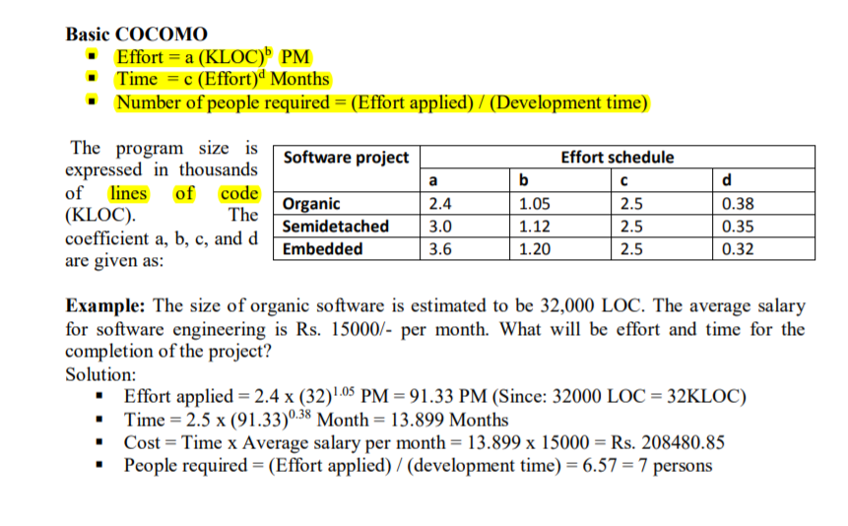
COCOMO Model

Slide 44
Define Measure and Metric with examples. Given the data below, compute the function point value, productivity, documentation and cost per function for a project with the following information domain characteristics.
Number of user inputs: 27
Number of user outputs: 43
Number of user inquiries: 5
Number of files: 4
Number of external interfaces: 2 and Effort = 37 PM, Technical document=360 pages, user document = 129 pages, cost= Rs 200 per month complexity adjustment values are 4,1,1,3,5,5,4,4,3,3,2,3,4,5

