Slide 1
Software Engineering Fundamental (SEF )
by
Er. Nirdosh Adhikari

Slide 2
Objective of Course
This course has intended to make familiar to software development Life Cycle (SDLC) and software development practice at the industrial level.
Make Familiar to the project management concept.
This course helps to make more familiar with Structural analysis and less with Object Oriented Analysis.

Slide 3
SEF Book
Pressman R.S Software Engineering a Practitioner Approach 5th Edition as Text book
Booch Grady, Rumbaugh James, Jacobson Avar The Unified Modelling Language User Guide as Reference Book

Slide 4
Object Oriented Concept
1.Class
2.Objects
3.Abstraction
4.Encaptulation
5.Inheritance
6.Polymorphism

Slide 5
Software Engineering Vs Computer Engineering
Computer Engineering deals with designing, developing, and developing overall computer system
Software Engineering deals with building and maintaining software

Slide 6
Software Vs Program
Program Usually small in size Single developer Lack of proper user interface Lack of Proper Documentation | Software 1.Large in size 2. Team of developer 3.Well-designed interface 4.Proper Documentation

Slide 7
Definition of Software
Software consists of :-
Set of instructions
Data structures
Descriptive information – both hard & soft copy

Slide 8
Types of software
System Software
Application Software – package , trailered
Utility Software
Artificial Intelligence software
Engineering/Scientific Software
Open source software

Slide 9
Characteristics of software
Some characteristics of software that is considerably different than hardware are:
1.Software is developed; it is not manufactured
2. Software doesn’t wear out but it deteriorate
3. Can be custom build

Slide 10
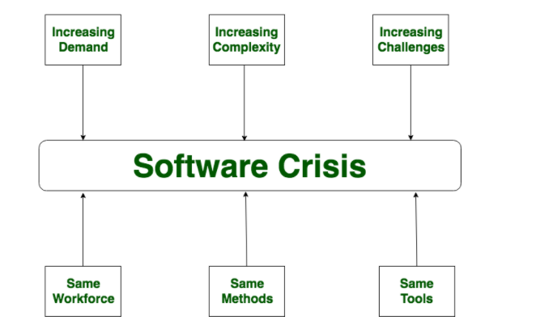
Software Crisis

Slide 11
Causes of Software Crisis
The cost of owning and maintaining software was as expensive as developing the software
At that time Projects was running over-time
At that time Software was very inefficient
The quality of software was low quality
Software often did not meet requirements

Slide 12
Solution to crisis
Reduction in software over-budget
The quality of software must be high
Experience working team member on software project
Software must be delivered on time

