Slide 1
ACCIDENT SENSING AND PREVENTION USING IOT
Team Leader:
Mentor:
M.R.S. ABIRAME (621319205002)
Team Members:
Dr. R. SATHYA, AP/IT
A. MADHUPRIYA (621319205018)
R. NIKALYA (621319205027)
M. PRITHIUSHA (621319205035)
1

Slide 2
TABLE OF CONTENTS
S.No. | Content | Page No.
1 | Abstract | 4
2 | Introduction | 5
3 | Motivation | 7
4 | Literature Survey | 8
5 | Existing System | 18
6 | Proposed System | 19
7 | Modules Split-up | 20
8 | Module – 1 (Architectural Design) | 21
2

Slide 3
TABLE OF CONTENTS
S.No. | Content | Page No.
10 | Module – 2 (Architectural Design) | 23
12 | Hardware & Software Requirements | 25
13 | Screenshots | 26
14 | Conclusion & Future Work | 29
3

Slide 4
ABSTRACT
Traveling has become risky despite being a vital necessity for human existence. The frequency of traffic accidents is rising over time. According to a recent Times India study, there have been 2 lakhs of documented occurrences of fatal road accidents. Additionally, the recorded mortality instances, almost two-thirds were the result of drunk driving and delayed medical recovery. In this proposed project, NodeMCU is used to transmit messages when the vehicle is met with an accident normally. Additionally, when the driver is boozed the alcoholic sensor will detect it, if the alcohol is detected then immediately it will be notified, and also the speed of the engine will be reduced. In case the vehicle met with an accident after the alcohol is sensed, immediately the vehicle engine will be get stopped and to be get notified.
4

Slide 5
INTRODUCTION
Transportation has made our world accessible to anything and everything in the world. Transportation is a great boon for the human life but some fear it is not to be transformed into a bane, due to the high speeding of vehicles and overriding Road safety measures.
In our day to day life we see that the counts of accident that are occurring in the world rising the death tolls. Government Statistics tell us that 1,10,000 accident cases are reported in a year due to drunk and drive.
5

Slide 6
INTRODUCTION
Thus to overcome this problem our proposed system, we were using NodeMCU, Alcoholic Sensor and Engine Control module to monitor and control the vehicle. Once, the vehicle met with an accident then the immediate notification will send to the App. Also, when the boozed person drives the car the immediate notify will sent and if incase the vehicle is met with an accident once after the alcohol is detected the engine will be stopped and immediately the notification will be sent to the App.
6

Slide 7
MOTIVATION
The major objectives of this project are to prevent accidents, control speed while intoxicated, and to notify while any incident occurs. We can actually reduce the death rate by doing this. The eventual aim of this approach is to save human lives.
7

Slide 8
LITERATURE SURVEY-1
Title of the Paper | Author | Year of Publication | Publisher | Methods | Advantages | Limitations
AI Enabled Accident Detection and Alert System Using IoT and Deep Learning for Smart Cities | Nikhlesh Pathik , Rajeev Kumar Gupta, Yatendra Sahu | 2022 | IEEE | Internet of Things-enabled Intelligent Transportation Systems (ITS) are gaining significant attention in academic literature and industry, and are seen as a solution to enhancing road safety in smart cities. | Advanced specifications of smart phones to design and develop a low-cost solution for enhanced transportation systems that is deployable in legacy vehicles. | In some places where there is no provision of GSM networks, it is difficult for communication.
8

Slide 9
LITERATURE SURVEY-2
Title of the Paper | Author | Year of Publication | Publisher | Methods | Advantages | Limitations
Accident Prevention Analysis: Exploring the Intellectual Structure of a Research Field | Rui Huang , Hui Liu , Hongliang Ma | 2022 | IEEE | The proposed system here in aims at preventing and controlling accidents by using a Night Vision Camera. | More and more people cluster in major cities and thus causing urbanization challenges. | Cities accident analysis for vehicle system.
9

Slide 10
LITERATURE SURVEY-3
Title of the Paper | Author | Year of Publication | Publisher | Methods | Advantages | Limitations
Sensing accident-prone features in urban scenes for proactive driving and accident prevention | Sumit Mishra, Praveen Kumar Rajendran, Luiz Felipe Vecchietti | 2022 | IEEE | The main idea of this paper is to build an application that makes use of the sensors present in mobile phones like GPS and Accelerometer and detect any collision if there is a sudden external disturbance in the speed with the help of the Sensor Fusion Based Algorithm. | By increasing the technology we can also avoid accidents by providing alerts systems that can stop the vehicle to overcome the accidents. | But this can be extended by providing medication to the victims at the accident spot.
10

Slide 11
LITERATURE SURVEY-4
Title of the Paper | Author | Year of Publication | Publisher | Methods | Advantages | Limitations
Safe Deep Driving Behavior Detection (S3D) | Ehsan Khosravi, Ali Mohamad Afshin Hematyar | 2022 | IEEE | We can monitor the speed of the vehicle. We can find the location of the vehicle. | The major advantage of this approach. is that the accident severity could be known and medical aid. | The eye blink sensor monitors the sleep state of a person and alerts the driver using a buzzer when an uncommon sleep state is detected.
11

Slide 12
LITERATURE SURVEY-5
Title of the Paper | Author | Year of Publication | Publisher | Methods | Advantages | Limitations
Intelligent Traffic Accident Prediction Model for Internet of Vehicles With Deep Learning Approach | Da-Jie Lin, Mu-Yen Chen , Hsiu-Sen Chiang | 2021 | IEEE | The IR sensor is used to detect the drowsiness of the driver. | There have late been various promising mechanical Achievements. | The driver might not be aware about the sign or intentionally doesn't follow.
12

Slide 13
LITERATURE SURVEY-6
Title of the Paper | Author | Year of Publication | Publisher | Methods | Advantages | Limitations
An IoT Based Vehicle Accident Detection and Classification System using Sensor Fusion | Nikhil Kumar, Debopam Acharya, and Divya Lohani | 2020 | IEEE | IOT based vehicle accident detection system using GPS and WIFI has gained attention. | To assist communication between underwater Remotely Operated Vehicle (ROV). | Manual mode, Way Point Mode and Anchor Mode.
13

Slide 14
LITERATURE SURVEY-7
Title of the Paper | Author | Year of Publication | Publisher | Methods | Advantages | Limitations
Deep spatio-temporal graph convolutional network for traffic accident prediction | Le Yu, Bowen Du, Xiao Hu, Leilei Sun, Liangzhe Han and Weifeng Lv | 2020 | Elsevier | In this system at first, we worked on the prevention of vehicle accident and even after all the preventive measures applied if the accident occurs the system detects. | The used electronic devices will be able to provide the spontaneous message and exact location to police and ambulance in order to recover victims. | This causes the loss of life due to the delay in the arrival of ambulance to the accident spot or from the accident spot to the hospital.
14

Slide 15
LITERATURE SURVEY-8
Title of the Paper | Author | Year of Publication | Publisher | Methods | Advantages | Limitations
Preventive and Active Safety Applications | Levent Güvenç | 2020 | IEEE | By monitoring the information from the accelerometer and the vibration sensor, a severe accident can be recognized. | They are cost-effective in implementation. They have a high tendency to assure safety. | In some places where there is no provision of GSM networks, it is difficult for communication.
15

Slide 16
LITERATURE SURVEY-9
Title of the Paper | Author | Year of Publication | Publisher | Methods | Advantages | Limitations
Energy Efficiency Characterization in Heterogeneous IoT System With UAV Swarms Based on Wireless Power Transfer | Q. Chi, H. Yan, C. Zhang, Z. Pang, and L. D. Xu | 2020 | IEEE | This paper presents a smart mishap detection and caution system that notifies the emergency contacts of the user when a mishap happens by sending a message with the detected location. | There is a reset button that can be pressed to prevent the alarm from being sent to the crisis contacts in an event where everybody inside the vehicle is safe. | Wrong mobile taken will not receive the message properly.
16

Slide 17
LITERATURE SURVEY-10
Title of the Paper | Author | Year of Publication | Publisher | Methods | Advantages | Limitations
A Comprehensive Study on IoT Based Accident Detection Systems for Smart Vehicles | Unaiza Alvi , Muazzam A. Khan Khattak | 2020 | IEEE | This system aims to alert the nearby centre about the accident to supply immediate medical care. | Vehicular adhoc networks (VANETs) allow wireless communication between vehicles without the aid of a central server. | Profusion of information may allow unscrupulous parties to violate user privacy.
17

Slide 18
EXISTING SYSTEM
The frequency of traffic accidents is rising over time. Additionally, of the documented mortality instances, over speeding, late medical recuperation, and drunk drive. In the existing system, if a person operating a vehicle is involved in an accident, there is a potential that person could sustain a serious injury or pass away instantly without anyone nearby to assist him. Additionally, the majority of collisions are caused by intoxicated driving and excessive speeding while intoxicated. So far, we haven't developed a workable, straightforward solution to this problem. Few of them have put some of the procedures into practice as the project has progressed, including sending messages and making an alarm sound for Over speed. However, it has still not been put into action on a real-time basis. The system is therefore useful for real-time tracking, accident detection, and accident avoidance.
18

Slide 19
PROPOSED SYSTEM
The major goal of this article is to develop a real-time application that utilizes NodeMCU and sensors to detect accidents. We intended to incorporate three modules in this project. When a vehicle is involved in an accident, an Notification alert is immediately sent over NodeMCU to the Configured App. Some accidents occurred as a result of drunk driving. So, we can quickly identify if a person has consumed alcohol or not with the use of an alcohol sensor. Once the Alcohol is detected, immediately the speed of the engine will be get reduced. Furthermore, the vehicle in which the alcohol is detected, is met with an accident immediately the notification will be sent to the App and the engine motor will be stopped.
19

Slide 20
MODULES SPLIT-UP
Module 1 – Accident Sensing
Module 2 – Drunk and Drive Detection and Speed Control
20

Slide 21
MODULE – 1
ACCIDENT SENSING
When a car accident occurs, the information will be displayed in car display and an immediate notification will be sent to an App. A 30sec of time will be given for the recovery of the driver, if the driver is recovered in that time, then the driver can abort the system and the continuous beep sound will be stopped. Else, the sound will be get increased and that indicates there seems to be an dangerous condition for a driver.
21

Slide 22
ARCHITECTURAL DESIGN – MODULE - 1
ACCIDENT SENSING - SENDER
VANET
Motor driver
LCD Display
Vibration sensor
Buzzer
Ignition ON / OFF
NodeMCU
Warning Message
22

Slide 23
MODULE – 2
DRUNK AND DRIVE DETECTION AND SPEED CONTROL
When a drunk driver operates a vehicle, an alert message is promptly sent to the owner or rescue personnel. This module's goal is to determine whether the motorist is intoxicated or not. Because, majorly the car were driven by the drivers. Few people were driving independently means by own. As a result, knowing the driver's state will aid the person who is travelling with the driver.
23

Slide 24
ARCHITECTURAL DESIGN – MODULE - 2
DRUNK AND DRIVE DETECTION AND SPEED CONTROL
VANET
Motor driver / Engine Control Module
LCD Display
Vibration sensor
Buzzer
Ignition ON / OFF
NodeMCU
Alcohol Sensor
Warning Message
24

Slide 25
HARDWARE & SOFTWARE REQUIREMENTS
Hardware Requirements:
Ignition Switch (ON/OFF)
Vibration sensor
MQ3 Alcohol sensor
Buzzer
Transformer
Power Supply Unit
Motor
Arduino Board
LCD display
Engine control module
Software Requirements:
Blynk IoT (Mobile App)
25

Slide 26
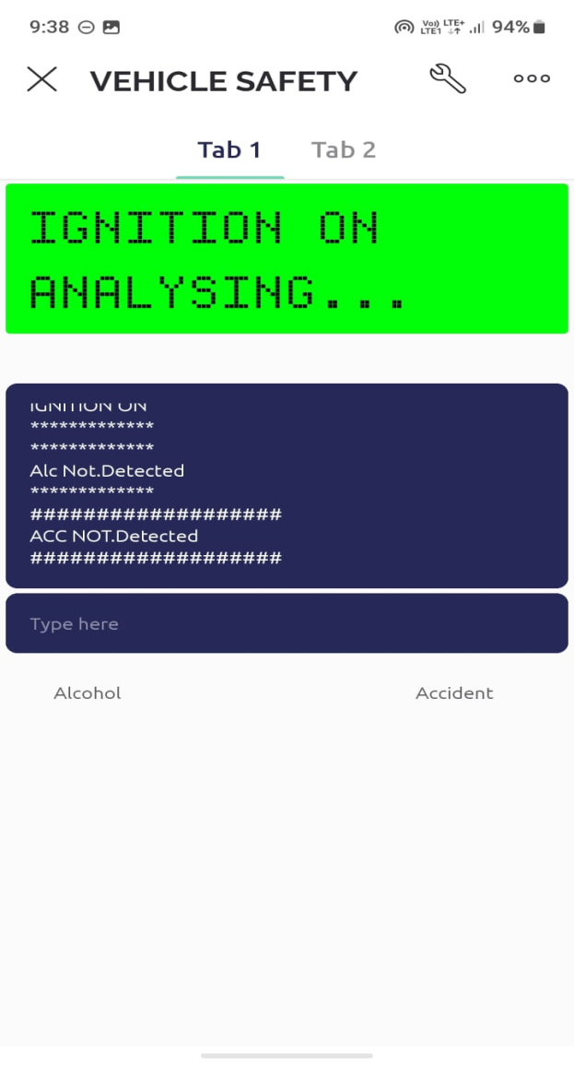
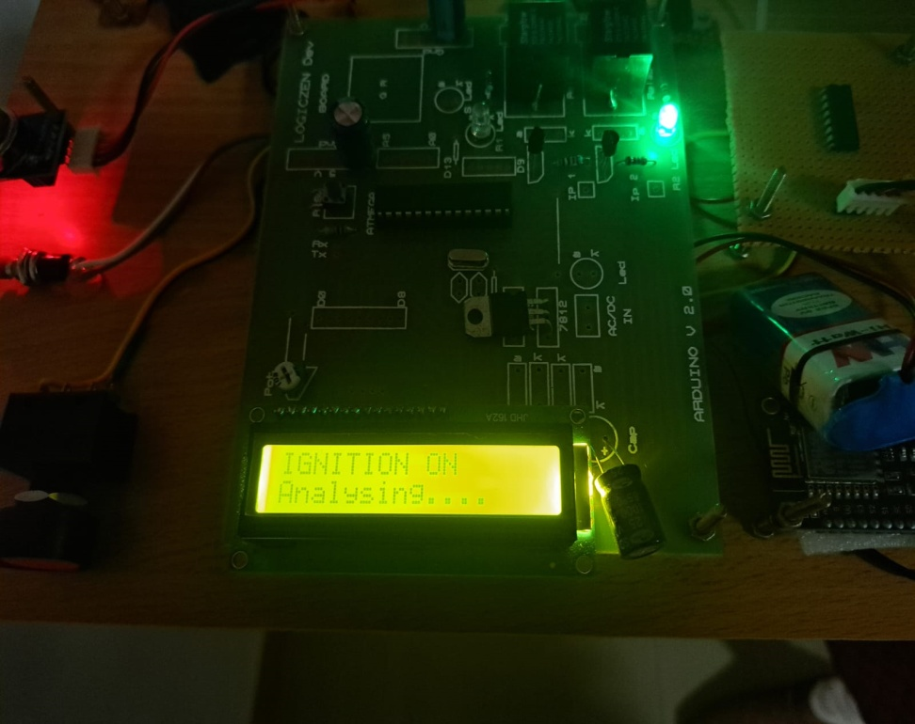
SCREENSHOTS
1. ENGINE ON
26

Slide 27
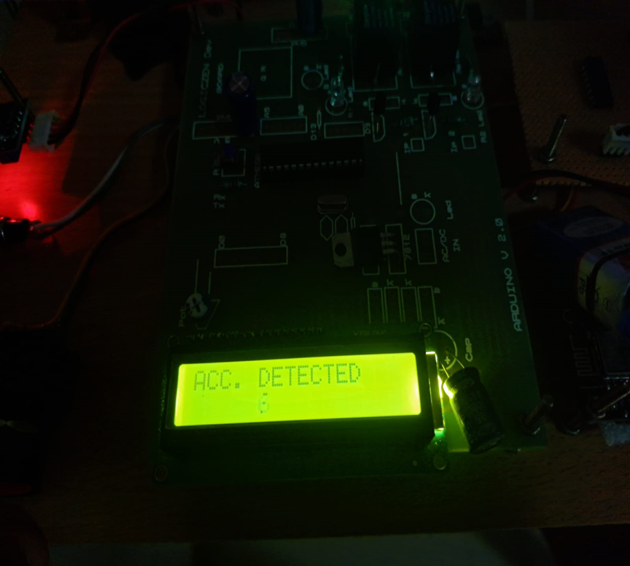
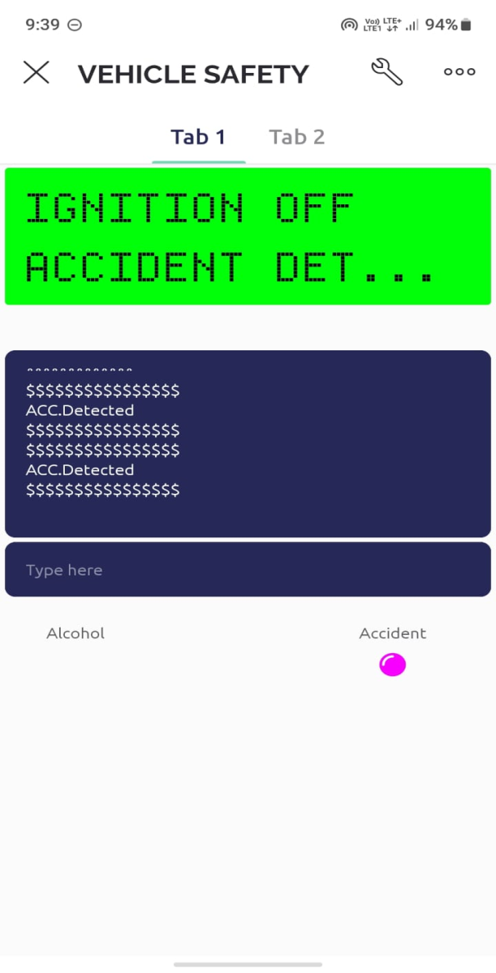
SCREENSHOTS
2. ACCIDENT DETECTED
27

Slide 28
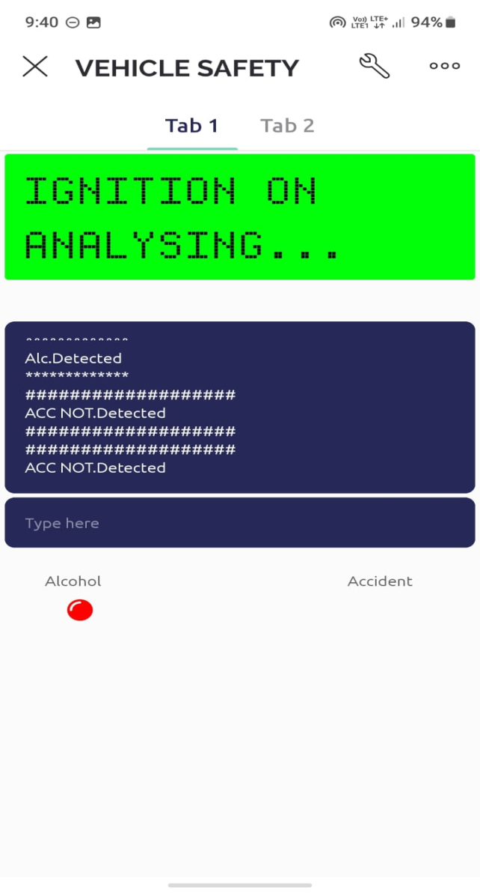
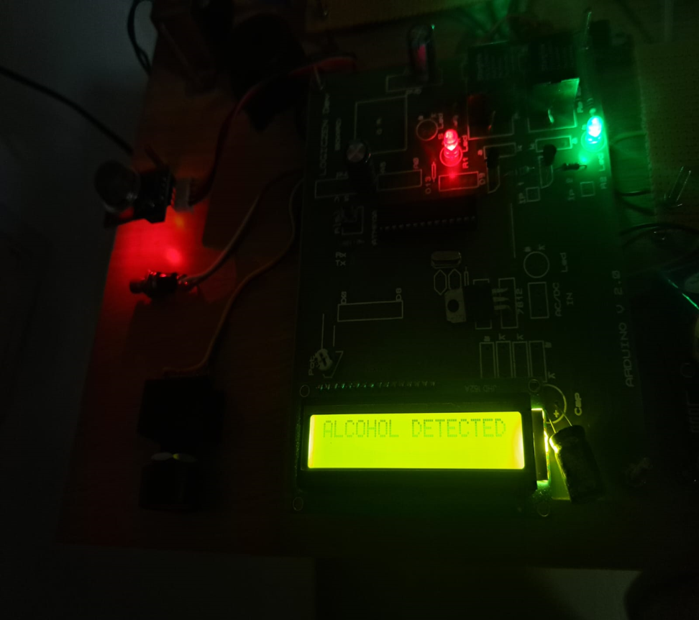
SCREENSHOTS
3. ALCOHOL DETECTED
28

Slide 29
CONCLUSION & FUTURE WORK
In comparison to the current systems, the proposed approach is significantly more dependable and may be more efficient. In proposed system we are able to detect accident normally also the accident happened because of consuming alcohol. When the Alcohol is detected the engine speed will be reduced automatically. The key benefit of this research is that, it allows us to prevent the over speed during intoxicated. In the future, we planned to implement in a real time basis, also with the help of GSM and GPRS we sent a alert message and current locations to the rescue team or relatives.
29

