Slide 1
NAME
:
ABIRAMI THIRUNAVUKKARASU
COURSE
:
DATA ANALYST (CDA)
TEAM ID
:
PTID-CDA-SEP-26-11202
BATCH ID
:
25-MAY-26-CDA-BUN-040-WDM1130-BAN-MAR
| HR Analytics | Abirami Thirunavukkarasu 2

Slide 2
PROJECT OBJECTIVE
POWER BI-BASED DESCRIPTIVE HR ANALYSIS
Measure overall workforce size and average age.
Understand the Remote versus Headquarters workforce mix.
Analyze year-wise hiring volume.
Compare gender, state, department and race composition.
Translate the dashboard into practical workforce-planning insights and recommendations.
| HR Analytics | Abirami Thirunavukkarasu 2

Slide 3
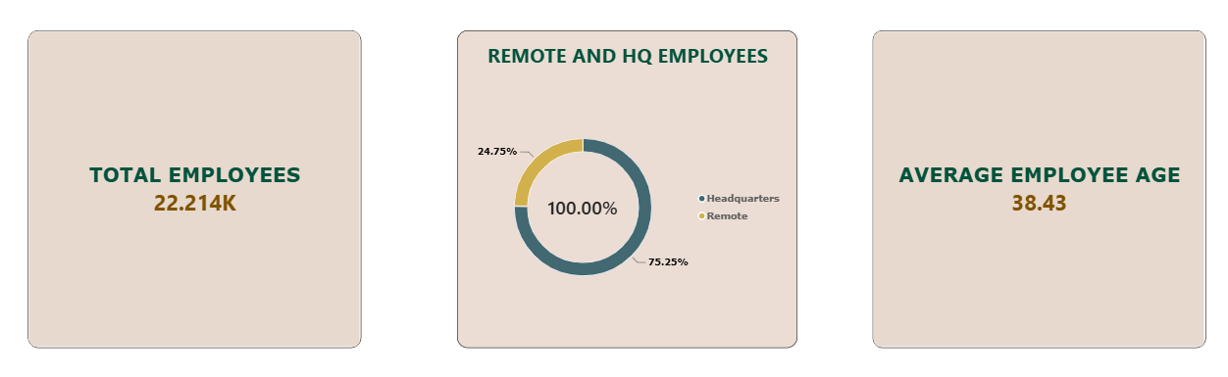
EXECUTIVE KPI SNAPSHOT
TOTAL EMPLOYEES – 22.214K
The organization has approximately 22,214 employees, providing an overall view of the current workforce size.
REMOTE VS. HEADQUARTERS – 75.25% / 24.75%
Approximately 75.25% of employees work remotely, while 24.75% work at headquarters, indicating a predominantly remote workforce.
AVERAGE EMPLOYEE AGE – 38.43 YEARS
The average employee age is 38.43 years, providing a high-level view of the workforce's overall age profile.
| HR Analytics | Abirami Thirunavukkarasu 3

Slide 4
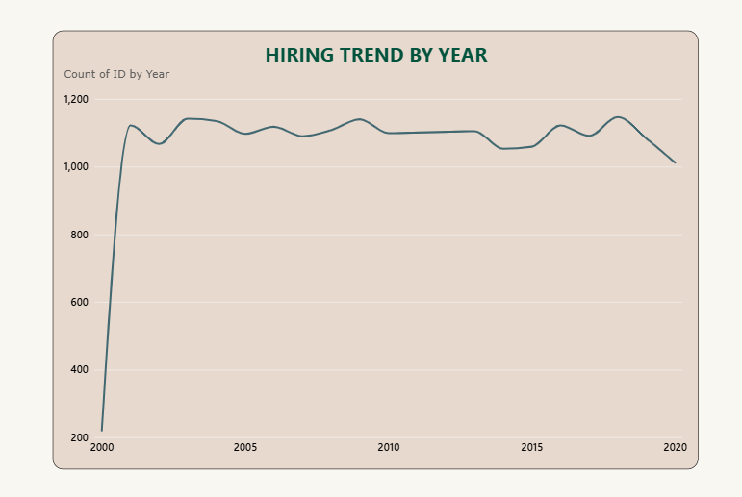
HIRING TREND BY YEAR
The hiring trend shows relatively consistent hiring activity across most years, with moderate fluctuations and a slight decline toward 2020. This provides a clear view of how employee hiring levels changed over time.
| HR Analytics | Abirami Thirunavukkarasu 4

Slide 5
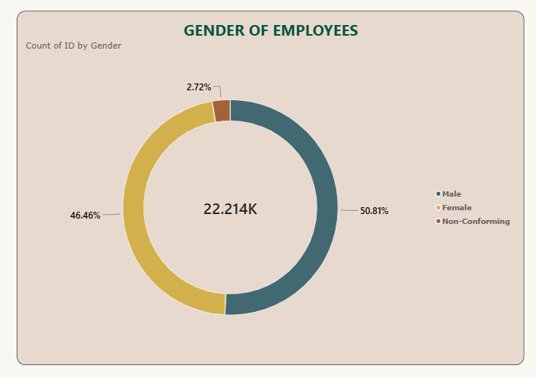
GENDER DISTRIBUTION
The workforce is composed of 50.81% male employees, 46.46% female employees, and 2.72% non-conforming employees, showing a relatively balanced distribution between male and female employees.
| HR Analytics | Abirami Thirunavukkarasu 4

Slide 6
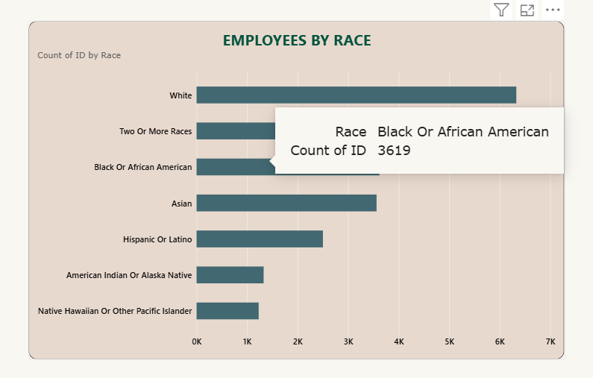
EMPLOYEE RACIAL COMPOSITION
The workforce represents multiple racial groups, with White employees forming the largest group, followed by Two or More Races, Black or African American, and Asian employees.
| HR Analytics | Abirami Thirunavukkarasu 5

Slide 7
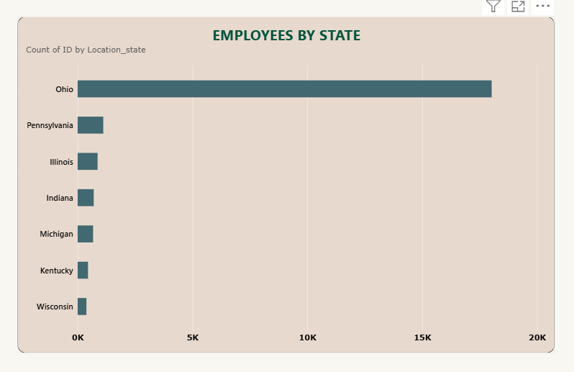
GEOGRAPHIC WORKFORCE DISTRIBUTION
The workforce is highly concentrated in Ohio, which has the largest employee population by a significant margin. Pennsylvania and Illinois follow, while the remaining states have comparatively smaller employee counts, showing a strong geographic concentration of the workforce.
| HR Analytics | Abirami Thirunavukkarasu 6

Slide 8
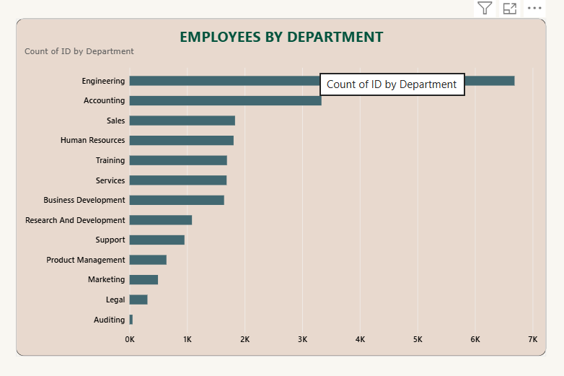
DEPARTMENT WORKFORCE DISTRIBUTION
Engineering has the largest employee workforce, followed by Accounting. Sales and Human Resources also have relatively high employee counts, while Legal and Auditing have the smallest workforce sizes. This shows a significant variation in workforce distribution across departments.
| HR Analytics | Abirami Thirunavukkarasu 7

Slide 9
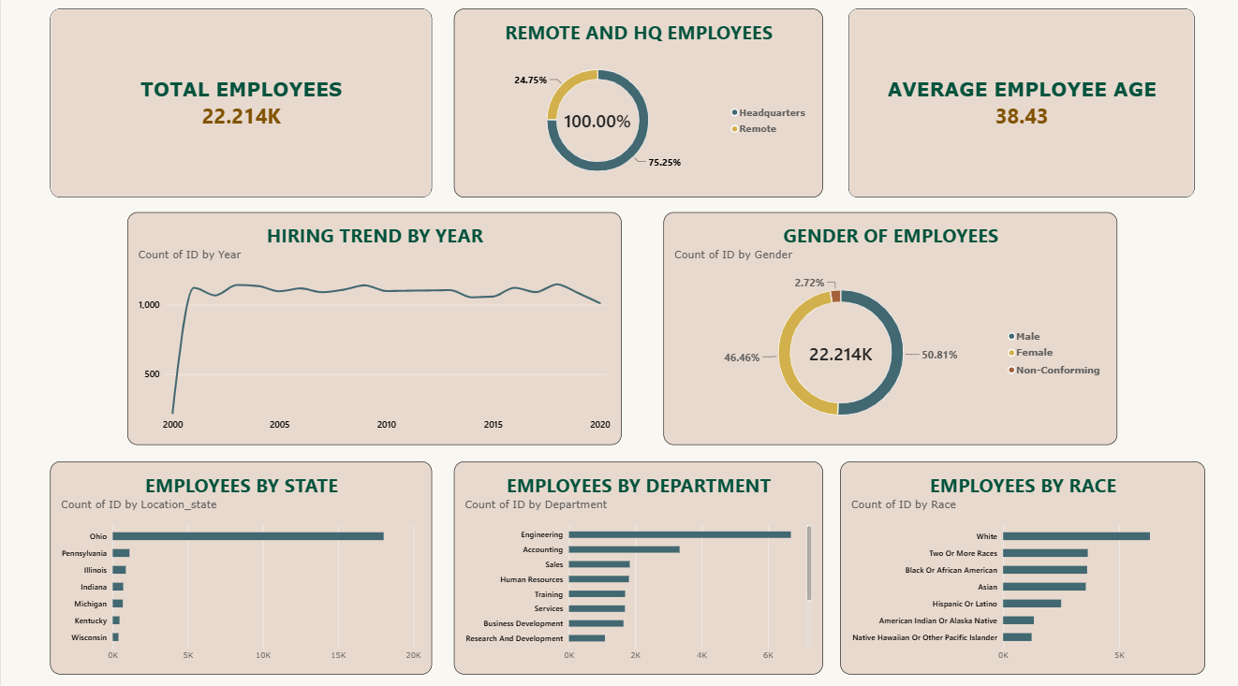
HR ANALYTICS DASHBOARD
| HR Analytics | Abirami Thirunavukkarasu 7

Slide 10
INTEGRATED INSIGHTS
Remote employees account for 75.25%, making remote-work operations a major workforce consideration.
Ohio is the dominant state in the displayed workforce, indicating strong geographic concentration.
Engineering has the largest department headcount by a clear margin.
Annual hiring volume is broadly stable after the initial jump, with a decline visible toward 2020.
Male and female employees account for 50.81% and 46.46% respectively; non-conforming employees account for 2.72%.
| HR Analytics | Abirami Thirunavukkarasu 8

Slide 11
RECOMMENDATIONS
Use year-wise hiring volumes to improve recruitment and workforce planning.
Review remote-work support, collaboration and headquarters capacity given the 75.25% remote share.
Monitor geographic concentration, especially the large Ohio workforce, when planning regional operations.
Track department headcount alongside workload and attrition to identify changing staffing needs.
Monitor gender and race representation over time and segment by department, location and hiring cohort where appropriate.
Combine average age with tenure and attrition data for stronger succession and long-term workforce planning.
| HR Analytics | Abirami Thirunavukkarasu 9

Slide 12
CONCLUSION
The dashboard provides a clear baseline of workforce size, location, age, hiring, department and demographic composition.
The most prominent structural patterns are remote-work dominance, geographic concentration and the large Engineering workforce.
Future versions of the analysis can be strengthened with attrition, tenure, salary, performance, recruitment-source and open-position data.
These additions would enable more actionable workforce planning beyond descriptive headcount reporting.
| HR Analytics | Abirami Thirunavukkarasu 10

