Slide 1
ONLINE E-AUCTION SYSTEM
Project Members:
P.Abirami(15CSR009)
R.Anitha(15CSR024)
R.Anushya(15CSR025)

Slide 2
OBJECTIVE
The Main purpose of E-Auction is to provide the ability to initiate sale, purchase and bid for a product by the customer.
This application enables users to buy the goods by making fast and easy for anyone to post all the details of the product on the application.

Slide 3
MODULES
ADMIN
The admin can login into the system and maintain the buyers and sellers and collect feedback to maintain the system.
USERS
The user can be buyer or seller. The seller will add the product to the cart .The seller will bid the product and buy it.

Slide 4
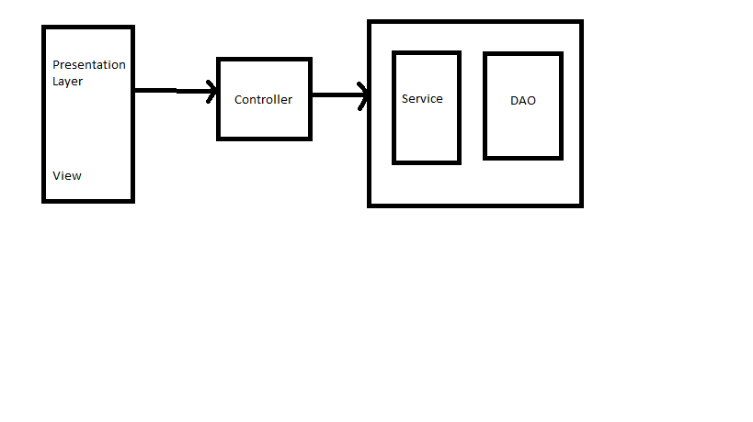
MVC ARCHITECHTURE

Slide 5
USER MODULE
SELLER
Put Product For Sale
Set Initial Bidding Price
BUYER
Bid a Product
Buy the Product

Slide 6
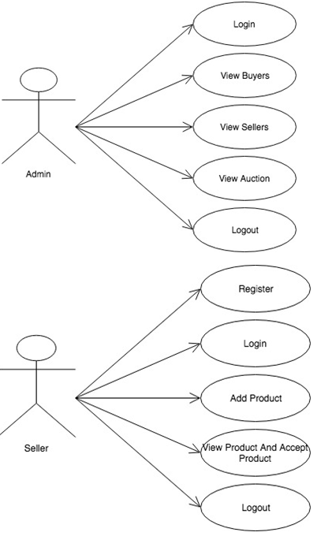
USECASE DIAGRAM

Slide 7
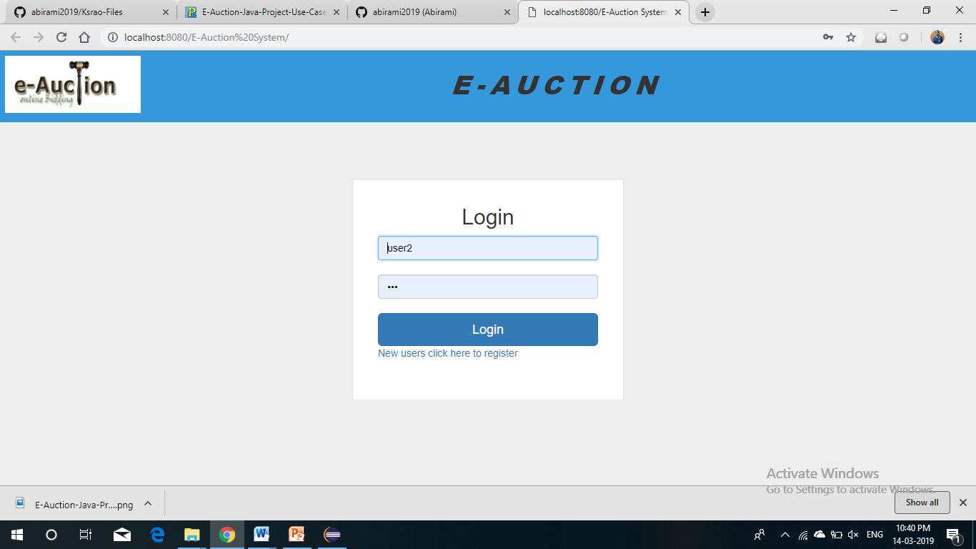
Screenshots

Slide 8
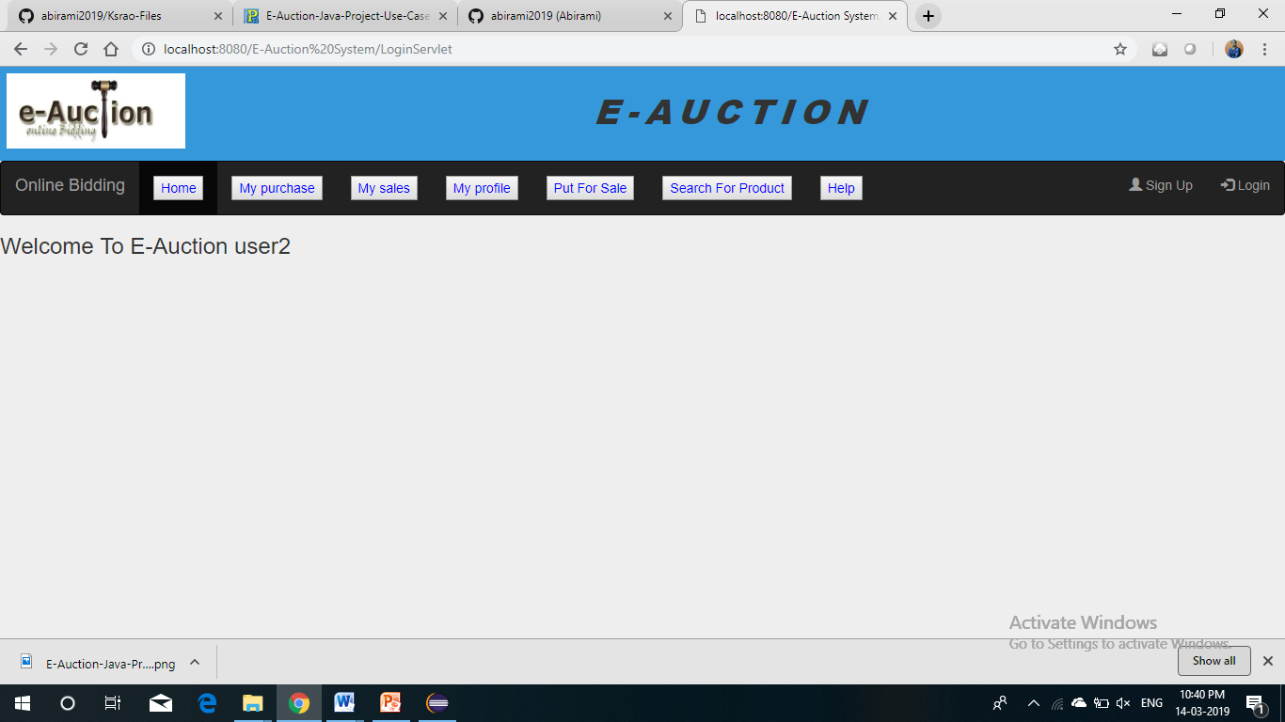

Slide 9
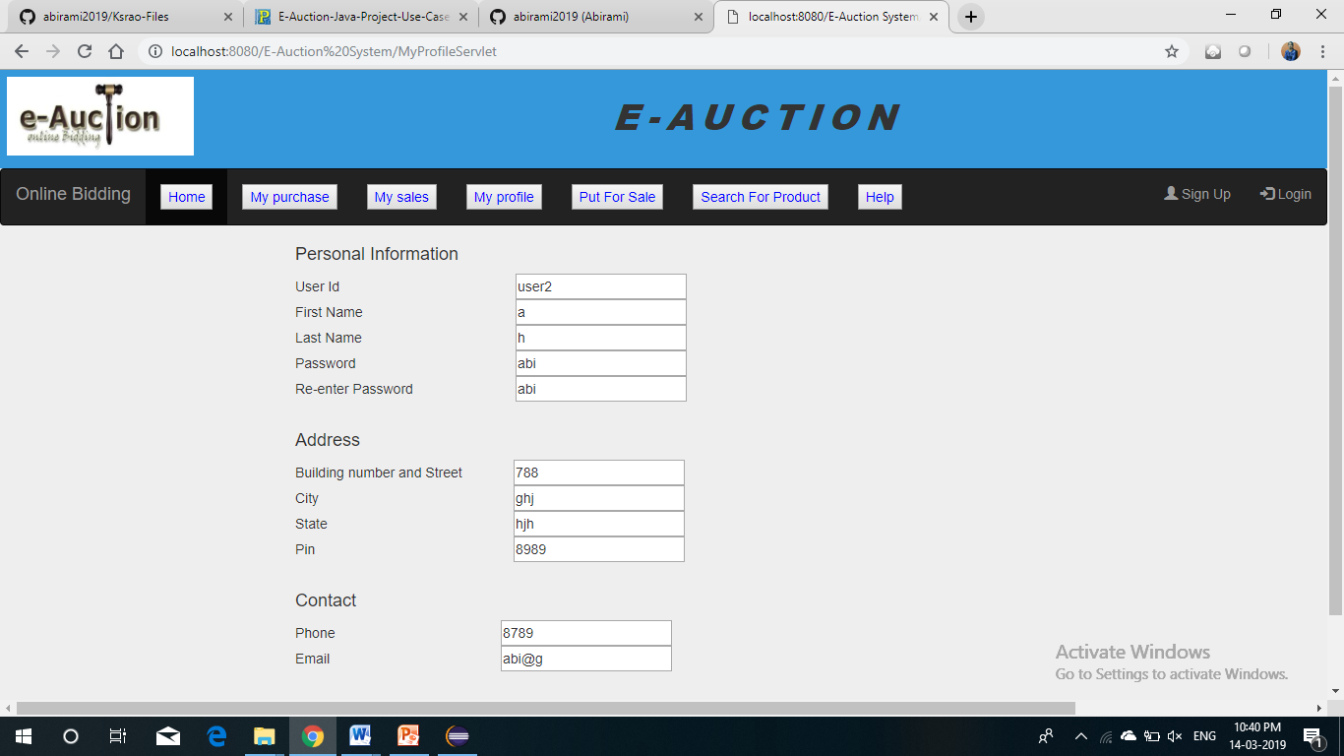

Slide 10
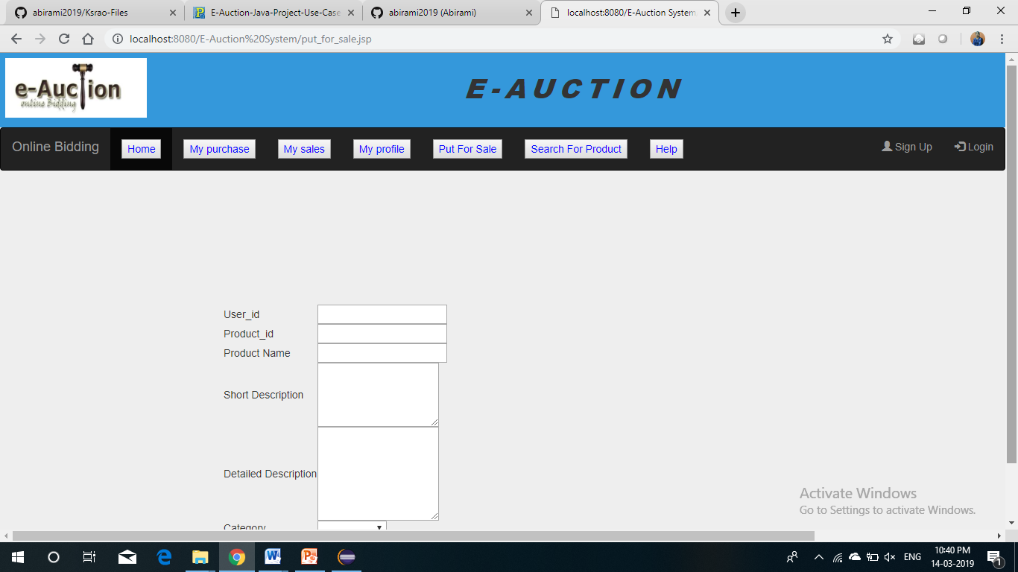

Slide 11
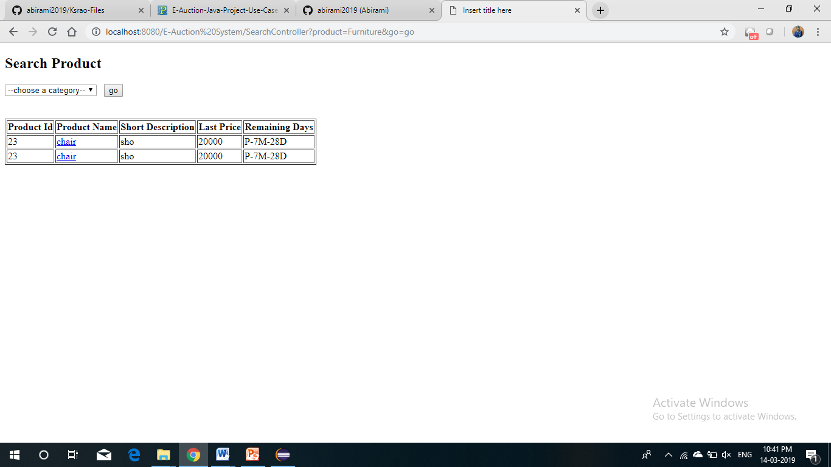

Slide 12
