Slide 1
Employee Data Analysis using Excel
STUDENT NAME: ABIRAMI.S
REGISTER NO: 312209537
DEPARTMENT: B.COM GENERAL
COLLEGE: ANNA ADARSH COLLEGE FOR WOMEN

Slide 2

PROJECT TITLE
Employee Performance Analysis using Excel

Slide 3


AGENDA
Problem Statement
Project Overview
End Users
Our Solution and Proposition
Dataset Description
Modelling Approach
Results and Discussion
Conclusion
3/21/2024 Annual Review

Slide 4

PROBLEM STATEMENT
To write a problem statement on employee performance, you need to identify the
specific area of performance that is problematic, such as low productivity, high
absenteeism, or poor quality of work.
Objective: Improve the effectiveness of the employee performance evaluation system
within Company to enhance overall productivity, employee satisfaction, and alignment
with organizational goals.
Background: The current employee performance evaluation system is perceived as
subjective and inconsistent. This has led to concerns about fairness, accuracy, and its
impact on employee motivation and development.
Identification and strengths and weekness: It helps in identifying which employees are
performing well and which ones need improvements .
Performance Metrics:It allows the organization to track key performance indicators
(KPIS)such as task completion,sales treagets,and other measurable objectives.
Informed Decision-making:Management can make informed decision about
promotions,rewards,or additional training based on performance data
Resource Allocation: It helps in optimizing the allocation of resources by identifying
where more support or training may be needed.
Employee Development : It assists in creating personalized development plans for
employees, helping them grow in their roles.

Slide 5

PROJECT OVERVIEW
Analyzing the performance of the employee by considering the various factor like agenda,
performance, achievements, etc.The employee performance analysis project aims to assess and enhance productivity by evaluating key performance metrics and competencies. It will
involve collecting data through surveys, evaluations, and performance indicators over a
defined period. The analysis will identify strengths, areas for improvement, and alignment
with organizational goals. Key stakeholders include employees, managers, and HR
personnel. The project will culminate in actionable insights and recommendations to support professional development and performance improvements.this project overview helps to
identify the trends and pattends of different categories of employees like high,
medium,low,etc. The employee performance analysis using excel project aims to evaluvate
and improve employee productivity within an organization by leveraging excels data analysis and visualization capabilities.the project involves collecting relevant performance data such
as attendance,task completion rates, and sales figures,and organizing this information into a structured excel workbook.Using various excel functions and tools,the data will be analyzed
to identify trends,strengths,and areas needing an improvement

Slide 6
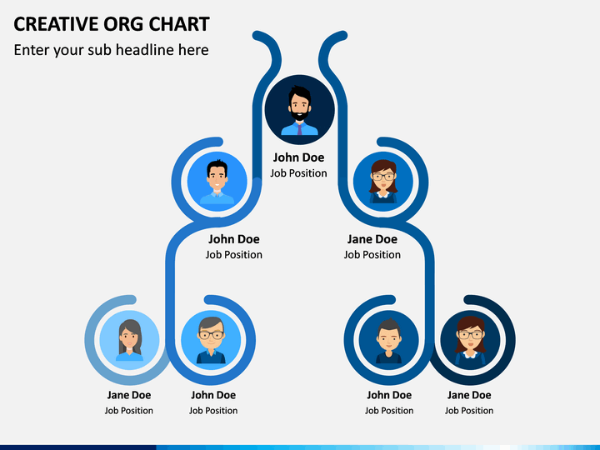

WHO ARE THE END USERS?
Management: They will gain insights into employee productivity and performance
trends, helping them make informed
decisions about promotions, rewards, and resource allocation.​​
•
HR Department: HR professionals can
use the analysis to identify training
needs, develop personalized
development plans, and ensure fair and
data-driven performance evaluations.​​
•
Employees: Employees will benefit from clear feedback on their performance,
leading to opportunities for growth,
recognition, and career advancement.​​
•
Team Leaders: They can use the
analysis to understand team dynamics,
identify top performers, and address any performance issues within their teams.​​
•
The Organization as a Whole: By
optimizing employee performance and
productivity, the organization can achieve better overall efficiency, reduce costs,
and improve employee satisfaction and
rete

Slide 7


OUR SOLUTION AND ITS VALUE PROPOSITION
Conditional formatting - missingFilter - remove
Formula - performance
Pivot - summary
Graph- data visualization

Slide 8

Dataset Description
Employee=tony stark
26- features
9-features
Emp ID number-3435
NAME-TEXT-Calibri
Business Unit-STKI
Job Function- Engineer
Gender-Male
Employee rating number-5
Performance Score-Fully Meets

Slide 9

THE "WOW" IN OUR SOLUTION
Performance level =IFS(Z11>=5,"very
high",Z11>=4,"high",Z11>=3,"medium",TRUE,"low")
3/21/2024 Annual Review
9

Slide 10
MODELLING
Data Collection and Entry:
•Sheet in: This sheet contains detailed employee information, including Employee ID, names, start dates, job titles, supervisors, email addresses, business units, and performance-related data. This is the primary data source for my analysis.​
2. Data Preparation:
•Sheet in:
•I have gathered comprehensive employee data, possibly from various sources, and
compiled it into this sheet.​
•The data includes demographic information, job details, and performance metrics like
"Performance Score" and "Employee Rating."​
•This sheet also has a "Performance level" column, though some values appear to be
missing.​
3. Aggregation of Performance Data:
•Sheet Sheet1:
•This sheet appears to summarize performance data by Business Unit.​
•The table is organized to show the count of employees in each performance level (high,
low, medium, very high) across different Business Units (e.g., BPC, CCDR).​
•I used Excel functions like COUNTIF or PivotTables to aggregate this data.
•The sheet also includes a "Grand Total" column, which summarizes the total count of
employees across performance levels for each Business Unit.​
10

Slide 11
MODELLING
4. Visualization:
•Although not explicitly shown in the provided data, it’s common to create charts or graphs in Excel to visualize performance distributions.
•I have used the data in Sheet1 to create bar charts or pie charts illustrating
the distribution of performance levels across different Business Units.
5. Additional Data Analysis (Sheet2):
•Sheet Sheet2:
•Contains ID-marks pair, possibly related to some other aspect of performance
or another dataset.
•It might be used for supplementary analysis, though it’s unclear how it ties
into the main performance analysis.
6. Final Analysis and Reporting:
•I would likely compile these analyses into a coherent report, possibly adding
explanations, visualizations, and insights directly into the Excel file or exporting the data into a presentation format.
•Key insights could include identifying top-performing Business Units, areas

Slide 12
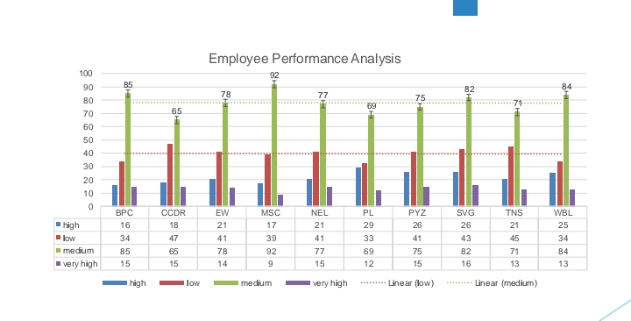
RESULTS
12

Slide 13
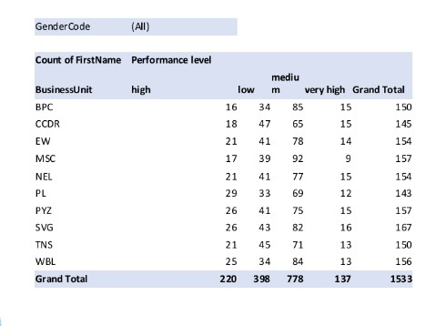
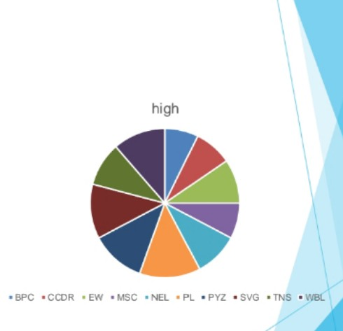
RESULTS

Slide 14
conclusion
The Employee Performance Analysis reveals varied performance levels across different Business Units, with a significant number of employees falling into the "medium" and "low" categories,
particularly in units like BPC and CCDR. There are also strong
performers in the "very high" category, suggesting potential for
leadership development. However, some data gaps, such as
missing "Performance level" entries, need addressing for more
accurate insights. Overall, the analysis suggests a need for
targeted training and development in lower-performing units,
recognition programs for high performers, and improved data
accuracy for future assessments.

