Slide 1
Neural Machine Translation for Indian Languages
Theme Name: Edu Tech
Team Name: BlueBottle
Team Members: Abirami.K, Balakumaran.K

Slide 2
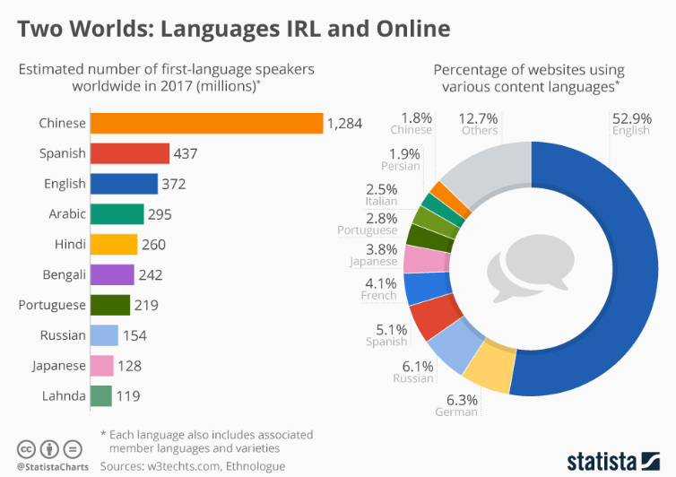
Why Is Translation So Important ?

Slide 3
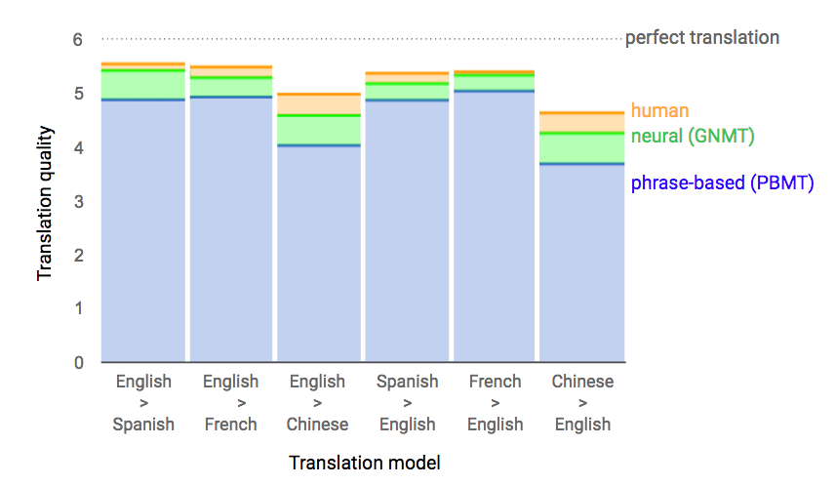
Human vs Machine

Slide 4
66%
24%
100%
Of people is literate only in regional language
Internet growth if regional content increases by 10%
Need for local language support

Slide 5
The Problem..
Mass quality educational videos are available only in English
A person can understand concepts and subjects better and express themselves more fluently when taught in their mother tongue
when an explanation is delivered in a native language, the thought process is simplified
For Content providers converting a content to other language is a tedious task and ultra expensive

Slide 6
Solution
Developed a Neural Machine translation platform. This Platform can convert any english video to indian language video.
This Platform uses Neural Machine Translation and Speech synthesis

Slide 7
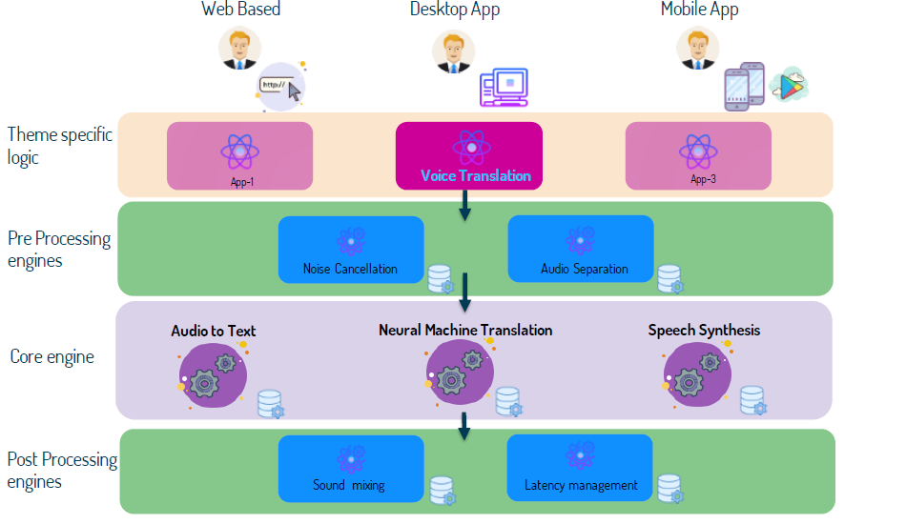

Slide 8
DEMO
https://github.com/abirami92/MishMash_Hack/blob/master/mishmash_demo_video.mp4

