Slide 1

DATA ANALYTICS
ABIRAMIDEVANATHAN

Slide 2
WHAT IS DATA ANALYTICS?
Data analytics is the pursuit of extracting meaning from raw data using specialized computer systems. These systems transform, organize, and model the data to draw conclusions and identify patterns.
Data analysts use a variety of tools and technologies to gather all sorts of data, like statistics about how much time users spend on a website, demographic information about customers or traffic patterns in a city.

Slide 3
WHERE IS DATA ANALYTICS USED?
Data Analytics techniques used in the researches, and businesses also use to inform their decisions. Data analysis can help companies better understand their customers, evaluate their ad campaigns, personalize content, create content strategies and develop products.

Slide 4
WHAT IS THE PURPOSE OF DATA ANALYTICS?
The chief aim of data analytics is to apply statistical analysis and technologies on data to find trends and solve problems. Data analytics has become increasingly important in the enterprise as a means for analyzing and shaping business processes and improving decision-making and business results.

Slide 5
ADVANTAGES OF DATA ANALYTICS
It allows teams within businesses to collaborate and achieve better results. It is useful for businesses to analyse past business performance and optimize future business processes. Analytics helps businesses gain a competitive advantage.

Slide 6
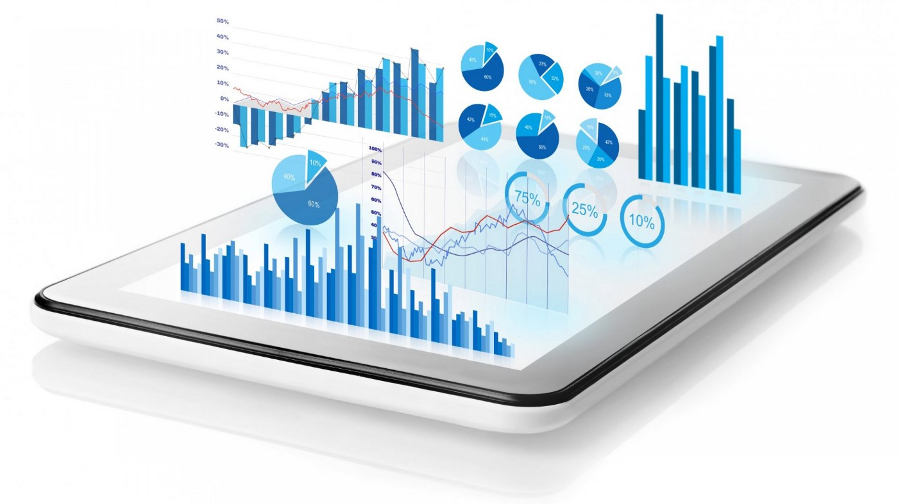
DATA VISUALIZATION

Slide 7
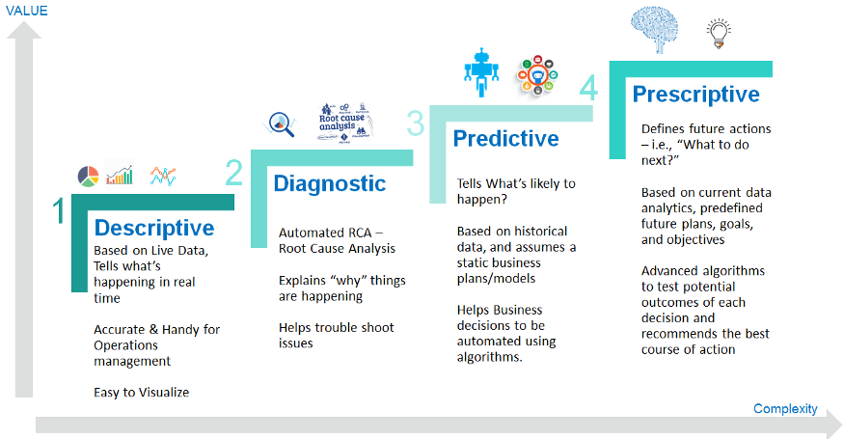
DATA ANALYTICS TYPES

Slide 8
DATA ANALYTICS EXAMPLES
Information security
Customer relationship management
Finance
Fraud detection
Real-time credit scoring
Logistics

Slide 9
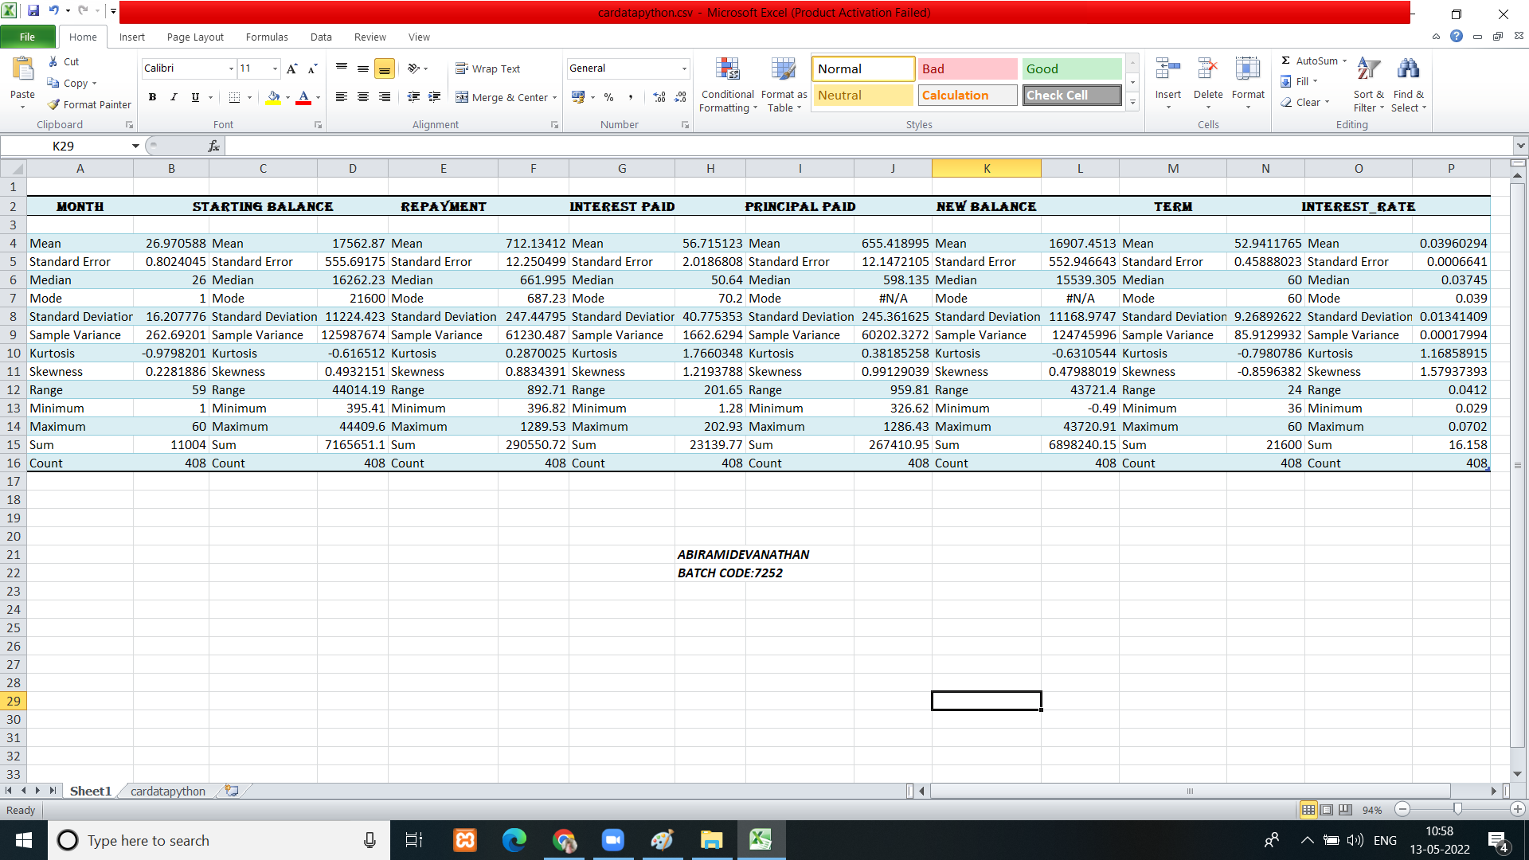
DATA ANALYTICS IN EXCELL

Slide 10
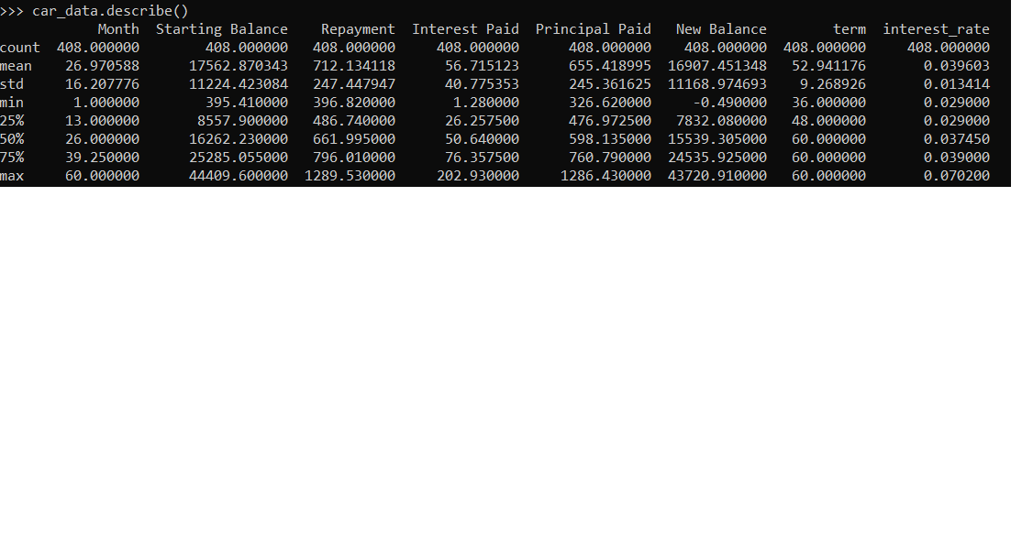
DATA ANALYTICS IN PYTHON

Slide 11
THANK YOU

