Slide 1
PRESENTED BY: ABIRAMI V REGISTER N0:813821104005 DEPARTMENT:COMPUTER SCIENCE AND ENGINEERING
PNEUMONIA DETECTION USING CONVOLUTIONAL NEURAL NETWORK(CNN)
3/21/2024 Annual Review

Slide 2
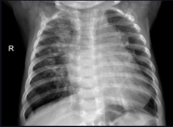
PROJECT TITLE
PNEUMONIA DETECTION USING CNN
3/21/2024 Annual Review

Slide 3


AGENDA
1.PROBLEM STATEMENT
2.PROJECT OVERVIEW
3.WHO ARE THE END USERS?
4.YOUR VALUE AND ITS VALUE PROPOSITION
5.THE WOW IN THE SOLUTION
6.MODELLING
7.RESULTS
3/21/2024 Annual Review

Slide 4

PROBLEM STATEMENT
Pneumonia, a severe respiratory infection, demands early and precise detection for effective treatment.
While chest X-rays aid diagnosis, their interpretation is time-consuming and requires expertise.
This project aims to employ Convolutional Neural Networks (CNNs) to automate pneumonia detection from chest X-ray images.
By training on a diverse dataset of labeled images, the goal is to develop a robust CNN model capable of accurately and efficiently identifying pneumonia cases.
3/21/2024 Annual Review

Slide 5

PROJECT OVERVIEW
Overview
The project aims to leverage deep learning techniques to automate and enhance the process of pneumonia detection from chest X-ray images, ultimately contributing to more efficient and accurate diagnosis and treatment of this serious respiratory condition.
Goals
Developing a model that is capable of accurately identifying pneumonia cases from chest X-ray images.
Early and precise identification of pneumonia cases for timely medical intervention.
How it Works
The system uses the dataset to automatically detect pneumonia, with data augmentation and class weights addressing imbalances, followed by evaluation for accuracy.
Objectives
Utilized machine learning algorithms to analyze and predict accurately
Enhancing healthcare system by early prediction and prevention of the disease.
3/21/2024 Annual Review

Slide 6

WHO ARE THE END USERS?
Radiologists: They will use the automated pneumonia detection system as a tool to assist in interpreting chest X-ray images more efficiently and accurately.
Physicians and Healthcare Providers: Those responsible for diagnosing and treating patients with respiratory conditions, including pneumonia, will utilize the system to receive timely and reliable assessments of chest X-ray images, facilitating faster treatment decisions.
Hospitals and Clinics: Healthcare institutions and clinical settings where chest X-rays are performed routinely will integrate the system into their imaging departments to streamline the diagnostic process and potentially expedite patient care.
Medical Research Institutions: Organizations focused on respiratory diseases and imaging technologies can use the system as a research tool, contributing to the ongoing development and refinement of the automated pneumonia detection technology.
3/21/2024 Annual Review

Slide 7

YOUR SOLUTION AND ITS VALUE PROPOSITION
Pneumonia Detection
Our solution demonstrates a comprehensive approach to building a Convolutional Neural Network (CNN) model for pneumonia detection from chest X-ray images using TensorFlow and Keras.
Unique Value Proposition
Automation and Efficiency: By leveraging CNNs, the project aims to automate the process of pneumonia detection, reducing the need for manual interpretation by radiologists. This automation significantly enhances the efficiency of the diagnostic process, allowing for faster and more accurate identification of pneumonia cases.
Improved Patient Outcomes: By streamlining the diagnostic process, the project contributes to more timely interventions and better management of respiratory infections.
Data-driven Approach: The project's utilization of a diverse dataset of labeled chest X-ray images ensures that the CNN model learns from a wide range of cases, enhancing its ability to generalize to unseen data.
3/21/2024 Annual Review

Slide 8

THE WOW IN YOUR SOLUTION
Innovative Technology: Leveraging CNNs demonstrates a forward-thinking approach to solving complex medical image analysis tasks.
Automation of Diagnosis: The solution aims to automate a critical aspect of healthcare diagnosis, reducing the burden on radiologists and healthcare providers.
Potential for Impact: Automating pneumonia detection has the potential to revolutionize healthcare practices, enabling faster and more accurate diagnosis, especially in regions with limited access to medical expertise.
3/21/2024 Annual Review
‹#›

Slide 9
MODELLING
Data Preparation:
The training, validation, and test directories containing chest X-ray images are defined.
ImageDataGenerator instances are created for data augmentation and normalization. Data augmentation techniques such as shearing, zooming, and horizontal flipping are applied to the training data to increase the diversity of samples and improve model generalization.
Data Loading:
ImageDataGenerator.flow_from_directory() is used to generate batches of augmented and normalized image data from the specified directories. Images are resized to a target size of 150x150 pixels during loading.
Class Imbalance Handling:
The number of images in each class (normal and pneumonia) is counted in the training data, and class weights are computed to address the class imbalance issue. This ensures that the model is trained effectively on both classes.
3/21/2024 Annual Review
‹#›

Slide 10
MODELLING
Model Architecture:
The CNN model is constructed using the Sequential API from TensorFlow.keras.
Three pairs of convolutional (Conv2D) and max-pooling (MaxPooling2D) layers are used to extract features from the input images while reducing spatial dimensions.
The convolutional layers are followed by ReLU activation functions to introduce non-linearity.
After the convolutional layers, the feature maps are flattened into a one-dimensional vector using the Flatten layer.
Two dense (Dense) layers are added for classification. The first dense layer consists of 512 units with a ReLU activation function, followed by a single unit output layer with a sigmoid activation function for binary classification.
3/21/2024 Annual Review
‹#›

Slide 11
MODELLING
Model Compilation:
The model is compiled using the Adam optimizer and binary cross-entropy loss function, suitable for binary classification tasks like pneumonia detection.
The accuracy metric is specified to monitor model performance during training.
Model Training:
The model is trained using the fit method, specifying the training generator, validation data, number of epochs, and class weights.
Training progresses through multiple epochs, with each epoch iterating over the training data in batches.
Model Evaluation:
The trained model is evaluated on the test data using the evaluate method, computing the test loss and accuracy.
3/21/2024 Annual Review
‹#›

Slide 12
MODELLING
The resulting CNN model is capable of detecting pneumonia from chest X-ray images with a high level of accuracy, providing a valuable tool for automating the diagnosis process in healthcare settings.
3/21/2024 Annual Review
‹#›

Slide 13
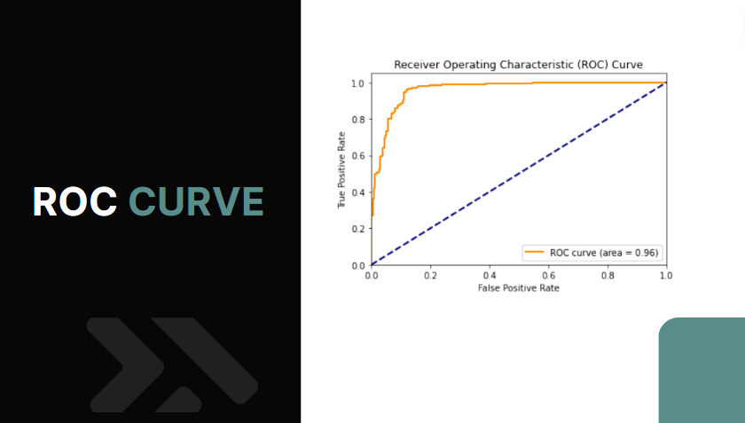
RESULTS
3/21/2024 Annual Review
‹#›

Slide 14
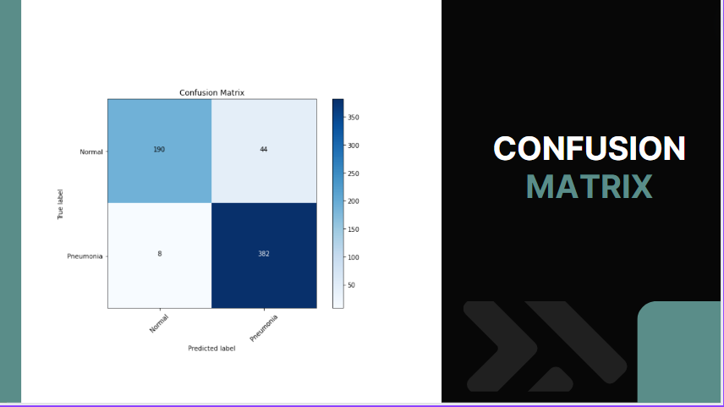
RESULTS
3/21/2024 Annual Review
‹#›

Slide 15
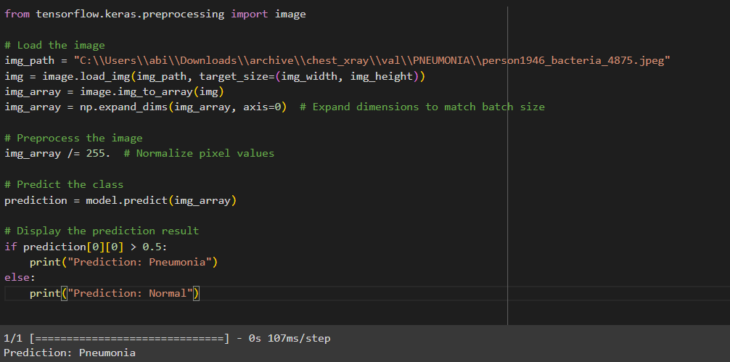
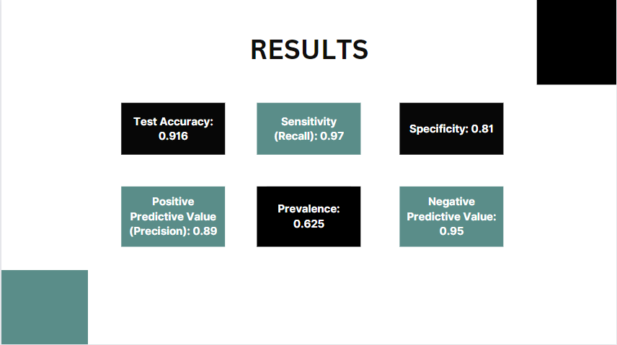
RESULTS
DEMO LINK
https://github.com/abiramiv29/Pneumonia_Detection_CNN.git
3/21/2024 Annual Review
‹#›

