Slide 1

Datagram
Technical test – data analyst

Slide 2
OVERVIEW
ORIENTED DATA ANALYSIS
DATA QUALITY
DASHBOARD
PERSPECTIVES

Slide 3
overview

Slide 4
2nd Part: Oriented Data analysis: 5 hours (Thursday – Friday)
1st Part: Data Quality: 10 hours (Saturday) + 5 more hours (8-9/12)
The choice of the tool used: Excel 2013 is a powerful tool for dashboarding and it exists in almost every pc even for non tech users, not the case for PowerBi and Qlik Sense
Of course, with the help of Python and SQL to understand, extract and manipulate data

Slide 5
2nd part
Oriented data analysis
main.py file

Slide 6
Code in main.py file
I don’t think that I have much to say, I used Python in Pycharm IDE to connect to matching_test datasource existed in Redash.

Slide 7
1st part
Data quality

Slide 8
Graphs & kpis
I tried to cover all the database tables and many graph types from categorical to numerical features, I used also some text boxes, images and slices to filter by month or category.

Slide 9
Data quality issues
Dashboard.py file: The date & time columns are timestamps (postegresql type): not in a format that can help us use them ➔ with Python I converted them to datetime and used them to show the number of products created & updated per month.
Names.py file: There are many categorical columns having different records referring to the same category: like chainproduct name and image url category ➔ I tried to clean data in order to show those categories: type of products: food, tire… / most referenced websites: ebay, amazon…

Slide 10
DASHBOARD
dash.xlsx file

Slide 11
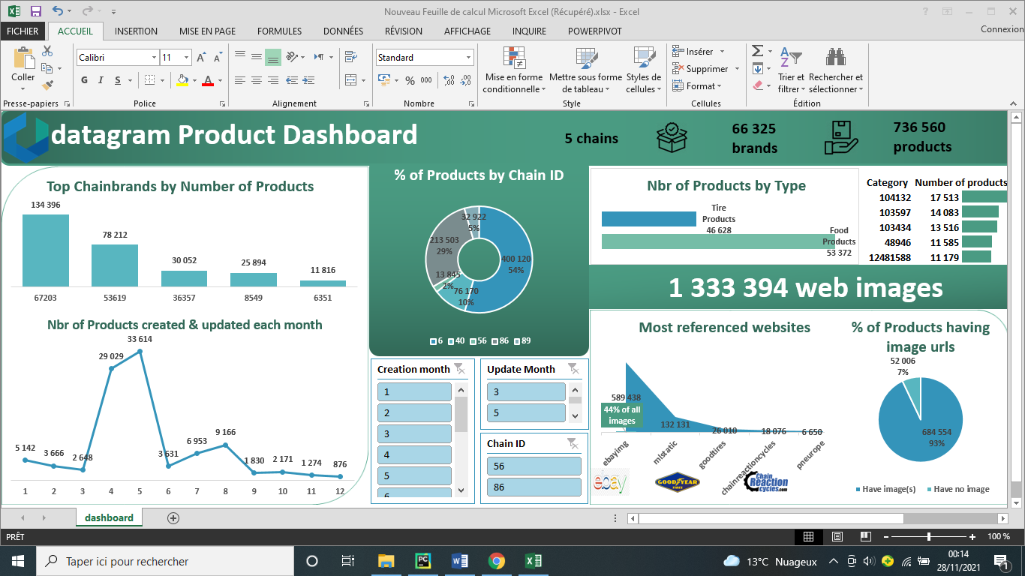

Slide 12
PERSPECTIVES

Slide 13
I would like to connect Excel to the Redash database.
I would like it to be more interactive and dynamic dashboard.
I know that Python has many powerful ploting libraries like plotly, matplotlib, seaborn… that can return clear and more complex graphs, but I chose Excel for its ability to return an ergonomic dashboard if it will be shown to clients.
I really enjoyed every hour doing the test, although the time limit and the hard competition ideas coming in my mind :’D.

Slide 14
DATAGRAM
Thank you

