Slide 1
EWU SecondHand Book Buy & Sell
Static Analysis and Dynamic Testing

Slide 2
Submitted By
Adnan Rahman Tushar
2019-3-60-099
Md. Abir Hasan Khan
2019-1-60-013
Humayun Rashid Rahat
2019-1-60-007
Submitted To
Dr. Shamim H Ripon
Professor, Department of Computer Science & Engineering
East West University
Course : CSE430 Software Testing and Quality Assurance

Slide 3
Introduction
Welcome to the introduction of the "EWU SecondHand Book Buy & Sell" a web-based software designed to streamline the process of buying and selling second-hand books within the EWU community. This innovative platform aims to connect students and faculty members, providing them with a convenient and reliable marketplace to trade pre-owned academic materials. Throughout this introduction, we will delve into the key features of the software and emphasize the importance of robust test cases in ensuring its functionality, usability, and security.

Slide 4
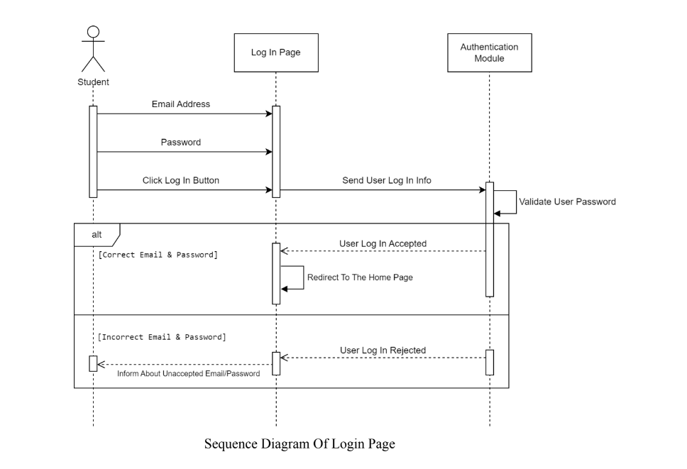
Sequence Diagram no.1

Slide 5
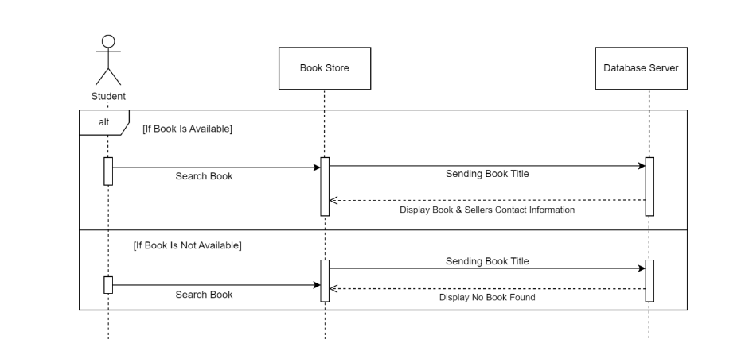
Sequence Diagram no.2
Sequence diagram of book buy

Slide 6
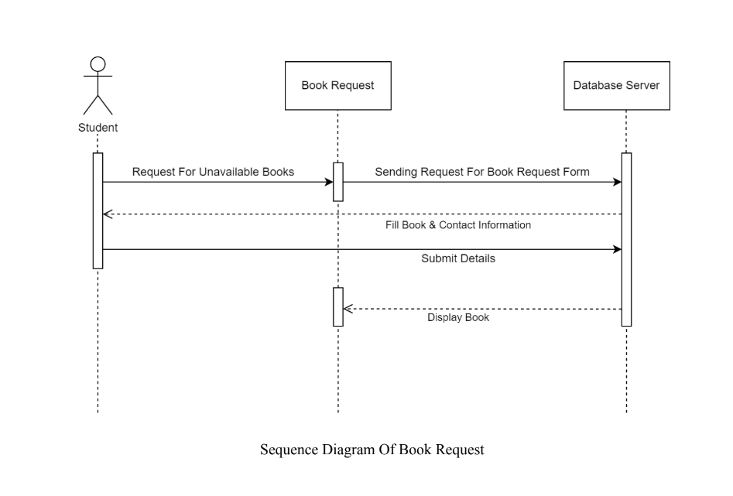
Sequence Diagram no.3

Slide 7
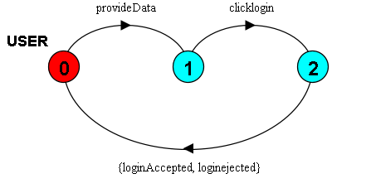
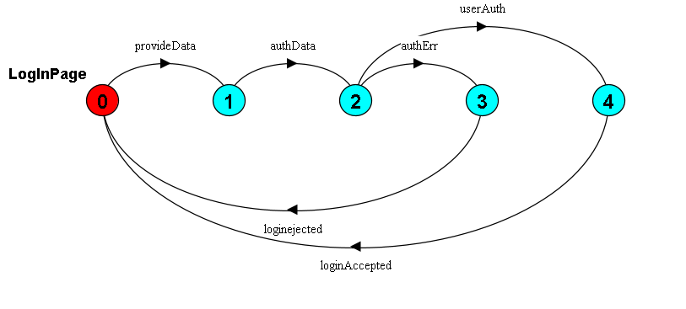
LTSA Diagram Log in

Slide 8
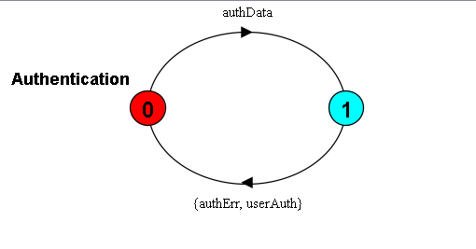
LTSA Diagram Log in

Slide 9
LTSA Code
#Log in
USER = (provideData->clicklogin->(getloginAccepted->USER|getloginRejected->USER)).LogInPage = (getData->authData->(getUserAuth->loginAccepted->LogInPage|getAuthErr->loginejected->LogInPage)).Authentication = (getauthData->(userAuth->Authentication|authErr->Authentication)).||LogIn = (USER || LogInPage || Authentication)/{authData/getauthData, userAuth/getUserAuth, authErr/getAuthErr, provideData/getData, loginAccepted/getloginAccepted, loginejected/getloginRejected}.

Slide 10
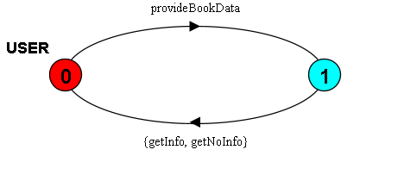
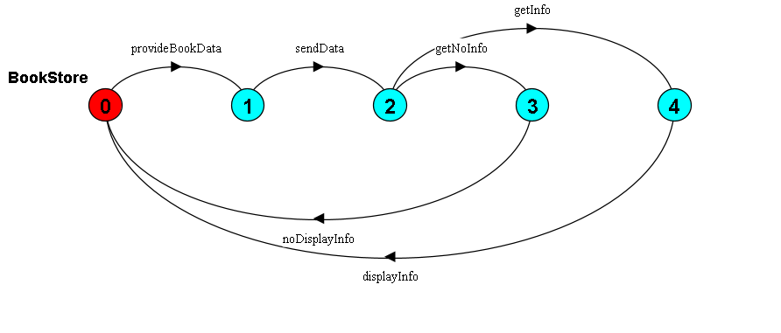
LTSA Diagram Bookbuy

Slide 11
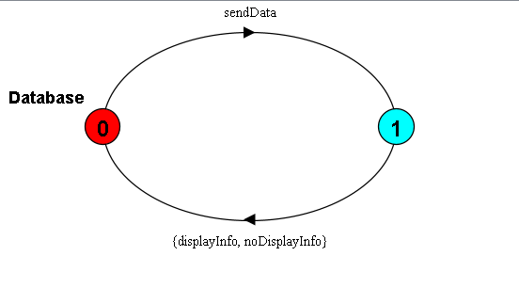
LTSA Diagram Bookbuy

Slide 12
LTSA Code
#Bookbuy
USER = (provideBookData->(getInfo->USER|getNoInfo->USER)).BookStore = (getBookData->sendData->(info->getDisplayInfo->BookStore|noInfo->getNoDisplayInfo->BookStore)).Database = (rcvData->(displayInfo->Database|noDisplayInfo->Database)).||BookBuy = (USER || BookStore || Database)/{provideBookData/getBookData, getInfo/info, getNoInfo/noInfo, sendData/rcvData, displayInfo/getDisplayInfo, noDisplayInfo/getNoDisplayInfo}.

Slide 13
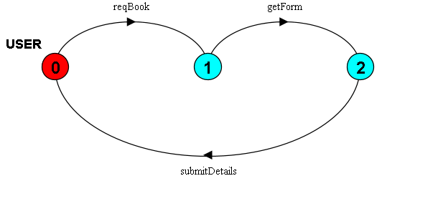
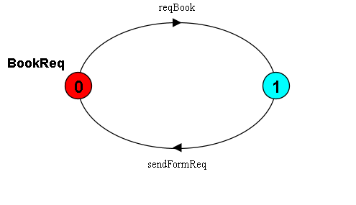
LTSA Diagram Bookrequest

Slide 14
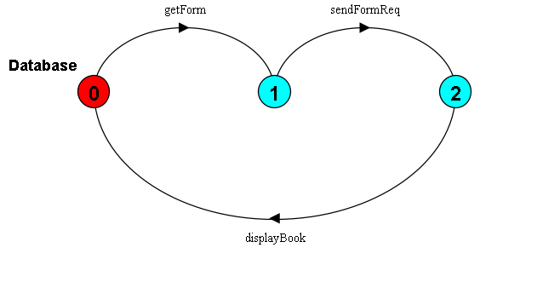
LTSA Diagram Bookrequest

Slide 15
LTSA Code
#Bookrequest
USER = (reqBook->getForm->submitDetails->USER).BookReq = (getReqBook->sendFormReq->BookReq).Database = (sendForm->rcvFormReq->(displayBook->Database)).||BookRequest = (USER || BookReq || Database)/{reqBook/getReqBook, getForm/sendForm, sendFormReq/rcvFormReq}.

Slide 16
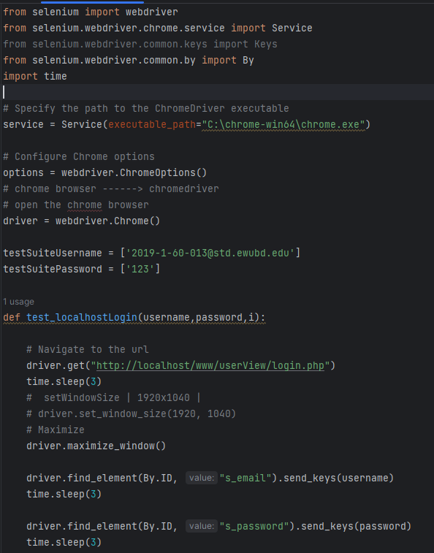
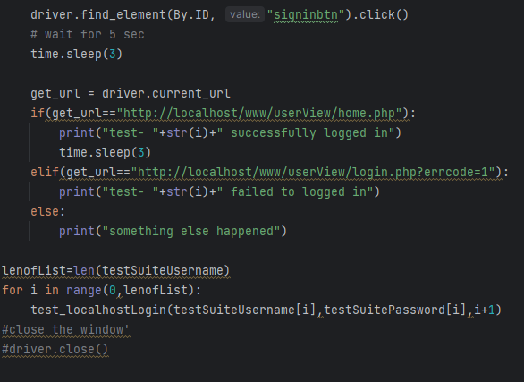
Dynamic Testing Test Case. 1
#login

Slide 17
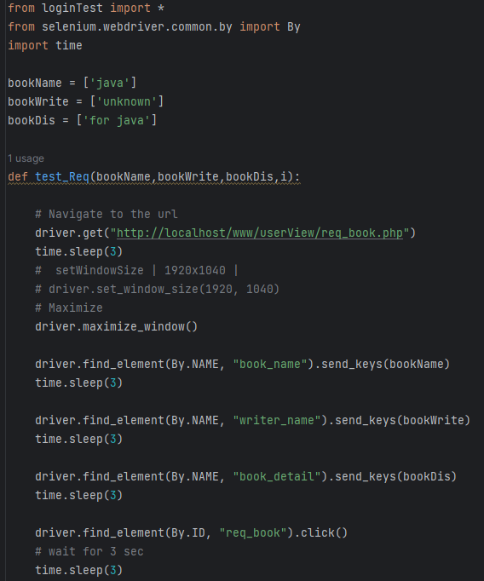
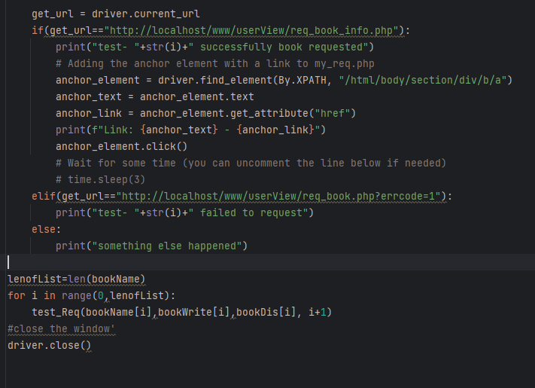
Dynamic Testing Test Case. 2
#Request Book

Slide 18
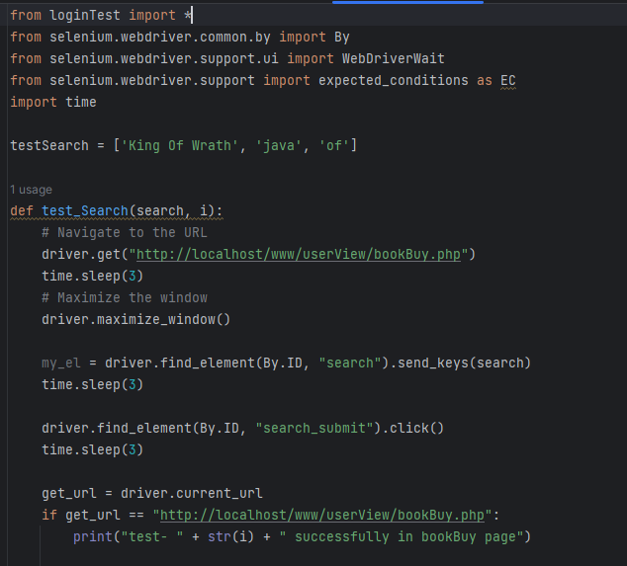
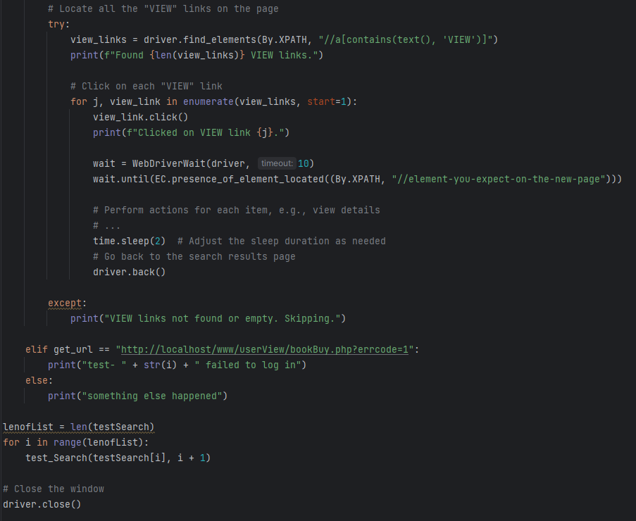
Dynamic Testing Test Case. 3
#SearchBook

Slide 19
Conclusion
Functional testing verifies that the software's features, such as book listing, search, transaction processing, and user profile management, perform optimally. Usability testing ensures an intuitive and engaging user experience, making the platform easy to navigate and use. Security testing guarantees the safety of user data protecting against unauthorized access and potential threats. The success and reliability of the "EWU SecondHand Book Buy & Sell" heavily rely on a robust testing strategy. The meticulously crafted test cases, spanning functional, usability, security, performance, and compatibility testing, ensure that the software meets the highest standards of quality and functionality.

Slide 20
Thank you !

