Slide 1

A Hitchhikers Guide to the ETH
By Antoine Brison & Andreas Biri

Slide 2
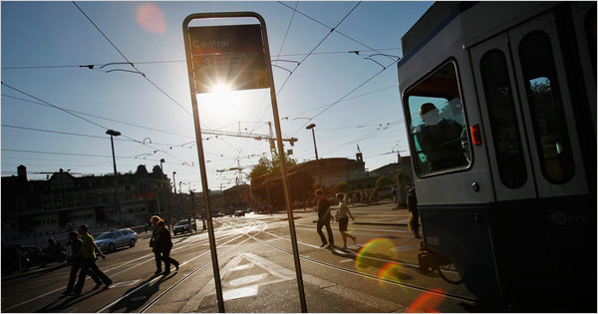
Motivation
Everyday, thousands of student travel from Zurich Main Station to the ETH
All of them ask themselves
« How can I reach the ETH as fast as possible? »

Slide 3
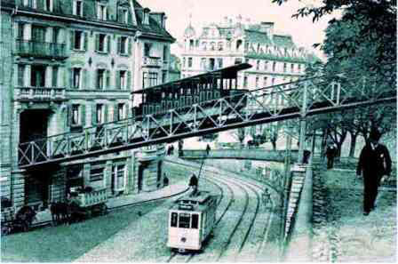
Overview
Introduction
Materials & Methods
Results
Conclusion
Discussion

Slide 4
Introduction
Nowadays, society postulates great mobility for all individuals
In a city, public transport is crucial for fast travel
High stress on heavily frequented routes
→ Needs to analyze traffic and adjust system to optimize flow

Slide 5
Introduction
This study concentrates on the three different paths between «Central» and ETH main building
Aim of the study:
Simulate current situation in Zurich
Analyze frequency and capacity influence on path loadings
Study impact of agents restricted to one path

Slide 6
Materials and Methods
From Central, three different paths can be chosen:
Polybahn ( 2 min )
Tram ( 5 min )
Walking ( 8 min )
Paths differ in:
Travel time
Frequency of departure
Capacity

Slide 7
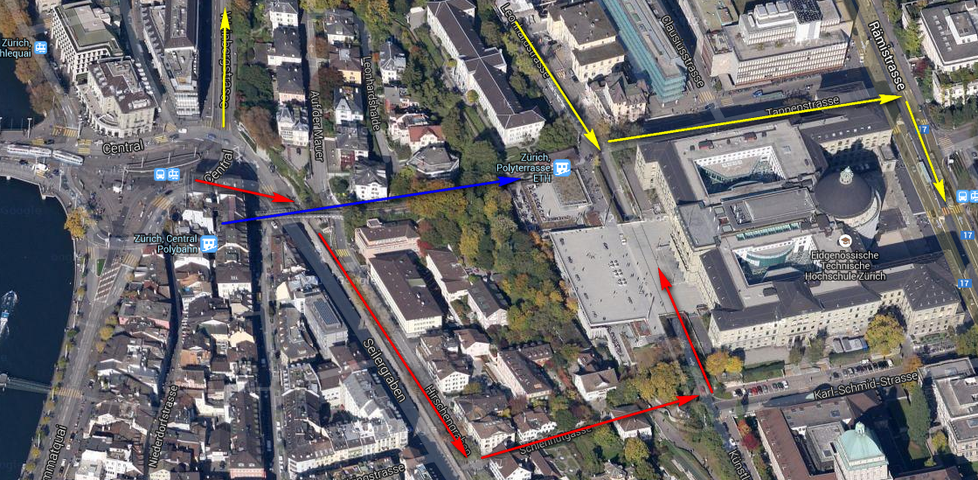
Paths

Slide 8
Materials and Methods
Agent-based, time-depending model
14’400 time steps of 10 sec → simulate 4 hours
Sinus function simulates arriving agents
Three different parts:
Creating agents
Simulate travel
Visualize movements

Slide 10
Results
Current situation, no limited agents assumed
Average agents in Polybahn : 39.6667
Average waiting time at Polybahn : 3.795 min
Average agents in Tram : 40.903
Average waiting time at tram : 4.7998 min
Average agents walking : 94.402

Slide 11
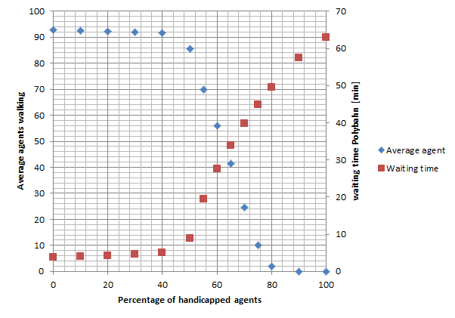
Results
Handicapped agents

Slide 12
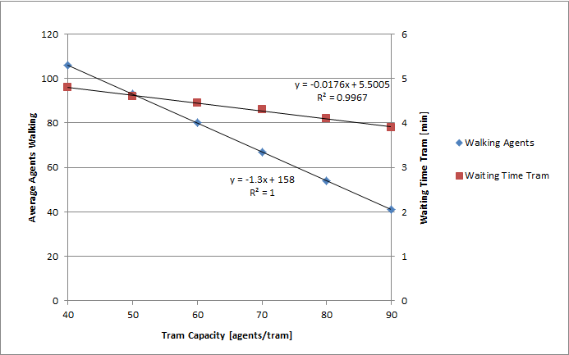
Results
Capacity dependence

Slide 13
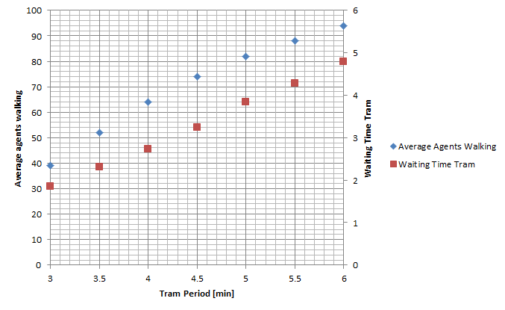
Results
Frequency dependence

Slide 14
Conclusion
Critical percentage of handicapped agents the Polybahn can handle lies between 40 – 45 %
Tram capacity impacts average agents walking three times stronger than waiting time
Increasing tram frequency most effective way of decreasing waiting time for the tram

Slide 15

Discussion / Q & A

