Slide 1
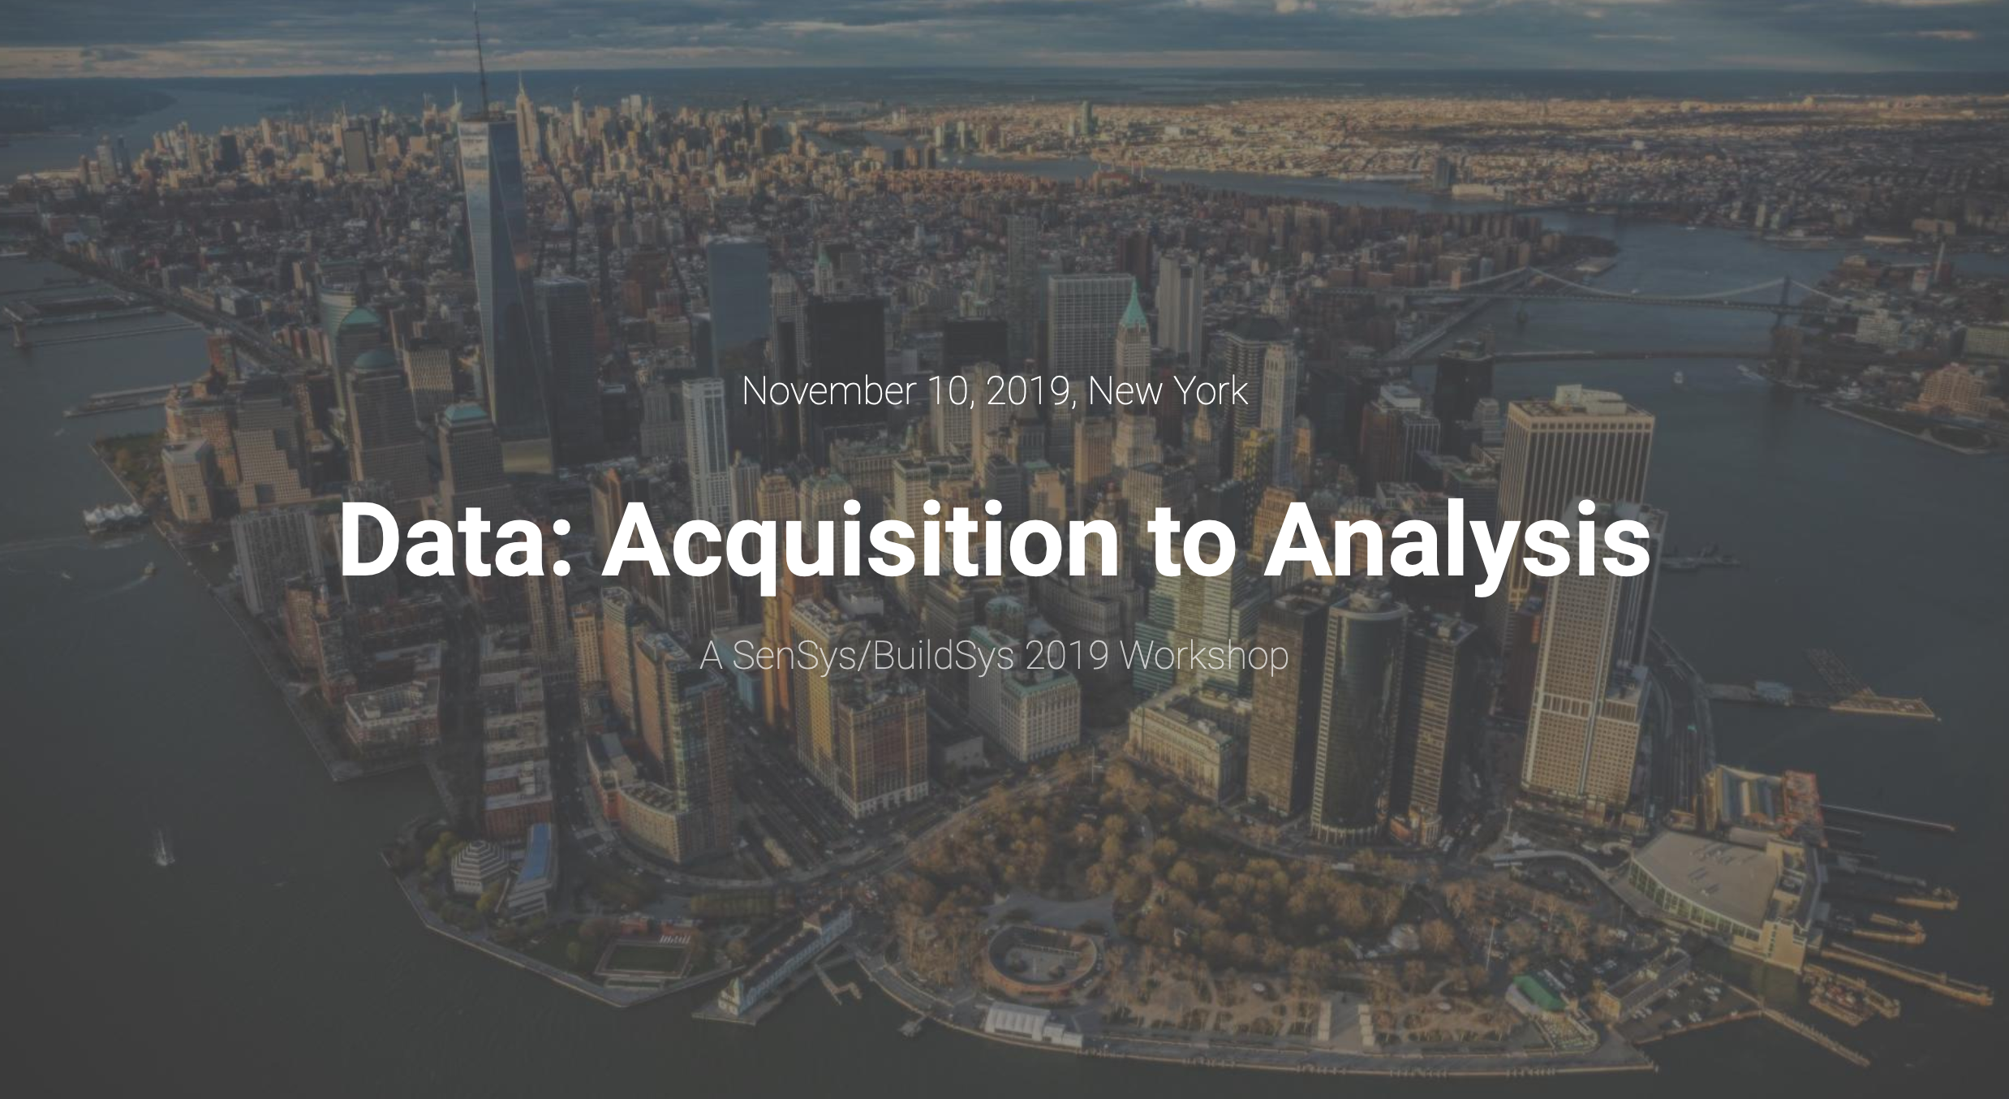

Slide 2
The Second Workshop on Data: Acquisition to Analysis DATA’19
Part of SenSys/BuildSys 2019
At Columbia University in New York City, New York, USA
November 10, 2019

Slide 3
Welcome!
Thank you for joining us!

Slide 4
A very brief history of DATA (It’s only been around two years… ☺)
The IPSN’18 business meeting discussed open access & reproducibility…
Shijia Pan, Pei Zhang, Jie Gao, and Chien-Chun Ni created DATA
First run at SenSys 2018
Most popular workshop!
14 datasets collected and promoted
Conclusion was to do it again
Refine criterion and filter for dataset submissions
Grow beyond ‘just datasets’ to understand data issues broadly

Slide 5
The origins and goals of DATA’19
Introducing the joint SenSys / BuildSys DATA’19 workshop
SenSys: Say lots of positive things about a workshop and you end up running it
BuildSys: Flora Salim and Mikkel Baun Kjærgaard were starting a similar one!
Long history of these communities working together: join forces!
The dual goals of DATA:
Collect and promote interesting, useful, high fidelity datasets
Became Dataset papers (1-2 page short papers)
Explore questions around the collection & use of data
Became Full papers (3-5 page papers)

Slide 6
DATA’19 by the numbers
Submissions received 2 reviews, then a 3rd if there was not consensus
(Average PC load 2.75 reviews / member)
22 submissions total
9 full papers
13 datasets
Accepted 16 submissions (73%)
5 full papers (56%)
11 datasets (85%)
Nice growth from DATA’18:
Accepted 14/15 (93%) datasets

Slide 7
Today’s Agenda
Session 1: Who’s There?
Coffee Break
DATA is at its heart a workshop
Discussion is highly valued & encouraged
What brought you to DATA?
Session structure
Paper presentations
Mixture of full papers and datasets
“End” discussion
Breakouts & discussion sections
Session 2a: The Built Environment
Session 2b: The Wireless Channel
BuildSys Breakout
SenSys Breakout
Lunch
Session 3: Great Outdoors
Session 4: Details Matter
Coffee Break
Group Discussion

Slide 8
Early seeding of breakout & group discussion ideas…
What makes a good dataset?
How to communicate, enforce(?) these properties
How to effectively promote datasets
What can DATA do
What can we as a community do outside DATA?
What should the future of the DATA workshop be?
What datasets are missing that are in demand?
How do we promote / reward their collection?
What is different, the same, about SenSys/BuildSys DATA?

Slide 9
Promotion of DATA and datasets at SenSys!
SenSys chairs have agreed to give us a little time in the main program
I will use this time to promote your cool datasets
One slide
With one “cool graph”
With optional “cool phrase”
Goal is to hook people, get them to look more
https://j2x.us/data19
(open to other uses of this time as a breakout topic!)

Slide 10
Thank you to all of our wonderful organizers, committee-members, and volunteers!
DATA’19 Chairs
Shijia Pan, Flora Salim, Mikkel Baun Kjærgaard, and Pat Pannuto
DATA’19 Advising Committee
Jie Gao, Pei Zhang, Prabal Dutta, Jie Liu

Slide 11
Thank you to our wonderful Program Committee!
Jorge Ortiz, Rutgers University
Wen Hu, University of New South Wales (UNSW)
Olga Saukh, TU Graz
Jun Han, National University of Singapore
Brano Kusy, CSIRO
Chris Xiaoxuan, Lu University of Oxford
Wan Du, University of California, Merced
Arun Vishwanath, IBM Research Australia
Clayton Miller, National University of Singapore
Salvatore Carlucci, NTNU
Rachel Cardell-Oliver, The University of Western Australia
Zoltan Nagy, UT Austin
Mohammad Saiedur Rahaman, RMIT University
Fisayo Caleb Sangogboye, University of Southern Denmark
Yongli Ren, RMIT University
Jason Koh, University of California, San Diego

Slide 12

An enormous thank you to our Dataset Management Chair
Chien-Chun Ni, Yahoo! Research

Slide 13
Quick Logistical Things
There’s no food or drink allowed in this building
So coffee breaks are in the quad in the next building over
We’ll find them together?
Restrooms
Women’s down the hallway through the doors
Men’s are on floors 1, 3, and 7 (we’re on 5)

