Slide 1
Dataset: An Open Dataset and Collection Tool for BMS Point Labels
Gabe Fierro gtfierro@cs.berkeley.edu
Sriharsha Guduguntla (UC Berkeley), David E. Culler (UC Berkeley)

Slide 2
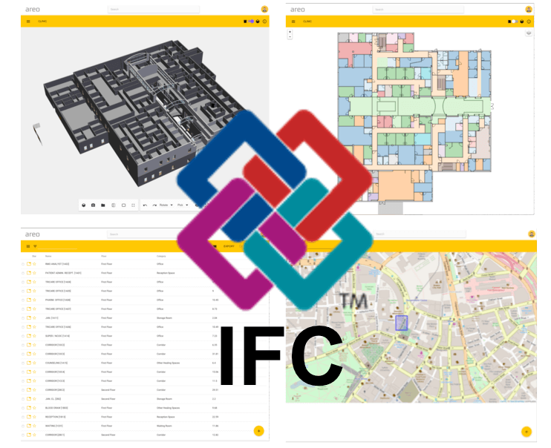


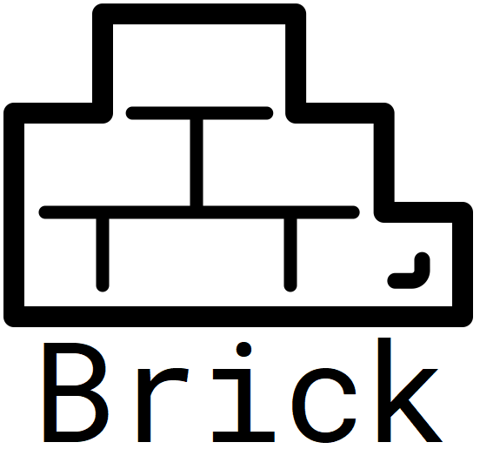



Standardized Building Metadata
Enables increased penetration of energy efficiency measures, facilitates data analysis at scale, lower commissioning costs
Growing interest and development on building metadata:
Academia, Industry, Government, Standards Bodies

Slide 3
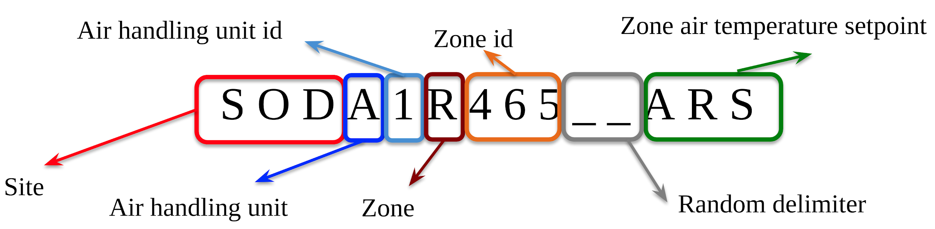
Challenges
Transformation/standardization of existing building metadata is still a problem
Metadata in built environment is characterized by extreme heterogeneity
Site-specific idioms and conventions
Inconsistent even within an enterprise

Slide 4
Automated Translation
Ongoing work to enable automated translation of existing, unstructured building metadata
Human-in-the-loop active learning (Bhattacharya 2015)
Clustering-based classification (Balaji 2015)
Transfer learning, NLP techniques (Koh 2018)
Development, evaluation limited by access to real-world building labels

Slide 5
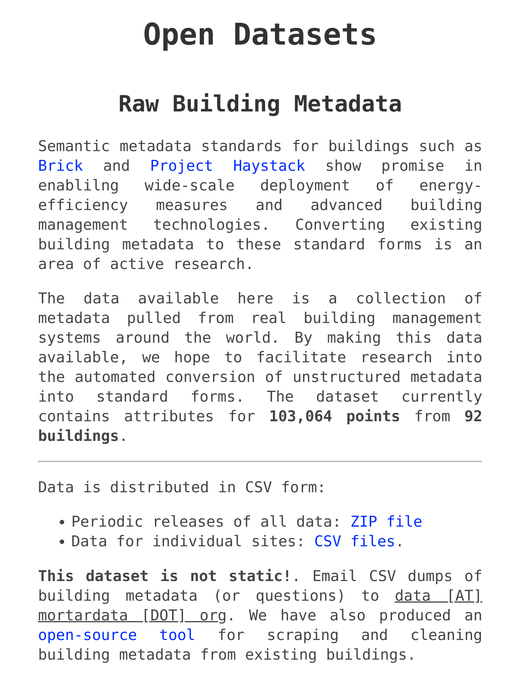
Dataset: Raw Building Metadata
Dataset of attributes (labels, units, descriptions) for 103,064 points for 92 buildings
Mostly campus buildings
Anonymized (no building names), but otherwise untreated
Available online; periodic releases
Open source tool for scraping and contributing additional data

Slide 6
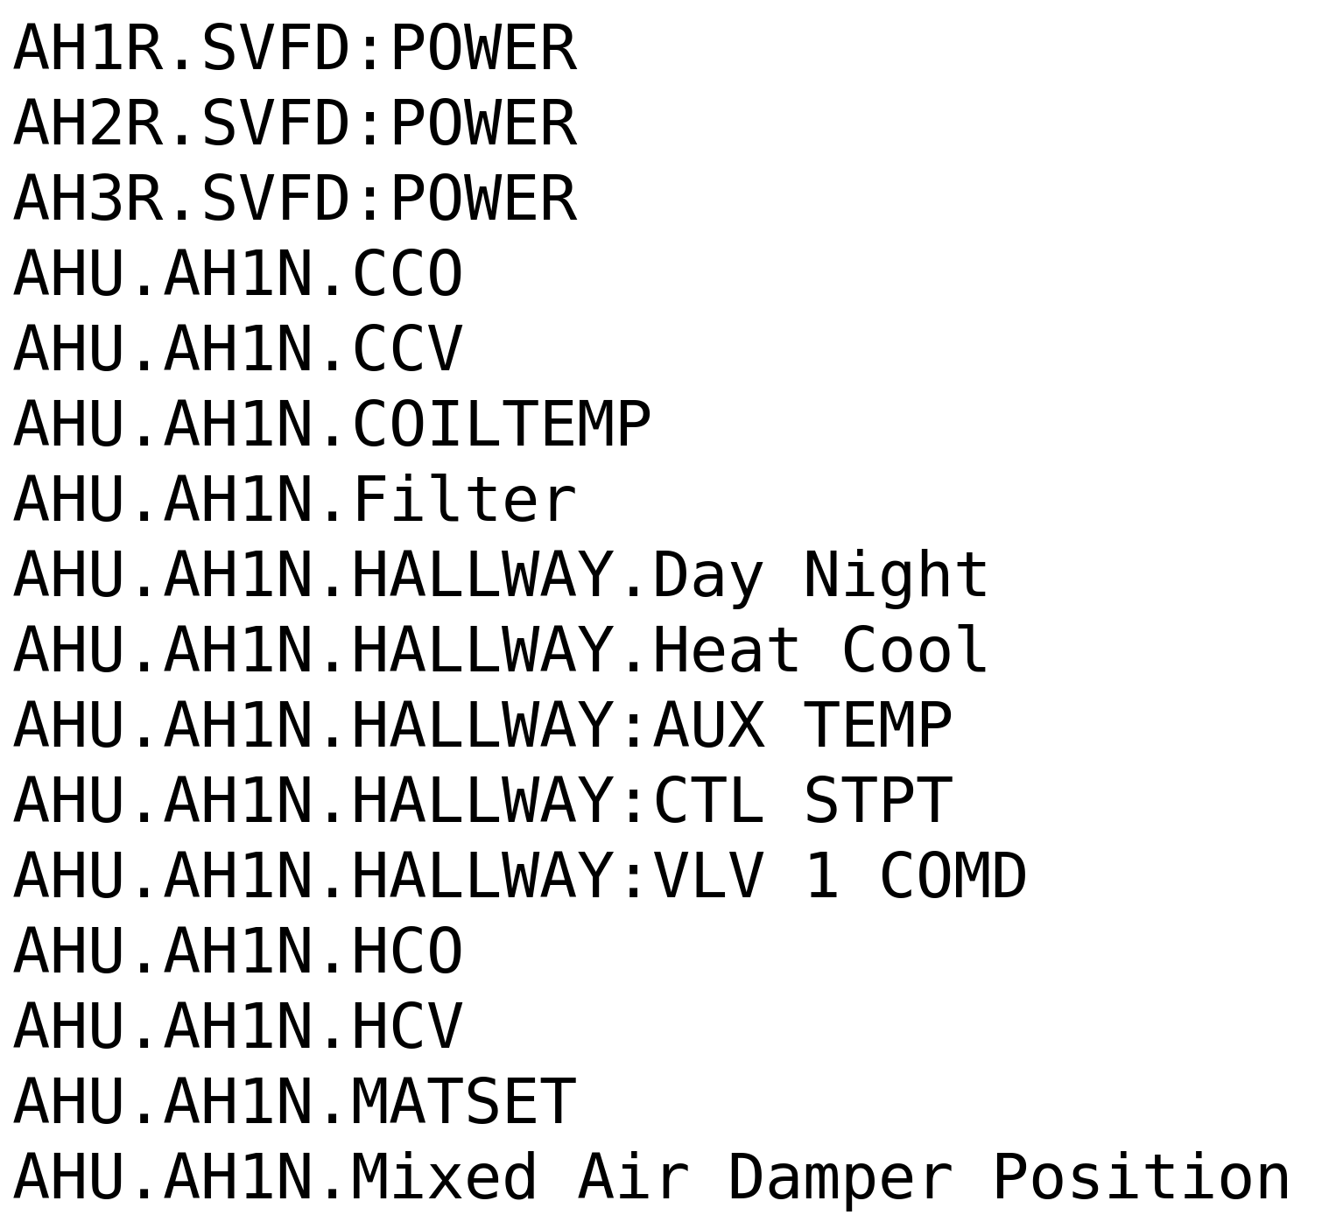
Dataset: Raw Building Metadata
Some with clear delimiters...

Slide 7
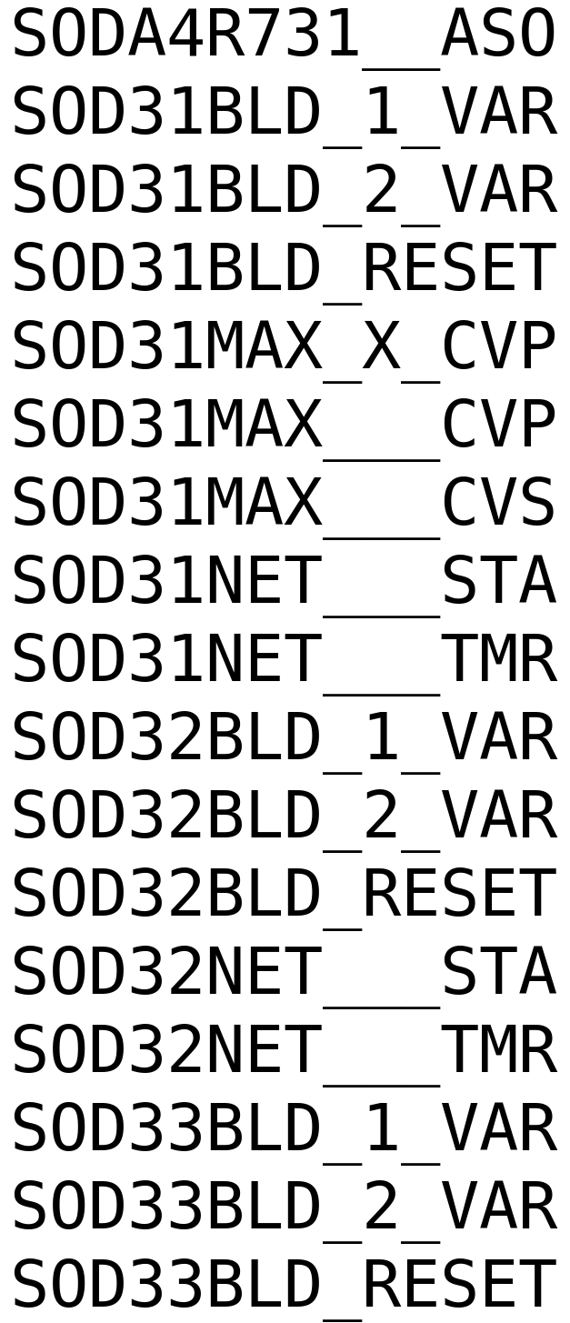
Dataset: Raw Building Metadata
Some with clear delimiters...
...and a few without

Slide 8
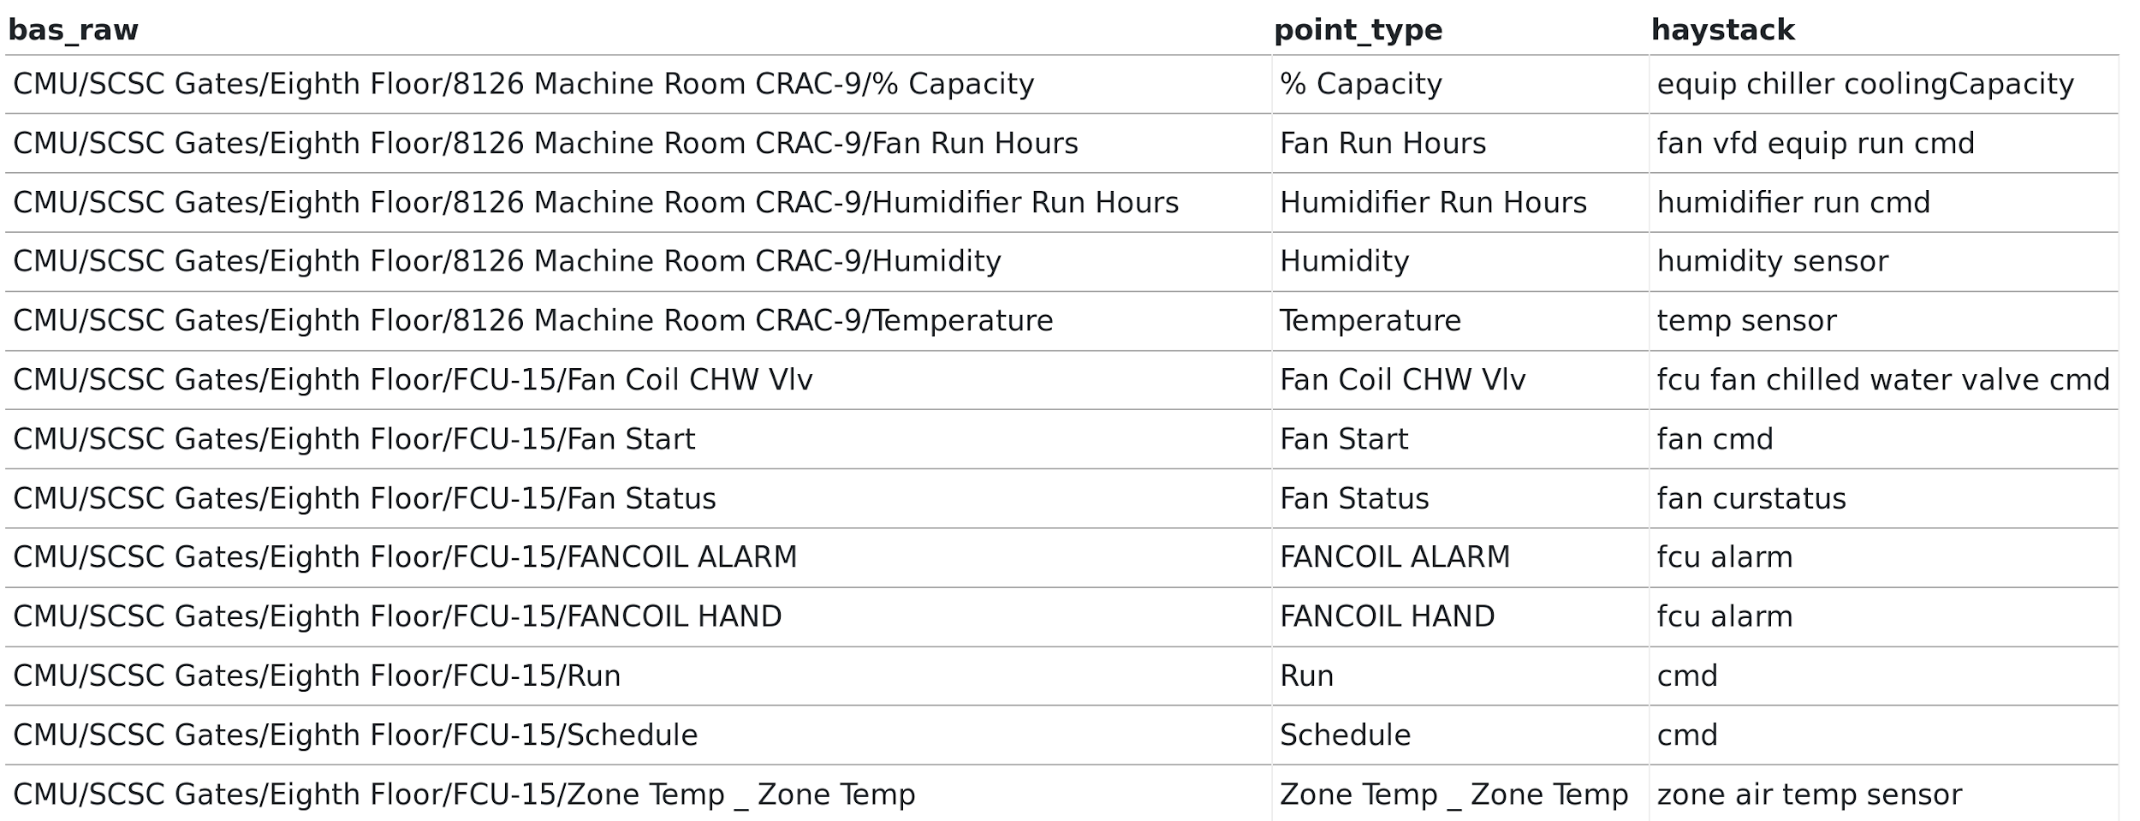
Dataset: Raw Building Metadata
- Some buildings have more than just labels
- Very few buildings with existing “ground truth”

Slide 9
Contributing to the Dataset
Point scraping tool:
Primitive, but open source :)
Scans network for BACnet devices
hoping to expand to other protocols
Dumps BACnet properties to CSV file

Slide 10
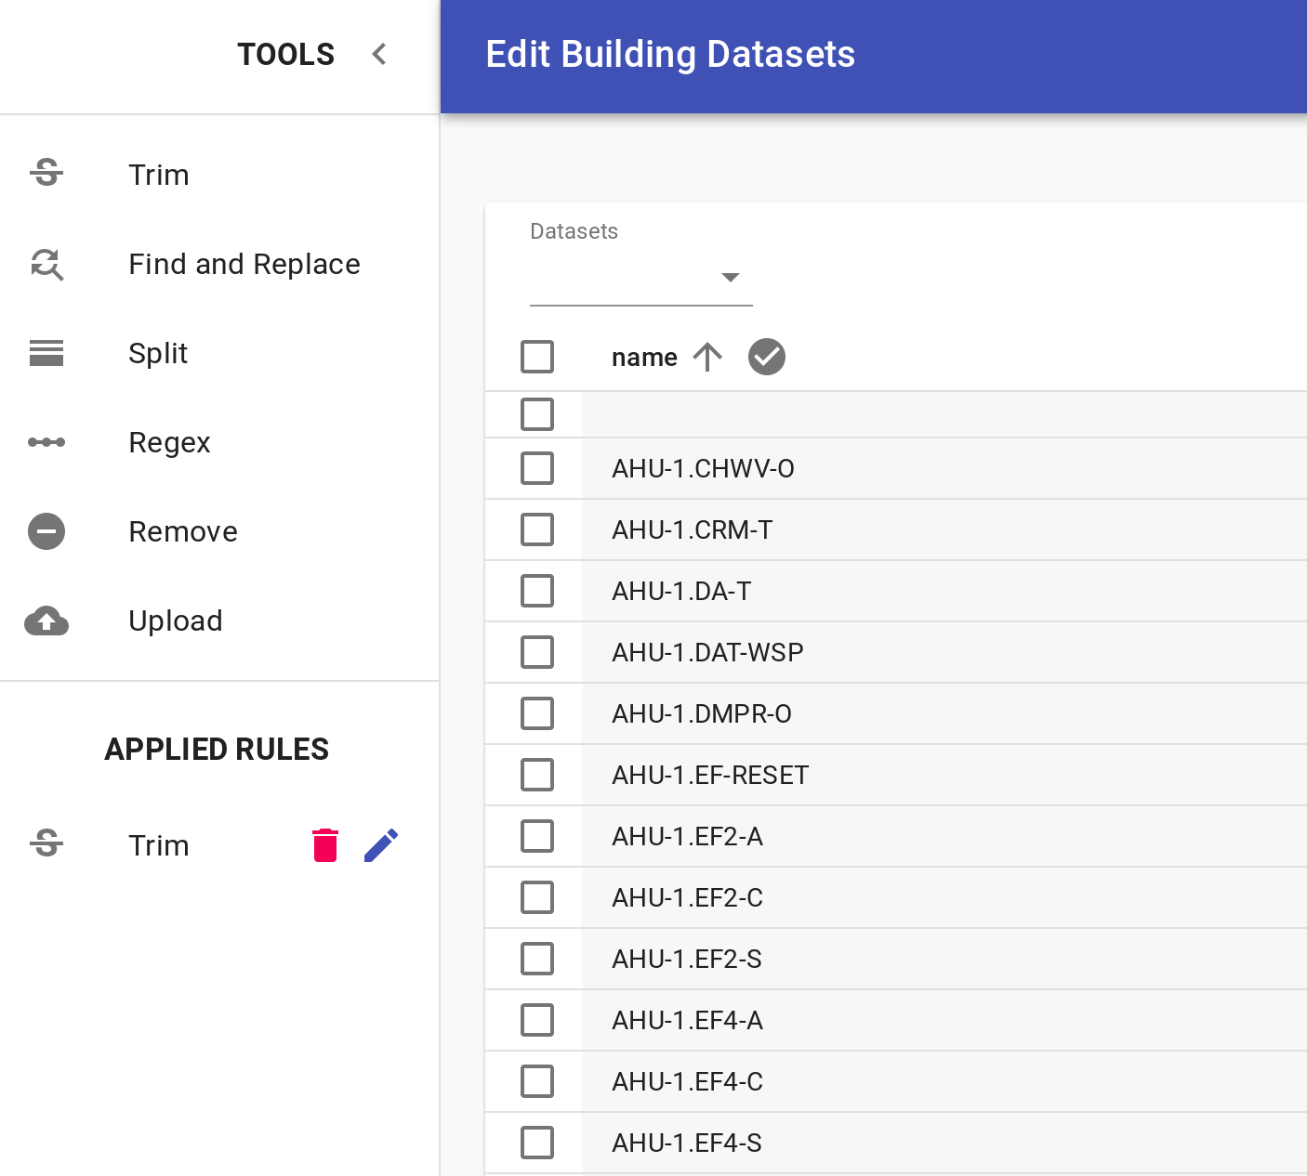
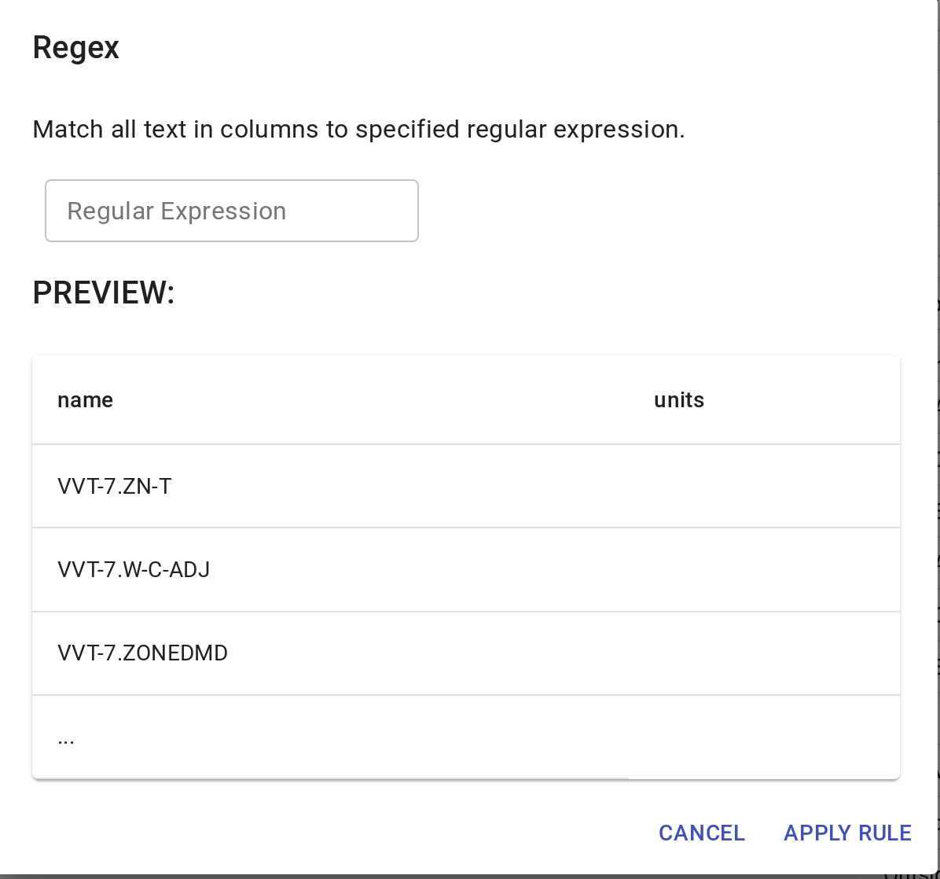
Contributing to the Dataset
Web-based tool for metadata cleaning and anonymization
Upload CSV produced by pointscan or other tool
Apply cleaning rules:
Find/replace substrings
Split fields
Remove sensitive text

Slide 11
Conclusion
Gabe Fierro
gtfierro@cs.berkeley.edu
https://brickschema.org
Open dataset of building point labels (and other attributes)
Data and collection tool at https://data.mortardata.org
Want to promote research in metadata normalization

