Slide 1








Synchronization Between Sensors and Cameras in Movement Data Labeling Frameworks
Jacob Kamminga, Michael Jones, Kevin Seppi, Nirvana Meratnia, Paul Havinga

Slide 2
Introduction
Obtaining labeled data is a tedious and daunting task
Ground truth often collected using video that record subjects wearing sensors
During labeling sensor-data preferably synchronized with video and displayed simultaneously

Slide 3
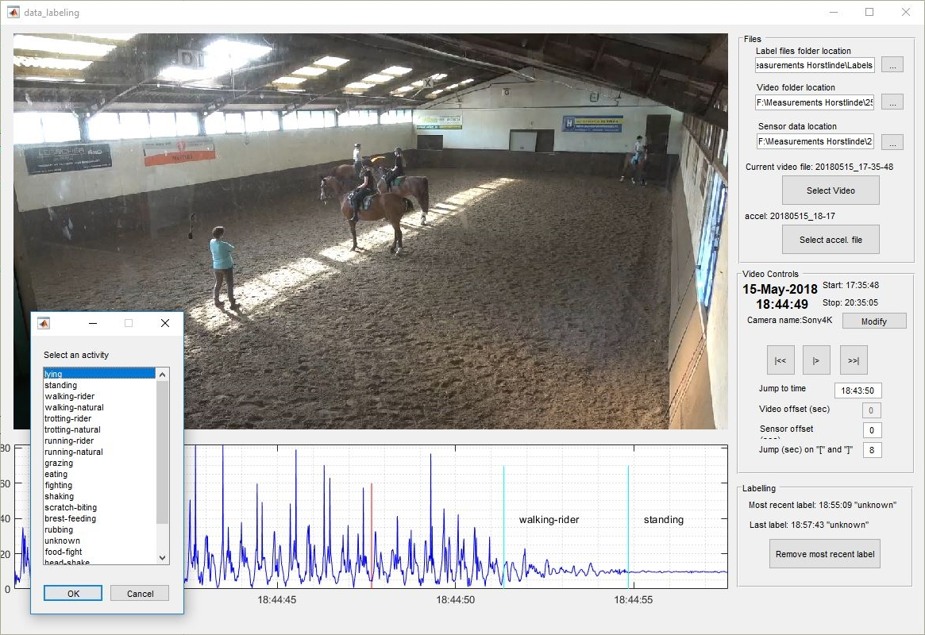

Slide 4
Approach Comparison
Approach A: Synchronization using visual key
Approach B: Synchronization using real-time clocks
Notes:
We compared two frameworks

Slide 5
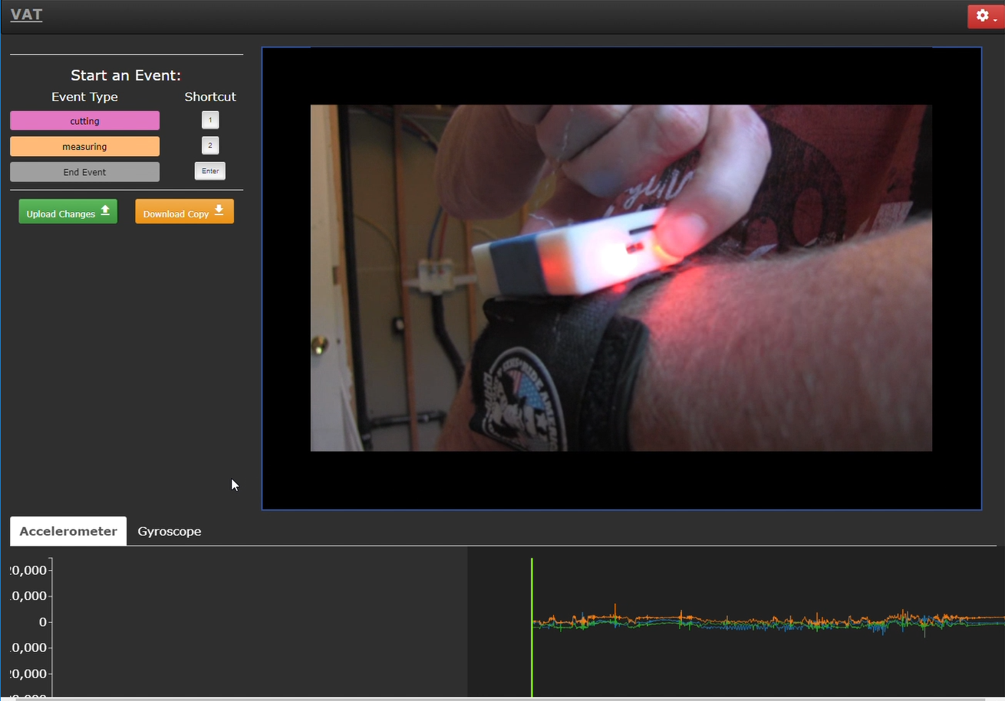
Approach A

Slide 6
Approach A: Synchronization using visual key
Data logger emits flash and timestamps sensor-data stream
The first video frame that contains flash is marked by user
1 subject per recording
Synchronization must be repeated for each video
Notes:
This is fine when recording human subjects one by one. Animals however different approach

Slide 7
Approach B: Synchronization using real-time clocks
Assumes camera and datalogger both contain RTC
RTC coarsely synchronized prior to experiments

Slide 8
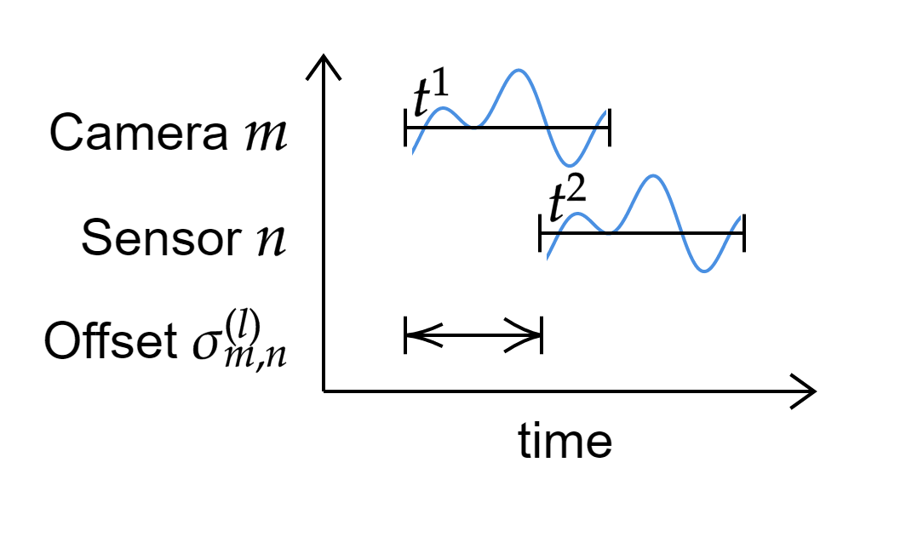
Approach B: Synchronization using real-time clocks
Synchronize on distinctive event in the video and adjust offset σ^{(l)}_{m,n} between a given camera m and sensor n on day l
shake sensors before camera during sync-recording

Slide 9
Comparison
Approach | Advantages | Disadvantages
A: visual key | High accuracy | Only one subject per recording
 |  | Each video must be synchronized individually
B: RTC | Sync only once | Lower accuracy
 | Multiple subjects in one video Easier to collect more data in parallel Higher chance to record rare activity | Susceptive to clock drift
 | Easier to use multiple cameras simultaneously
 | Dataloggers can be post-synchronized among each-other

Slide 10
Conclusion
Timestamped visual keys on the datalogger result in accurate synchronization between sensors data and video
Using RTC for synchronization allows to monitor multiple subjects simultaneously on same video

Slide 11
Ideas
Best idea seems to combine both approaches
Use visual keys on datalogger for both sensor identification and synchronization
Automatic synchronization by encoding time information in blinking pattern

Slide 12
Thanks for your attention
Synchronization Between Sensors and Cameras in Movement Data Labeling Frameworks
Jacob Kamminga, Michael Jones, Kevin Seppi, Nirvana Meratnia, Paul Havinga

