Slide 1
Anatomy of Deep Neural Network
Abirlal Metya
Application of neural networks in Time Series Reconstruction

Slide 2
Index
Introduction
Building Neural Networks
from Scratch
Few example of NN in Keras
Look into several Hyper parameters
Linear
Single Perceptron
Non Linear
Multilayer Perceptron

Slide 3
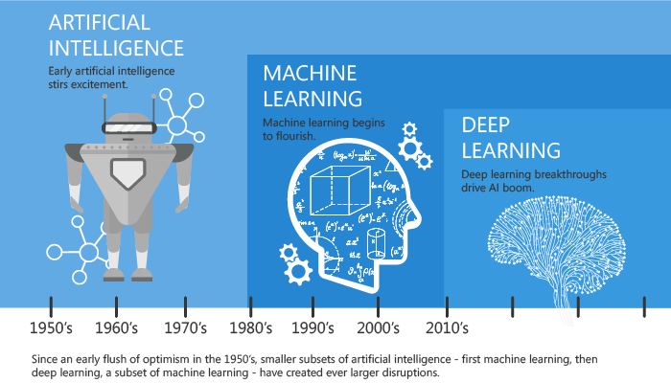
Introduction

Slide 4
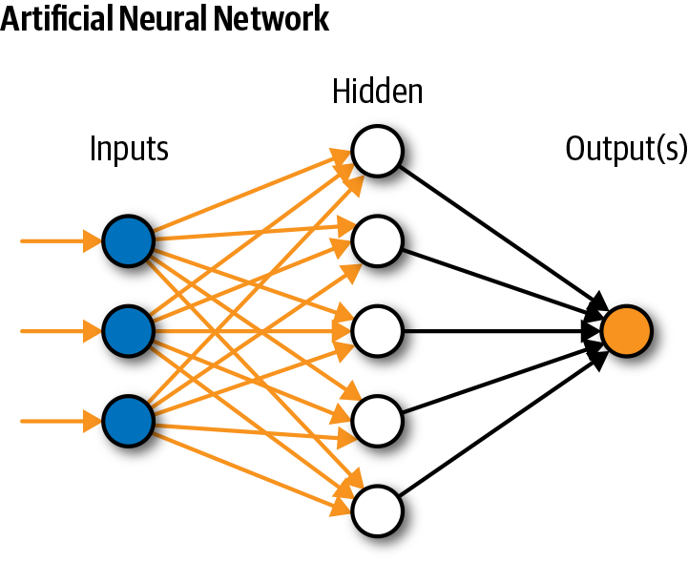
Building Neural Network
Black Box

Slide 5
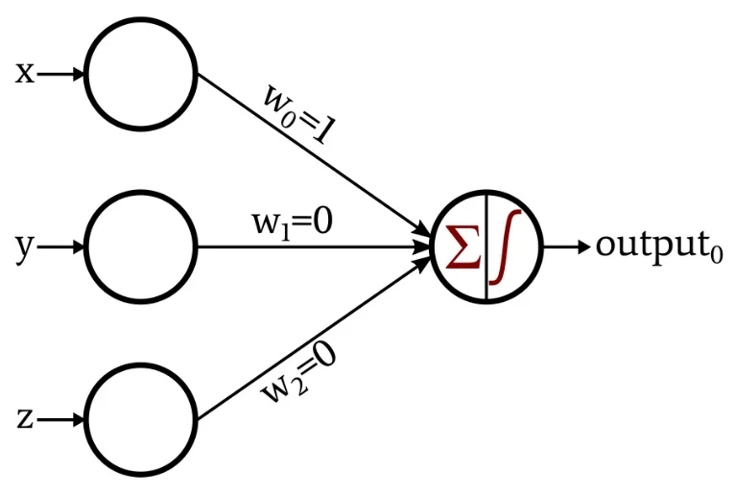
Building Blocks
Perceptrons are the building blocks of a neural network.
A Perceptron can be simply visualize as anything that takes multiple inputs and produce one output
Contd. To Excel

Slide 6

Linear Perceptron
x₁
w₁
Z = w₁x₁+w₂x₂
$$\hat{y}$$
w₂
, c
x₂
Input
Weights
Operation
Output
Contd. To MS-Word

Slide 7

Non-Linear Perceptron
x₁
w₁
z
$$σ(z)$$
$$\hat{y}$$
w₂
, c
x₂
Input
Weights
Operation
Output
Contd. To MS-Word

Slide 8




Multi-Layer Perceptron
X
W_{i}
W_{i}.X
$$σ\left(U\right)$$ $=σ\left(Wi.X\right)$
W_{h}
$$U^{′}=σ\left(U\right).Wh$$
$$σ\left(U′\right)$$
x₁
x₂
$$\hat{y}$$
, c
Input
Weights
Operation
Weights
Operation
Output
Contd. To MS-Word

Slide 9
Unity is Strength
Perceptions are very much connected with each other.
Sometimes we have to break this connection for better prediction (dropout) otherwise over fit.
Each Perceptron has limited ability but a network of them can solve big problems.

Slide 10
A Challenge
Can neural network be constructed in MS-Excel?
In mathematics there are few element-wise multiplication and some are matrix multiplication. I didn’t explicitly introduce them separately in the derivations. In MS-Excel we can clearly identify this steps.
Contd. To MS-Excel

Slide 11
Time Series Prediction Using Keras
Contd. To Jupyter Notebook

Slide 12
Deep Neural Network using Keras
Let’s do a very simple time series prediction using DNN in Keras.
Problem statement-
We have Temperature as well as Relative Humidity data in every 30-min over Pune for 6 days during 2018-Dec-1 to 2018-Dec-06.
Say, Temperature as independent variable (x) and RH as dependent variable (y).
Train a DNN using T and RH for first 5-days and predict RH using T data for the 6th day.
Contd. To simple_dnn_keras.ipynb

Slide 13
A Challenge for You
1. (a) Try to improve the accuracy using DNN model
Using feature engineering, more layers, more hyper parameter tuning, etc. as you like.
(b) Improve the accuracy beyond 0.86 or more of this reconstruction using any technique
Use any model

Slide 14
Summary
Simple Neural Network from Scratch
DNN using Keras
Different Hyper-parameters

Slide 15
Thank You

