Slide 1
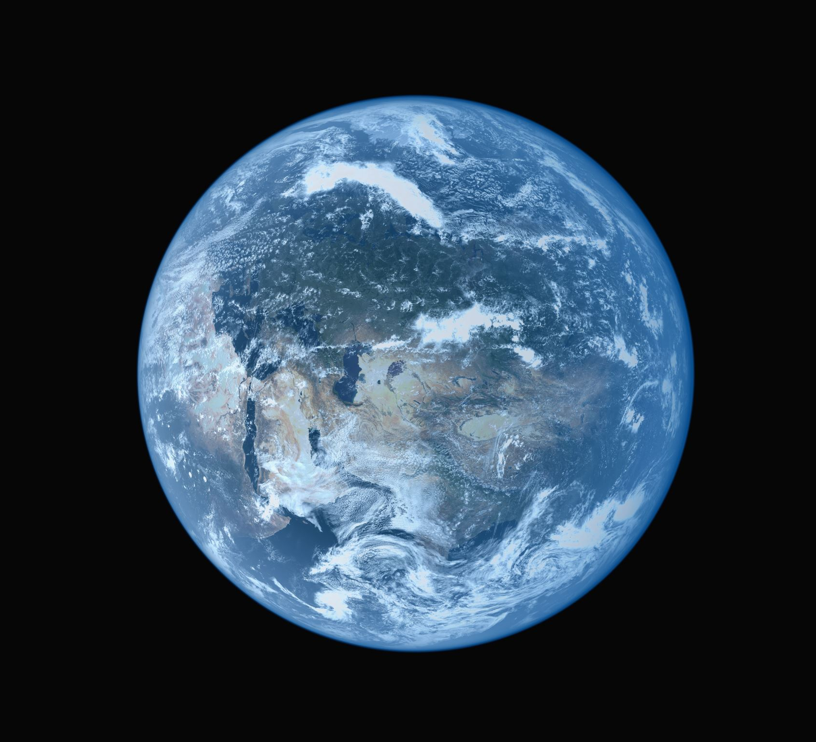
NASA – Near Earth Objects
Team: NASA
Mentor: Kashif Bari
Members:

Slide 2
Introduction
Near-Earth Objects (NEOs) are comets and asteroids that have been nudged by the gravitational attraction of nearby planets into orbits that allow them to enter the Earth’s neighborhood. As they orbit the Sun, Near-Earth Objects occasionally approach close to Earth. We plan to develop several models for detecting whether or not a NEO is hazardous.

Slide 3
Description of the data
The data contains
9 features
90836 observations

Slide 4
Description of features
id | Unique Identifier for each Asteroid
name | Name given by NASA
est_dia_min | Minimum Estimated Diameter in Kilometres
est_dia_max | Maximum Estimated Diameter in Kilometres
relative_velocity | Velocity Relative to Earth
miss_distance | Distance in Kilometres missed
orbiting_body | Planet that the asteroid orbits
sentry_object | Included in sentry - an automated collision monitoring system
absolute_magnitude | Describes intrinsic luminosity

Slide 5
Label
Hazardous: True or False

