Slide 1
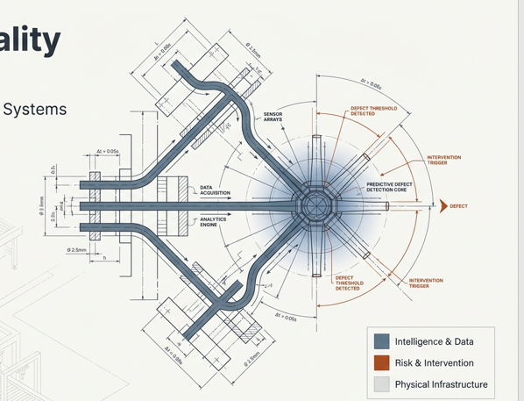

Proactive Quality Intervention
Transitioning Apex Industrial Systems From Reactive Inspection to Predictive Defect Detection.
IVY DATA SCIENCE INTERSHIP
FINAL PRESENTATION
Logistic Regression Predictive Quality Control – 2026
Data science – Quality Engineering - Operations

Slide 2
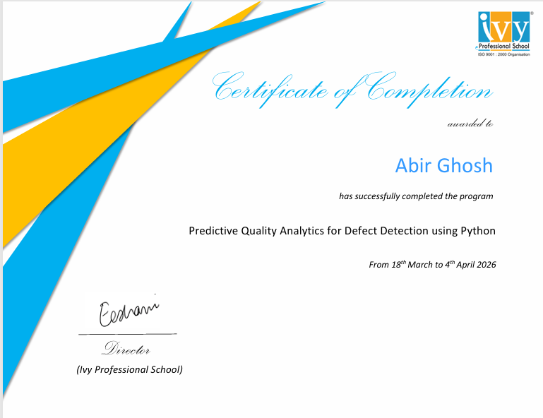

Slide 3
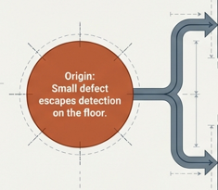








Business Problem
Primary Impact:
Increased
manufacturing
costs
Secondary Impact:
Increased
Scrap
Rates
Terminal Impact:
Customer dissatisfaction
Origin:
Small defect escapes detection on the floor
Primary Impact:
Spikes in
Production Losses
Terminal Impact:
Systemic Supply chain disruptions
Primary Impact:
Production
Inefficiencies

Slide 4
Strategic objectives of Business Transition
Current Paradigm
(Reactive)
Future Paradigm
(Predictive)
Methodology
Reactive Quality Control
Predictive classification model
Timing
Post-production manual inspection
Pre-shipment defect production
[1 = Defective, 0 = Non-defective]
Impact of scrap
High baseline scrap rates and uncontrolled production losses
Proactive intervention determining high-risk production runs in real-time
Insight Generation
Blind to systemic root causes
Continuous determination of key operational and environmental drivers

Slide 5
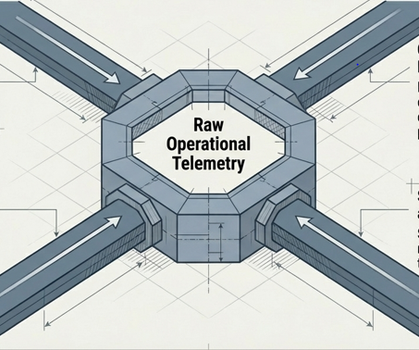
DATA OVERVIEW AND CONSOLIDATION
QMS(Quality Management Systems)
Providing outcomes of quality inspection, defect codes ad critical production ratings
ERP(Enterprise resource planning) Supply work orders, production schedules, rework and scrap records
SCADA(Supervisory Control and Data Acquisition)
Streaming production sensor-relates data including pressure, temperature and humidity
MES(Manufacturing Execution Systems)
Tracking machine cycle times, downtime, shift logs and operator IDs

Slide 6

DATA OVERVIEW AND CONSOLIDATION
Machine
Master Data
Injects context on machine type, capacity, configuration and criticality
The Single Source of Truth
Raw Operational Data
ERP
QMS(2)
MES(2)
SCADA
Operator
Master Data
Consolidated dataset established as the absolute foundation for predictive model development
Injects context on operator experience level, role and training details

Slide 7
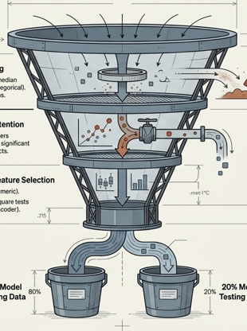
Feature Preparation & Analysis
12204 rows and 38 columns of chaotic, raw operational data
Layer1: Data Cleaning
Handling missing values with median for numerical columns and mode for categorical column. Duplicate rows were dropped
Layer2: Strategic retention
Preserving theoretical outliers because they demonstrate significant impact on production defects
Layer 3: Statistical feature selection
Boxplot and Anova tests for numeric column
Grouped bar and chi-square tests for categorical columns through performing one-hot coder
80% Model training data
20% model testing data

Slide 8
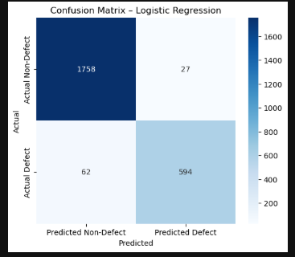
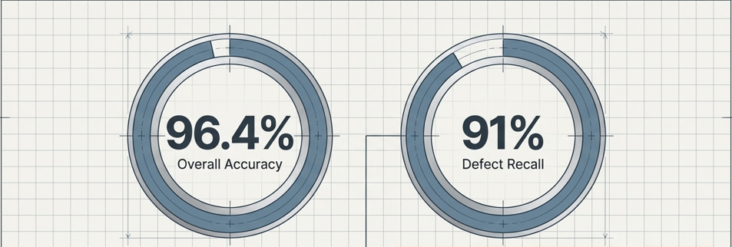
Validation of Model intelligence
The predictive model is fully validates and strong enough to be deployed into the live production process immediately
Total Matches(1758+594)= 2352(True)
Total Mismatches(27+62) = 89(False)
Business Translation: A 91% Recall rate ensures that 9 out of every 10 defective units are successfully flagged and intercepted before shipment. It will directly neutralize supply chain disruptions.

Slide 9
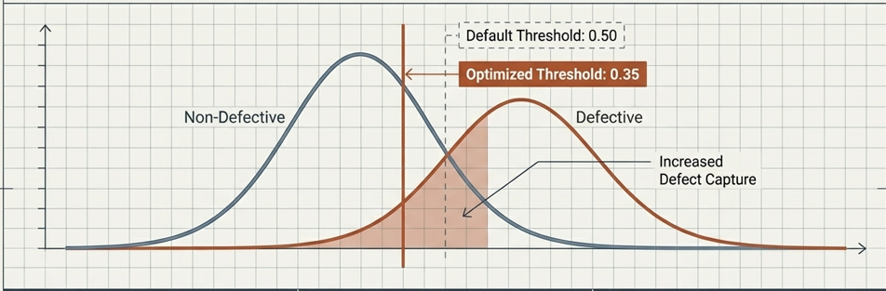
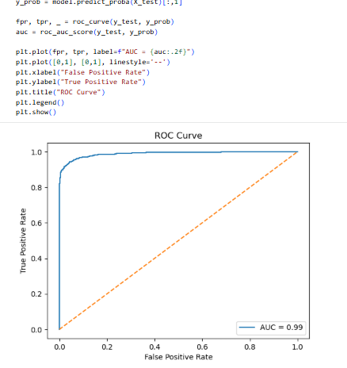
Recommendations for model integration
AUC Score: 0.99
Model is enough strong to separate defect from non-defect class.
Minimizes false negatives (escaped defects) at a fundamental level. Prioritizes defect capture to drastically reduce downstream supply chain costs
Reduce the classification threshold from 0.50 to 0.35.
Sliding the threshold leftward increases sensitively, capturing a significantly higher volume of true defects while accepting a minor increase in false alarms
The Business Impact
The Recommendation
The Tradeoff Mechanics

Slide 10
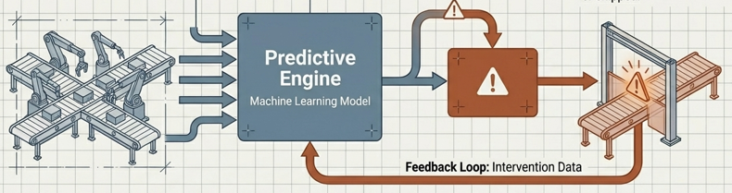
REAL-TIME ARCHITECTURE
Step1: Live operational and environmental data streams into the integrated pipeline
Step2: The model analyzes telemetry and contextual master data in real time
Step3: System flags high-risk production runs (Classification = 1)
Step4: Proactive quality intervention is deployed before the run the completed or shipped
Combines real-time IoT sensors, environmental feeds and historical context.
Predictive model continuously evaluates risk against optimized thresholds
Automated physical gates prevent high –risk unites from escaping to the next stage
DATA INTEGRATION
INTELLIGENT ANALYSIS
PROACTIVE CONTROL

