Slide 1
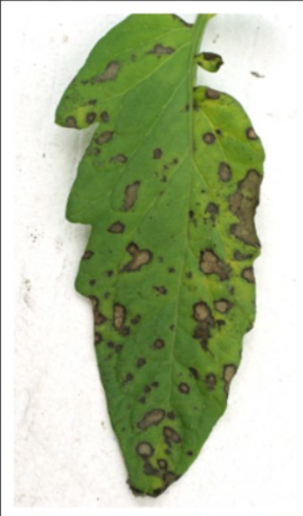
DEEP LEARNING / PROJECT PRESENTATION
Plant Leaf Disease
Classification
Classifying plant leaf diseases using image-based deep learning models.
TEAM MEMBERS
• 1. Vedant Pokale (60)
• 2.Abir Singh Sharma(45)
• 3.Ashay Bodhane(46)
• 4. Yash Dharmik (62)
PlantDoc test set | 3 models compared | 8 test classes
PLANT LEAF DISEASE CLASSIFICATION • DEEP LEARNING PROJECT

Slide 2
02 / PROBLEM STATEMENT
02
Why classify plant leaf diseases?
Project motivation and objective
THE PROBLEM
THE TASK
Plant diseases can appear as visible symptoms on leaves. Identifying the disease from a leaf image can be difficult when symptoms look similar.
Build an image-classification approach that takes a plant leaf image and predicts its disease label.
PROJECT OBJECTIVE
EXPECTED OUTPUT
Compare a baseline CNN with two transfer-learning models on the PlantDoc test set.
One predicted class from the eight labels represented in the supplied test confusion matrices.
PLANT LEAF DISEASE CLASSIFICATION • DEEP LEARNING PROJECT

Slide 3
03 / DATASET
03
PlantDoc evaluation data
What is confirmed by the supplied presentation
DATASET
LABELS IN THE CONFUSION MATRICES
PlantDoc
01 Apple Scab Leaf
02 Apple rust leaf
Evaluation shown:
PlantDoc test set
03 Bell pepper leaf spot
04 Corn leaf blight
05 Corn rust leaf
06 Potato leaf early blight
8 disease / healthy-label
categories are visible in
the confusion matrices.
07 Squash Powdery mildew leaf
08 Tomato Septoria leaf spot
Not provided: total image count, train/validation split, class balance and preprocessing details.
PLANT LEAF DISEASE CLASSIFICATION • DEEP LEARNING PROJECT

Slide 4
04 / METHODOLOGY
04
Model architecture & workflow
Conceptual pipeline based on the stated classification task
01
02
03
04
Leaf image
→
Image model
→
Classifier
→
Disease label
Input image
CNN / transfer model
Predict class
One of 8 labels
BASELINE CNN
MOBILENETV2
EFFICIENTNETV2B0
Convolutional neural network used as the baseline.
Transfer-learning model included in the comparison.
Second transfer-learning model included in the comparison.
Exact layer-by-layer architecture, input resolution and classifier-head design were not specified in the supplied material.
PLANT LEAF DISEASE CLASSIFICATION • DEEP LEARNING PROJECT

Slide 5
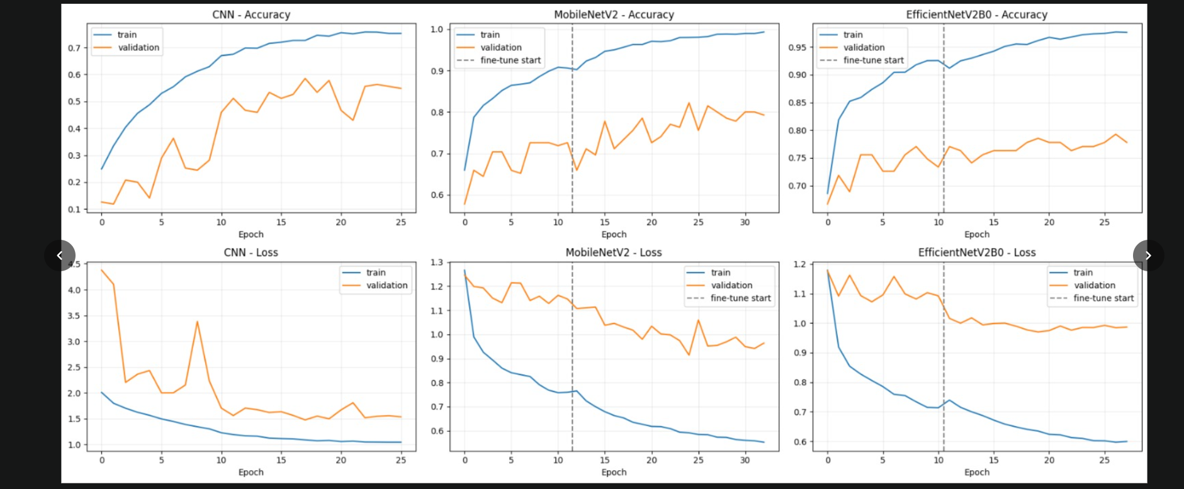
05 / EXPERIMENTS
05
Training experiments & hyperparameters
Training and validation curves supplied for all three models
Compared: train/validation accuracy and loss. Dashed vertical lines mark fine-tuning start for transfer models. • Test-time augmentation (TTA) used for reported test scores.
Hyperparameters not reported: optimizer, learning rate, batch size, image size, augmentation settings and exact fine-tuning schedule.
PLANT LEAF DISEASE CLASSIFICATION • DEEP LEARNING PROJECT

Slide 6
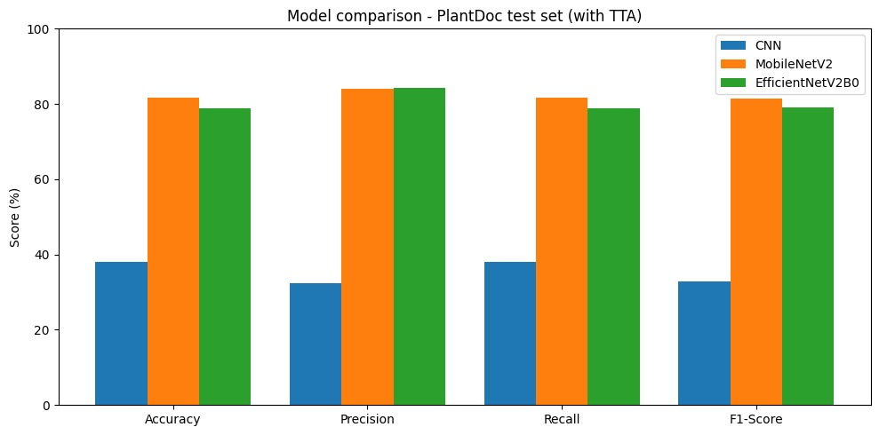
06 / RESULTS
06
Test performance comparison
PlantDoc test set with test-time augmentation (TTA)
KEY FINDINGS
MobileNetV2
Leads in accuracy, recall and F1-score.
EfficientNetV2B0
Has the highest precision by a small margin.
Exact metric values are not printed in the supplied chart; bars are shown as provided.
PLANT LEAF DISEASE CLASSIFICATION • DEEP LEARNING PROJECT

Slide 7
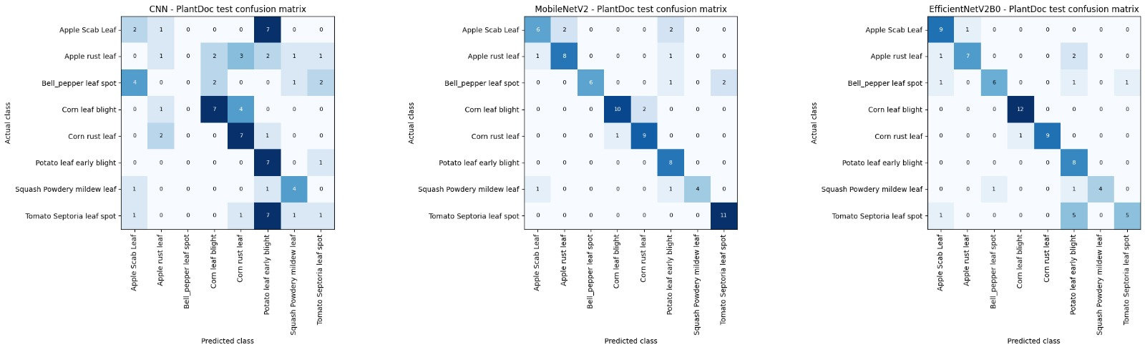
07 / EVALUATION
07
Class predictions, challenges & learnings
Confusion matrices show per-class predictions for each model
OBSERVATION
LEARNING
The baseline CNN has visibly weaker test performance than the two transfer models in the comparison chart.
Transfer-learning models performed better overall; precision and the other metrics can rank models differently.
PLANT LEAF DISEASE CLASSIFICATION • DEEP LEARNING PROJECT

Slide 8
08 / CONCLUSION
08
Conclusion & future work
Summary of the comparison and practical next steps
CONCLUSION
WHAT WE LEARNED
The project compares a baseline CNN, MobileNetV2 and EfficientNetV2B0 for PlantDoc leaf-image classification. MobileNetV2 leads on accuracy, recall and F1, while EfficientNetV2B0 leads slightly on precision.
Transfer-learning models outperform the baseline in the supplied test comparison. Model selection should consider multiple metrics, not accuracy alone.
FUTURE WORK
•
Report dataset size, class distribution and train/validation/test split.
•
Document preprocessing, optimizer, learning rate, batch size and fine-tuning settings.
•
Tune augmentation and evaluate robustness on more unseen leaf images.
•
Add per-class precision, recall and F1 to identify difficult categories.
Note: Future-work items are recommendations; they were not reported as completed experiments.
PLANT LEAF DISEASE CLASSIFICATION • DEEP LEARNING PROJECT

