Slide 1

Arithmetic Calculator
ECE 425 Microprocessor Systems
Course #: 16129
Abisai Vilches and Brandon Vargas
Professor Aaron Nanas

Slide 2
Introduction to project
Our project consisted of implementing an arithmetic calculator using EduBase Keypad buttons as inputs. The user could see their input and output as it would be displayed using the teraterm pro terminal which was used in the UART experiment in the lab.
The calculator functions in the following manner:
Running the program display a visualizer for the buttons and their corresponding value (numbers 0-9) as well as which buttons are used for each available operation.
The user is prompted to enter their first value and submit the number.
The user then selects the operation and submits.
The user then enter the second value and submits.
The result is displayed if all inputs are valid, invalid output is displayed in case of an invalid operation (for example dividing by zero).
The user can press a button in case they wish to clear their previous input.

Slide 3
Concepts Used
GPIO (for keypad, LEDs)
Each time a button is pressed, an LED pattern lights up
UART (for display)
SysTick Timer (for debouncing)
EduBase Keypad buttons have switch bouncing; to counter this, we added a 500 ms delay between inputs

Slide 4
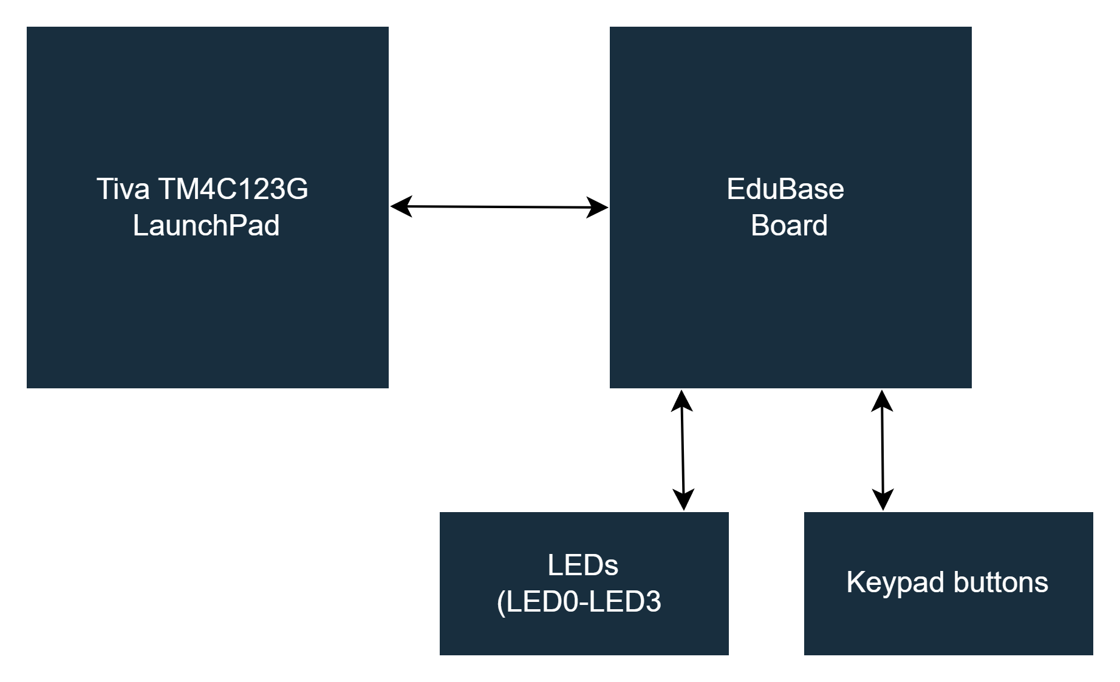
Block Diagram

Slide 5
List of Components
Description | Quantity | Manufacturer
Tiva TM4C123G LaunchPad | 1 | Texas Instruments
EduBase Board | 1 | Trainer4Edu
EduBase Board Keypad | 1 | Trainer4Edu
Teratermpro (terminal used to display calculator) | 1 | N/A
USB-A to Micro-USB Cable | 1 | N/A

Slide 6
Pinout
Pins | Function
PA2 | Keypad
PA3 | Keypad
PA4 | Keypad
PA5 | Keypad
PD0 | Keypad
PD1 | Keypad
PD2 | Keypad
PD3 | Keypad
PA1 | UART
PA0 | UART

Slide 7
Challenges
Getting an output on the UART using the keypad of the EduBase board
Setting up the keypad button for clearing an unwanted value.

Slide 8
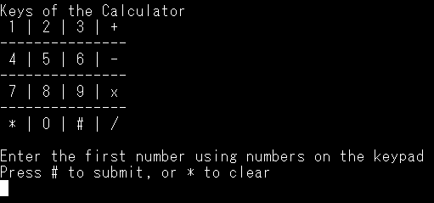
Demo

Slide 9
Further Improvements
Maximum number displayable is 4,294,967,295 (integer limit)
Code that resets when either the inputs or the output exceed this value
Improve code documentation
Clean up program for better readability

Slide 10
Acknowledgement
We’d like to thank Professor Nanas for the Keypad driver
Questions?

