Slide 1
Creation of Simple Calculator Graphical User Interface by Using PYTHON Coding
NEXTHIKES IT Solutions
Abish Chaurasia
16th February 2025

Slide 2
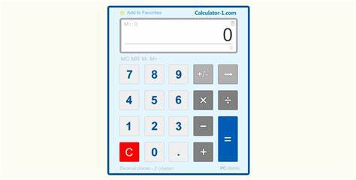
INTRODUCTION
OBJECTIVE : Code a simple calculator using python as programming language
Scope : Function catered in calculators are Addition/ Subtraction/ Multiplication and Division
Tools Used : Python programming language with Tkinter for basic GUI support

Slide 3
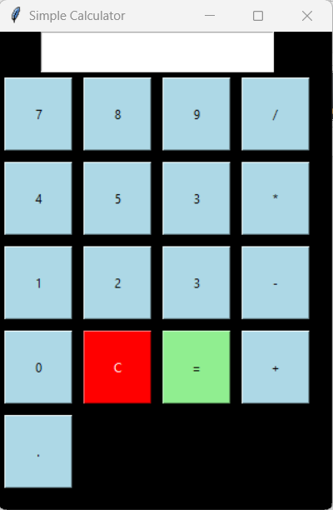
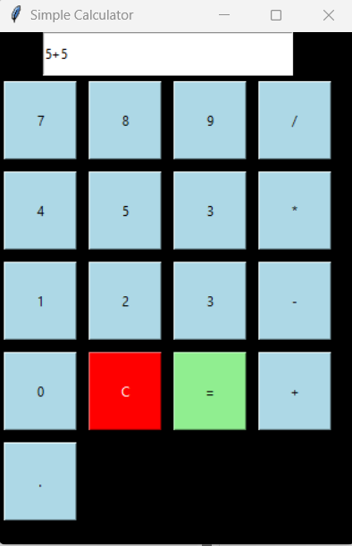
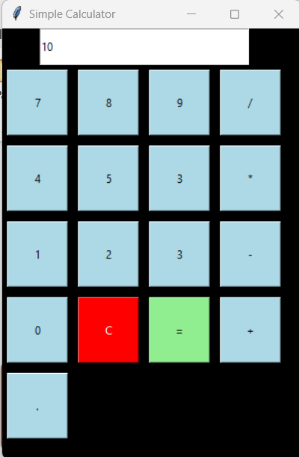
Basic GUI

Slide 4
Design Challenges & Approach
The layout of calculator interface must be simple & attractive.
Strategic placement of buttons to ensure the proper navigation and easy of use.
The final interface should be user friendly & easy to understand.
Approach:
Simple code in python for arithmetic operation.
Graphical User Interface (GUI) with libraries like Tkinter

Slide 5
Interface
Components:
Input: User provides numbers and operation (+, -, *, /)
Processing: Perform the chosen arithmetic operation
Output: Display the result (using =)
C are used to clear screen
Entry Box : To display the results.
Flow:
User inputs numbers and operator
Calculator processes the input
Result is displayed

Slide 6
Reference & Links
Reference:
A simple yet functional calculator built with Python & Tkinter Libraries.
Examples of open-source calculator implementations for inspiration.
Some various online tutorials for building GUI application with Tkinter.
Helpful Links:
https://docs.python.org/3/library/tkinter.html
https://www.geeksforgeeks.org/python-simple-gui-calculator-using-tkinter/

Slide 7
Thank You
Thanks for watching this presentation and hope you liked it. Please feel free to reach out for any questions or suggestions.

