Slide 1

DHAGA & CO. | PROJECT ACCELERATOR
Accelerating the Catalog: From 9 Days to 48 Hours
Capturing the Tuesday drop momentum by eliminating the manual listing wall.
PROBLEM: 9-DAY LAG
GOAL: < 2 DAY STAGING
DHG-EXEC-SUMMARY
Slide 01
Notes:
Good morning Ritu, Vivek, Dev. We are here to talk about accelerating Dhaga's catalog from 9 days down to 48 hours. Our goal is simple: capture the Tuesday drop momentum by eliminating the manual listing wall that currently stops your inventory from reaching customers.

Slide 2
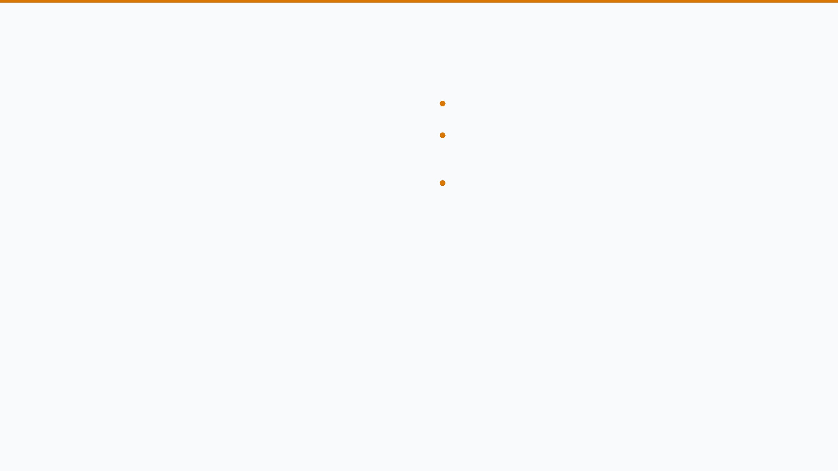
THE CATALOG BOTTLENECK
400 SKUs
arriving weekly from Tiruppur and Jaipur.
OPERATIONAL REALITY
Listing Wall:
6 agents typing strings like "rani pink" vs "magenta" by hand.
35 Mins/SKU
Inconsistency:
Tone drifts between writers; search filter pills break for 92% of shoppers.
Vivek’s team manually typing 60 attributes across messy WhatsApp texts, PDFs, and handwritten challans.
Result: 6–9 days from studio sample to live app.
DHG-SYS-BOTTLENECK
Slide 02
Notes:
Vivek, naming the problem in your language: it takes 35 minutes per SKU just to type 60 attributes across messy WhatsApp texts, PDFs, and handwritten challans. With 400 SKUs arriving weekly, your 6 agents are stuck behind a manual wall, and the search filter pills break for 92% of your shoppers because of inconsistent data entry.

Slide 3

WHY IT MATTERS TODAY
Trapped Capital
Return Rates
Target Standard
6-Week Pull
28% Driven
2 Days
Inventory depreciation accelerates every day a SKU sits in listing purgatory.
Return rate driven by fabric disputes and inconsistent care instructions at intake.
Listing agent touch time reduced by 85%. Scaling from 400 to 1,000 SKUs without hiring.
DHG-STRAT-IMPORTANCE
Slide 03
Notes:
This lag matters today because inventory depreciation is accelerating on your 6-week pull cycle. 28% of your returns are currently driven by fabric disputes and inconsistent care instructions that weren't caught at intake. By hitting our 2-day target, we reduce touch time by 85% and let you scale without adding headcount.

Slide 4

ONE WORKBENCH, FOUR INCOMING GARMENTS
01
02
03
04
Intake
Derivation
Review
Handoff
Pending raw vendor drops from Tiruppur & Jaipur.
AI extracts 60+ attributes in < 2 seconds.
Human-in-the-loop for flagged edge cases.
Cleaned JSON push to Unicommerce ERP.
DHG-SYS-DEMOFLOW
Slide 04
Notes:
Let's look at the live demo. We start with the Ingestion Workbench showing raw vendor drops. With one click, the system derives and enriches attributes across the entire batch in under two seconds, moving items from Pending to Acceleration.

Slide 5
DHG-101: MESSY INPUT TO CLEAN LISTING
RAW VENDOR INPUT
STRUCTURED OUTPUT (DHAGA SCHEMA)
Garment: Anarkali Kurti
Origin: Jaipur
Color: Dusty Gulabi
Fabric: 100% pure slub rayon with foil work
Price: 799
Notes: Dry clean recommended. Wash separately.
Attribute
Mapped Value
Canonical Color
#RANI_PINK
Fabric Category
Slub Rayon
Price Validation
Verified (₹799)
SEARCH TAGS (HINGLISH)
🔍 mehndi function dress
🔍 office wear kurti
🔍 festive ethnic wear
DHG-PROD-ENRICHMENT
Slide 05
Notes:
Look at DHG-101. The messy vendor input is deterministically mapped to Dhaga's canonical Rani Pink palette and Slub Rayon fabric category. We validated the ₹799 price and generated Hinglish search tags like 'mehndi function dress' to capture mobile search intent.

Slide 6
DHG-999: STOP THE UNSAFE LISTING
QUALITY CONFLICT FLAGGED: ITEM HELD FOR HUMAN REVIEW
FABRIC CONTRADICTION
INVALID WASH CARE
Vendor claims "Denim" and "Silk" in the same item description. System flags impossible blend.
"Do not wash / Do not dry clean" instructions detected. Blocked to prevent customer returns spike.
⚡ RESOLVE CONFLICT IN UI
DHG-SAFE-GUARDRAILS
Slide 06
Notes:
Brand safety is non-negotiable. For DHG-999, the vendor sent contradictory fabric specs. Our system flagged the conflict immediately, holding the item in red for human review. I can resolve this in the UI, selecting the correct cotton rayon blend, and the item is instantly staged for listing.

Slide 7
COMPLETING THE VISION
THE CLIENT ASK
WHAT WE BUILD NEXT
Multimodal OCR Ingestion
Immediate Requirements:
For handwritten challans and supplier PDF invoices.
• Scoped Shopify staging API key.
• 100 historical handwritten challans.
• 2 hours/week with one listing operator.
Two-Way Shopify Sync
Automated draft creation via direct Shopify Admin API.
Image-Text QC
Cross-verification of studio photos against vendor
descriptions.
Vendor WhatsApp Bot
Prompting suppliers for missing attributes at source.
DHG-FUTURE-VISION
Slide 06
Notes:
Completing the vision means building multimodal OCR for those handwritten challans and supplier PDFs, plus a direct two-way Shopify Admin API sync. We need a scoped Shopify staging key, 100 historical challans, and 2 hours a week with an operator to hit the Phase 4 milestones.

Slide 8
Questions & Discussion
DHAGA & CO. | PROJECT ACCELERATOR
DHG-QA-SESSION
Slide 07
Notes:
Q&A DEFENSE MATRIX (Internal Only):
- Dev (CTO): It's standard Python/API calls, no ML weights to tune.
- Ritu (CEO): The evaluator catches contradictions; no silent fails.
- Finance: ₹72/week API cost vs ₹1 Lakh/month labor savings.
- Vivek: Adoption is simplified through the single 'Resolve' UI button.

