Slide 1

Note: The data and information in this document is reflective of a hypothetical situation and client. This document is to be used for KPMG Virtual Internship purposes only.
Sprocket Central Pty Ltd
Data analytics approach
[Division Name] - [Engagement Manager], [Senior Consultant], [Junior Consultant]

Slide 2
Note: The data and information in this document is reflective of a hypothetical situation and client. This document is to be used for KPMG Virtual Internship purposes only.
Agenda
Introduction
Data Exploration
Model Development
Interpretation

Slide 3
Note: The data and information in this document is reflective of a hypothetical situation and client. This document is to be used for KPMG Virtual Internship purposes only.
Introduction
Potential customers identification
Company Overview: Sprocket Central Pty Ltd is a long-standing KPMG client specializing in high-quality bikes and accessible cycling accessories.
Three-week time period
Processes required Data Exploration, Model Development, and Interpretation.
Goal - improve business by analyzing existing customer dataset to determine top 1000 potential customers.

Slide 4
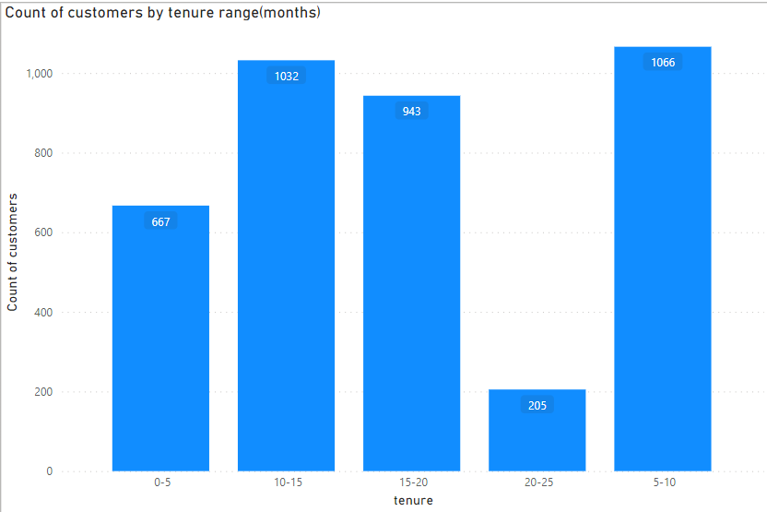
Note: The data and information in this document is reflective of a hypothetical situation and client. This document is to be used for KPMG Virtual Internship purposes only.
Data Exploration
Understand the existing customer dataset and identify necessary transformation
Place any information about this point here.
Have consistency trough the data in each columns(instead of F or M use Female or male).
Have correct data type for all columns.
Use Other instead of blank on n/a or blank.
Use Ranges for tenure.

Slide 5
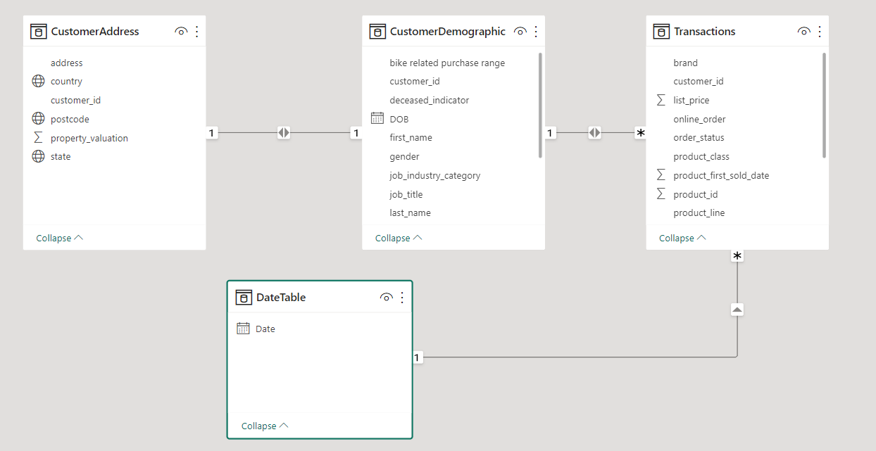
Note: The data and information in this document is reflective of a hypothetical situation and client. This document is to be used for KPMG Virtual Internship purposes only.
Model Development
Develop a model to enable filtering between tables
Build Star schema
Introduce a date table for viewing date wise data.
Introduce calculated columns to define ranges for Age and tenure columns.
Build Field parameter for product line ,product class , product size columns.
Create hierarchy for Job wise categories.

Slide 6
Note: The data and information in this document is reflective of a hypothetical situation and client. This document is to be used for KPMG Virtual Internship purposes only.
Interpretation
Understanding visuals to determine potential customers.
Tenure wise customer count provides new and old customers list column chart.
Product wise sales provide top selling products Bar chart.
Month wise top selling product and top buying customers line chart.
Wealth segment wise top selling products pie chart.
Online vs offline orders sales stacked column chart.
These visuals can be developed to analyze the customer, product and buying trends.

Slide 7
Note: The data and information in this document is reflective of a hypothetical situation and client. This document is to be used for KPMG Virtual Internship purposes only.
Appendix

Slide 8
Note: The data and information in this document is reflective of a hypothetical situation and client. This document is to be used for KPMG Virtual Internship purposes only.
Appendix
This is an optional slide where you may place any supporting items.

