Slide 1
K.RAMAKRISHNAN COLLEGE OF TECHNOLOGY Monopole Meta Material Antenna For WLAN Applications
PRESENTED BY
DIVAKAR.R
BHARATH.G
ABISHEK BHAT.R

Slide 2
Index
INTRODUCTION
MATERIAL AND SOFTWARE USED
ABOUT OUR PROPOSAL
RESULTS OF THE PROPOSAL
ADVANTAGES AND APPLICATIONS
CONCLUSION

Slide 3
INTRODUCTION
ELC based Meta material is used for developing a broad band printed monopole antenna which is used in WLAN applications. The design is very unique such that it has small metallic stub within the Ring Hexagonal structure incubated inside a Square loop. This structure helps to enhance the impedance bandwidth of the antenna due to EM Wave property. The Meta material provides a negative permeability, that are explained through a waveguide setup method.

Slide 4
MATERIAL AND SOFTWARE USED
META MATERIAL ELEMENT
GOVERNS ELECTRIC AND MAGETIC CURRENTS TO GENERATE WIDEBAND CHARACTERISTICS.
MONOPOLE ANTENNA
LOW-COST FLAME RETARDANT -4 SUBSTRATE
SOFTWARE USED:
HIGH FREQUENCY STRUCTURE SIMULATOR SOFTWARE

Slide 5
ABOUT OUR PROPOSAL
COMPRISES OF 3 DIFFERENT STRUCTURE.
ELC DESIGN WITH A SQUARE LOOP INSIDE A SINGLE RING HEXAGON WHICH IS COUPLED WITH SMALL METAL STUB.
ELC DESIGN CONSISTS OF INVERTED DESIGN OF 1st PROPOSAL WITH SAME OUT STRUCTURE.
ELC DESIGN CONSISTS OF A HEXAGON RING INSIDE A HEXAGON RING.

Slide 6



STRUCTURE OF THE PROPOSAL

Slide 7
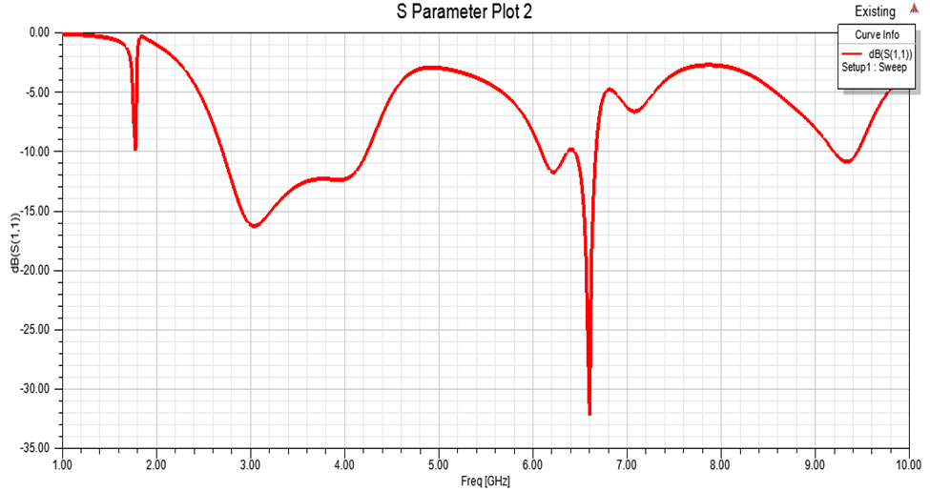
Structure 1(s-parameter):

Slide 8
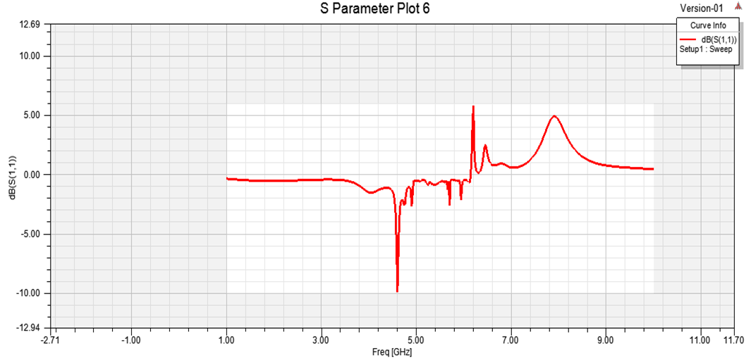
STRUCTURE 2(s-parameter):

Slide 9
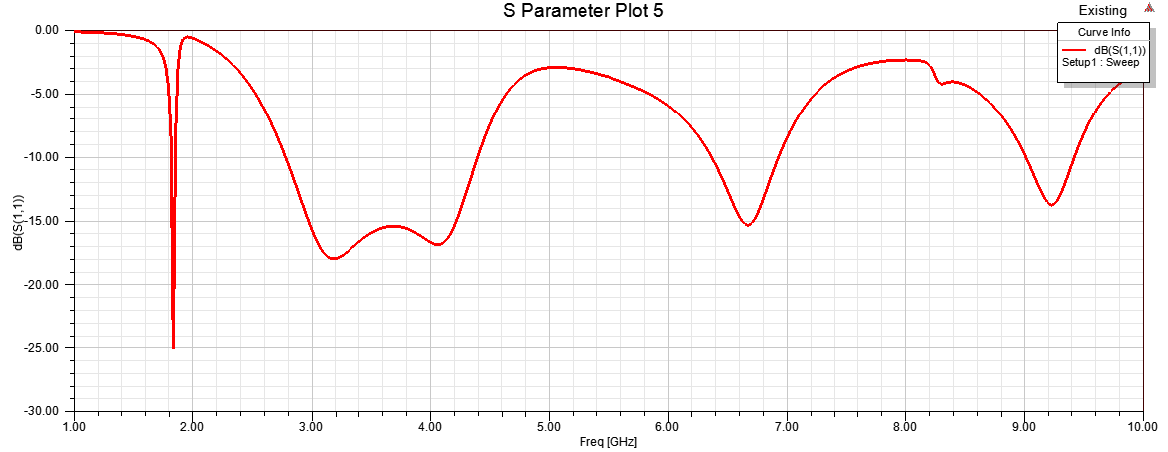
STRUCTURE 3(S-PARAMETER):

Slide 10
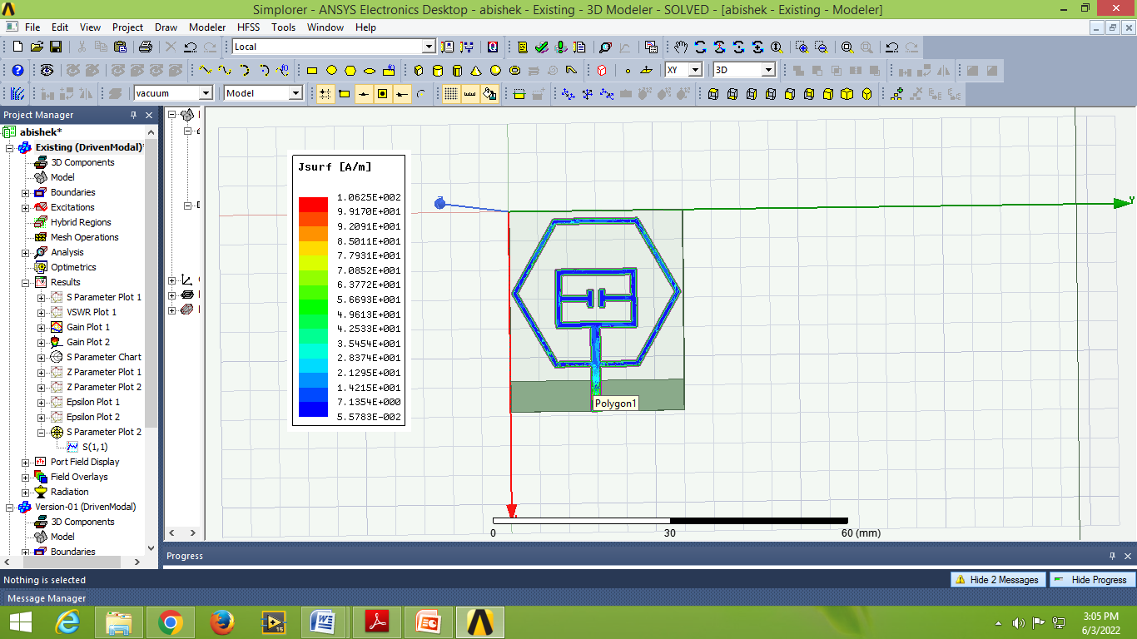
Current Distribution:

Slide 11
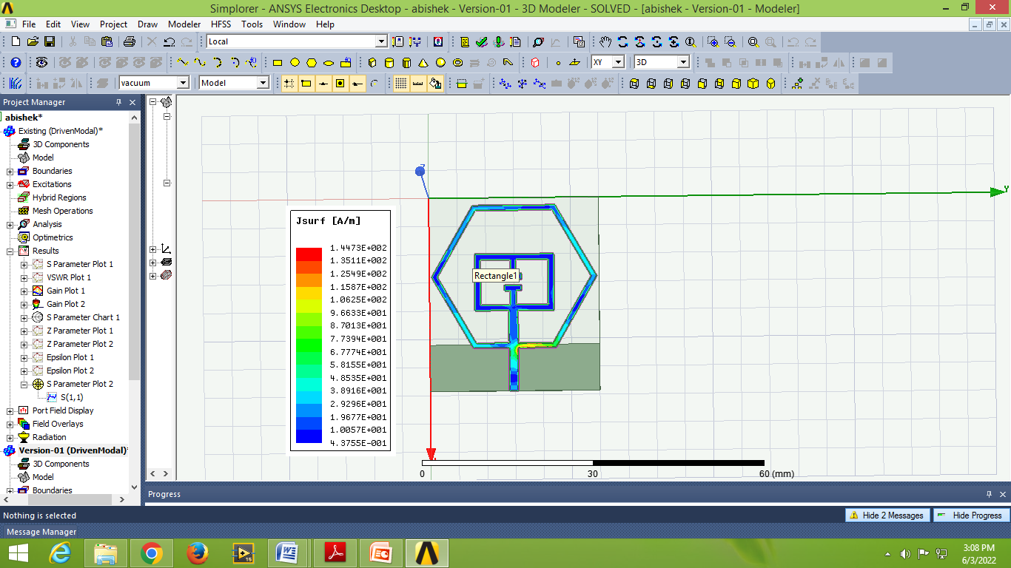
Current Distribution:

Slide 12
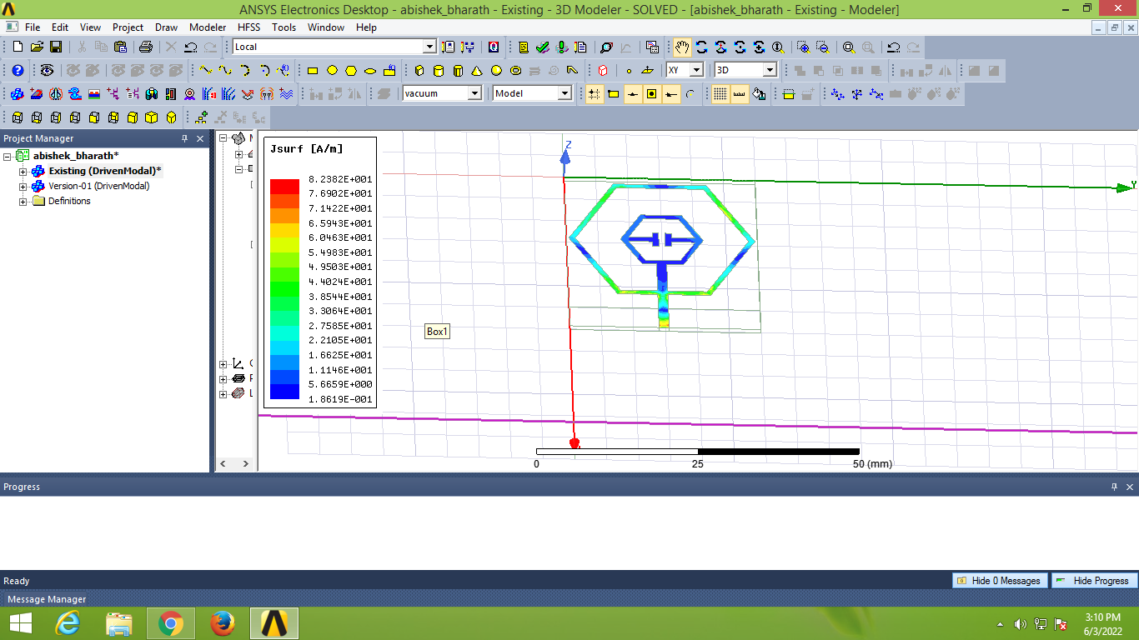
Current Distribution:

Slide 13
ADVANTAGES
CONSUMES VERY LOW POWER
ANTENNA IS VERY FLAT
LIGHT IN WEIGHT
THEY ARE PREETY SMALL IN SIZE(COMPACT)
WIDER BANDWIDTH

Slide 14
APPPLICATIONS:
WLAN
WiMAX
C-band

