Slide 1
Reverse Engineering of an Advertisement.

Slide 2
Why This Presentation!!!
To get more knowledge about the analysis of Data and it’s types to analysis.
To understand how the Advertisement are designed.
To know more about the usage of data.
To know about Graphs and other plotting functions.

Slide 3
What is the content!!!
Few samples of average sales data of BAJAJ PULSAR BIKE.
Bike was introduced in the market on 2001.
Main concept is to check whether the movie of actor Dhanush ”Polladhavan[2007]”and other advertisments made any changes in the sales of pulsar bike.

Slide 4
DATA!!!!!
'year', 'Age(31-50)', 'Age(15-30)’] are the columns in the data set which will be used for the Hypothesis testing.
Sample data :
year | Age(31-50) | Age(15-30)
2002 | 1769.890 | 2299.40
2003 | 1377.890 | 2395.50
2004 | 1983.765 | 2907.60
2005 | 1718.340 | 2132.20

Slide 5
Hypothesis Testing!!!
x="Age(31-50)" , y="Age(15-30)“.
Alpha value is 0.05. The confidence level is 95%.
Since we need to check whether the sales of the 2 different age groups has increased , We will be using 2 sample t test.
Hypothesis Test :
H0: µa=µb
H1 : µa!=µb
P –value[1.05*10^9] and alpha value is compared and it shows that alpha value is higher than p value. Hence null Hypothesis is rejected and H1 is accepted.
Hence there is a change in sales of Pulsar bike after the movie and many other advertisement.
The average sales after the advertisement is higher than that of before advertisement.
This shows that, there is an increase in the sales of Pulsar Bike after the Year 2007.

Slide 6
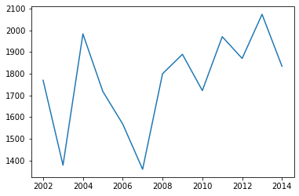
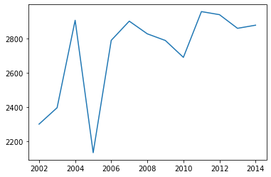
Graph of 2 Different Age Group vs Year
data['year’] Vs data["Age(31-50)"]
data['year’] Vs data['Age(15-30)']

Slide 7
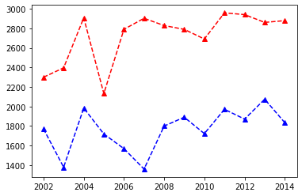
Comparison Graph
Blue dotted lines represents the bike owned within the 31-50.
Red dotted lines represents the bike owned within the 15-30.

Slide 8
Analytical Analyzation of a Data for analysis By:
R.ABISHEK BHAT
KRCT.

