Slide 1
TNQ Assessment
Presented by:
Abishek Bhat. R
K. Ramakrishnan college of Technology
Roll Number:811719106005

Slide 2
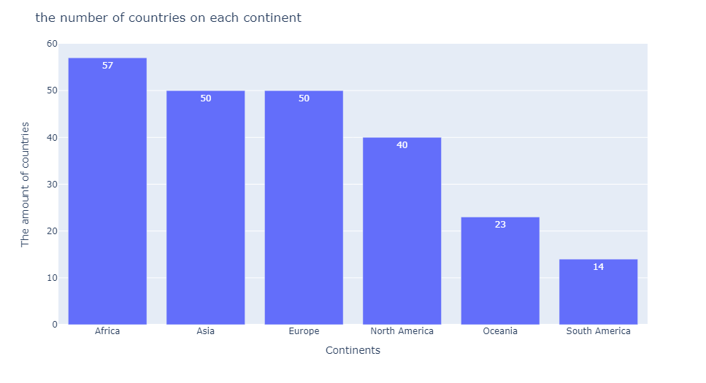
About the dataset
There are 6 continents and 234 nations according to statistics.
Here are the number of nations in each continent:
There are 57 nations in Africa.
50 nations make up Asia and Europe.
Forty nations make up North America.
There are 23 nations in Oceania.14 nations make up South America.

Slide 3
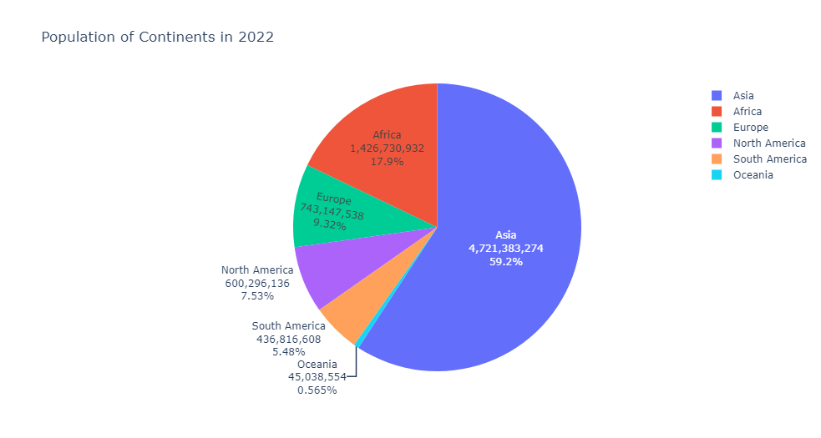
Population percentage of the continents in 2022
It is evident from the pie chart above that in 2022, a sizable portion of the world's population will reside on the Asian continent alone. It is 59.2%, which is significantly greater than Africa, which makes up 17.9% of the global population and comes in second place to Asia.

Slide 4
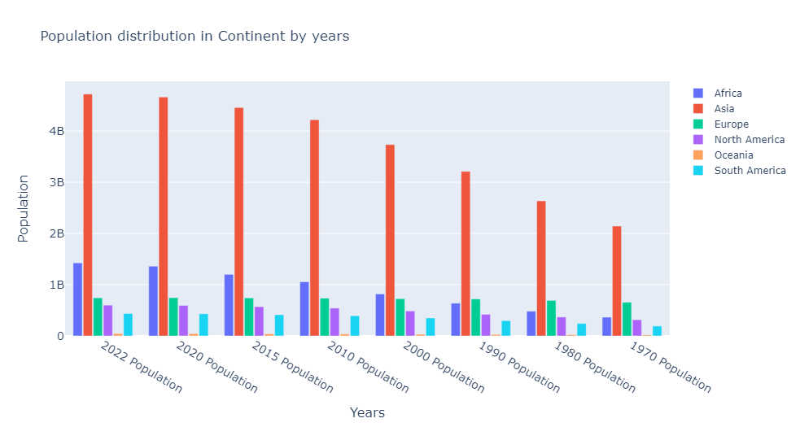
Population distribution in continents by years
This graph demonstrates that Asian has historically had the largest population, followed by Africans.

Slide 5
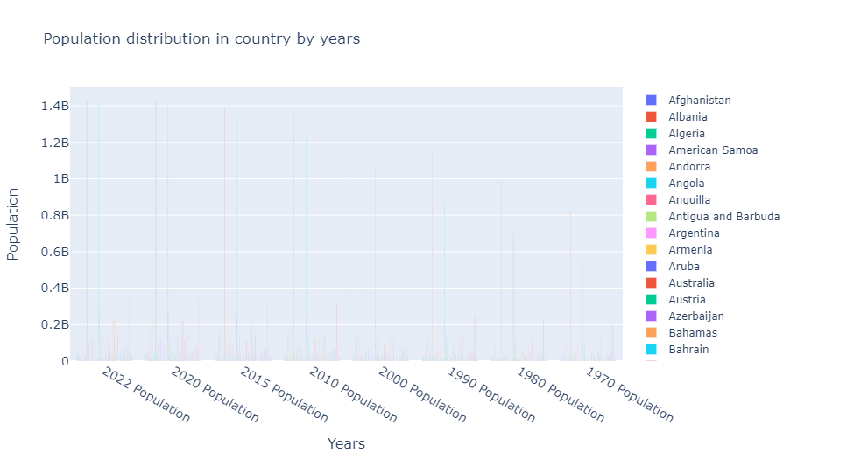
Population distribution in Countries by years

Slide 6
Two-year population change in continents with 2 different years
Over 60 million people's population changed between 2022 and 2020, as shown in the graph above. Asia, with a growth of more than 55M, is in second place, right behind Africa. Looking at this shift between 2020 and2022, we can infer that Asia and Africa have a difference of about 10M people.A lot of facts may need to be looked at right now, but it can be assumed basically that Africa will surpass Asia in the future. As an illustration, consider growth rate, birth rate, welfare level, and population density.

Slide 7
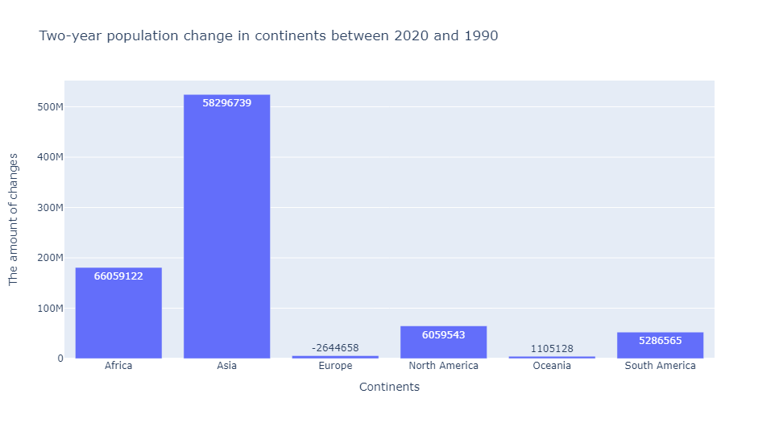
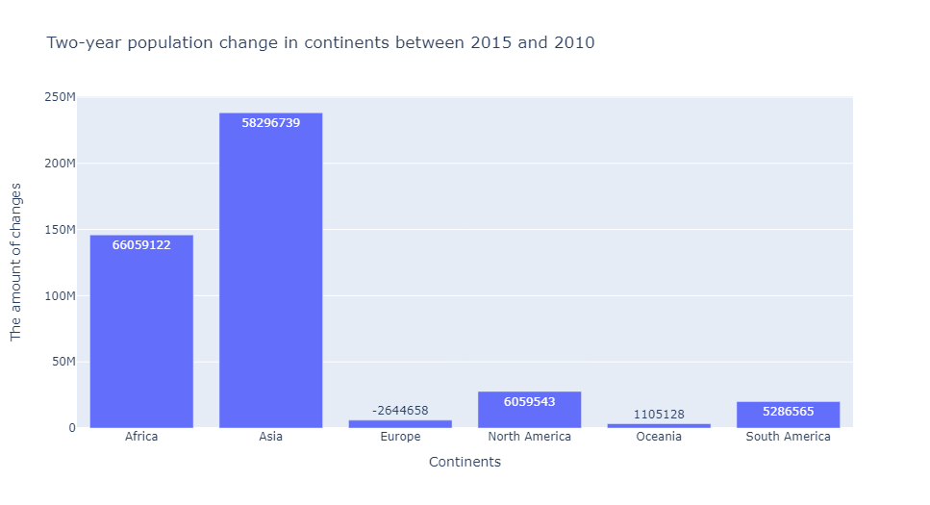
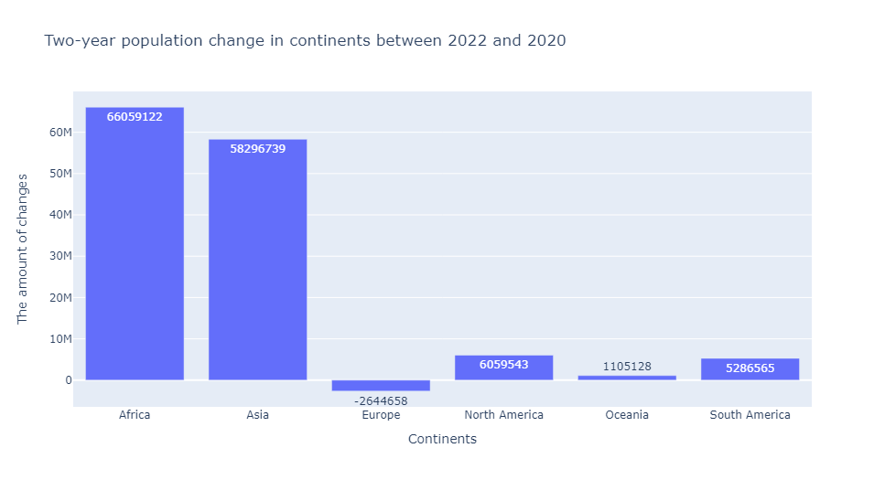
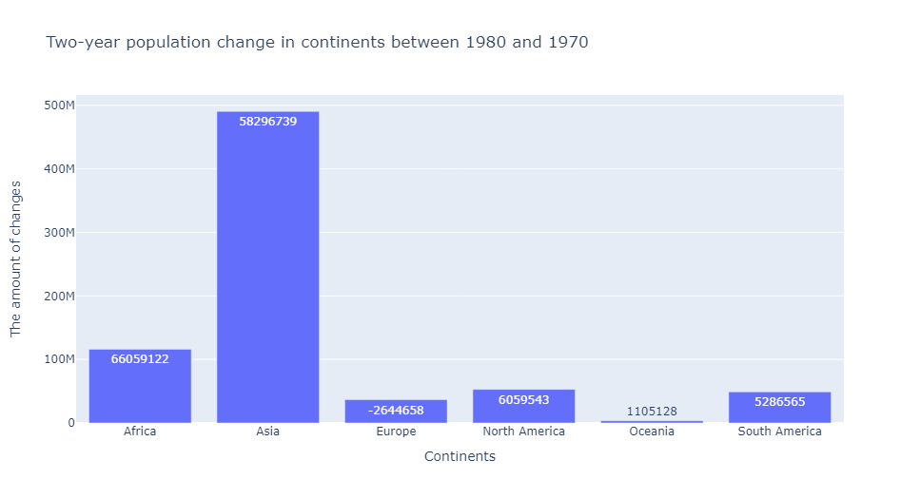

Slide 8
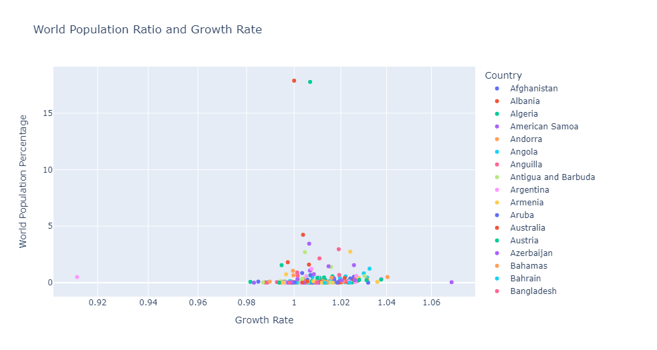
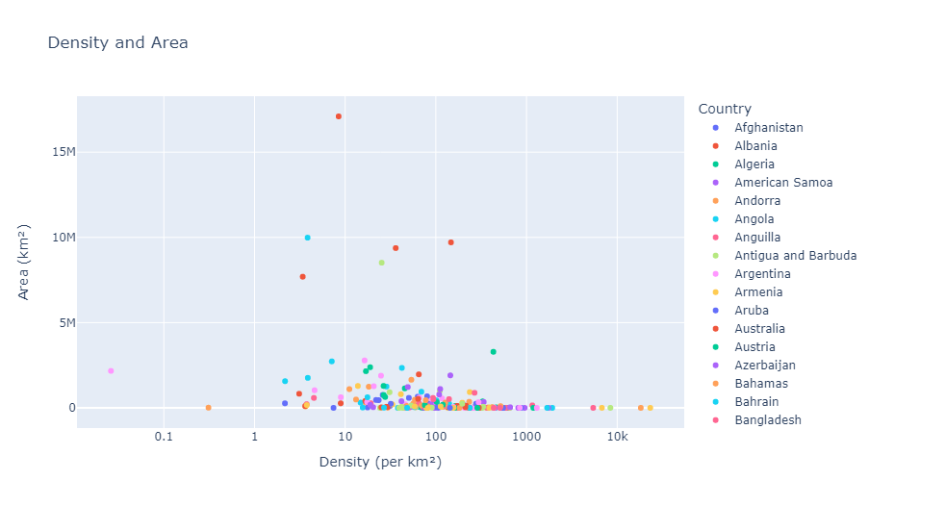
Country, Density, Area, Growth Rate and WPP

Slide 9
Thank You!

