Slide 1
AI-Based Restoration of
Degraded Inspection Images
23.63 dB
PSNR on the organisers’ test set
+3.18 dB
over bicubic ×2
KLA Problem Statement PS01 · SemiCon India Hackathon 2026 · Round 2
0.193
Team ForgeX
Abishek SR · Anmol BA · Hardik
VIT Vellore · abisheksundar1114@gmail.com
LPIPS (bicubic 0.466)
1.37 M parameters · 5.5 MB · 297 images in 5.9 s end-to-end on an RTX 4050 laptop · torch + numpy only

Slide 2
Problem Statement Addressed
The statement asks for generalisation across distributions. Everything below was built and tested against that.
 | Round 1 | Round 2
Content | natural photographs | SEM micrographs
Training pairs | 3,200 | 4,785
Sizes present | mixed | all 256→128; no 512×512
f90 — structure fineness | 0.0945 | 0.2913 (3.1× finer)
Downsampling operator | exact 2×2 box average | exact 2×2 box average
Bicubic ×2 baseline | 23.23 dB | 20.46 dB
THE FOUR THINGS THE STATEMENT ASKS FOR
Recover fine spatial detail lost to downsampling
Suppress speckle noise across diverse image types
Generalise broadly across multiple image distributions
Handle the reduction in spatial resolution (the ×2 path)
The third one is the whole deck. Every decision below was made against it.
Bicubic falls 2.77 dB between rounds. Equal skill therefore shows as a lower score.
Why f90 matters. f90 is the radial frequency below which 90% of non-DC energy sits. Round-2 structure is 3.1× finer, so 3.1× more of the signal lives above the Nyquist limit of the downsampled input — information genuinely destroyed by the 2×2 average, not merely obscured by noise. That sets a ceiling no architecture can lift, and it is why we spent the round measuring data rather than trying models.

Slide 3
Test & Evaluation Setup
Every number in this deck is a final-5-epoch mean, scored against a 0.005 dB measured noise floor, on a shared baseline.
THE NOISE FLOOR
FINAL-5, NEVER BEST-EPOCH
ONE PASS, ONE BASELINE
0.0049 dB two runs differing only in random seed, final-5-epoch means, matched at epoch 39.
We use 0.010 dB as the reporting threshold — deliberately conservative. Anything under it is reported as null.
Best-epoch selection inflates a score by a median 0.058 dB across our six 120-epoch runs — six times the floor. Every number in this deck is a mean of the last five epochs.
All 11 models are scored by the same code on the same inputs. The shared bicubic column is the checksum — if it differs between two files, those files cannot be compared. We learned this the hard way.
Six ways we measure, and what each one is for
Test set | n | Distribution | What it answers
Our held-out split | 200 | in-distribution | day-to-day comparison between runs
Organisers’ test set | 297 | in-distribution | the score they will see
Withheld content block | 478 | unseen morphology | does it work on content never trained on
Ten NFFA morphologies | 240 | different source | does it work on a different corpus
Nine-level noise sweep | 60 × 9 | ID → far OOD | does it hold when the sensor changes
Nine-axis OOD suite | 40 × 9 | noise / blur / kernel / content | worst-case axis, not just the mean
Zero exact overlap between the organisers’ 297 images and the 4,785 training images — verified by SHA-1 over the raw arrays.

Slide 4
Degradation Discovery
We measured KLA’s degradation before touching a model: a three-term variance law, and speckle over shot noise by ΔBIC = 1118.
var(residual) = σ²add + σ²mul·m² + c·v
downsample = exact 2×2 box average
Measured on KLA’s own pairs: σmul 0.155–0.258 σadd 0.000–0.065 c 0.026–0.234
m = 2×2 block mean of the clean image, v = within-block variance. adjusted R² = 0.9987 over 288 bins / 6.55 M pixels.
Speckle or shot noise? Settled by BIC, not by assumption.
Poisson shot noise has variance linear in the mean; multiplicative speckle quadratic. They call for different variance-stabilising transforms, so we fitted four models to identical bins over 6.55 M pixels.
Model | form | adj R² | BIC
M1 multiplicative | a + b·m² + c·v | 0.9987 | −1814.5
M2 Poisson | a + p·m + c·v | 0.9370 | −696.2
M3 both terms | a + p·m + b·m² + c·v | 0.9989 | −1849.5
M4 no brightness term | a + c·v | 0.1808 | +37.7
ΔBIC = 1118.3 — decisive. M3 fits marginally better but drives its Poisson coefficient negative (−0.00196), which is meaningless for shot noise. We keep M1.
Consequence: the generator multiplies rather than drawing Poisson counts. Assuming shot noise would have stabilised the wrong thing.
tools/noise_physics.py — raw output committed at docs/tool_output/noise_physics.txt

Slide 5
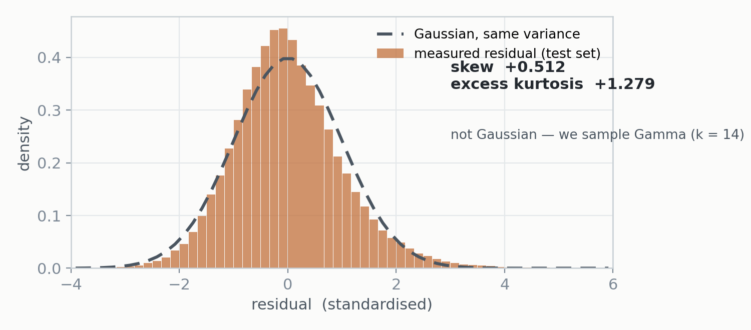
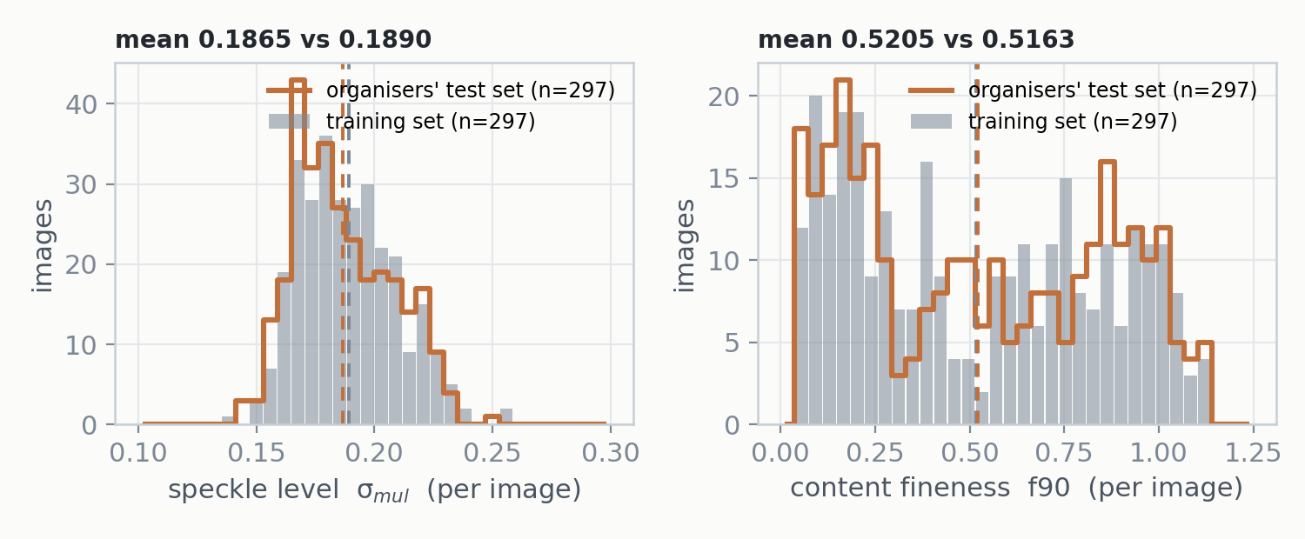
Distribution Analysis
The noise is not Gaussian, so we draw Gamma — and the organisers’ test set is in-distribution, so we did not optimise for it.
THE ORGANISERS’ TEST SET IS IN-DISTRIBUTION
WHY GAMMA, NOT GAUSSIAN
We refitted the degradation on the 297 images they shared and compared it against 297 random training images. Every property matches — σmul 0.1865 vs 0.1890, f90 0.5205 vs 0.5163, skew +0.512 vs +0.539, kurtosis +1.28 vs +2.08, lag-1 −0.052 vs −0.048. Only 1–3% of test images fall outside the training p1–p99 band, which is what two samples of the same distribution give by construction.
The statement promises a test of generalisation across distributions. This set is not that test — so we assume it is not the final one, and we did not optimise for it.
The residual is spatially white — lag-1 correlation −0.052 horizontal, −0.050 vertical — but it is not Gaussian: skew +0.51, excess kurtosis +1.28. A Gaussian generator would match the variance and miss the shape, so the network would never see the heavy right tail that real speckle produces. We sample Gamma with k = 14.

Slide 6
Synthetic Degradation Generator
Two generators: one calibrated to reality, one deliberately wider — and no randomised operation order, because we measured that it was wrong.
parameter | NARROW — measured in KLA’s pairs | WIDE — deliberately broader
σ_add | 0.000 – 0.065 | 0.000 – 0.180
σ_mul | 0.155 – 0.258 | 0.060 – 0.500
c (detail term) | 0.026 – 0.234 | 0.000 – 0.450
Gamma k | 14 | 4 – 60
optical blur | absent | σ 0.3–1.1 on 30% of samples
downsampling kernel | exact 2×2 box | box, or Gaussian-weighted on 25%
THE MIXTURE, PRECISELY
wide_p is the fraction of the synthetic draws, not of all draws. The roll is sequential:
real = p wide = (1−p)·w narrow = (1−p)·(1−w)
So --p-real 0.5 --wide-p 0.5 is 50% real / 25% wide / 25% narrow.
src/degrade.py — degrade() and degrade_wide(). 2.1 ms per call, so synthesis never starves the GPU.
CALIBRATION IS A TEST, NOT A CLAIM
ONE DESIGN DETAIL THAT MATTERS
We re-fit our own synthetic output with the same estimator used on the real pairs:
KLA real σa 0.0414 σm 0.1863
ours NARROW σa 0.0415 σm 0.1986
ours TRAINING σa 0.0507 σm 0.2192
The narrow family brackets reality — that is the test. The training mixture is visibly wider on purpose.
Three changes from Round 1, each forced by a measurement: added the c·v detail term (4.4% of variance on SEM vs 1.8% on photos), removed the blur from the narrow family (residual error rose 0.01074 → 0.01235 with it), Gaussian → Gamma.
Blur is applied to the clean image before noise is sampled — never to the output. Optics act on the image, not the sensor. Blurring the output would correlate noise we measured to be white (lag-1 −0.052), teaching the network to remove a structure that does not exist in real data.

Slide 7
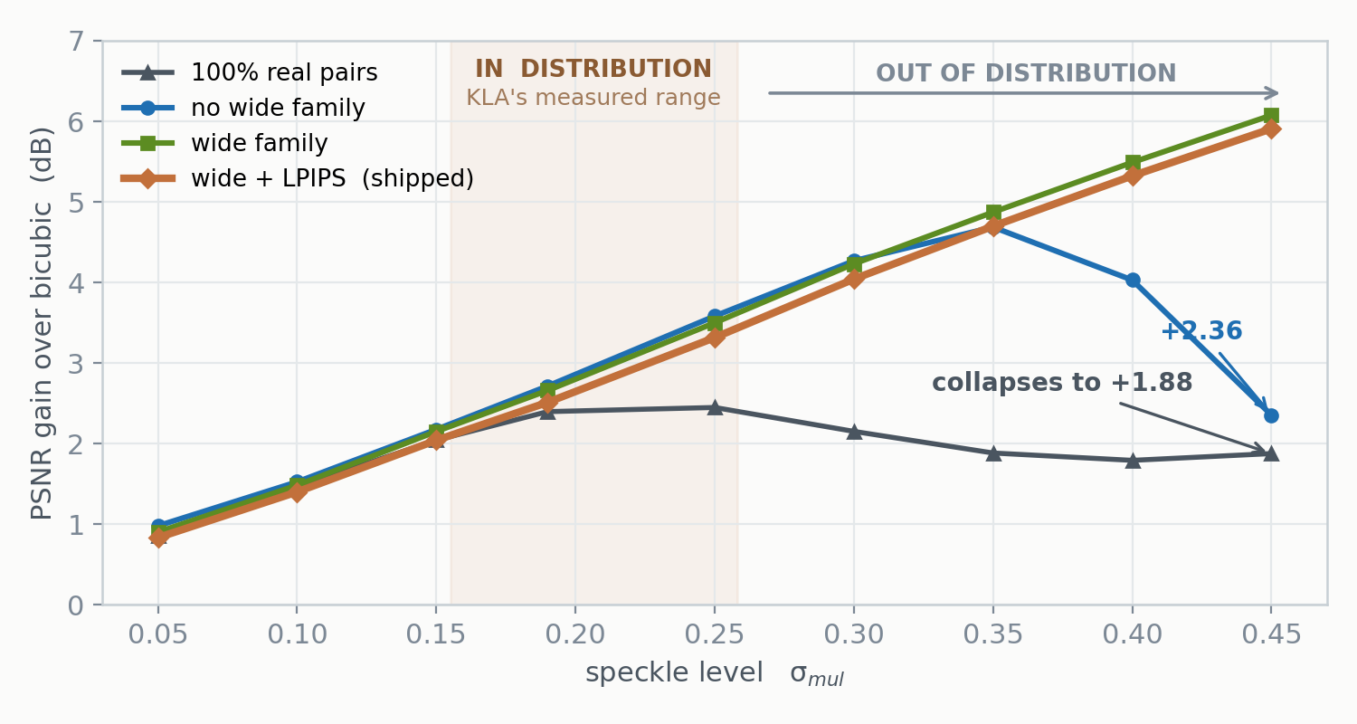
Real vs Synthetic — the Reversal
Real-only training wins in-distribution and collapses outside it. Training wider than reality costs 0.013 dB and buys 3.72 dB.
WHAT WE BELIEVED FOR A WEEK
100% real pairs beat every synthetic mixture on the held-out split — 23.267 vs 23.218 vs 23.134. Measurement sound, inference wrong.
σ ≈ 0.19 is where KLA’s data sits. All models agree there — within 0.30 dB. We were resolving a 0.13 dB difference at the one operating point where there is nothing to see.
Three σ-steps out, the real-only model is 4.03 dB behind. And it does not merely stop improving — it turns over at σ = 0.25 and declines. A model that had learned the inverse problem would keep gaining, because there is more noise to remove. Turning over is the signature of a model that memorised a noise amplitude.
The objection we had to answer. noise_sweep.py builds its inputs with our own generator, which structurally favours a synthetic-trained model — we flagged this ourselves and nearly discarded the sweep. Two things rescue it. (1) The bias does not appear where it should: at σ 0.05–0.19 the real-only model beats the model trained on that very generator. (2) The conclusion reproduces on inputs the generator never touched — the ten NFFA morphologies and the withheld content block, both against real ground truth. The sweep is where we found the effect; it is not where we certify it.

Slide 8
Proposed Solution
A 1.37 M-parameter residual CNN with a bicubic skip and a measured loss — Charbonnier + SSIM + gradient + LPIPS.
Clean GT
→
Degradation
→
Noisy LR
→
Restorer
→
Output
→
Loss
256²
real / wide / narrow
128²
1.37 M params
256²
vs GT
Architecture
Training & loss
Residual CNN — EDSR-style body, all work at low resolution, PixelShuffle ×2 only in the final block. 4× cheaper than upsample-first designs, and inference time is scored.
Global bicubic skip. The network predicts only the correction to a cheap baseline, so it starts at the bicubic score and converges fast.
Variance-stabilising stem. A parameter-free layer feeds the first convolution raw x, √x and log(1+x). It picks the representation where signal-dependent noise is closest to uniform — rather than us assuming which one that is.
No BatchNorm. Well established to hurt super-resolution; confirmed here.
64 channels · 16 residual blocks · 1,368,705 parameters · 5.5 MB
Charbonnier + 0.15·SSIM + 0.05·gradient + 0.05·LPIPS. No GAN.
120 epochs × 500 iterations, batch 32, 64×64 crops, AMP. Adam, cosine schedule.
The gradient term sharpens edges only where the ground truth has edges — that is the mechanism that keeps the perceptual term honest.
--seed and --split-seed are deliberately separate. The validation split must stay fixed while training randomness varies, or a seed-variance experiment compares two models on two different validation sets and measures nothing.
RTX 4050 Laptop 6 GB (75 W): 4.3 h. RTX 4090 pod: 28 min. Peak VRAM 0.95 GB.

Slide 9
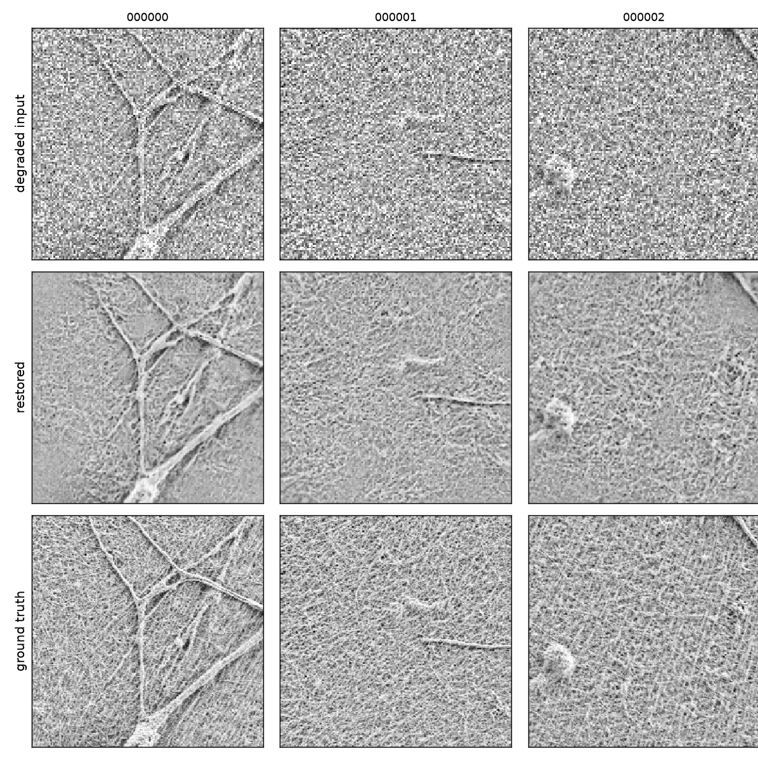
Results
23.63 dB on the organisers’ own 297-image test set: +3.18 dB over bicubic, 59% lower perceptual distance.
Method | PSNR ↑ | SSIM ↑ | LPIPS ↓
Bicubic ×2 (no denoising) | 20.455 | 0.5099 | 0.4655
Ours — 1.37 M params ★ submitted | 23.632 | 0.6079 | 0.1929
gain | +3.18 dB | +0.098 | −59%
+3.18 dB over bicubic
and 59% lower perceptual distance, for 1.37 M parameters
THE SAME MODEL, EVERYWHERE ELSE WE MEASURED IT
test set | n | PSNR | vs bicubic
organisers’ test set | 297 | 23.632 | +3.18
our held-out split | 200 | 23.104 | +2.88
withheld content block | 478 | 24.302 | +3.65
ten NFFA morphologies | 240 | — | +4.01
512×512, never trained at that scale | 778 | 25.392 | +4.52
Every row is real ground truth. The gain is largest where the model has seen least.
degraded input → restored → ground truth

Slide 10
Ablations
Eleven interventions measured against the noise floor. Seven did nothing. One — the wide degradation family — decided the model.
Change tested | Effect on PSNR | Verdict
Random seed alone (matched at epoch 39) | 0.0049 dB | the floor itself
1.8× receptive field, parameters matched | +0.0077 dB | null
Degradation recalibration on its own | −0.0162 dB | null
Gaussian-weighted downsampling (soft_p) | no saved measurement | undocumented
Content-balanced sampling (p ∝ f90) | −0.0903 dB | null
8× test-time augmentation | +0.0181 dB, 7.1× slower | rejected
Pinned-buffer + CUDA-stream I/O path | +0.04 s on a 1.94 s spread | rejected
channels_last layout fix | −0.06 s on a 0.73 s spread | rejected
4× parameters (343 k → 1.37 M) | +0.108 dB | real, but see capacity
Rebuilt generator vs Round-1 generator | +0.0836 dB | real effect
Real pairs instead of synthetic (in-distribution) | +0.0494 dB | real effect
Wide degradation family, at σ = 0.45 | +3.72 dB | the effect that decided the model
THREE CLAIMS WE WITHDREW
“9× more training data = +0.006 dB” — the 500-image run validated on a different 200 images. Not comparable. Dropped.
“3× training length = +0.030 dB” — no matched pair exists in runs/. Dropped.
“2.7× parameters = +0.026 dB” — a Round-1 number. The Round-2 answer is the capacity sweep.
WHAT DOMINATES THE SCORE
Not anything we control.
Coarsest content block 26.664 dB
Finest content block 21.274 dB
5.39 dB from content alone — 40× larger than any architectural change we measured, and 1100× the noise floor. That is why this pipeline targets robustness across content rather than peak score on one split.
Matched final-5 windows from runs/*/log.csv, or one scoring pass over identical inputs. docs/ENGINEERING_LOG.md §10.

Slide 11
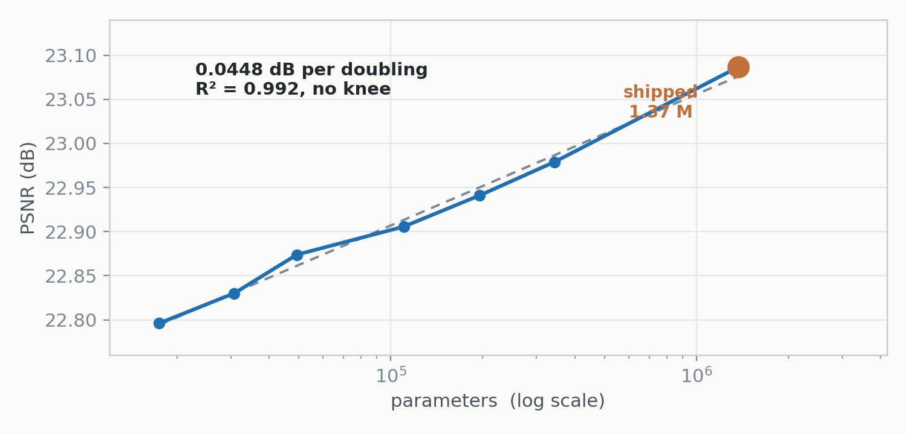
Capacity & Inference
1.37 M parameters is a deliberate quality-versus-efficiency choice, not a default — and 297 images take six seconds
END-TO-END, MEASURED THE WAY IT WILL BE SCORED
5.9 s
297 images, process start to last file written, RTX 4050 laptop — 19.9 ms per image. The network itself is ~2 ms of that; roughly 72% is Python importing torch and CUDA initialising, which amortises over test-set size.
WHAT WE TRIED AND DID NOT SHIP
Three inference optimisations were written and benchmarked with alternating repetitions against the run-to-run spread: 8× test-time augmentation, a pinned-buffer + CUDA-stream I/O path, and a channels_last layout fix. None cleared the noise; all produced bit-identical output. ONNX export was rejected without benchmarking — it adds a dependency the submission forbids. Details in the ablation table and docs/bench_results.txt.
Seven sizes across 78.4× of parameters buy 0.291 dB in total — 0.045 dB per doubling, R² = 0.992, no knee. A capacity-starved model climbs and then flattens; this is a straight line, so the bottleneck is information the 2×2 average destroyed, not model size. A 49 k model gives up 0.21 dB and is 9× faster — we know the price of going smaller, and chose not to pay it.

Slide 12
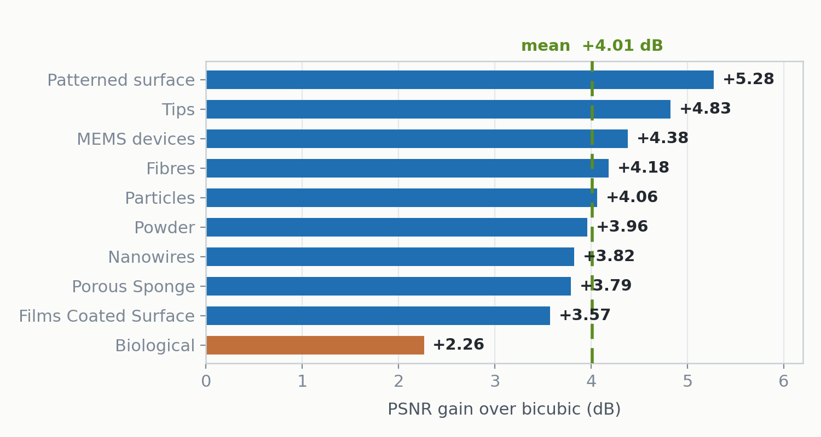
Generalisation
Unseen content +3.65 dB. Unseen scale +4.52 dB. Ten morphologies from a different corpus, all positive. The gain is largest where the model has seen least.
UNSEEN CONTENT BLOCK — 478 IMAGES WITHHELD ENTIRELY
model | trained on it? | PSNR | LPIPS
bicubic ×2 | — | 20.652 | 0.458
r2-preal1 (real only) | yes | 24.562 | 0.338
shipped | no | 24.302 | 0.182
+3.65 dB on content never trained on, and 60% better LPIPS than the model that WAS trained on it.
256 → 512 WITH ZERO TRAINING AT THAT SCALE
778 held-out 512×512 | PSNR | SSIM | LPIPS
ours | 25.392 | 0.576 | 0.236
bicubic ×2 | 20.877 | 0.410 | 0.538
Ten labelled NFFA-EUROPE morphologies — a different corpus, and the source dataset ships the labels
+4.52 dB — a larger gain than at 256×256, at a scale never trained on.
All ten positive. Mean +4.01 dB — higher than on KLA’s own data. LPIPS stays 0.199–0.299 across all ten. The 3.01 dB spread orders morphologies exactly as the f90 analysis predicts: regular geometric structure easiest, soft organic structure hardest. Honest caveat: we first tried to recover KLA’s category boundaries from spectral content and failed — one number cannot separate ten morphologies. We used the labels the source dataset already provides.
HALLUCINATION GUARD
Energy above the input’s Nyquist — the band where content is necessarily invented. On their 297 images: ours 0.421 vs bicubic 0.375. Bicubic cannot fabricate by construction, so it is the floor. Zero of our outputs cross ratio 1.0, against fourteen of bicubic’s.

Slide 13
The OOD Suite, on the Organisers’ Own Test Set
Better than real-only training on every degradation axis of their own images — 3.50 dB ahead under severe noise.
axis | bicubic | SHIPPED | 100% real pairs
noise 0.05 | 23.09 | +1.07 | +1.01
noise 0.19 | 19.79 | +2.89 | +2.66
noise 0.40 | 15.54 | +5.59 | +2.09
blur 0.4 | 19.82 | +2.84 | +2.64
blur 0.8 | 19.70 | +2.68 | +2.57
blur 1.2 | 19.44 | +2.63 | +2.56
soft (non-box) kernel | 19.74 | +2.89 | +2.66
MEAN gain |  | +2.94 | +2.31
WORST axis |  | +1.07 | +1.01
BETTER ON EVERY SINGLE AXIS
r2-preal1 — 100% real pairs — has the best score of anything we trained on the undamaged test set: 23.866 dB against our 23.632.
It loses on all seven axes the moment the degradation moves. At noise 0.40 the gap is 3.50 dB.
It is ahead by 0.234 dB when nothing changes, and behind by 3.50 dB when the sensor does. That is the whole argument of this deck, measured end-to-end on the data the organisers gave us.
297 images from the organisers, re-degraded seven ways. docs/tool_output/ood_testset.txt
Result. The shipped model improves over real-only training on every tested degradation axis of the organisers’ own images, with the largest advantage under severe noise — +5.59 dB against +2.09 dB at σ = 0.40. It gives up 0.234 dB on the undamaged set and gains 3.50 dB the moment the degradation moves. That asymmetry is the case for this model.

Slide 14
Multiple Runs & Stability
Seed floor 0.005 dB. Identical to five decimals across two GPUs. Our split ranks all eleven models in the same order theirs does.
1
Seed variance
2
Final-5 vs best-epoch
3
Cross-machine
r2-full-s0 23.1038
r2-full-s1 23.1087
0.0049 dB apart — identical configuration, different seed, matched final-5 window at epoch 39. This is the floor everything else is judged against.
Across six 120-epoch runs, best-epoch selection reads median +0.058 dB above the final-5 mean — six times the seed floor. Reporting a best epoch would manufacture an effect out of nothing.
The shipped weights score 23.632 / 0.60791 / 0.19288 on an RTX 4090 pod and 23.632 / 0.60791 / 0.19288 on an RTX 4050 laptop — identical to five decimals, different GPU, different machine.
THE STRONGEST STABILITY RESULT WE HAVE — AND IT ARRIVED FROM OUTSIDE
Our entire selection process rests on a 200-image validation split we constructed ourselves. When the organisers released a 297-image paired test set we ranked all eleven models on it and compared against our own ranking:
Spearman ρ PSNR +0.955 SSIM +0.991 LPIPS +1.000
Our split ranked all eleven models in exactly the LPIPS order their data does. The absolute numbers differ — their set is 0.231 dB easier on bicubic — but the ordering, which is what every decision in this deck depends on, is identical. Every comparison in the engineering log was measured on a good ruler, and that is now demonstrated rather than assumed.

Slide 15
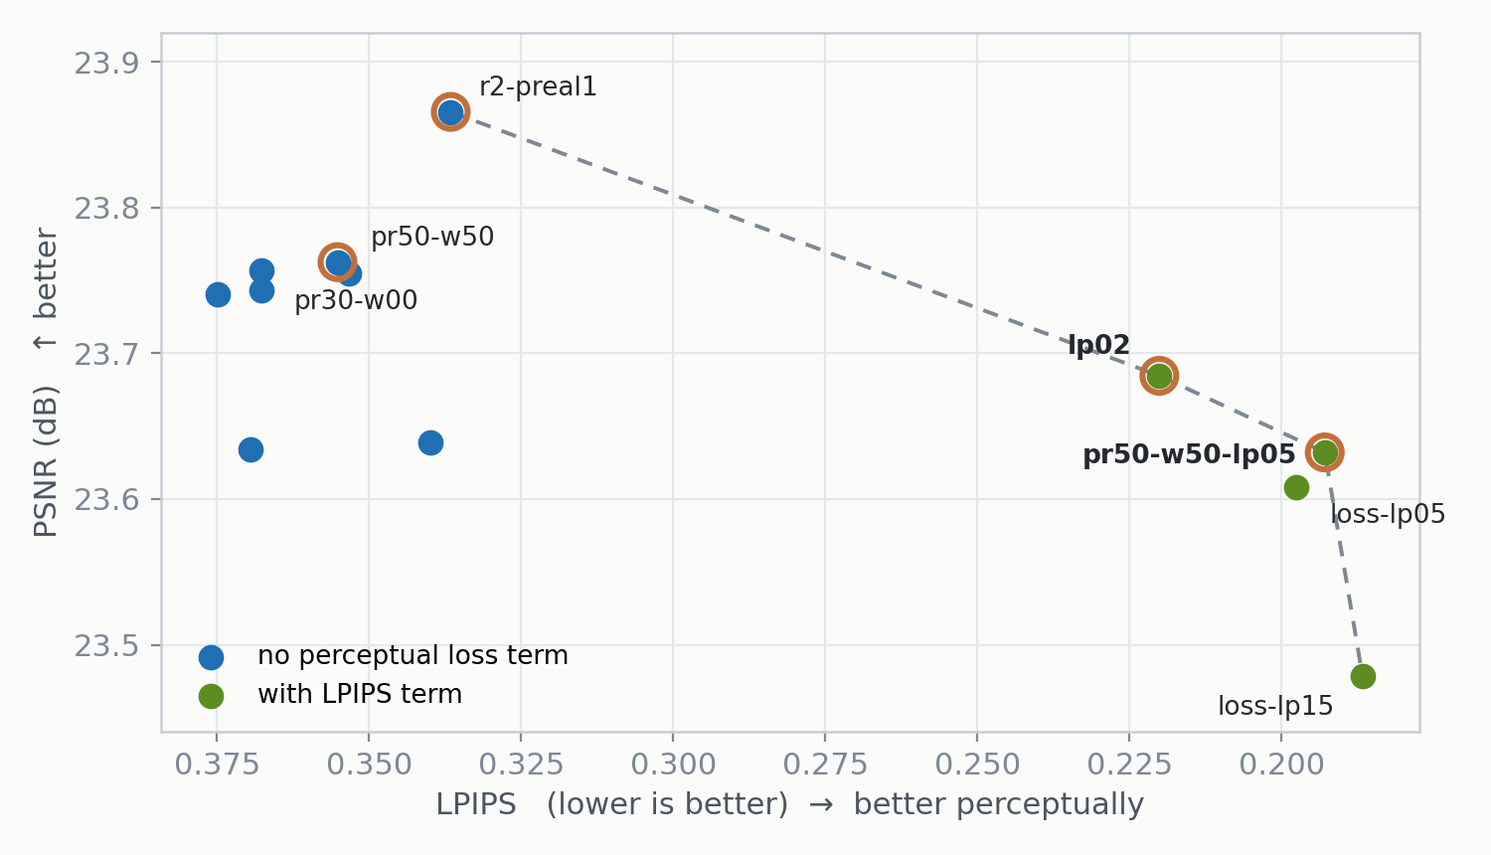
Final Model Selection
We did not ship the best-PSNR model. We shipped the one whose weakest axis is strongest — because the downside is 7.6× larger on the perceptual side.
run | PSNR | SSIM | LPIPS | σ=0.45
r2-preal1 (100% real) | 23.866 | 0.632 | 0.337 | +1.88
pr50-w50 (best of the wide, no LPIPS) | 23.763 | 0.619 | 0.355 | +6.03
pr30-w00 (no wide family) | 23.757 | 0.613 | 0.368 | +2.36
lp02 | 23.685 | 0.607 | 0.220 | +6.00
pr50-w50-lp05 | 23.632 | 0.608 | 0.193 | +5.91
loss-lp05 | 23.608 | 0.604 | 0.198 | +5.91
loss-lp15 | 23.479 | 0.595 | 0.187 | +5.76
THE TRADE, AND WHY IT IS NOT SYMMETRIC
Across the eleven models the worst PSNR gain still keeps 91.4% of the best. The worst LPIPS reduction keeps only 32.5%.
Ship perceptual and LPIPS is not scored → we lose 6.9% of achievable PSNR gain.
Ship non-perceptual and LPIPS is scored → we lose 52.7% of achievable LPIPS reduction, plus 4.03 dB of noise headroom.
A 7.6× asymmetry in downside. Insuring against the large loss costs almost nothing, and that argument holds under every normalisation we tested.
Circled: the efficient frontier candidates. Bicubic ×2 baseline 20.455 / 0.5099 / 0.4655, identical for all eleven.

Slide 16
Reproducibility & Submission Readiness
All four required components, each verified by running it. Bit-identical output from a directory holding only those four files.
pip install -r requirements.txt python run.py <input-dir> <output-dir>
THE ENVIRONMENT SPECIFICATION
VERIFIED, NOT ASSERTED
THE CONTRACT
requirements.txt — the complete pip freeze of the environment that trained the weights, exactly as specified. One line is added — the CUDA index URL — because torch==2.13.0+cu126 is not on PyPI and the file would not install without it. No package line altered or removed.
requirements-inference.txt — a convenience, not the spec: the two packages run.py actually imports.
tools/package_check.py restores a held-out sample, checks dtype, finiteness, range and shape on every output, then copies only run.py, requirements.txt, README.md and models/model.pt into an empty directory and runs it from an unrelated working directory. Prints PASS or a specific FAIL.
In: .npy (H,W) float32, any range.
Out: .npy float32 (2H,2W), same name, finite, in [0,1].
Weights resolve relative to run.py.
No internet, no keys, no downloads, no interaction.
WHAT THE REPOSITORY CARRIES BEYOND THE FOUR REQUIRED FILES
docs/ENGINEERING_LOG.md — every experiment including the failures and eight claims we published and had to withdraw · docs/queue/ — all eleven models scored on both test sets, with the raw CSVs · docs/superseded/ — two result files produced against a different test set, kept with a note explaining why they must not be quoted · docs/bench_results.txt — the timing runs behind three rejected optimisations.

Slide 17
We measured the degradation, trained for variation beyond it,
and validated on unseen content and unseen degradation.
23.63 dB
+3.18 dB
0.193
PSNR · organisers’ 297-image test set
over bicubic ×2
LPIPS (bicubic 0.466)
VALIDATED WHERE THE MODEL HAS SEEN LEAST
STATED BEFORE ANYONE HAS TO ASK
· +3.65 dB on a content block withheld entirely from training
· +4.52 dB at 512×512 — a scale it was never trained at
· +4.01 dB mean across all ten NFFA morphologies, a different corpus — every one positive
· Better than real-only training on every OOD axis of their test set; 3.50 dB ahead under severe noise
· The 512 path is verified on NFFA natives, not KLA 512 data — the training set has none
· The wide family’s bounds are a judgement about breadth, not a measurement
· We do not know how PSNR, SSIM and LPIPS will be combined — so we optimised all three
· Biological morphology is the weakest class, +2.26 dB against the +4.01 mean
Team ForgeX · Abishek SR · Anmol BA · Hardik · VIT Vellore python run.py <in> <out> · torch + numpy only · 1.37 M params

