Slide 1
Digital Portfolio
STUDENT NAME: Abishek kumar . J
REGISTER NO AND NMID: 222403551 &
DEPARTMENT: bsc computer science
COLLEGE: sri devi arts and science COLLEGE in ponneri / Madras UNIVERSITY

Slide 2
PROJECT TITLE
Super market

Slide 3
AGENDA 3
A
3
1. Problem Statement
2. Project Overview
3. End Users
4. Tools and Technologies
5. Portfolio design and Layout
6. Features and Functionality
7. Results and Screenshots
8. Conclusion
9. Github Link

Slide 4
PROBLEM STATEMENT
Create a supermarket shopping cart web page using HTML, CSS, and JavaScript. The page should: Display a list of products with price. Allow users to add products to a cart. Show the cart items and total amount dynamically. Provide a checkout button to clear the cart after purchase. Goal: Make a simple, user-friendly supermarket website for basic shopping simulation.

Slide 5
PROJECT OVERVIEW
Dynamic Product Display: Products are listed using JavaScript instead of writing them manually in HTML. Interactive Cart: When users click “Add to Cart,” items are shown in a cart section with an updated total. Responsive & Simple UI: A clean design with a supermarket-friendly theme (green and white). Checkout Feature: Clears the cart and thanks the user after purchase.

Slide 6
WHO ARE THE END USERS?
End Users Customers: To browse products and add to cart. Supermarket Owners/Admins: To use as a base for online store. Students/Learners: To practice web development concepts.

Slide 7
TOOLS AND TECHNIQUES
Tools and Techniques Tools: HTML5, CSS3, JavaScript, VS Code, Web Browser Techniques: DOM Manipulation, Event Handling, Array Handling, Real-time Total Calculation, Flexbox Layout

Slide 8
POTFOLIO DESIGN AND LAYOUT
Design: Green and white color theme for a fresh supermarket look. Simple fonts (Arial) for readability. Rounded buttons with hover effect for better UX. Layout: Header: Title at the top. Left Side: Product listing with “Add to Cart” buttons. Right Side: Cart section showing selected items, total price, and checkout button.

Slide 9
FEATURES AND FUNCTIONALITY
Features & Functionality Product Listing: Displays items with price. Add to Cart: Adds selected products to cart. Dynamic Total: Updates total price automatically. Remove / Clear Cart: Option to checkout and reset cart. Responsive Layout: Works on different screen sizes. Interactive UI: Buttons and hover effects for better user experience.

Slide 10
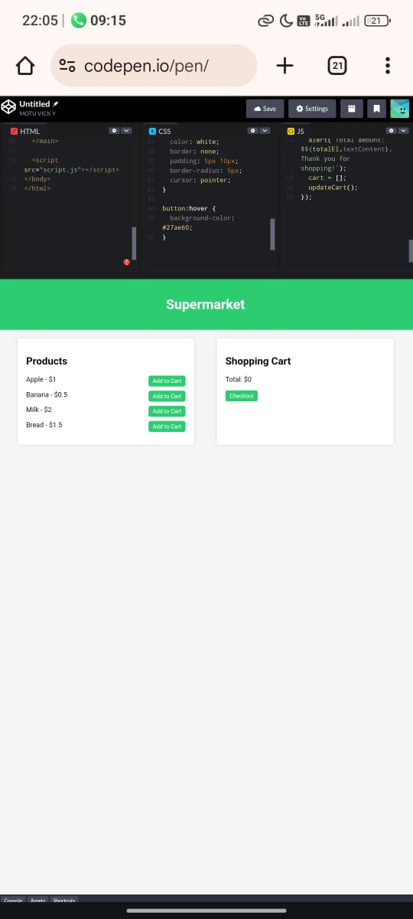
RESULTS AND SCREENSHOTS
Result: A working supermarket web page. Users can view products, add to cart, see total price, and checkout. Screenshots: 1. Home Page: Shows product list. 2. Cart Section: Displays selected items and total amount. 3. Checkout Message: Confirmation alert after purchase.

Slide 11
CONCLUSION
Conclusion This project successfully demonstrates a basic supermarket shopping cart using HTML, CSS, and JavaScript. Users can easily browse products, add them to a cart, view the total in real time, and checkout — giving a simple and interactive shopping experience.

Slide 12
GITHUB LINK
https://github.com/abishek252007/abishek_24101.git

