Slide 1
Protein families classification using Machine/Deep Learning
Abishek Adhikari

Slide 2
Motivation/Objective:
Proteins are the complex biomolecules that plays an important role in living organism.
Proteins are made up of amino acids; a long chain of chemical units represented by alphabets
There are 20 most common amino acids that are arranged randomly in a sequence which generates millions of unique proteins
Traditional experimental methods uses chemical and physical properties to classify protein families, which is complex and time consuming
This project aims to classify protein families using several Machine/Deep Learning approaches.

Slide 3
Data wrangling
Protein sequence data is downloaded from Kaggle. (https://www.kaggle.com/shahir/protein-data-set)
There are two data files, one contains protein sequence whereas other is physical and chemical properties of protein.
More than 85000 Protein families are present in the data sets with approximately 3900 classes.
Each features are carefully examine for missing values and the missing instances are removed from the data set.
After cleaning, approximately 75000 instances are available for the further steps.

Slide 4
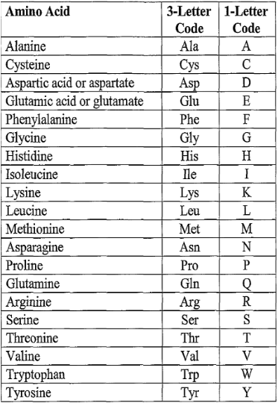
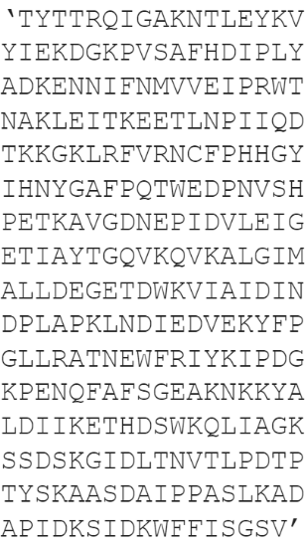
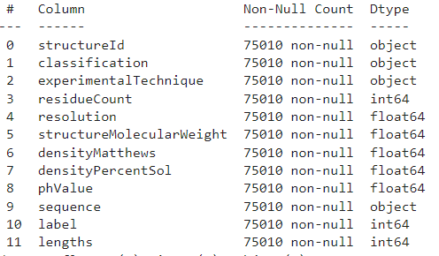
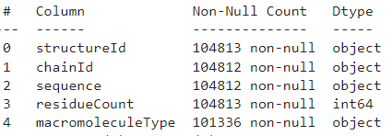
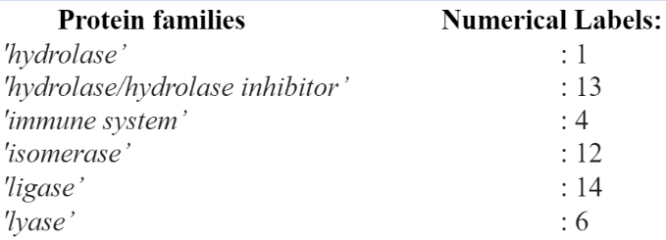
Understanding data
Amino acids are represented by alphabets
“Hydrolase” family with 286 amino acid units
Dataset 1
Dataset 2

Slide 5
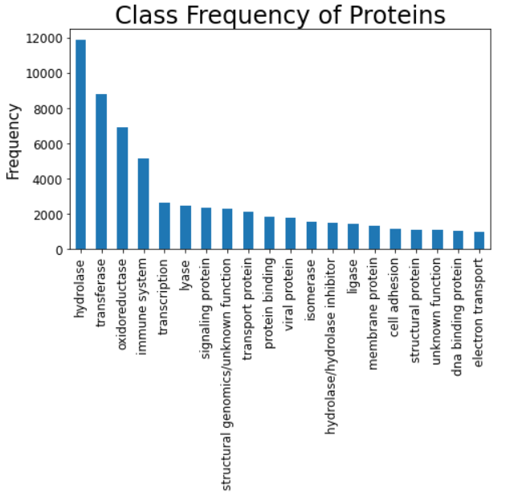
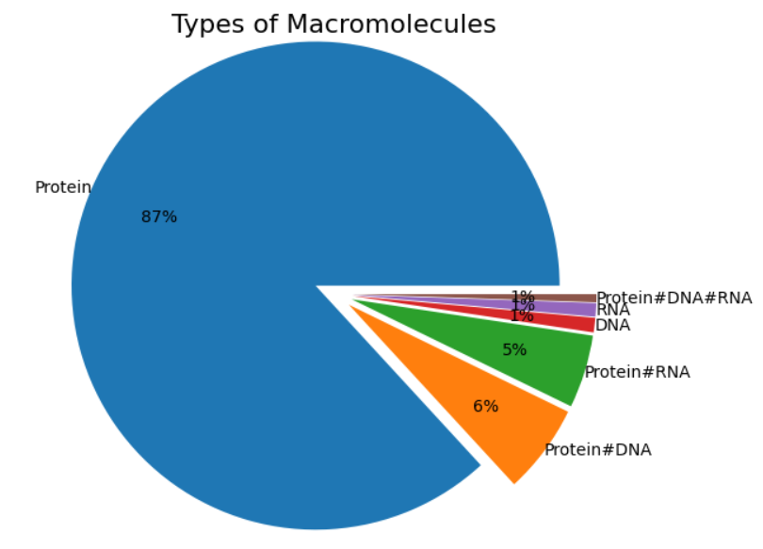
Exploratory Data Analysis

Slide 6
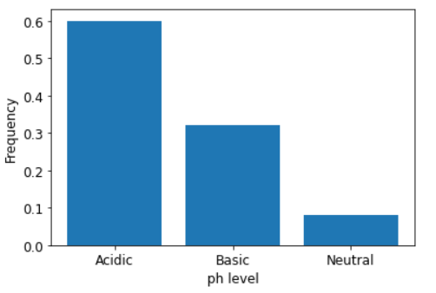
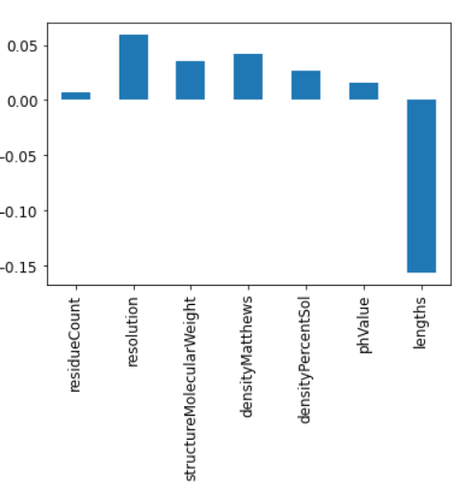
Exploratory Data Analysis

Slide 7
Machine Learning Models
Three ML algorithms (Random Forest, Decision Tree, and KNN) are trained and tested.
75% data are used to train the model and the remaining 25% are tested
Hyperparameters are tuned in each model
Models | Accuracy | Recall | precision
Decision Tree | 0.43 | 0.43 | 0.49
Random Forest | 0.52 | 0.52 | 0.57
KNN | 0.28 | 0.28 | 0.27

Slide 8
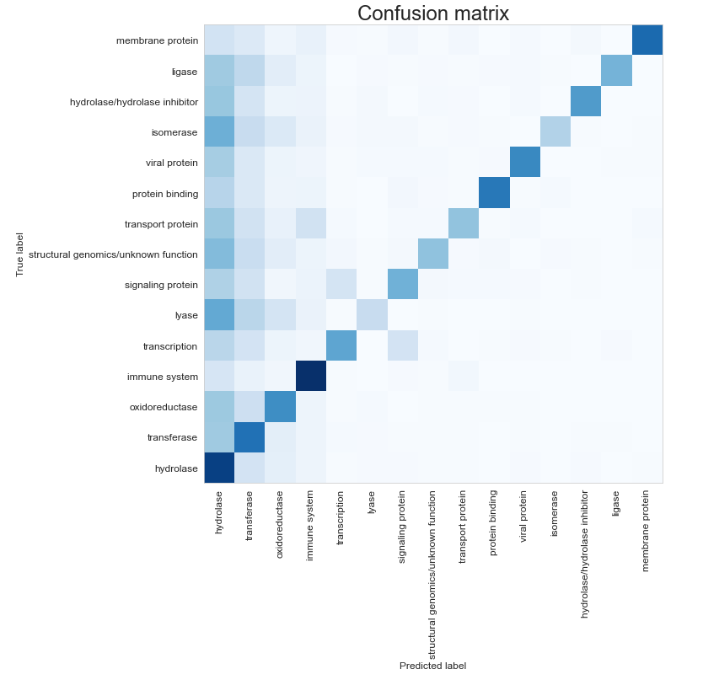
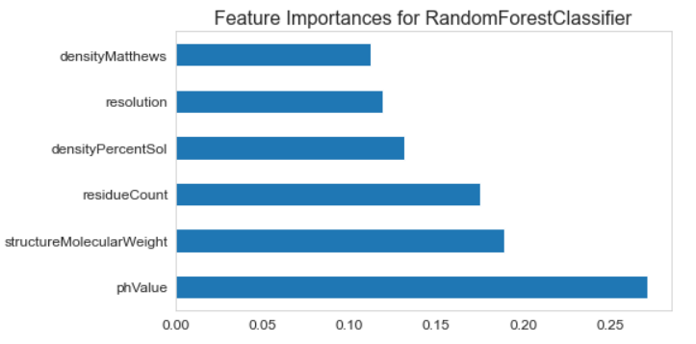
Random Forest
Feature Importance

Slide 9
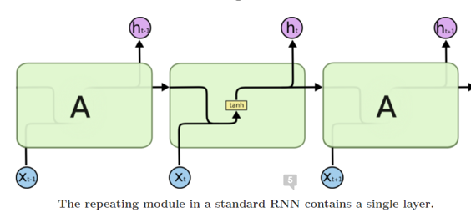
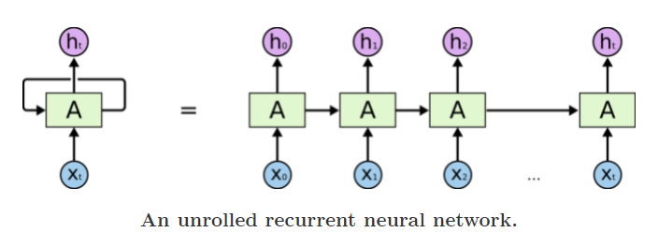
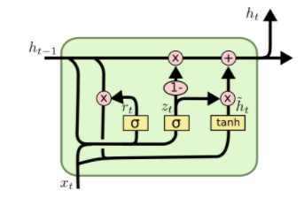
Brief introduction of Sequential Model
Long Short-Term Memory (LSTM)
Recurring Neural Network (RNN)
“LSTMs” – are a special kind of RNN, capable of learning long-term dependencies
Remembering information for long periods of time is practically their default behavior, not something they struggle to learn!
The key to LSTMs is the cell state, the horizontal line running through the top of the diagram.
The LSTM does have the ability to remove or add information to the cell state, carefully regulated by structures called gates
In other neural networks, all the inputs are independent of each other. But in RNN, all the inputs are related to each other.
An RNN can be thought of as multiple copies of the same network, each passing a message to a successor.
RNNs can learn to use the past information.
Unfortunately, as that gap grows, RNNs become unable to learn to connect the information.

Slide 10
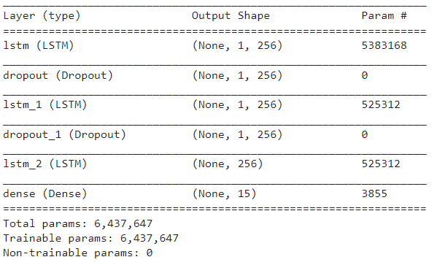
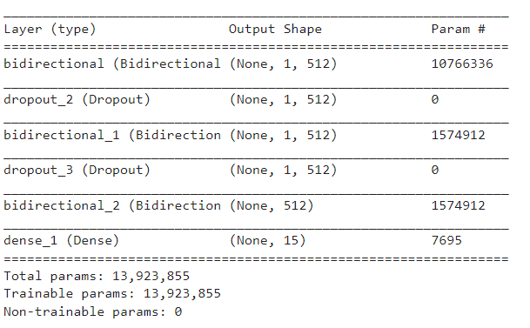
Deep Learning Models (Model architecture):
LSTM
BiDirectional LSTM

Slide 11
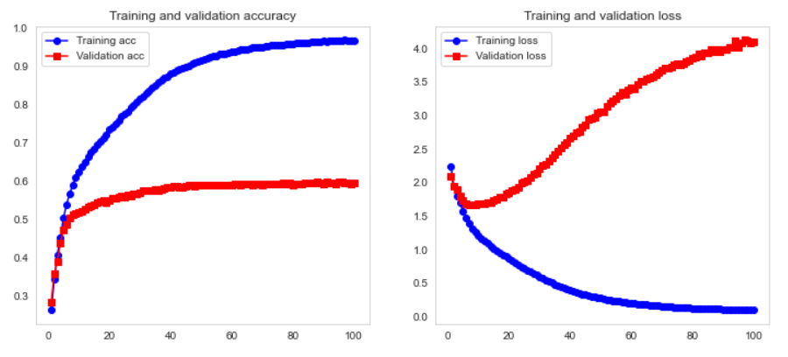
Model evaluation
Models | Accuracy | Recall | precision | AUC
LSTM | 0.59 | 0.59 | 0.61 | 0.83
BiLSTM | 0.59 | 0.59 | 0.60 | 0.84

Slide 12
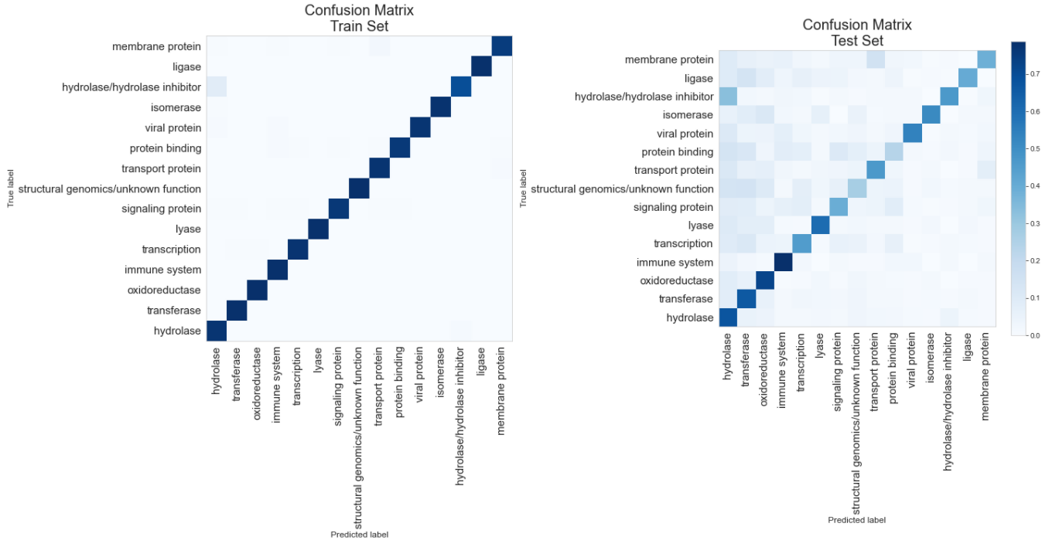

Slide 13
Summary and recommendation:
This projects aims to classify 15 most common protein families using two separate approaches (Machine Learning and Deep Learning).
Machine learning algorithm uses physical and chemical properties of protein whereas deep learning uses amino acid sequence to predict the protein families.
Machine learning algorithms are not much useful to classify protein families because of the limited features.
Both LSTM and BiLSTM are some how useful to classify protein families.
Recommendation:
More features are need to ML model to improve its predictability.
More data is needed for LSTM to improve its predictability.

Slide 14
Thank you.

