Slide 1
Protein families classification using Machine/Deep Learning
Abishek Adhikari
Springboard 2021

Slide 2
Motivation/Objective:
Proteins are the complex biomolecules that plays an important role in living organism.
Proteins are made up of amino acids; a long chain of chemical units represented by alphabets
There are 20 most common amino acids that are arranged randomly in a sequence which generates millions of unique proteins
Traditional experimental methods uses chemical and physical properties to classify protein families, which is complex and time consuming
This project aims to classify protein families using several Machine/Deep Learning approaches.

Slide 3
Data wrangling
Protein sequence data is downloaded from Kaggle. (https://www.kaggle.com/shahir/protein-data-set)
There are two data files, one contains protein sequence whereas other is physical and chemical properties of protein.
More than 85000 instances are present in the datasets
Each features are carefully examine for missing values and the missing instances are removed from the data set.
After cleaning, approximately 75000 instances are available for the further steps.

Slide 4
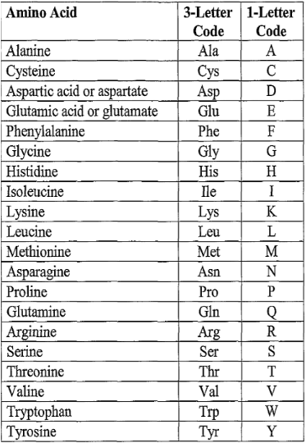
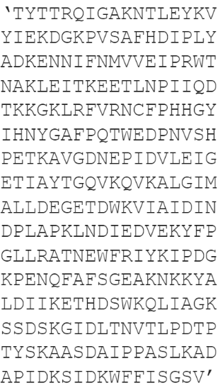
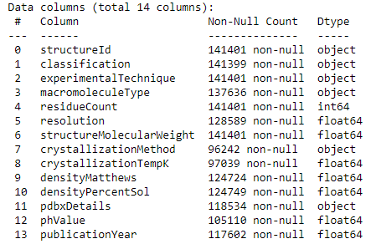
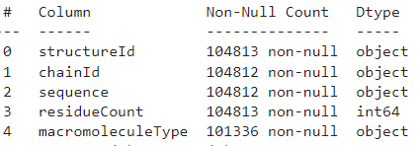
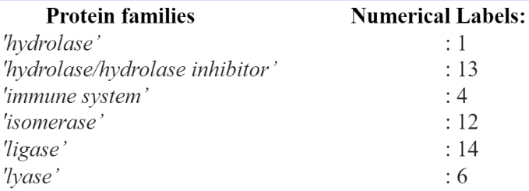
Understanding data
Amino acids are represented by alphabets
“Hydrolase” family with 286 amino acid units
Dataset 1
Dataset 2

Slide 5
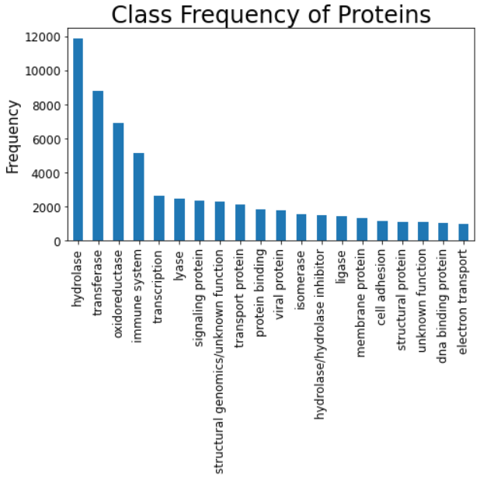
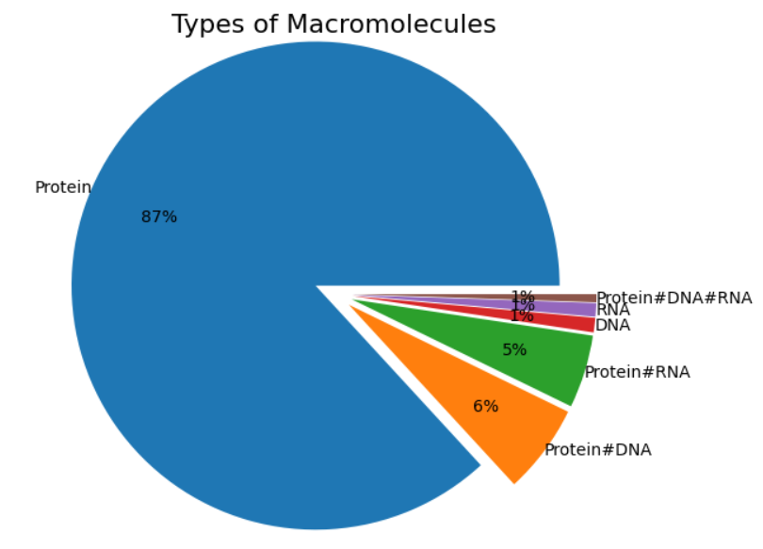
Exploratory Data Analysis
87% of Macromolecules belong to Protein
Protein family class (label)

Slide 6
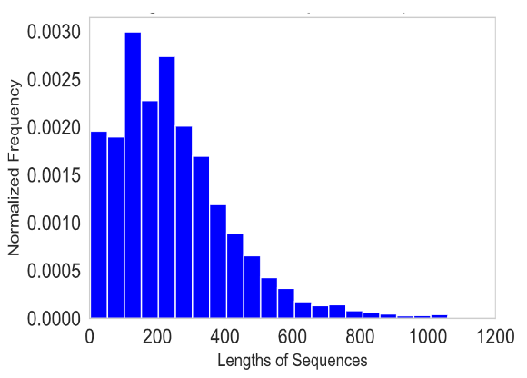
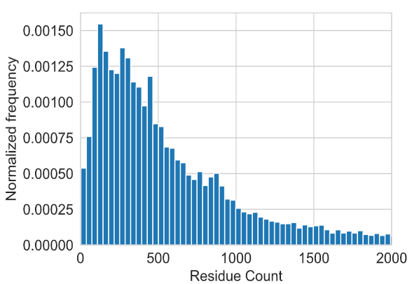
Exploratory Data Analysis
Normalized frequency distribution:
Majority of sequences have lengths less than 500 units
number of residues in macromolecules
a residue refers to a single unit that makes up an amino acid in a protein

Slide 7
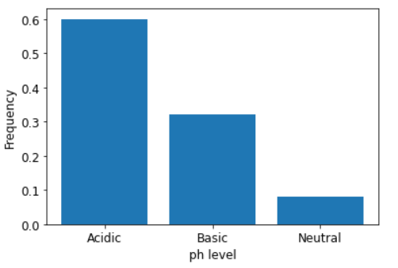
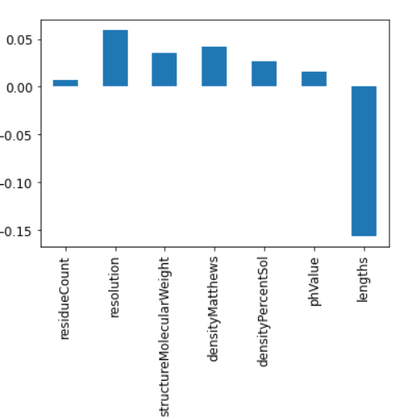
Exploratory Data Analysis
Features correlation with the classes label
Acidic: PhValue < 7
Basic: PhValue > 7
Neutral: PhValue = 7

Slide 8
Part I: Machine Learning Models
Three ML algorithms (Random Forest, Decision Tree, and KNN) are trained and tested.
75% data are used to train the model and the remaining 25% are tested
Hyperparameters are tuned in each model
Models | Accuracy | Recall | precision
Decision Tree | 0.43 | 0.43 | 0.49
Random Forest | 0.52 | 0.52 | 0.57
KNN | 0.28 | 0.28 | 0.27

Slide 9
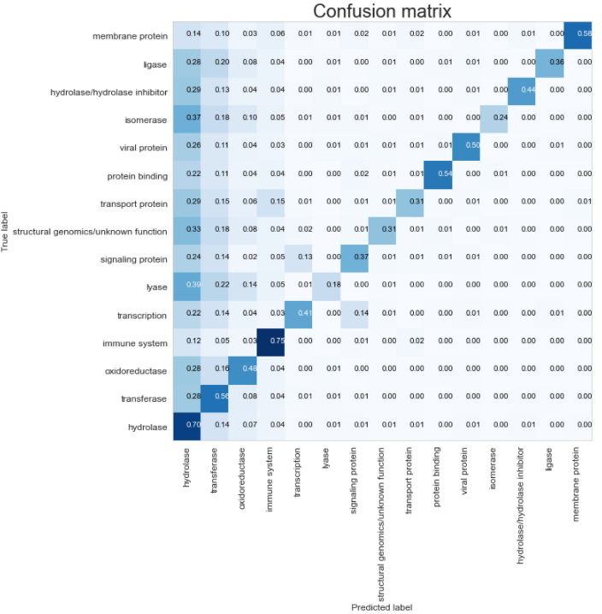
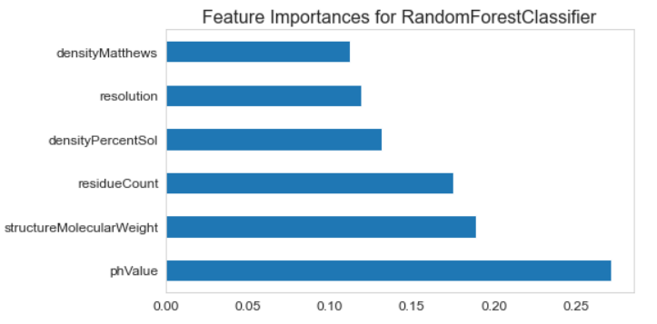
Random Forest
Feature Importance

Slide 10
Part II: Deep Learning Models
“Hydrolase” family with 286 amino acid units
Character to numerical vectors:
Tf-idf is used to convert to the numerical vectors
ngram = 3. (it collects all the possible combinations of 3 adjacent letters from the whole datasets)
Tf-idf provides value between 0 to 1. Most important word has value closer to 1.
Levels are converted to the numerical vectors by one hot encoding method

Slide 11
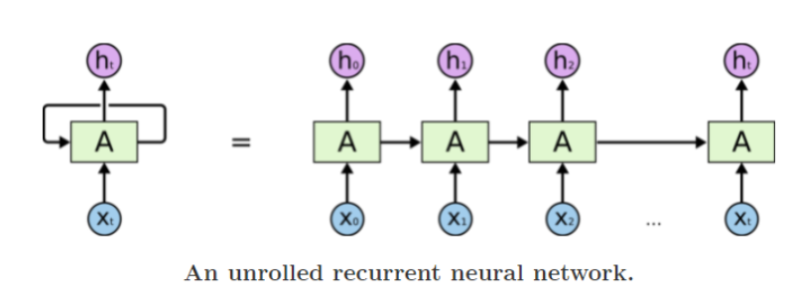
Brief intro of Sequential model
RNN are the "time series version" of ANNs. They are meant to process sequences of data.
A looping constraint on the hidden layer of ANN turns to RNN.
An RNN can be thought of as multiple copies of the same network, each passing a message to a successor.
RNNs can learn to use the past information but as that gap grows, RNNs become unable to learn to connect the information.
Also, vanishing and exploding gradient issues come with a simple RNN.
Reference: https://colah.github.io/posts/2015-08-Understanding-LSTMs/

Slide 12
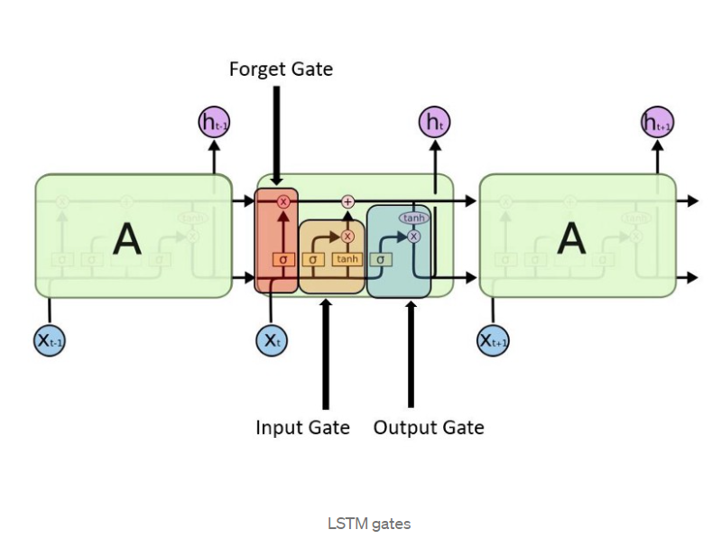
LSTM & BiLSTM
“LSTMs” – are a special kind of RNN, capable of learning long-term dependencies
The key to LSTMs is the cell state
The LSTM does have the ability to remove or add information to the cell state, carefully regulated by structures called gates.
Forget gate: what is relevant to keep from the prior steps?
Input gate: what information is relevant to add from the current state
Output gate: determines next hidden states
LSTM only preserves information of the past because the only inputs it has seen are from the past.
BiLSTM will run your inputs in two ways, one from past to future and one from future to past so it preserve information from both past and future.

Slide 13
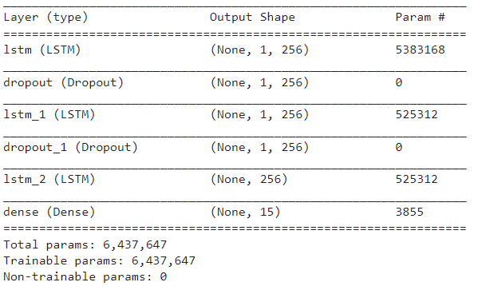
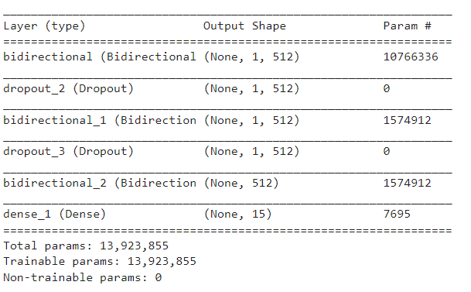
Deep Learning Models (Model architecture):
LSTM
BiDirectional LSTM

Slide 14
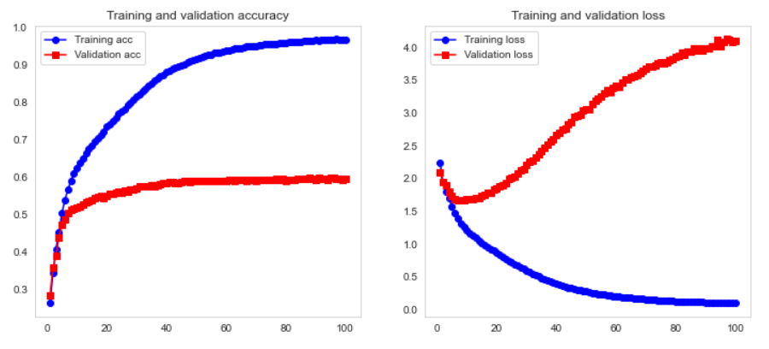
Model evaluation
Models | Accuracy | Recall | precision | AUC
LSTM | 0.59 | 0.59 | 0.61 | 0.83
BiLSTM | 0.59 | 0.59 | 0.60 | 0.84

Slide 15
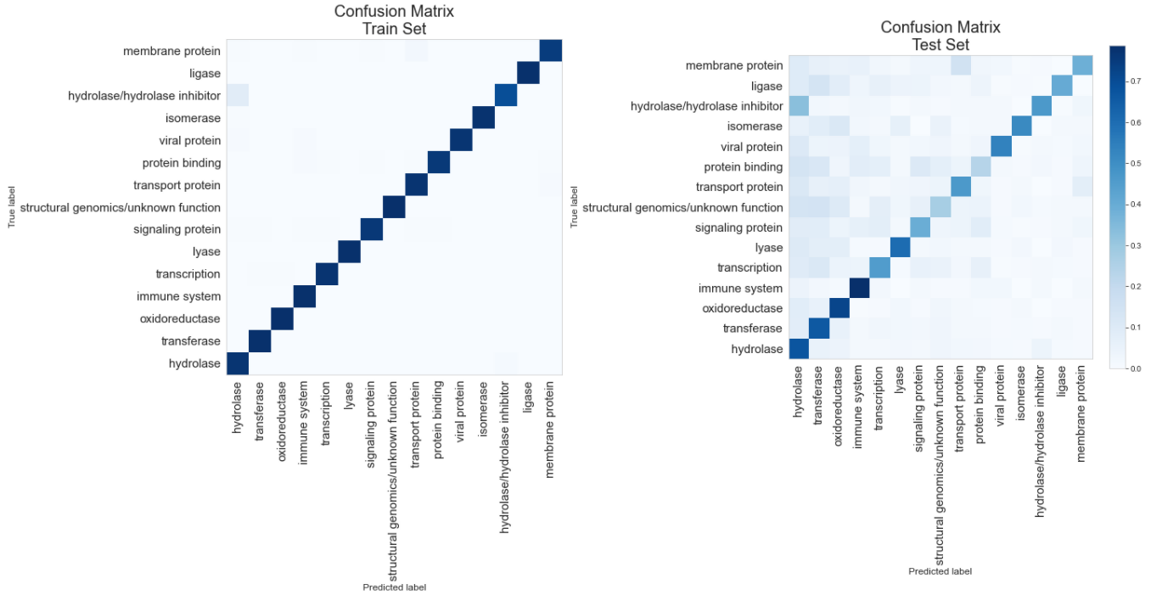

Slide 16
Summary and recommendation:
This projects aims to classify 15 most common protein families using two separate approaches (Machine Learning and Deep Learning).
Machine learning algorithm uses physical and chemical properties of protein whereas deep learning uses amino acid sequence to predict the protein families.
Machine learning algorithms are not much useful to classify protein families because of the limited features.
Both LSTM and BiLSTM are some how useful to classify protein families.
Recommendation:
More features are need to ML model to improve its predictability.
More data is needed for LSTM to improve its predictability.

Slide 17
Thank you.

