Slide 1
Big Mountain ticket pricing Recommendation
-Abishek Adhikari
01.12.2021

Slide 2
Problem Identification
The Big Mountain Resort recently installed an additional chair lift which increases the operating costs by $ 1.54 Million.
The resort ticket pricing has been based on the above-average price strategy
How can Big Mountain Resort select a better value for the tickets this season by either cutting operating costs or increasing ticket prices?

Slide 3
Key Findings & Recommendations
The weekend ticket price could go up to $94.22 which is approximately $13 more than the current price of $81.
The four most important features that influence the ticket pricing are runs, fastquads, snowmaking_ac, and vertical drop.
The best way to increase the revenue is by adding a vertical drop by 150 ft. It supports increasing ticket pricing by $1.99 and collecting a revenue of approximately $ 3.5 million.
More dataset (such as operating cost of each feature) is needed for accurate prediction

Slide 4
Modeling Results and Analysis

Slide 5
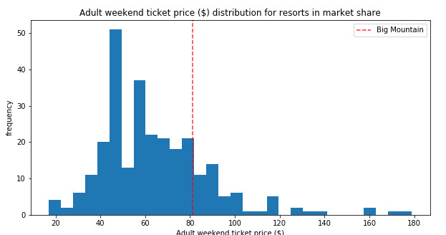
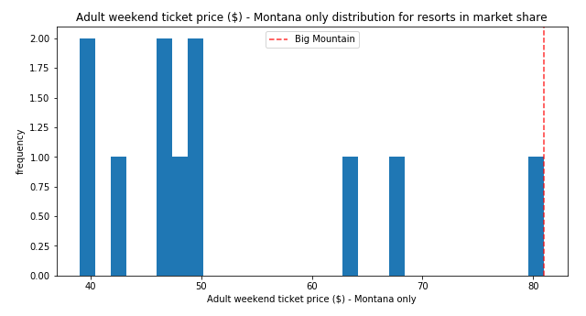
Current Pricing position of Big Mountain Resort
USA
Montana
Red Dash line: Big Mountain Standing

Slide 6
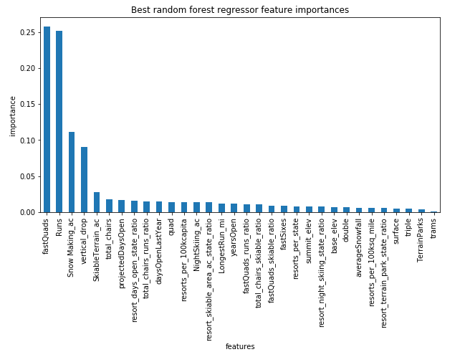
Feature Importance:

Slide 7
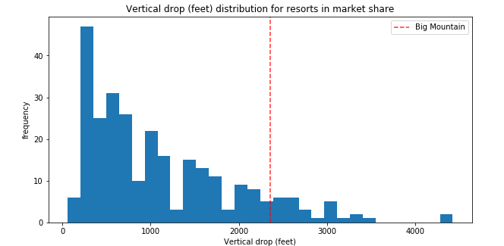
Frequency distribution of vertical drop.
Red Dash line: Big Mountain Standing

Slide 8
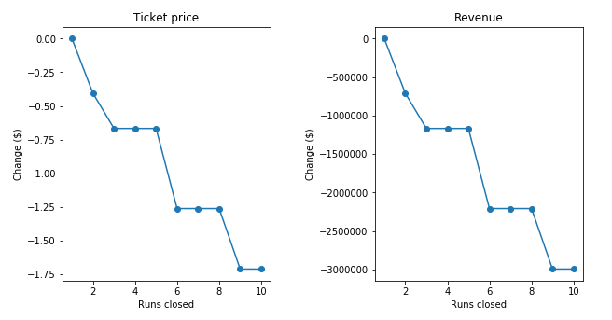
Changes in the ticket price and revenues due to Run closure.

Slide 9
Summary and Conclusion:
There is room to increase ticket prices at Big Mountain Resort.
Closing one Run does not hurt ticket pricing.
By adding a vertical drop by 150 ft, the ticket price could be increased by $1.99, resulting in a revenue of 3.5 million.
Adding extra snowmaking area, Increasing the longest run by 0.2 miles would not help the revenue.
More scenarios can be tested, and more data is needed for correct prediction.

