Slide 1
Money Matters: A Personal Finance Management App
TEAM MEMBER’S
ABISHEK V
ASWIN PAUL S
ARULSANGAMESHWAR M
KAVIN PRABHU N

Slide 2
DESCRIPTION
Thrifty is a personal finance management application with features that are beneficial for managing the finance of users.
The personal finance management app developed includes updating income, tracking expenses and sending alerts at the right time, etc. Each of these activities involves accessing information from different locations, collecting and consolidating monetary information.
This app helps users to set their goals, keep track of their income and expenses by monthly basis. Users can set reminders to get timely alerts.
This app includes different modes of updating expenses either manually using the app’s interface or by using OCR.
Graphical representation of income and expenses of the individual is another feature of this app which makes the user view the graph at a glance and can make a decision very quickly which is hardly possible through descriptive reports.
The app is designed and developed using JAVA, XML, and SQLite as the backend database.

Slide 3
FEATURES
Expenses Tracking: Users can track their expenses by category (e.g. food, transportation, entertainment) and view their spending habits over time.
Investment Opportunities: Users can view investment opportunities in stocks and crypto and track their portfolio performance.
User-Friendly Interface: The app is designed with a fun and user-intuitive interface to engage teenagers and encourage financial literacy.
Secure Login: The app requires a secure login to ensure the privacy of user data.
Personalized Dashboard: Users can customize their dashboard to display the information that is most relevant to them.
AI-integrated Features: Users can scan their receipts with the app's AI technology to automatically categorize their expenses.

Slide 4
Main Activity.java:
package com.thriftyApp;
import android.content.Intent;
import android.os.Bundle;
import android.support.v4.app.Fragment;
import android.support.v4.app.FragmentManager;
import android.support.v7.app.AppCompatActivity;
import android.view.View;
import android.view.View.OnClickListener;
public class MainActivity extends AppCompatActivity {
private static FragmentManager fragmentManager;
public DatabaseHelper databaseHelper = new DatabaseHelper (this);
@Override
protected void onCreate(Bundle savedInstanceState) {
super.onCreate(savedInstanceState);
setContentView(R.layout.activity_main);
if( getIntent().getBooleanExtra("Exit me", false)){
finish();
return; // add this to prevent from doing unnecessary stuffs
}
fragmentManager = getSupportFragmentManager();

Slide 5
// If saved instance state is null then replace login fragment
if (savedInstanceState == null) {
fragmentManager
.beginTransaction()
.replace(R.id.frameContainer, new Login_Fragment(),
Utils.Login_Fragment).commit();
}
// On close icon click finish activity
findViewById(R.id.close_activity).setOnClickListener(
new OnClickListener() {
@Override
public void onClick(View arg0) {
finish();
}
});
} // Replace Login Fragment with animation
protected void replaceLoginFragment() {
fragmentManager
.beginTransaction()
.setCustomAnimations(R.anim.left_enter, R.anim.right_out)
.replace(R.id.frameContainer, new Login_Fragment(),
Utils.Login_Fragment).commit();
}

Slide 6
@Override
public void onBackPressed() {
// Find the tag of sign up and forgot password fragment
Fragment SignUp_Fragment = fragmentManager
.findFragmentByTag(Utils.SignUp_Fragment);
// Check if both are null or not
// If both are not null then replace login fragment else do back pressed
// task
if (SignUp_Fragment != null)
replaceLoginFragment();
else
super.onBackPressed();
}
public void moveToSplash () {
Intent intent = new Intent (getApplicationContext (), SplashActivity.class);
startActivity (intent);
finish ();
}
}

Slide 7
PayActivity.java
package com.thriftyApp;
import android.content.DialogInterface;
import android.content.Intent;
import android.support.design.widget.FloatingActionButton;
import android.support.v7.app.AlertDialog;
import android.support.v7.app.AppCompatActivity;
import android.os.Bundle;
import android.util.Log;
import android.view.View;
import android.widget.EditText;
import android.widget.TextView;
import android.widget.Toast;
import java.text.SimpleDateFormat;
import java.util.Date;
import java.util.Locale;
public class PayActivity extends AppCompatActivity {
EditText pay, tag;
FloatingActionButton addExpense;
DatabaseHelper databaseHelper;
TextView thrifty;

Slide 8
@Override
protected void onCreate(Bundle savedInstanceState) {
super.onCreate (savedInstanceState);
setContentView (R.layout.activity_pay); databaseHelper = new DatabaseHelper (this);
pay = findViewById (R.id.payEditText);
tag = findViewById (R.id.tagEditText);
addExpense = findViewById (R.id.floatingActionButtonPay);
thrifty = findViewById (R.id.thriftyTitlePay);
findViewById(R.id.close_pay).setOnClickListener(
new View.OnClickListener () {
@Override
public void onClick(View arg0) {
onBackPressed ();
}
}); Intent intent = getIntent ();
if (intent.getStringExtra ("ocr") != null) {
String str = intent.getStringExtra ("ocr");
pay.setText (str);
}

Slide 9
findViewById (R.id.travelImageViewP).setOnClickListener (new View.OnClickListener ( ) {
@Override
public void onClick(View v) {
tag.setText ("Travel"); });
findViewById (R.id.foodImageViewP).setOnClickListener (new View.OnClickListener ( ) {
@Override
public void onClick(View v) {
tag.setText ("Food");
}
});
findViewById (R.id.billsImageViewP).setOnClickListener (new View.OnClickListener ( ) {
@Override
public void onClick(View v) });
findViewById (R.id.sportsImageViewP).setOnClickListener (new View.OnClickListener ( ) {
@Override
public void onClick(View v) {
tag.setText ("Sports");
}
});
findViewById (R.id.petsImageViewP).setOnClickListener (new View.OnClickListener ( ) {
@Override
public void onClick(View v) {
tag.setText ("Pets");
});

Slide 10
public void addPay () {
Transactions t = new Transactions ();
t.setExin (0);
Double d = Double.parseDouble (pay.getText ().toString ());
Log.i("Omg", d.toString ());
long l = Math.round (d);
t.setAmount (l);
t.setTag (tag.getText ().toString ());
t.setUid (Integer.parseInt (Utils.userId));
databaseHelper.insertTransaction (t);
databaseHelper.getTransactions ();
databaseHelper.setIncomeExpenses ();
int exp = Utils.expense;
int bud = Integer.parseInt (Utils.budget);
Log.i("Alert build", bud*0.5 +" "+ exp);
if (exp > (bud/2)) {
Toast.makeText (getApplicationContext (),"Added Expense", Toast.LENGTH_SHORT).show ();
buildAlertExpense ( );
}
else {
Intent intent = new Intent (getApplicationContext ( ), TransactionsActivity.class);
startActivity (intent);
finish ( );
}
}

Slide 11
@Override
public void onBackPressed() {
Intent intent = new Intent (getApplicationContext (),TransactionsActivity.class);
startActivity (intent);
finish ();
}
public void buildAlertExpense () {
AlertDialog.Builder builder = new AlertDialog.Builder (this);
builder.setCancelable (true);
builder.setTitle ("Alert");
builder.setMessage ("Spend money wisely. More than half of the allocated budget amount has already been spent in this month." );
builder.setPositiveButton ("OK", new DialogInterface.OnClickListener ( ) {
@Override
public void onClick(DialogInterface dialog, int which) {
Toast.makeText (getApplicationContext (),"Spend Less, Save more.",Toast.LENGTH_SHORT).show ();
Intent intent = new Intent (getApplicationContext (), TransactionsActivity.class);
startActivity (intent);
finish ();
}
});
builder.show ();
}
}

Slide 12
package com.thriftyApp;
import android.content.Intent;
import android.support.design.widget.FloatingActionButton;
import android.support.v7.app.AppCompatActivity;
import android.os.Bundle;
import android.view.View;
import android.widget.AdapterView;
import android.widget.ArrayAdapter;
import android.widget.Button;
import android.widget.ListView;
import android.widget.TextView;
import android.widget.Toast;
import com.github.mikephil.charting.charts.PieChart;
import com.github.mikephil.charting.data.PieData;
import com.github.mikephil.charting.data.PieDataSet;
import com.github.mikephil.charting.data.PieEntry;
import com.github.mikephil.charting.utils.ColorTemplate;
import java.util.ArrayList;
import java.util.List;

Slide 13
public class Dashboard extends AppCompatActivity { DatabaseHelper databaseHelper;
boolean flagFloatingButton;
FloatingActionButton floatingActionButton;
Button scan, take, pay;
PieChart pieChart;
TextView income, expense;
TextView userName, logout; public void FloatingButtonToggle(View view) { if (flagFloatingButton) { flagFloatingButton = false;
scan.setVisibility (View.INVISIBLE);
take.setVisibility (View.INVISIBLE);
pay.setVisibility (View.INVISIBLE);
}
else { flagFloatingButton = true;
scan.setVisibility (View.VISIBLE);
take.setVisibility (View.VISIBLE);
pay.setVisibility (View.VISIBLE);
} }
@Override
protected void onCreate(Bundle savedInstanceState) {
super.onCreate (savedInstanceState);
setContentView (R.layout.activity_dashboard); income = findViewById (R.id.income);
expense = findViewById (R.id.expense);
logout = findViewById (R.id.logoutTextView);

Slide 14
scan = findViewById (R.id.scanButton);
take = findViewById (R.id.takeButton);
pay = findViewById (R.id.payButton);
scan.setVisibility (View.INVISIBLE);
take.setVisibility (View.INVISIBLE);
pay.setVisibility (View.INVISIBLE);
pieChart = findViewById (R.id.pieChart);
databaseHelper = new DatabaseHelper (this);
flagFloatingButton =false;
floatingActionButton = findViewById (R.id.floatingActionButtonD);
databaseHelper.setIncomeExpenses ();
income.setText ("₹ " + Utils.income);
expense.setText ("₹ " + Utils.expense);
scan.setOnClickListener (new View.OnClickListener () {
@Override
public void onClick(View view) {
Intent intent = new Intent(getApplicationContext (), scanActivity.class);
startActivity (intent);
finish ();
}
});

Slide 15
take.setOnClickListener (new View.OnClickListener () {
@Override
public void onClick(View view) {
Intent intent = new Intent(getApplicationContext (), TakeActivity.class);
startActivity (intent);
finish ();
}
}) logout.setOnClickListener (new View.OnClickListener ( ) {
@Override
}); pay.setOnClickListener (new View.OnClickListener () {
@Override
public void onClick(View view) {
Intent intent = new Intent(getApplicationContext (), PayActivity.class);
startActivity (intent);
finish ();
}); TextView showAll = findViewById (R.id.showAllTextView);
showAll.setOnClickListener (new View.OnClickListener () {
@Override
public void onClick(View view) {
Intent intent = new Intent(getApplicationContext (), TransactionsActivity.class);
startActivity (intent);
finish () }
});

Slide 16
public void getTChart() {
List<PieEntry> value = new ArrayList<> ( );
if (Utils.expense != 0 && Utils.income !=0) {
pieChart.setHoleRadius (15f);
pieChart.setTransparentCircleRadius (15f);
value.add (new PieEntry (Utils.expense, "Expenses"));
value.add (new PieEntry (Utils.income, "Income"));
PieDataSet pieDataSet = new PieDataSet (value, "Transactions");
PieData pieData = new PieData (pieDataSet);
pieChart.setData (pieData);
pieChart.setContentDescription (null);
pieChart.getLegend ( ).setEnabled (false);
pieChart.getDescription ( ).setEnabled (false);
pieChart.setEntryLabelTextSize (10f);
pieChart.animateXY (1000, 1000);
pieDataSet.setColors (ColorTemplate.PASTEL_COLORS);
}
}
}

Slide 17
app:layout_constraintVertical_bias="0.85" />
<EditText
android:id="@+id/over"
android:layout_width="143dp"
android:layout_height="65dp"
android:layout_marginStart="244dp"
android:layout_marginLeft="244dp"
android:layout_marginBottom="16dp"
android:ems="10"
android:inputType="number"
android:text="@string/_0"
android:textColor="@color/DarkRed"
android:textSize="28sp"
android:textStyle="bold"
app:layout_constraintBottom_toBottomOf="parent"
app:layout_constraintStart_toStartOf="parent" />
<Button
android:id="@+id/button2"
android:layout_width="wrap_content"
android:layout_height="wrap_content"
android:text="OUT"
android:textColor="@color/BlueViolet"
android:textSize="28sp"
app:layout_constraintBottom_toBottomOf="parent"

Slide 18
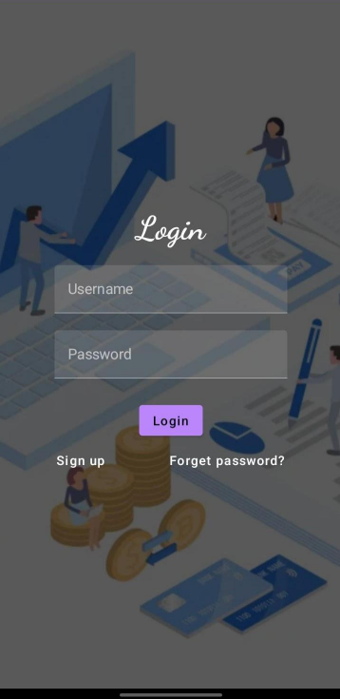
OUTPUT:
Login Page :

Slide 19
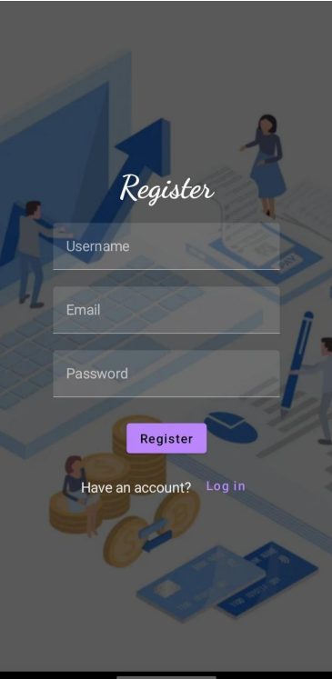
OUTPUT:
Register Page :

Slide 20
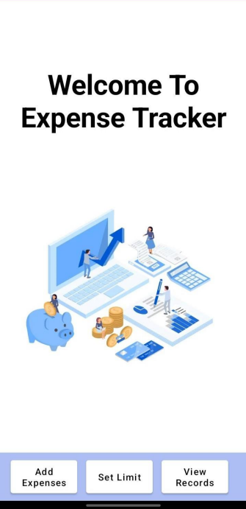
OUTPUT:
Welcome Page :

Slide 21
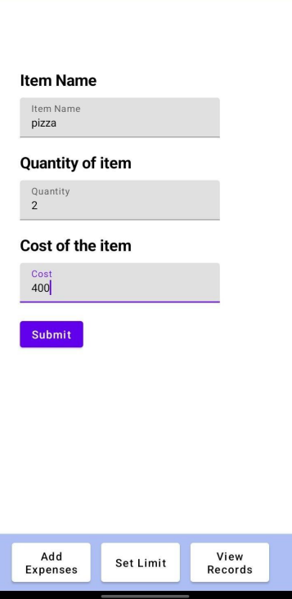
OUTPUT:
Welcome Page :

Slide 22
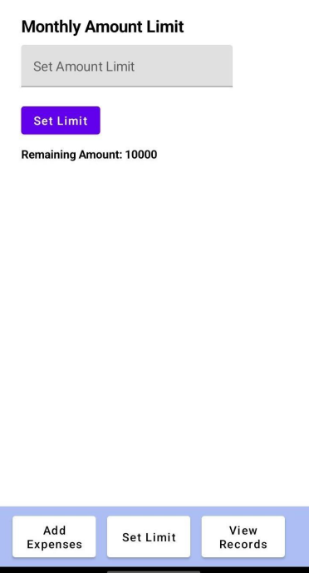
OUTPUT:
Set Limit Page :

