Slide 1
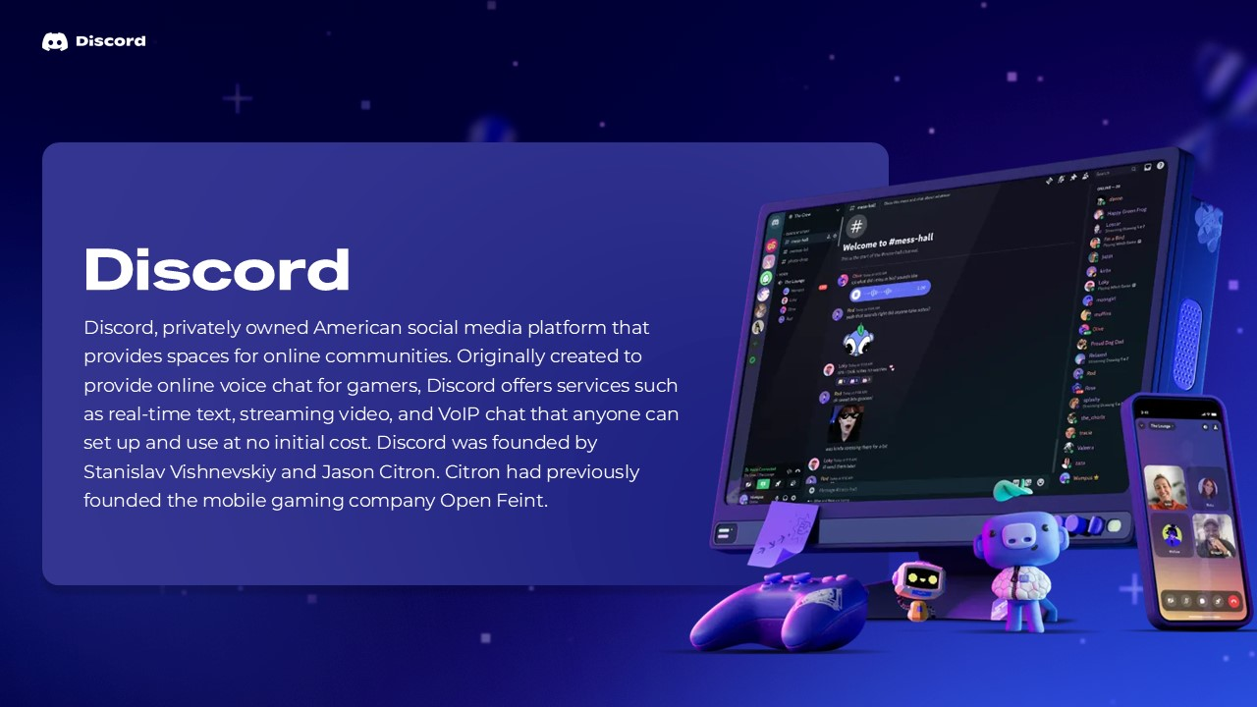

ASSIGNMENT: UI/UX DESIGN
UI/UX DESIGN
ANALYSIS OF
DISCORD MOBILE
APPLICATION
ABISHEK
BSC AI & ML

Slide 2
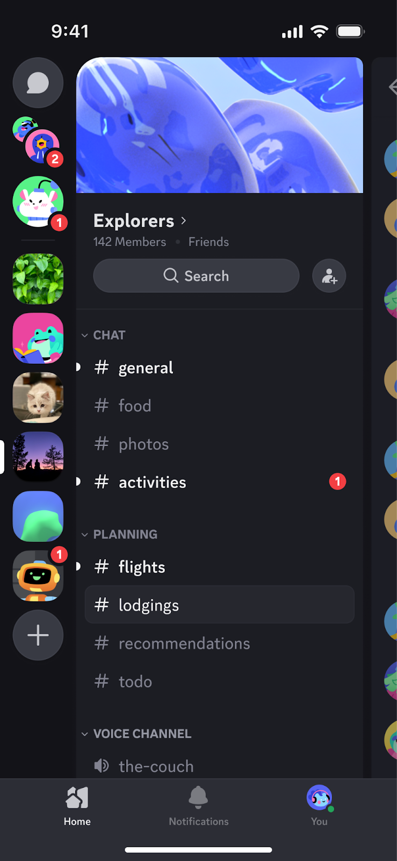
ASSIGNMENT: UI/UX DESIGN
1. NAVIGATION STRUCTURE
• Discord uses a layered navigation system with servers, channels, direct messages, and settings.
• Servers are accessed from the left side, while channels are organized inside each server.
• Users can quickly switch between text channels, voice channels, and direct messages.
• Navigation is consistent across the main parts of the application.
n

Slide 3
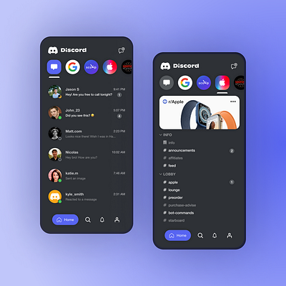
ASSIGNMENT: UI/UX DESIGN
2. LAYOUT ORGANIZATION
• The interface is divided into clear sections: server list, channel list, chat area, and user controls.
• Information is grouped logically, reducing confusion while moving between conversations.
• Icons and spacing help users identify important actions quickly.
• The layout supports both casual chatting and large communities.

Slide 4
ASSIGNMENT: UI/UX DESIGN
3. COLOR SCHEME
• Discord mainly uses dark neutral backgrounds with purple as its recognizable accent color.
• Dark surfaces help reduce visual distraction and make chat content stand out.
• Accent colors are used for selected servers, buttons, links, notifications, and important states.
• Consistent colors strengthen Discord's visual identity.
Dark Gray
Channel Gray
Purple
White

Slide 5
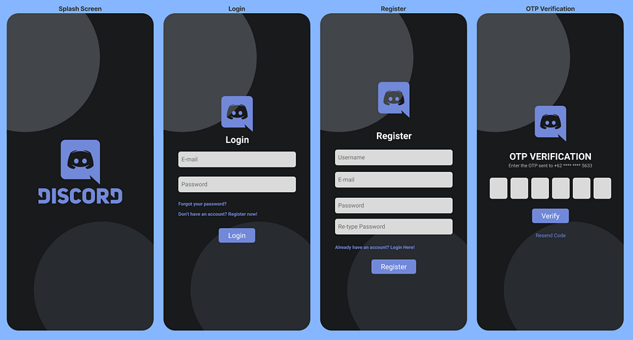
ASSIGNMENT: UI/UX DESIGN
4. TYPOGRAPHY
• Discord uses clean, modern sans-serif typography throughout the interface.
• Server names, channel names, usernames, and messages have clear visual hierarchy.
• Different font weights and sizes help users understand what is important.
• Readable text supports long conversations and quick scanning.

Slide 6
ASSIGNMENT: UI/UX DESIGN
5. USERFLOW
1
2
3
4
5
Open Discord
Choose a server
Select a channel
Read or send a message
Use voice/video if needed
• The main flow is direct: choose a community → choose a conversation → communicate.
• Frequent actions are kept close to the conversation area.

Slide 7
ASSIGNMENT: UI/UX DESIGN
STRENGTHS
• Well-organized server and channel structure.
• Fast access to text, voice, and video communication.
• Strong visual identity and consistent interface.
• Good support for both small groups and large communities.
• Clear feedback through icons, highlights, notifications, and status indicators.

Slide 8
ASSIGNMENT: UI/UX DESIGN
WEAKNESSES
• The interface can feel crowded when a user joins many servers.
• New users may need time to understand servers, channels, roles, and permissions.
• Frequent notifications can become distracting if not managed.
• Some advanced settings and community features may be difficult for beginners.

Slide 9
ASSIGNMENT: UI/UX DESIGN
CONCLUSION
• Discord provides a strong example of community-focused UI/UX design.
• Its organized navigation, consistent layout, dark color scheme, and clear typography support communication.
• Although the interface can become complex for beginners, its structure becomes easier with regular use.
• Overall, Discord offers an effective balance between functionality, customization, and user interaction.

Slide 10
ASSIGNMENT: UI/UX DESIGN
LEARNING OUTCOME
• This experiment helped me understand how navigation, layout, color, typography, and user flow affect usability.
• I learned how to identify strengths and weaknesses in a real mobile application's interface.
• The analysis showed me how consistent design choices can make a complex application easier to use.
• These principles can be applied when designing my own mobile applications in the future.

Slide 11
