Slide 1
DIGITAL PORTFOLIO
STUDENT NAME :ABISHEK.A
REGISTER NUMBER:36624U09001
NMID:224623A68BDA4B79C11452AFC2A201C2
DEPARTMENT:BCA-BACHELOR OF COMPUTER APPLICATION
COLLEGE NAME:MERIT HAJI ISMAIL SAHIB ARTS AND SCIENCE COLLEGE
UNIVERSITY: THIRUVALLUVAR UNIVERSITY

Slide 2
PROJECT TITLE
1.EXPENSE REIMBURSEMENT PORTAL
2.DIVERSITY AND INCLUSION TRAINING
3.LEADERSHIP DEVELOPMENT PROGRAME
4.VIRTUAL PRESENTATION PLATFORM

Slide 3
AGEND A
1.PROBLEM STATEMENT
2.PROJECT OVERVIEW
3.END USERS
4.TOOLS AND TECHNOLOGIES
5.PORTFOLIO DESIGN AND LAYOUT
6.FEATURES AND FUNCTIONALITY
7.RESULTS AND SCREENSHOTS
8.CONCLUSION
9.GITHUB LINK

Slide 4
PROBLEM STATEMENT
DESCRIPTION OF THE PROBLEM:
A BRIEF OVERVIEW OF THE ISSUE
IMPACT:
THE EFFECTS OR CONSEQUENCES OF THE PROBLEM
GOALS:
WHAT YOU WANT TO ACHIEVE IN SOLVING THE PROBLEM

Slide 5
PROJECT OVERVIEW
OBJECTIVE:
BRIEFLY STATE WHAT THE PROJECT AIMS TO ACHIEVE
BACKGROUND / PROBLEM STATEMENT:
EXPLAIN WHY THIS PROJECT IS BEING UNDERTAKEN(THE NEED,ISSUE,OR OPPORTUNITY).
SCOPE:
DEFINE WHAT IS INCLUDEIN THE PROJECT(AND SOMETIMES WHAT IS EXCLUDED).

Slide 6
WHO ARE THE END USERS
EDUCATION PROJECT:
STUDENTS (END USERS),TEACHERS (SOMETIMES ALSO END USERS).
HEALTHCARE PROJECT:
PATIENTS (END USERS),DOCTORS/NURSES(IF THEY USE THE SYSTEM.
IT SOFTWARE PROJECT:
EMPLOYEES OR CUSTOMERS WHO LOG IN AND USE THE SYSTEM.
CONSTRUCTION PROJECT (E.G..HOUSING):
RESIDENT WHO WILL LIVE IN THE BUILDINGS.
E-COMMERECE PROJECT:
SHOPPERS BUYING PRODUCTS ONLINE.

Slide 7
TOOLS AND TECHNIQUES
PROJECT MANAGEMENT TOOLS
DEVELOPMENT TOOLS
COMMUNICATION AND COLLABORATION TOOLS
DESIGN AND PROTOTYPING TOOLS
TECHNIQUES

Slide 8
PORTFOLIO DESIGN AND LAYOUT
1. “ THE PORTFOLIO HAS BEEN DESIGNED WITH A CLEAN AND STRUCTURED LAYOUT THAT EMPHASIZES CLARITY , USABILITY , AND VISUAL BALANCE.”
2. “ A GRID-BASED DESIGN APPROACH HAS BEEN ADOPTED TO ENSURE CONSISTENCY ACROSS SECTIONS,MAKING THE PORTFOLIO EASY TO NAVIGATE AND VISUALLY APPEALING.”
3. “ MINIMALISM AND SIMPLICITY WERE CHOSEN AS THE CORE DESIGN PRINCIPLES, ALLOWINGS THE CONTENT AND PROJECTS TO STAND OUT WITHOUT UNNECESSARY DISTRACTIONS.”

Slide 9
FEATURES AND FUNCTIONALITY
1. CLEAN AND STRUCTURED LAYOU:
ORGANIZED SECTIONS SUCH AS HOME,ABOUT ME,PROJECT,RESUME AND CONTACT.
2. RESPONSIVE DESIGN:
ADJUSTS AUTOMATICALLY TO SCREEN SIZES(DESKTOP, TABLET, MOBLIE).
3. NAVIGATION MEN:
EASY-TO-HEADER OR SIDEBAR FOR QUICK ACCESS TO DIFFERENT SECTIONS.

Slide 10
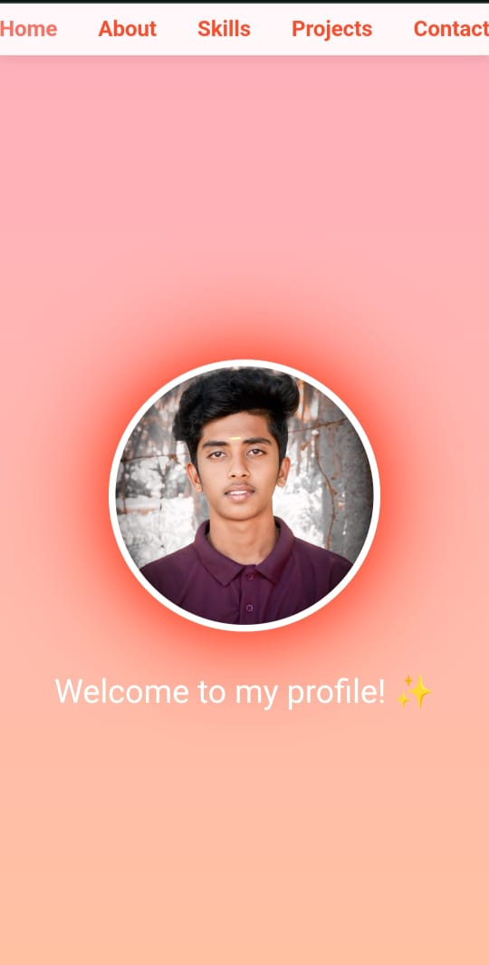
RESULTS AND SCREENSHOTS
CRAFTED WITH CLEAN CODE AND CREATIVITY , THIS PROJECT IS MADE WITH LOVE TO BE USER-FRIENDLY, FAST, AND CALABLE
HI, I’M ABISHEK A
Notes:
ABISHEK

Slide 11
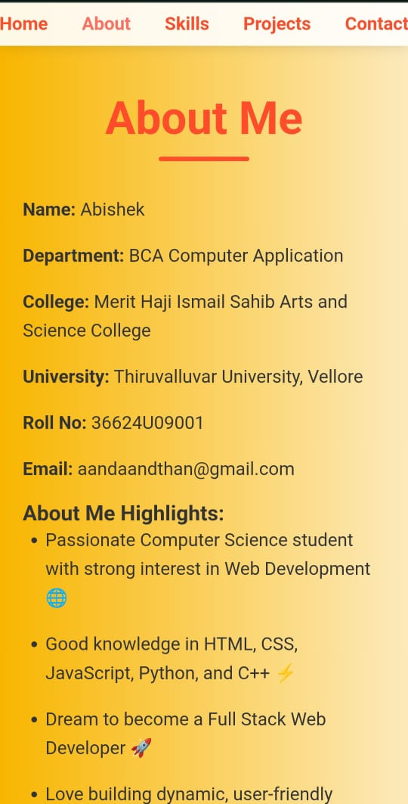
ABOUT PAGE

Slide 12
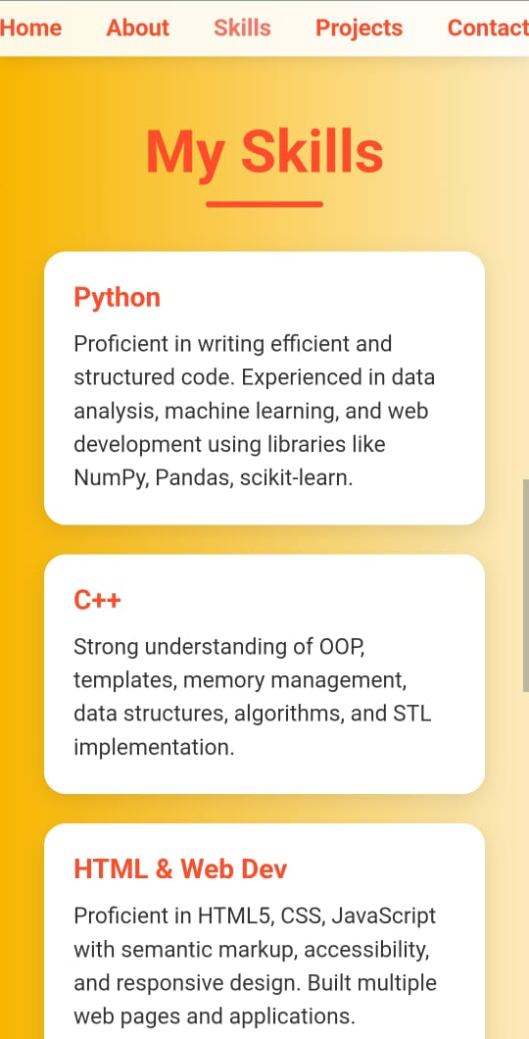
MY SKILLS

Slide 13
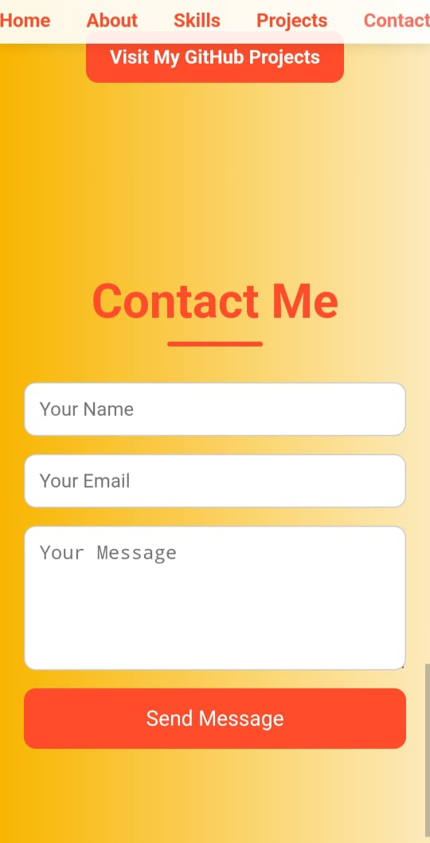
CONTACT ME PAGE

Slide 14
CONCLUSION
MY PROJECT PORTFOLIO REFLECTS MY CREATIVITY ,TECHINICAL SKILLS, AND DESIGN THINKING THROUGH PLANNING,LAYOUT, AND EXECUTION ,I HAVE SHOWCASED MY ABILITY TO COMBINE FUNCTIONALITY WITH AESTHETICS. EACH PROJECT HIGHLIGHTS NOT ONLY MY PROBLEM-SOLVING APPROACH BUT ALSO MY COMMITMENT TO DELIVERING USER-FRIENDLY AND VISUALLY APPEALING OUTCOMES. THIS PORTFOLIO IS NOT JUST A COLLECTION OF WORK, BUT A REPRESENTATION OF MY GROWTH, LEARNING, AND PASSION FOR DESIGN.

