Slide 1
Concealing of data in digital images
Project Guide
Dr I Kala B.E. ,M.E. , Ph.D.
Associate Professor/CSE.
PSG iTech.
Team Members
Akash M
Karthikeyan S
Abishek Adapa
13/03/2020
Concealing of data in digital images
1

Slide 2
Steganography
Definition :
- It is a practice of concealing the Data onto a image or video
- In Greek Steganography is referred to as steganographia
* steganos - covered or concealed
* graphia - writing or drawing
Applications of Steganography
- Defense purposes
- Secret Data Storing
1
13/03/2020
Concealing of data in digital images

Slide 3
Scope of Image Steganography
It is used to limit unauthorized access
It is used to provide better security during data transmission
Prevent fraudulent actions against public
Cyrptic messages can be further hidden using Image Steganography
.
13/03/2020
Concealing of data in digital images

Slide 4
Advantage of Image Steganography
It is used in the way of hiding not in information but the password to reach that information
Difficult to detect only receiver can detect
It can be done faster with large number of software
13/03/2020
Concealing of data in digital images

Slide 5
Proposed methodology
Decrypt the secret message based on Image Steganography
Framework in implement in three phases
  - Encryption of Data
  - Decryption of Data
  - Testing and Debugging
Least Significant bit Steganography
Rivest – Shamir – Adleman Algorithm
13/03/2020
Concealing of data in digital images

Slide 6
Modules
Encryption
  - Encryption of Data using RSA Algorithm
Encoding
  - Encoding of Data using LSB Encoding into an image
Decoding
  - Decoding of Data using LSB Stratergy from the image
Decryption
  - Decryption of Data using RSA Algorithm
13/03/2020
Concealing of data in digital images

Slide 7
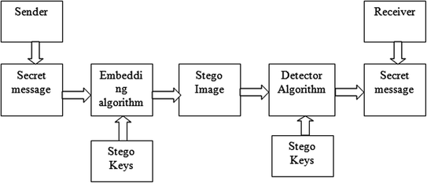
Block diagram
13/03/2020
Concealing of data in digital images

Slide 8
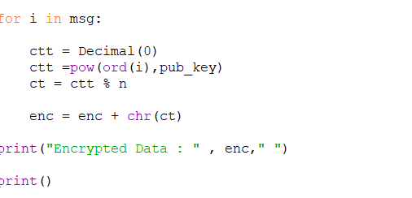
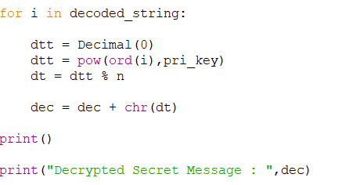
Code Snapshot of Encryption
and Decryption
E
C
13/03/2020
Concealing of data in digital images

Slide 9
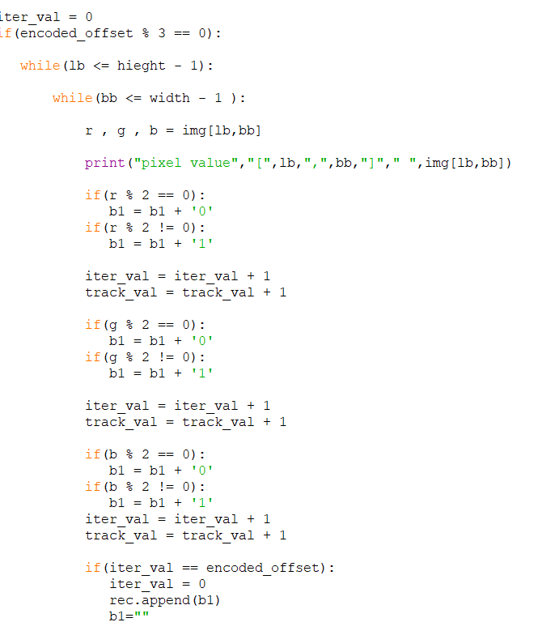
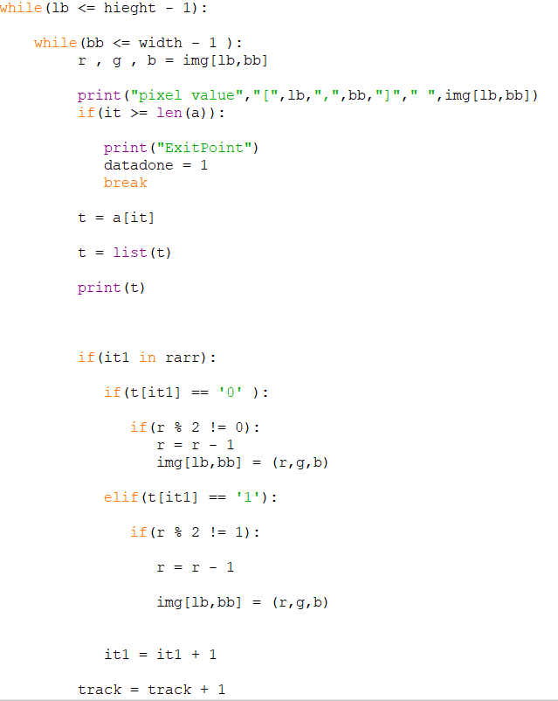
Code Snapshot of Encoding
and Decoding
E
C
13/03/2020
Concealing of data in digital images

Slide 10
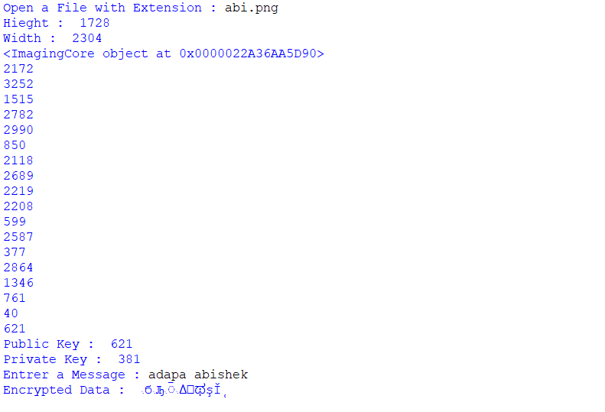
INPUT
E
C
13/03/2020
Concealing of data in digital images

Slide 11
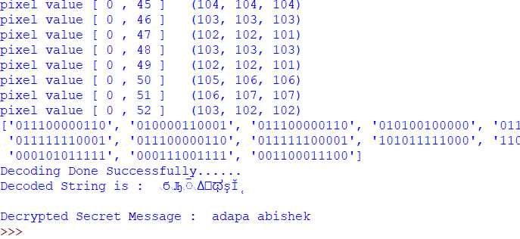
OUTPUT
E
C
13/03/2020
Concealing of data in digital images

Slide 12

INPUT Image v/s OUTPUT Image
E
C
13/03/2020
Concealing of data in digital images

Slide 13
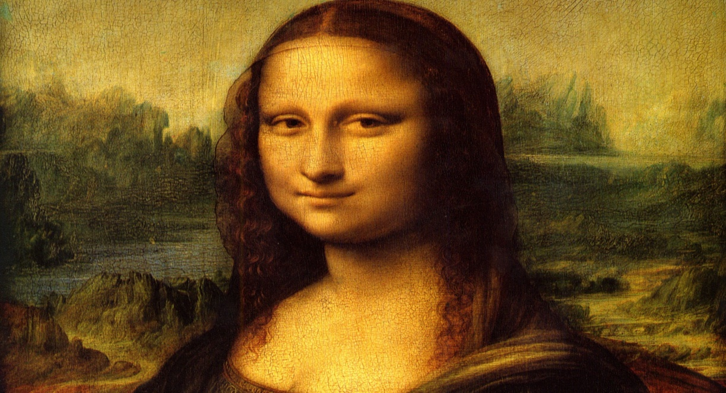
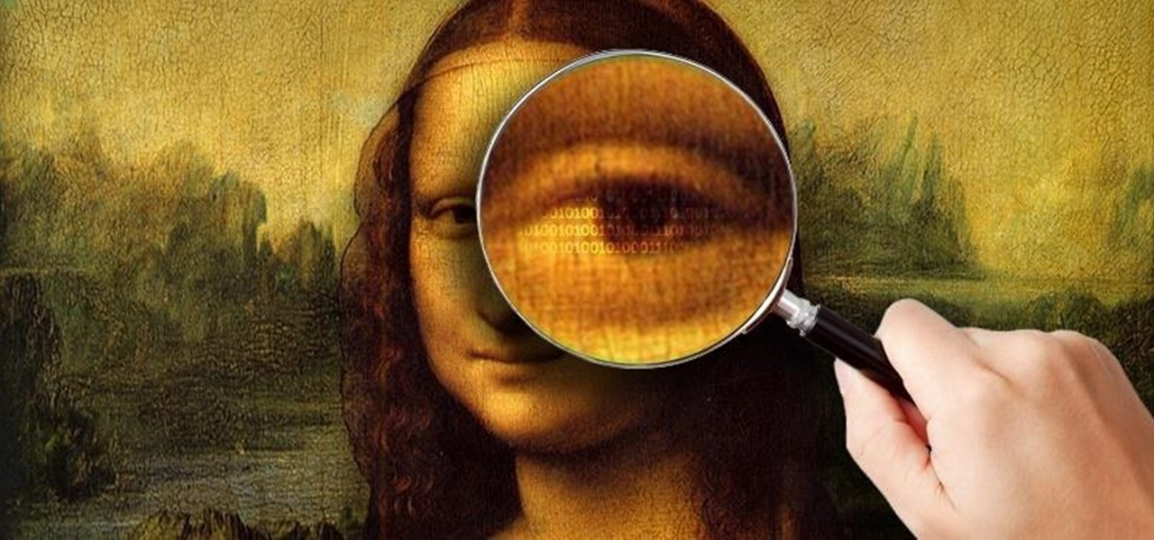
Image vs Stego Image
13/03/2020
Concealing of data in digital images

Slide 14
System Requirements for Model
Software requirement
  Visual Studio Code
  Python 3.6
Hardware requirement
  Intel i5 processor
  8GB RAM
  HDD of 10GB or more
28/02/2020
Concealing of data in digital images

Slide 15
Progress
Work done
  Pre Processing
  Encryption & Encoding
  Decryption & Decoding
Work pending
  Testing
  Debugging
28/02/2020
Concealing of data in digital images

Slide 16
Roles and Responsibilities of the Team members
Karthikeyan S
  Preprocessing
  Testing
Abishek Adapa
  Encryption of Data onto the Image
  Decryption of Data from the Image
Akash M
  Application Development
  Debugging
28/02/2020
Concealing of data in digital images

Slide 17
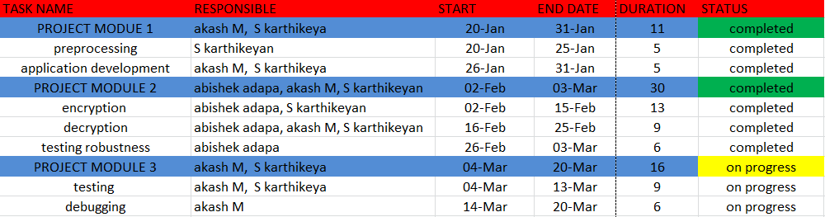
Timeline of the Project
START DATE : 20-JAN
END DATE : 20-MAR
PROGRESS : 90%
28/02/2020
Concealing of data in digital images

Slide 18
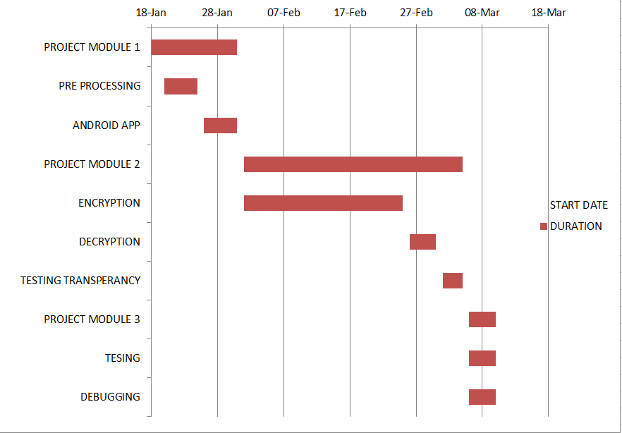
GANTT CHART
28/02/2020
Concealing of data in digital images

Slide 19
References
Best free steganography program (i.e. hide files within other files)', 2013.
B. Dunbar, 'A detailed look at Steganographic Techniques and their use in an Open-Systems Environment', Sans Institute: Information Security Reading Room, 2002.
J. Judge, 'Steganography: Past, Present, Future', Sans.org, 2001
A. Davidson, 'Java Art Chapter 6. Steganography'
28/02/2020
Concealing of data in digital images

Slide 20
Thank you!
28/02/2020
Concealing of data in digital images

