Slide 1

Logistic Regression
Ishwar K Sethi

Slide 2
Logistic Regression
Despite its name, the logistic regression model is for classification and not for regression
To see why such a name, let’s look at the linear regression model:
y = a₀ + a₁ x₁ + a₂ x₂ + …………………… + a_{k} x_{k}
In regression, the dependent variable is a numerical variable. But let’s take the situation where the dependent variable is a categorical variable representing class labels, i.e., for example good vs bad customers
For such a situation, the dependent variable must remain between 0-1.

Slide 3
Logistic Regression
Let’s look at the following expression
The quantity p will always lie in the range 0-1 and thus can be interpreted as the probability of outcome y being good or bad
The ratio p/(1-p) is called odds.

Slide 4

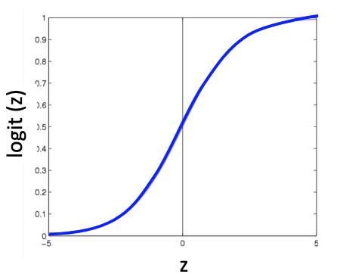
Logistic Regression
Also
The plotted function is known as logistic function.
Thus, the name logistic regression
Z

Slide 5
Logistic Regression
By simple rewriting, we get:
log(p/(1-p)) = a₀ + a₁x₁ + a₂x₂ +··· + a_{k}x_{k}
This ratio is called log odds
The parameters of the logistic model are determined using the likelihood maximization-based cost function optimized via gradient search
Logistic regression results in a linear boundary

Slide 6
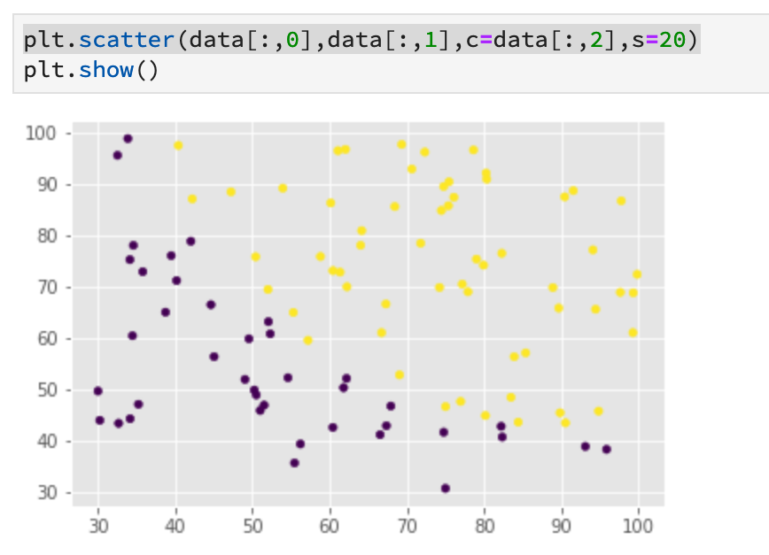
Python Example using 2-D Data

Slide 7
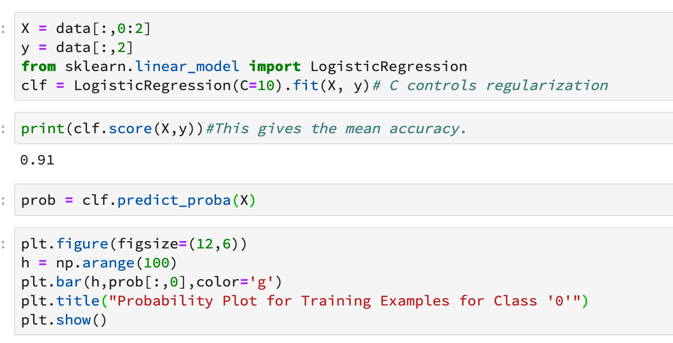

Slide 8
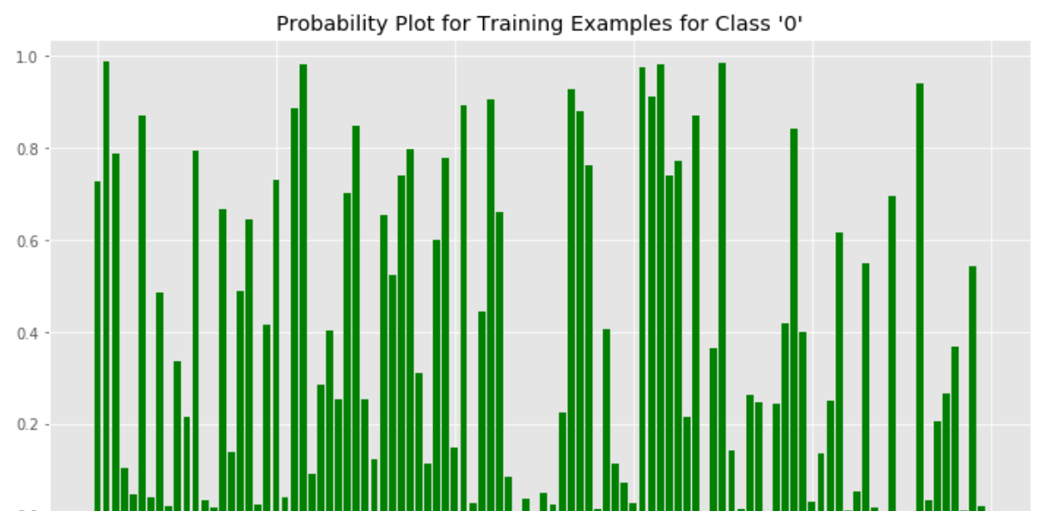
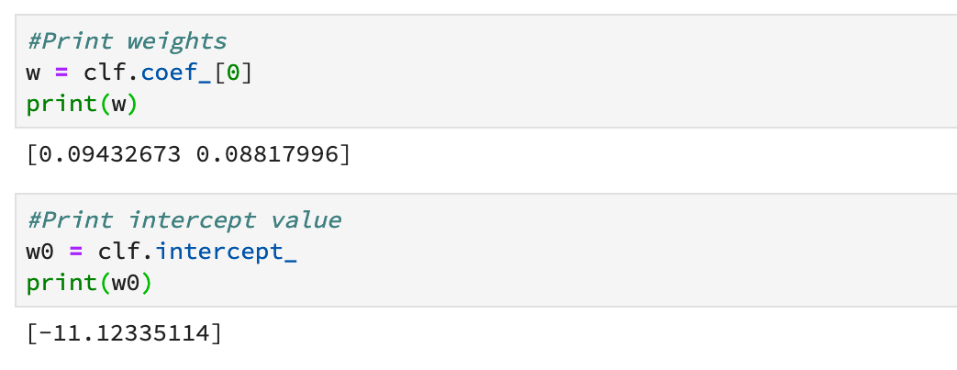

Slide 9
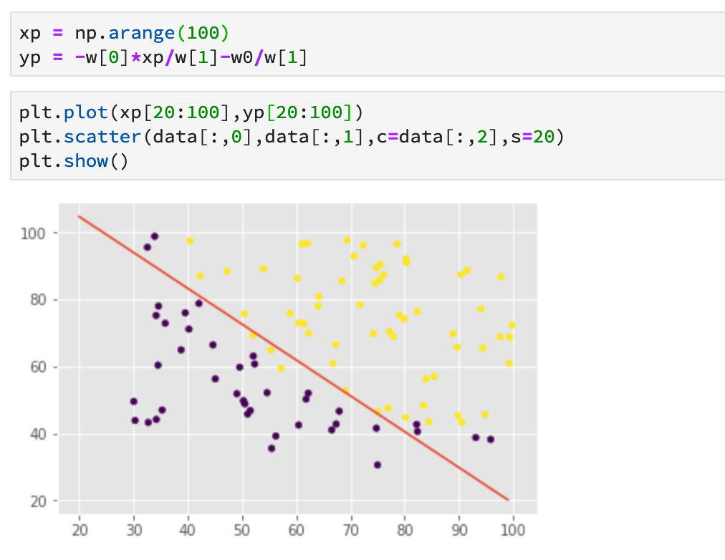
Logistic regression is identical to a single neuron classifier with sigmoidal nonlinearity

