Slide 1

Support Vector Machines
Ishwar K Sethi

Slide 2
Support Vector Machine (SVM)
Which of the linear boundaries is better?

Slide 3
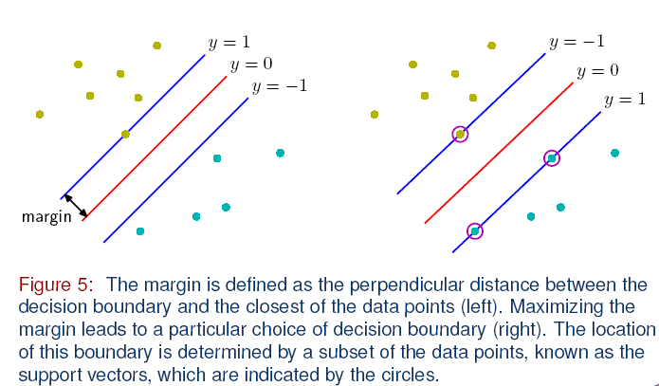
Support Vector Machine (SVM)
Why not look for a “fat line” to provide for some margin across the decision boundary?
Support vectors

Slide 4
Support Vector Machine (SVM)
Distance from example x_{i} to the separator is
Examples closest to the hyperplane are support vectors.
Margin ρ of the separator is the distance between support vectors.
ρ
Intuitively, maximizing the margin is good
r
Training examples other than support vectors are not important
ρ = 1/||w||

Slide 5
Linear SVM (How to find the support vectors?)
The support vectors are found via optimization by minimizing a function using hinge loss
Of course, supervised learning is used.
When the training set is not linearly separable, Slack variables ξ_{i} can be added to allow misclassification of difficult or noisy examples. The resulting margin is called soft margin.
ξ_{i}
ξ_{i}

Slide 6
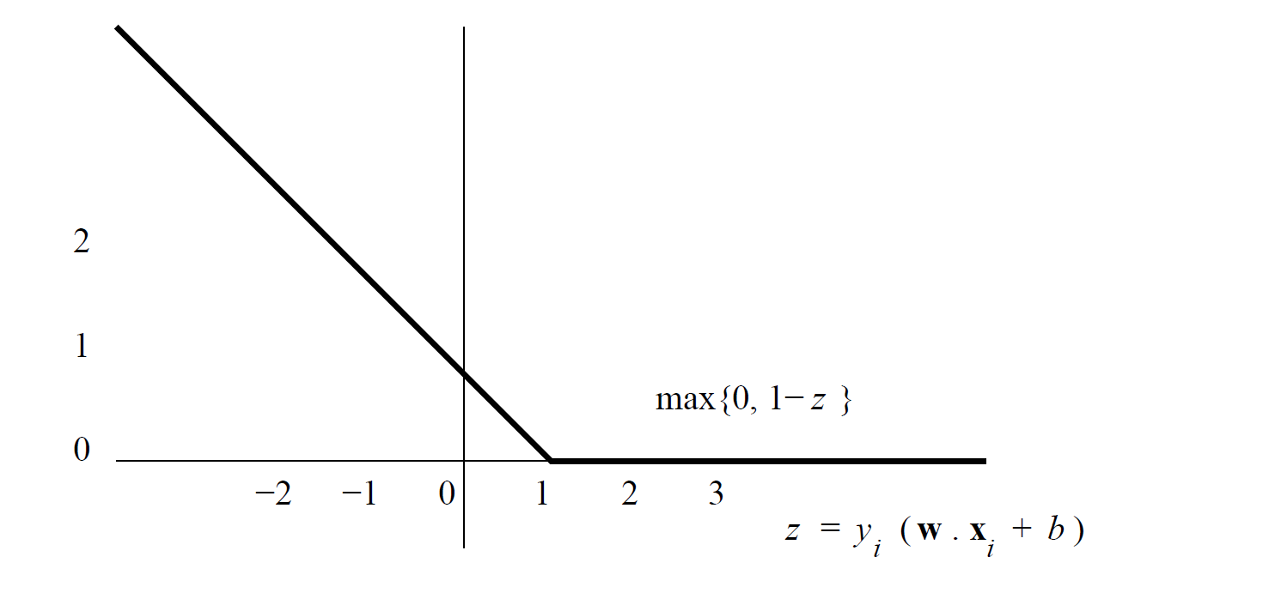
Hinge Loss Function
Given a training set (x1, y1), (x2, y2), . . . , (xn, yn), minimize ||w|| (by vary-
ing w and b) subject to the constraint that for all i = 1, 2, . . . , n,
yi(w.xi + b) ≥ 1

Slide 7
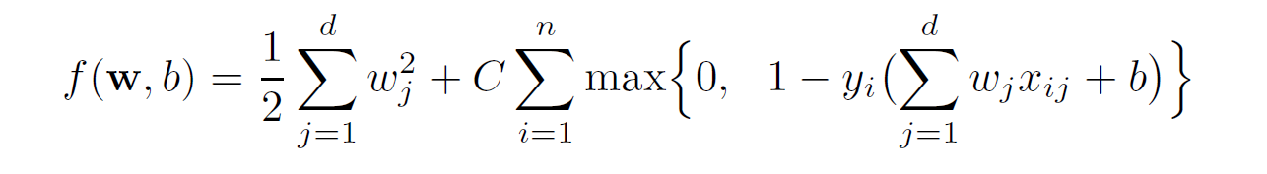
Hinge Loss Function Based SVM Objective
It turns out that minimizing ||w||^2/2 produces results. The second term accounts for the hinge loss and C is a regularization term.

Slide 8
Nonlinear SVM
Most interesting problems are nonlinear
Use a mapping to a higher dimensional space wherein the boundary may be linear
The linear classifier relies on inner product between vectors K(x_{i},x_{j})=x_{i}^{T}x_{j}
If every data point is mapped into high-dimensional space via some transformation Φ: x → φ(x), the inner product becomes:
K(x_{i},x_{j})= φ(x_{i}) ^{T}φ(x_{j})

Slide 9
Nonlinear SVM (Kernel Trick)
Consider the following example:
2-dimensional vectors x=[x₁ x₂]; let K(x_{i},x_{j})=(1 + x_{i}^{T}x_{j})²,
K(x_{i},x_{j})=(1 + x_{i}^{T}x_{j})²,= 1+ x_{i1}²x_{j1}² + 2 x_{i1}x_{j1} x_{i2}x_{j2}+ x_{i2}²x_{j2}² + 2x_{i1}x_{j1} + 2x_{i2}x_{j2}=
= [1 x_{i1}² √2 x_{i1}x_{i2} x_{i2}² √2x_{i1} √2x_{i2}]^{T} [1 x_{j1}² √2 x_{j1}x_{j2} x_{j2}² √2x_{j1} √2x_{j2}]
= φ(x_{i}) ^{T}φ(x_{j}), where φ(x) = [1 x₁² √2 x₁x₂ x₂² √2x₁ √2x₂]
Let φ(x) = [1 x₁² √2 x₁x₂ x₂² √2x₁ √2x₂], then K(x_{i},x_{j})= φ(x_{i}) ^{T}φ(x_{j})
The function φ(x) with the property K(x_{i},x_{j})= φ(x_{i}) ^{T}φ(x_{j}) are known as kernel functions
Using a kernel function for high dimensional space mapping implicitly maps data to a high-dimensional space without the need to compute each φ(x) explicitly. Thus, the term kernel trick.

Slide 10
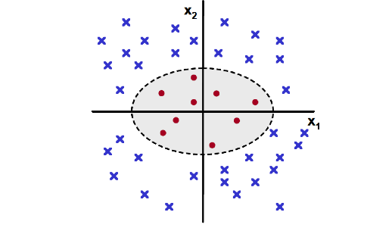
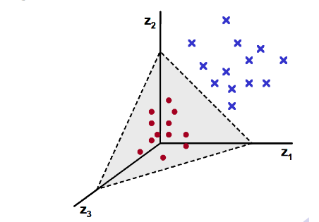
Kernel Example (1)
Original two-dimensional space with patterns from two classes
Mapped three-dimensional space with z₁=x₁², z₂= √2x₁x₂, and z₃=x₂². The data is linearly separable in this space.

Slide 11
Kernel Examples
Gaussian Radial Basis Function Kernel
d stands for Euclidean distance; sigma a parameter
Sigmoid Kernel
Alpha (called gain) and theta (called threshold) are parameters. It does not satisfy the Mercer condition for all parameter values

