Slide 1

Decision Tree Classifiers
Ishwar K Sethi

Slide 2
Decision Tree Classifiers (DCT)
The classifier has a tree structure where each node is either:
A leaf/terminal node with a class label, or
An internal node indicating some test to be carried out on the example passing through it
Most tree classifiers use a single attribute-based test at internal nodes
These classifiers are intuitive and easy to understand

Slide 3
A Simple DTC Example
Sender in Address Book?
Y | N
Read Email
Does it contain words from Spam list?
Y | N
Delete
Email
Read Email

Slide 4
Another Example of a Decision Tree
categorical
categorical
continuous
class
Splitting Attributes
Attributes involved in a test split the data. These are shown in yellow. Leaf/terminal nodes in blue.
Refund
Yes
No
NO
MarSt
Single, Divorced
Married
TaxInc
NO
< 80K
> 80K
NO
YES
Training Data

Slide 5
Building Decision Trees aka DT Induction
A two-phase procedure consisting of growing and pruning
The growth phase searches for successive splits to divide training examples into smaller subsets of increasing purity or homogeneity in a top-down greedy manner
Splitting is generally done by finding an attribute-value pair that maximizes some purity criterion

Slide 6
Decision Tree Induction
Many Algorithms:
AMIG (Average Mutual Information Gain)
CART (Classification and Regression Trees)
ID3, C4.5
Perceptron Tree

Slide 7
Tree Induction
Issues in tree growing
Determine how to split the records
How to specify the attribute test condition?
How to determine the best split?
Determine when to stop splitting

Slide 8
How to Specify A Test (Splitting) Condition?
Depends on attribute types
Nominal
Ordinal
Continuous
Depends on number of ways to split
2-way split
Multi-way split

Slide 9
Splitting Based on Nominal Attributes
Multi-way split: Use as many partitions as distinct values.
Binary split: Divides values into two subsets. Need to find optimal partitioning.
CarType
Family
Luxury
Sports
CarType
CarType
{Sports, Luxury}
OR
{Family, Luxury}
{Family}
{Sports}

Slide 10
Splitting Based on Ordinal Attributes
Multi-way split: Use as many partitions as distinct values.
Binary split: Divides values into two subsets.
Need to find optimal partitioning.
Size
Small
Large
Medium
Size
Size
{Small, Medium}
OR
{Medium, Large}
{Large}
{Small}

Slide 11
Splitting Based on Continuous Attributes
Different ways of handling
Discretization to form an ordinal categorical attribute
Static – discretize once at the beginning
Dynamic – ranges can be found by equal interval bucketing, equal frequency bucketing (percentiles), or clustering.
Binary Decision: (A < v) or (A ≥ v)
consider all possible splits and finds the best cut

Slide 12
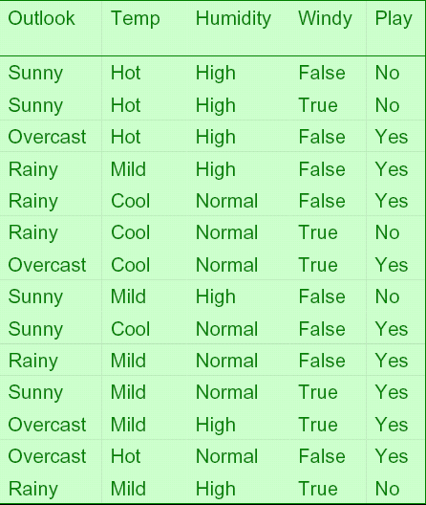
A Simple Example of Tree Building
Training data consisting of four features, two classes

Slide 13
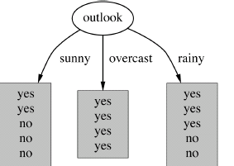
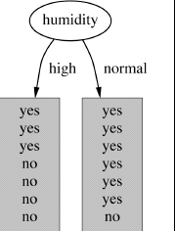
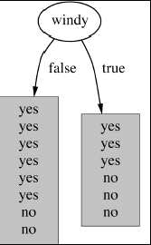
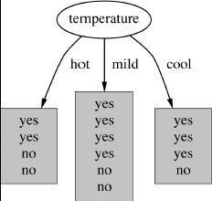
Which attribute to select?
Four possibilities at the starting node

Slide 14
Measuring Split Quality
Select an attribute that is likely to result in a smaller tree
Small tree is likely to result from splits that are “purer”
Use a purity measure

Slide 15
A Measure of Purity: Information Gain
Let’s look at entropy first. Entropy is a measure of uncertainty. Let’s look at three jars with balls. Think of your action as blindly pulling out a red ball from each of the jar. For the left most jar, the uncertainty about the pulled ball being red is very little while it is much more for the right most jar. The entropy measure captures this notion of uncertainty. This is defined as shown below. The numbers p_{1,} p_{2,…,} p_{n} represent the probabilities of different outcomes or the states of the system.
In our example, we have two states/outcomes for each jar. Plugging in the numbers, we get
Entropy of the leftmost jar = -0.1log0.1 – 0.9log0.9 =>
Entropy of the center jar = -0.3log0.3 – 0.7log0.7 =>
Entropy of the rightmost jar = -0.5log0.5 – 0.5log0.5 =>
0.14118174
0.265295
0.30103
We see that the action of blindly pulling a red ball has most uncertainty for the rightmost jar. Also, a low value of entropy means more purity. The above entropy calculations were done using base 10. When using base 2, the entropy is measured in bits.

Slide 16
Information Gain
Going back to the example of the previous slide, what we calculated was the entropy before the intended action.
Once, a ball has been pulled out from a jar, the probabilities of outcomes change. This means the entropy associated with each jar changes.
Information gain is then nothing but the difference between two entropies. It tells us how the uncertainty/purity is going to change as a result of a planned action.

Slide 17
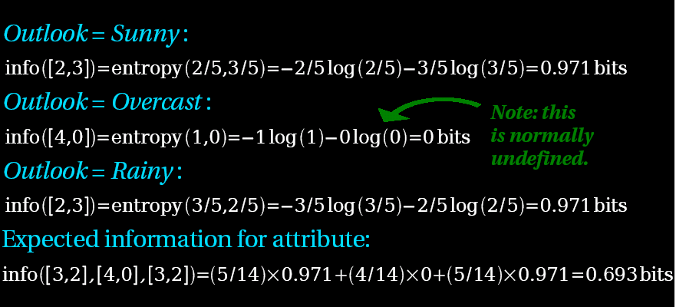
Calculating Information Gain for the Play/No-Play Example
Entropy of the attribute “Outlook”

Slide 18
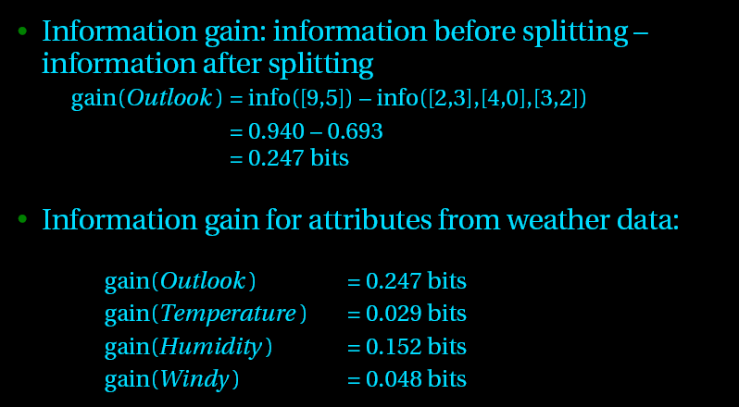
Information Gains Based on Different Splits
We see that the attribute “Outlook” provides the most gain. Thus, it is the preferred attribute to split the data.

Slide 19
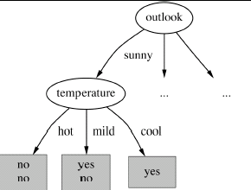
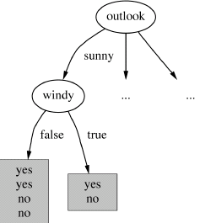
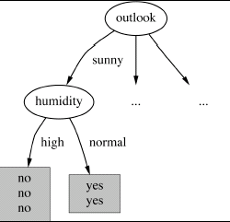
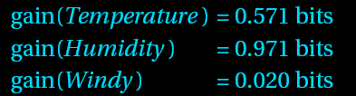
Now let’s look at three attributes for splitting at the leftmost descendent node after using “Outlook” at the previous node.
Continuing with similar calculations at the other two descendent nodes, we arrive at the final decision tree shown in the next slide.

Slide 20
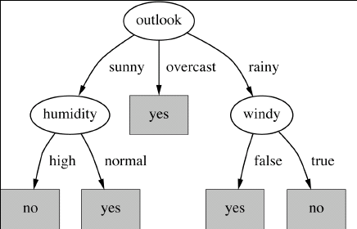
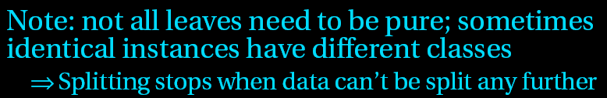
Final Decision Tree

Slide 21
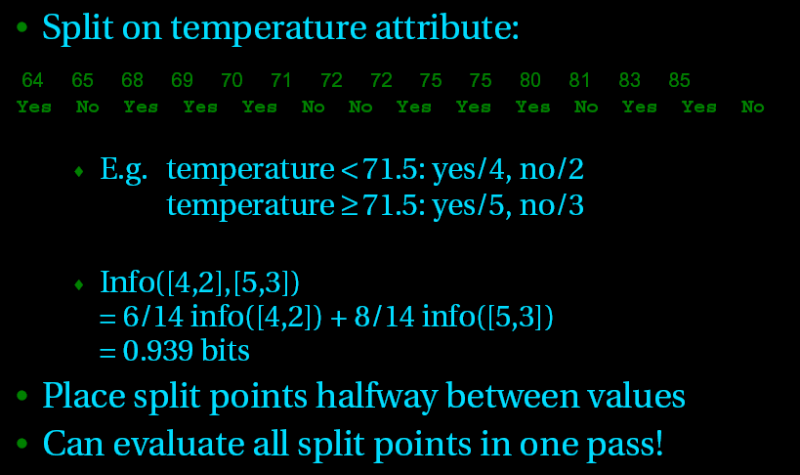
Finding Splits on Numerical Attributes
When working with continuous attributes, we sort the attribute values and create an array of associated labels.

Slide 22


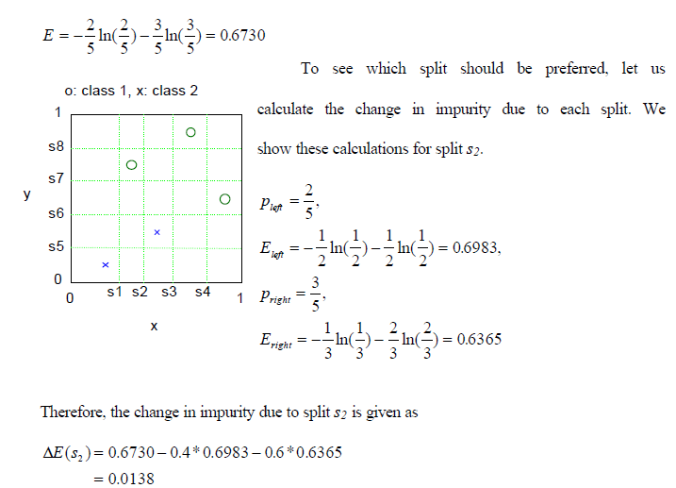
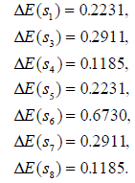
Entropy Measure for Splits’ Quality: An Example with Continuous Attributes
Best split: S₆

Slide 23
GINI Measure of Impurity
Another popular measure is Gini Index for a given node t :
(NOTE: p( j | t) is the relative frequency of class j at node t).
Maximum (1 - 1/n_{c}) when records are equally distributed among all classes, implying least interesting information
Minimum (0.0) when all records belong to one class, implying most interesting information
The Gini index, or Gini coefficient, is a measure of the distribution of income across a population developed by the Italian statistician Corrado Gini in 1912. It is often used as a gauge of economic inequality, measuring income distribution or, less commonly, wealth distribution among a population.

Slide 24



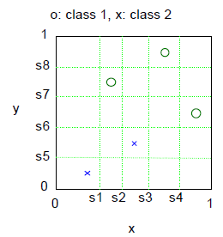
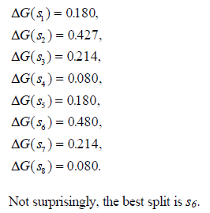
GINI Measure of Impurity

Slide 25
Stopping Criteria for Tree Induction
Stop expanding a node when all the records belong to the same class
Stop expanding a node when all the records have similar attribute values

Slide 26
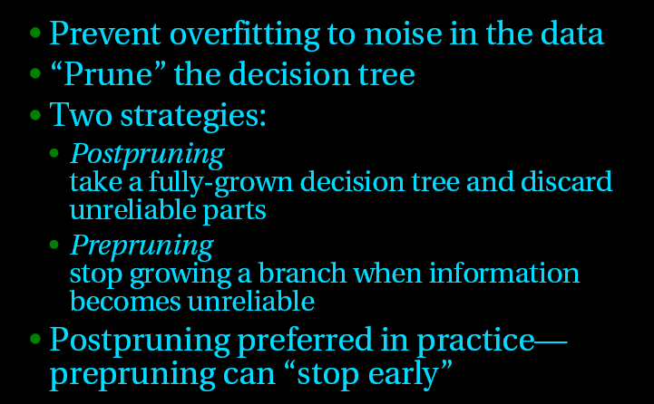
Pruning for Right Size Tree
If we keep splitting and growing the tree, we are likely to end with a decision tree customized for that particular dataset that is being used to grow the tree. This means overfitting and likely poor performance in practice.

Slide 27
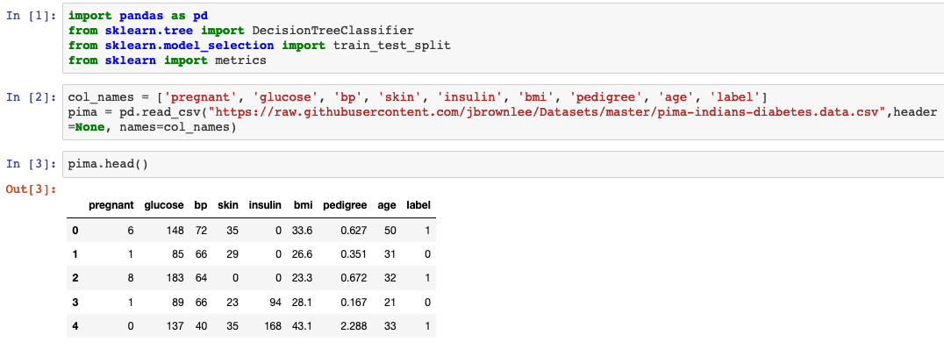
DT Classification Example
Pima Indian Diabetes dataset consisting of 8 features and 2 classes. 768 examples with 268 in Class 1
Getting data and defining column names

Slide 28
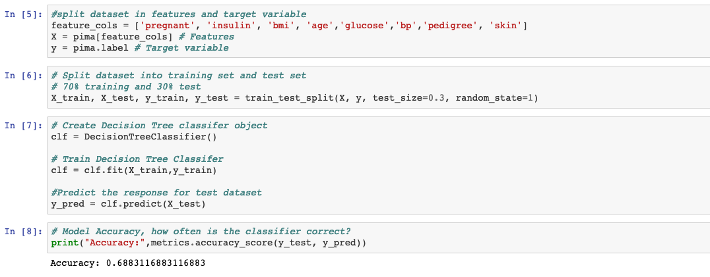
This is the accuracy of the DT built using default parameters in sklearn. This tree is fully grown (shown in the next slide) and overfitted.

Slide 29
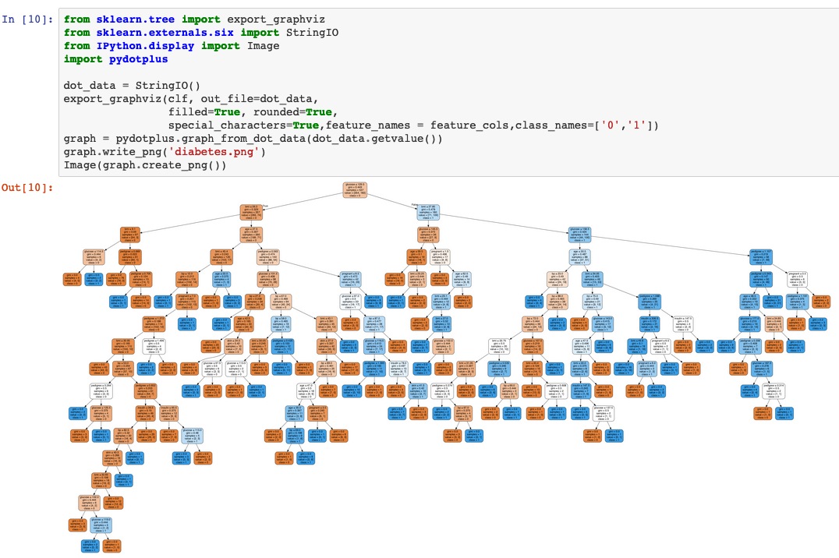
We should never use such an overfitted tree.

Slide 30
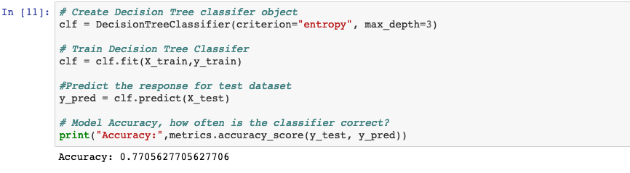
This creates a smaller tree (shown in next slide) with maximum depth of 3, meaning at most 7 internal nodes. You can see this tree performs better on the test data.

Slide 31
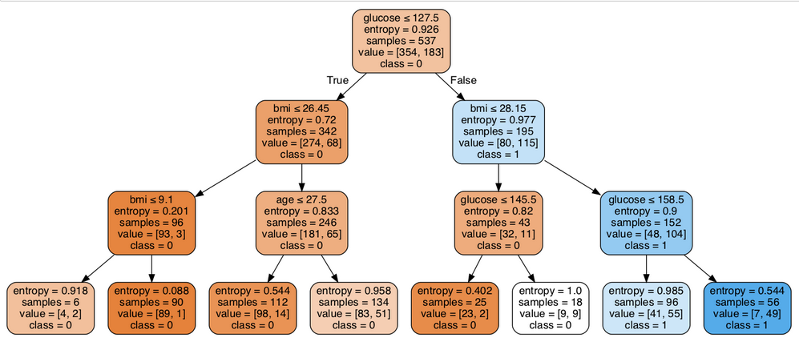

Slide 32
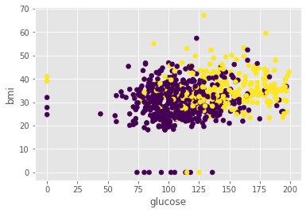
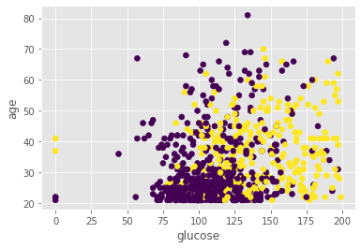
Understanding the top-level splits of the resulting DT

Slide 33
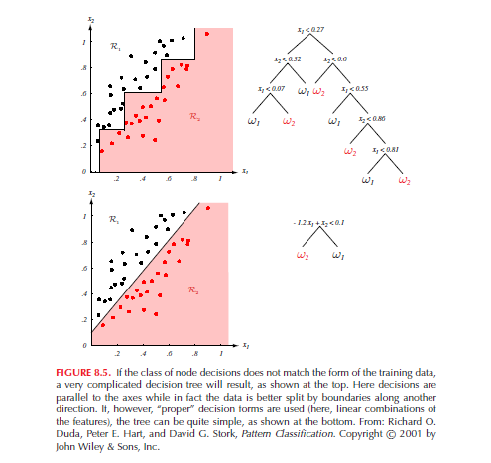
Multifeature Splits

Slide 34
DTC Strengths
Intuitive, easy to comprehend
Fast classification
Can deal with continuous and categorical attributes
Built in attribute selection [All attributes may not appear in the final tree]

Slide 35
DTC Weaknesses
Prone to errors due to noise in attributes
May not yield good performance with single feature splits
Can over-fit if not pruned properly
May mask important relationships because of greedy top-down search while building the tree [https://iksinc.online/2013/04/06/best-split-doesnt-necessarily-produce-the-best-decision-tree/]

Slide 36
Summary of Classifier Building Methods
Both linear and nonlinear models can be built
Overfitting needs to be avoided
Hyper-parameter tuning may be needed
Most methods discussed can also be used for regression

