Slide 1
Project
Recognizing Faces and Traffic Signs: An Application of PCA/SVD

Slide 2
Assignment Goal
Build a face recognition demo using Eigenfaces approach
Extend the concept to another domain, for example traffic sign recognition

Slide 3
Assignment Steps: Step1
You will collect your own images of 10-20 persons for this project. Suggested personalities: Your family and friends, Cricket Players, Movie personalities]
Collect at least 12-15 images per person, use 10-12 for building the model and rest for testing

Slide 4
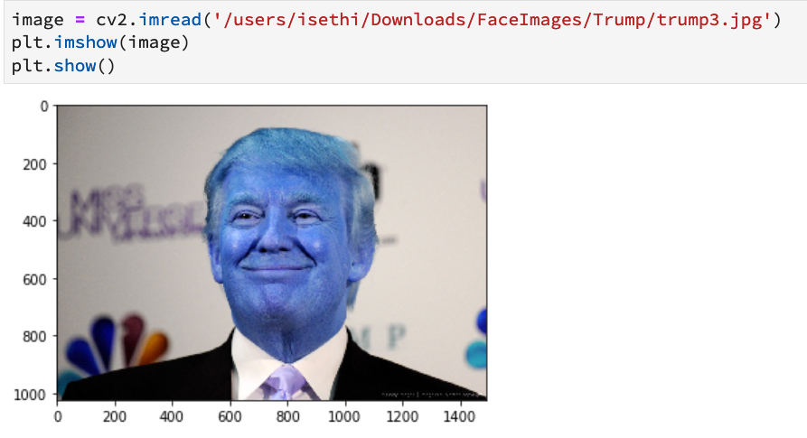
Assignment Steps: Step2
Install OpenCV if not already installed
Opencv will be used for reading/writing images as well as for detecting faces in images

Slide 5
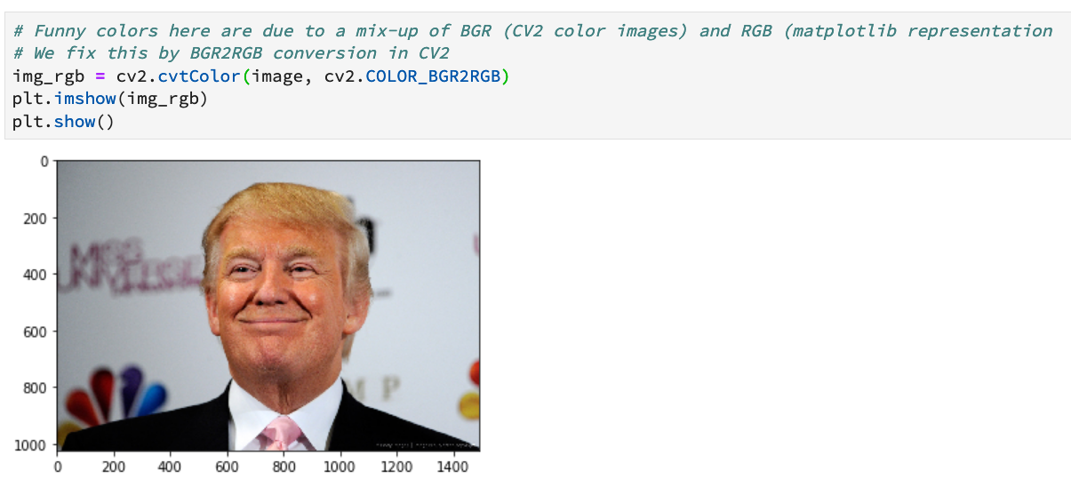

Slide 6
Assignment Steps: Step3
After reading images, you need to detect and locate faces in images
This will be done using Haarcascade face detector. You will need to download the corresponding file from opencv. The file is: haarcascade_frontalface_alt.xml
This face detector works on gray images. So you will convert images to gray images before applying face detector.

Slide 7
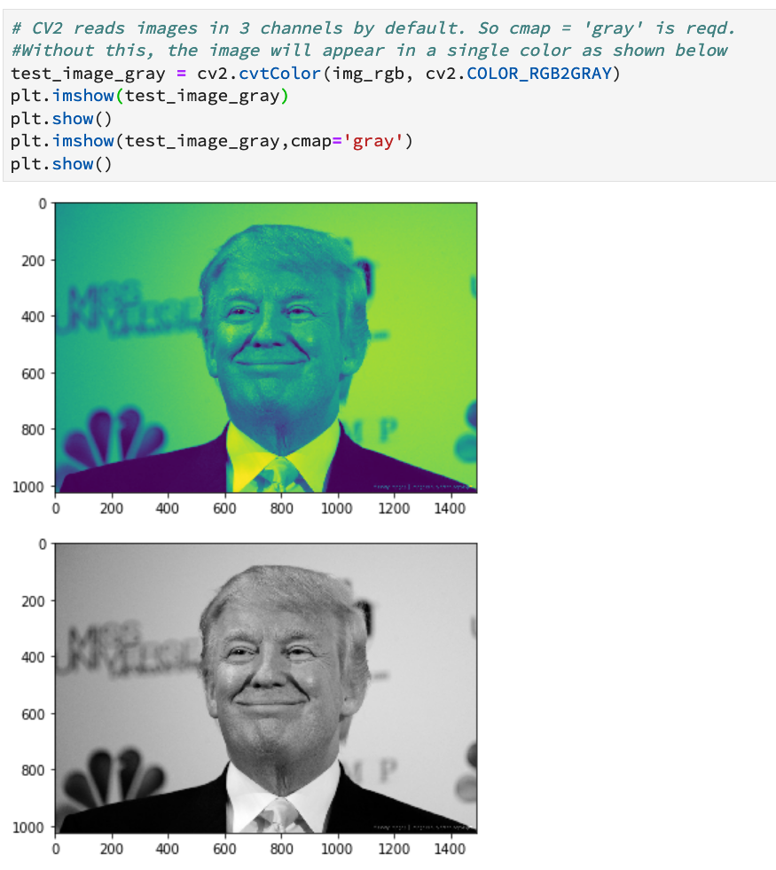

Slide 8
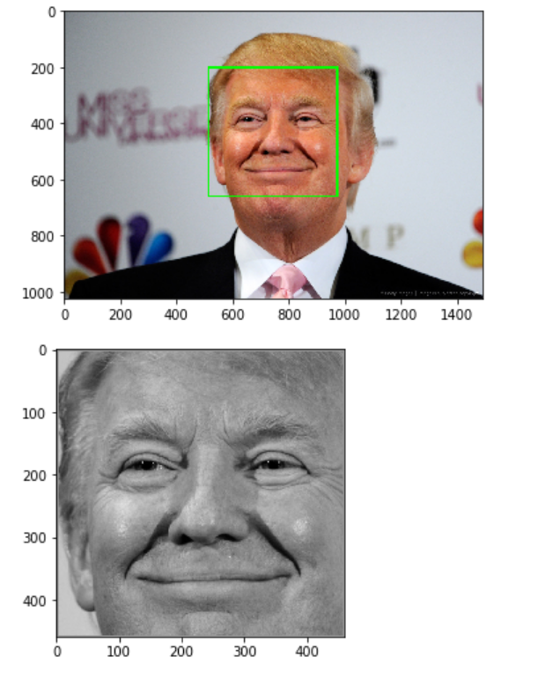
Assignment Steps: Step4
Detect faces in downloaded images and extract cropped faces

Slide 9
Step 5
Use the extracted cropped faces as your data for PCA and obtain a 5-dimensional representation for each face image
Take the test images, extract faces in gray. Using the PCA transformation obtained earlier, get the 5-dimensional representation for every test image
Apply 1-NN classification to perform recognition.

Slide 10
Step 6
Locate another domain to perform recognition using the same idea of eigenfaces.
One potential domain is traffic sign recognition. The link below can be used for downloading images.
http://benchmark.ini.rub.de/?section=gtsrb&subsection=dataset
Another potential domain is action recognition. Use the link below to get data.
http://vision.stanford.edu/Datasets/40actions.html

