Slide 1
Project 1: Sales Data Analysis
-Abishek Ganesh
Under Dr Kay Yut Chen

Slide 2
Data Description
Dataset: Project1.11.csv
Data Summary:

Slide 3
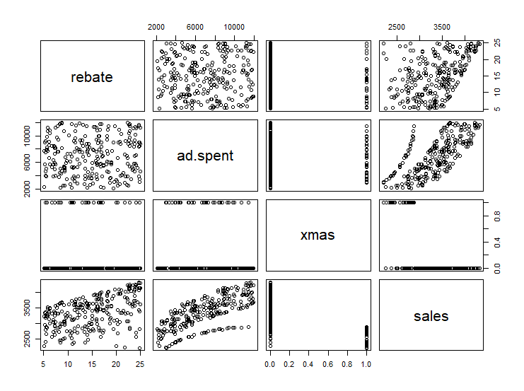

Slide 4
Beta & P Values
Bootstrapped: 1000
B0 (Intercept) | B1 (rebate) | B2 (adspent) | B3 (xmas) | B4 (rebate*adspent) | B5 (adspend*xmas) | B6 (rebate*xmas) | r1 | r2
312.1931 | -13.4404 | 43.1998 | -113.0556 | 0.0069 | -0.0223 | -35.8796 | 0.02091 | 0.01673
0.04 | 0.02 | 0 | 0.01 | 0.45 | 0 | 0.1 | 0 | 0

Slide 5
Full Model
sales = 312.1931 -13.44039* ((1-e ⁻ ^{0.02091*rebate})/ 0.02091)
+ 43.1998*((1-e ⁻ ^{0.01673*adspent})/ 0.01673) -113.0556*dxmas
+ 0.0069*rebate*adspent - 0.0223*adspent*dxmas
-35.8796*rebate*xmas

Slide 6
Selected Model
sales = 312.1931 -13.44039* ((1-e ⁻ ^{0.02091*rebate})/ 0.02091)
+ 43.1998*((1-e ⁻ ^{0.01673*adspent})/ 0.01673) -113.0556*dxmas
- 0.0223*adspent*dxmas

Slide 7
Interpretation
We are having a 43.2 dollars for every dollar we invest in advertising.
The sales is lower by 0.0223 for every dollar we invest in ad during xmas. But over all we have a positive sales.
Xmas days is negatively affecting or sales ie. The sales in not as high as the non-Xmas days

Slide 8
Insights
Investment in rebate is not yield a positive return as it negatively affecting the sales so we can reduce the investment in the rebate
We are having higher sales when its not a special day. This could be investigated further.
Consider having a different strategy during for xmas.

