Slide 1
Spark Structured Streaming Basics
Data Savvy

Slide 2



What is Streaming

Slide 3
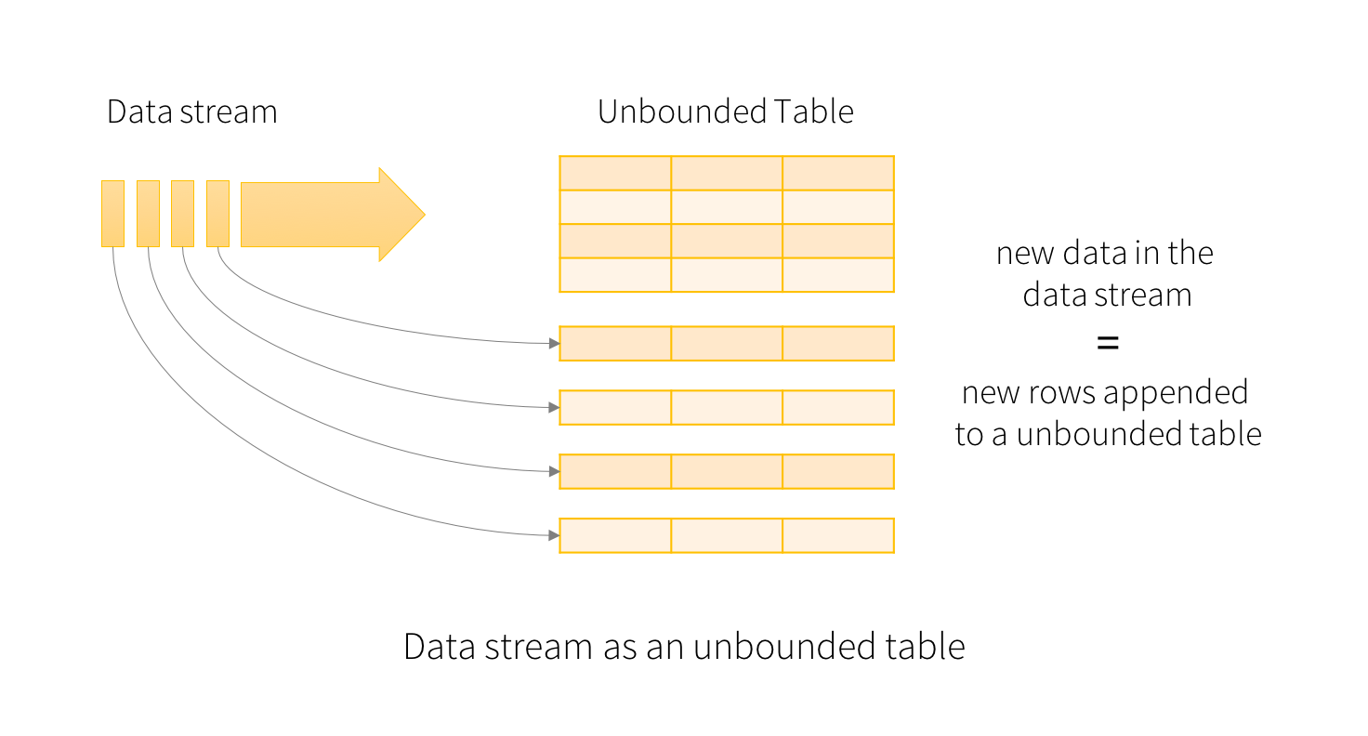
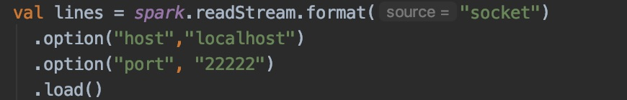
Unbounded Table

Slide 4
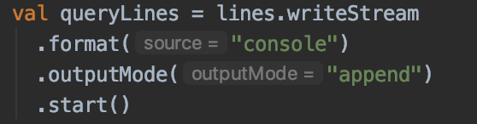
Write Modes
Complete
The entire updated Result Table will be written to the external storage
Append
Only the new rows appended in the Result Table
Update
Only the rows that were updated in the Result Table

Slide 5
Thanks

