Slide 1

2024 PARIS OLYMPICS PERFORMANCE ANALYSIS

Slide 2

TABLE OF CONTENT
Report Title
Primary Objectives
Dashboard Overview
Dashboard Overview Introduction
Key Findings
Observation
Insights
Conclusion
Recommendations

Slide 3
Report Title: Analysis of the 2024 Paris Summer Olympics
(Stakeholder Report)
Audience: Sports analysts, IOC representatives, National Olympic Committees (NOCs)
Tooling: Power BI (Power Query, DAX), Star-schema model
Data Sources: medals_total.csv, athletes.csv, events.csv, coaches.csv, noc.csv (and any related lookup tables)
Purpose: This report explains the key visuals and insights from the Power BI dashboard on the 2024 Paris Summer Olympics. It helps stakeholders understand medal distributions, athlete participation, and trends. The data has been modeled in a star schema to support flexible and interactive analysis.

Slide 4
Primary Objectives
This analysis was conducted to:
1. Evaluate overall performance patterns across participating nations in the 2024 Paris Olympics
2. Identify demographic trends in athlete participation and medal achievement
3. Assess gender equity progress in Olympic competition
4.Analyze sport specific participation and performance metrics.

Slide 5
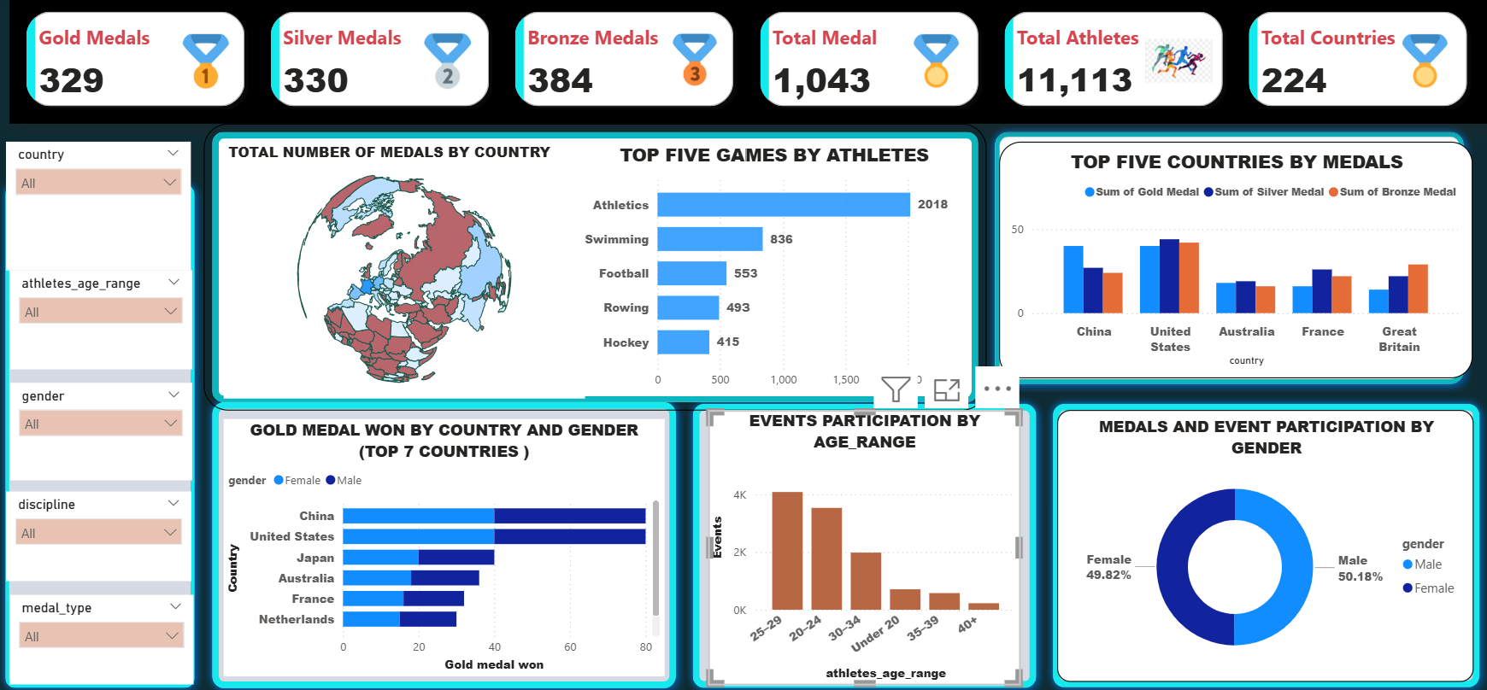
Dashboard Overview

Slide 6
1. The dashboard is divided into sections viewing from top left to bottom right
3. Bar charts for top sports with athletes participation, Stacked charts for gold medals by gender,
2. The Dashboard starts with the KPI’s, a world map for total medals by country,
4. And column charts for age range participation in events and pie chart for gender participation in event.
Dashboard Introduction

Slide 7
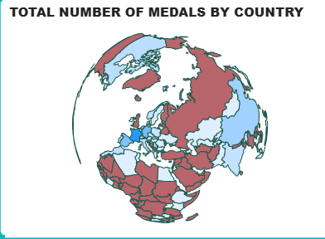
Key Findings
(1) Total Number of Medals by Country (Global Medal Distribution)
observation:
Top Performers: United States (126 medals), China (91), Great Britain (65).
Regional Trends: North America and Asia dominate, with Europe showing strong but distributed performance.
Total Medals: 1,043 awarded across 92 countries.
Insights :This map provides a geographic overview of medals won. Hovering over countries reveals exact totals. The US and China lead, highlighting their investment in sports infrastructure.
  Visual Description: A choropleth map showing total medals won by each country, with color intensity representing medal count (darker shades for higher totals).

Slide 8
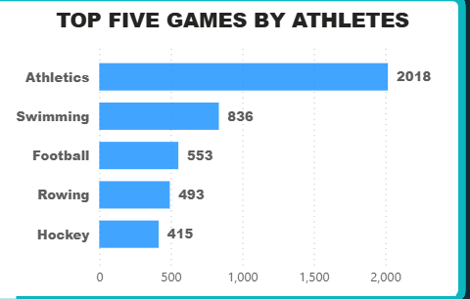
(2) Top Five Games by Athletes
Observation:
Athletics dominates with 2,018 total events/participants
Swimming shows strong engagement with 836 participants
Football maintains significant presence with 553 participants
Rowing and Hockey complete the top five most participated sports
Insights: The chart highlights games with the largest athlete pools. Athletics stands out due to its variety of events, suggesting opportunities for broader talent development.

Slide 9
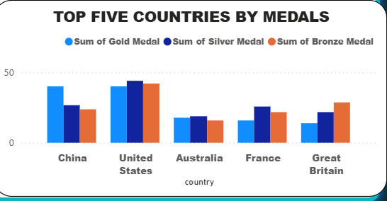
(3) Top Five Countries by Medals
Insights: Here, we see the medal breakdown for top countries. The US excels across all types of medals revealing the countries investment in athletes training and infrastructure, while China focuses on gold, reflecting strategic training emphases.
United States: Overall leader (126 total, 40 gold).
Australia: Strong performance (53 total).
France (host): 64 total.
Great Britain: 65 total.
Trend: Balanced medal types indicate versatile athletic programs.
China: High gold count (40), balanced medals.

Slide 10
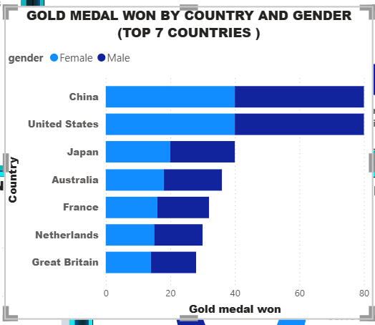
(4) Gold Medal Won by Top 7 Countries on Gender Based
Observation:
Balanced gender performance across all major Olympic nations
China and United States showing similar male-female gold medal ratios
Consistent patterns across different countries, indicating effective gender inclusion in elite sports programs
Insights : This chart reveals gender equity in gold medals aligning with Olympic gender parity goals.

Slide 11
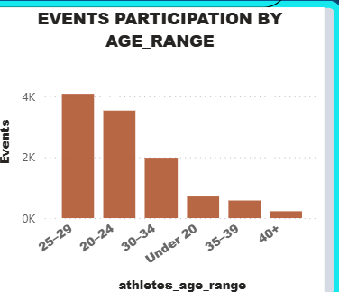
(5) Athlete Events Participation by Age Group
Key Observation:
Peak Age: 25-29 (highest participation).
Trends: Decline after 35; youth (Limited youth participation in Under 20)
Implications: Focus on youth development for future Olympics.
Insights: Participation peaks in the 25-29 range, indicating prime athletic age. This data can guide talent scouting and training programs.

Slide 12
Conclusion
The data-driven insights presented establish a foundation for informed decision-making across Olympic sport development initiatives.
Stakeholders should leverage these findings to optimize talent development strategies, benchmark performance expectations, and allocate resources toward maximum impact areas.
The successful implementation of these evidence-based approaches will contribute to continued Olympic excellence and expanded global participation in elite athletic competition.

Slide 13
RECOMMENDATION
Focus and invest in youth (Under 20) and female programs for future Olympics
Infrastructure investment in countries showing potential for performance improvement
Technology integration for performance optimization and injury prevention
Use dashboard for real-time monitoring in future Olympics.
Analyze underperforming countries for collaboration.

Slide 14
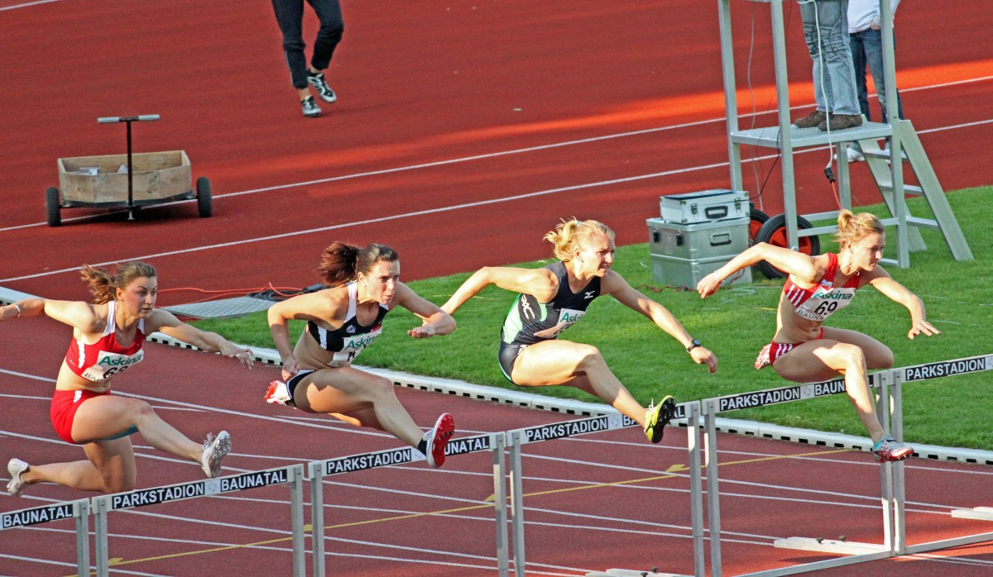

THANK YOU

