Slide 1
INTRODUCTION AND OBJECTIVES
This presentation is built on an exploratory data analysis (EDA) of company registration records, covering the period 2021 to 2025. The dataset includes information on UK-based businesses as well as foreign-registered companies, giving a broad view of business activity across different jurisdictions. By analyzing company registration, turnover, and closure patterns, this study aims to uncover meaningful insights into how businesses are performing over time, and how these trends may indicate tax compliance risks or opportunities for improved policy-making.
Objectives
Analyze trends in turnover, sector stability, and company closures
Highlight potential risks of non-compliance and tax revenue loss
Recommend data-driven actions for HMRC and tax planning
Data Analysis Tools Used: Microsoft Excel (Power Query, Pivot Tables), PowerPoint
Analysis Process: Data loading → Cleaning → Modeling → Analysis → Pivot Table reporting → Visualization → Presentation

Slide 2
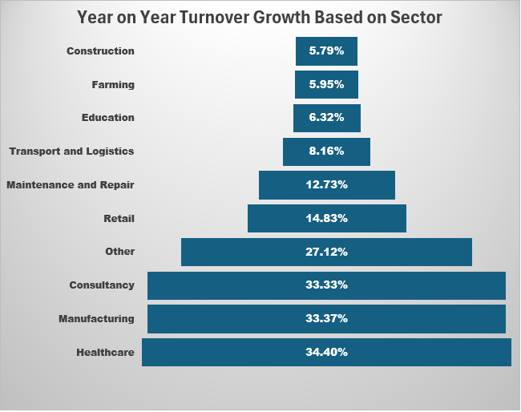
1. Which sector shows the most consistent year-on-year turnover growth or decline?
The Construction Sector demonstrates the most consistent year-on-year turnover trend.
This is based on the lowest standard deviation (5.79%) in its YoY turnover growth figures across 2022 to 2025.
Unlike other sectors that show higher volatility (e.g., Healthcare 34.4%, Manufacturing 33.37%), the construction sector maintained stable performance over time, indicating steady economic activity or resilience to external shocks.

Slide 3
2. What is the MOST common month to incorporate a business? Is this true for all Company Types?
This is not true for all company type as it is observed from the chart that other incorporation month exist apart from the month of march.
The Most Common Month To incorporate a business Is March

Slide 4
3. How has the number of Closed companies changed over time?
Insights
It was observed that lots of businesses shutdown in 1900 ,then from 1983, the number of business closed were moderate < less than 35 yearly. Then a noticeable changes was observed starting from 2019 - 2023 with a spike in year 2022. This could be as a result of Covid 19 (Pandemic)

Slide 5
4. What other conclusions can be drawn from the data. We are particularly interested in trends over time, and comparisons between different geographic areas.
It was observed that new company were incorporated : 3,435 (2021) → 3,893 (2022) → 6,269 (2023) → 6,653 (2024) → 12 (2025 YTD) which Signifies a strong growth
This chart shows where active companies originate from, and from observation: The UK is overwhelmingly the source of registered companies, while very few come from offshore or foreign territories.

Slide 6
Conclusion Recommendation
Use the Construction sector as a benchmark for stable and compliant tax behavior.
Implement real-time tax monitoring or quarterly reminders for volatile sectors like Healthcare and Manufacturing.
Provide early-stage tax education and onboarding for new incorporations, especially in Q1–Q2.
Flag businesses with missing postcodes, as location affects tax rates and obligations.
Investigate Active companies with zero turnover for five years for possible non-compliance or tax avoidance.
Use 2023–2025 turnover trends to forecast future tax revenue and support public budgeting.
Flag low incorporations in 2025 YTD as a potential data quality issue or reporting delay.
The UK is the main location for company registrations, reflecting its strong legal and business environment, while offshore registrations appear to be declining.
Business growth is increasing, especially in the other sector, showing renewed confidence despite recent economic challenges.
COVID-19 had a major impact on business closures, particularly affecting small and newly established companies around 2022.

