Slide 1
SOPHO_HACKERS
Complaint/QUERY CLASSIFICATION APPLICATION

Slide 2
The Motive of Our Application
We are devising a method to decrease the time taken between a complaint / query registration from a customer and the rectification / addressal for the same by the company. In a real life scenario when a consumer registers a complaint he/she is made to do multiple calls to multiple officials, who keep redirecting them. And each time a customer calls someone he/she must repeat the entire description of the complaint/query. This not only consumes a lot of time for the customers, but also reduce the efficiency of officials’ work. Also, the officials need to manually direct the complaint to the respective departments, going through every complaint and also receive many spam calls, which only add to the time and pressure.
We, hence developed a ‘program’ where the complaint is registered by a consumer via a phone call, our software records the call and pulls out the essential information from it (Summarizes it) using Machine Learning / Deep Learning. The caller details are obtained from the bank’s database using the phone number they used to register the complaint. This condensed information is then categorised / classified using the summary, and along with the user’s account details are mapped to the appropriate person (official) for resolving that particular issue, using Machine Learning and other similar concepts, thereby reducing the time taken by officials too, to address the customer’s issue. The complaint, before being sent to the official is also classified as spam or not spam which would enable him/her to inspect the complaint accordingly.
Any complaint is best addressed by a human in the end. At the same time, humans' workload and time can be saved a lot by using machines. This application is one good way of striking a balance between which parts a machine needs to do and which a human needs to do.

Slide 3
Benefits
Saves time for consumer
The complaint need not be repeated each time it is getting redirected to a new official. (Prevents data loss when complaint gets repeated each time)
Directly reaches the concerned official in the organization after classification and spam checking. (Saves human effort and time for the Company)

Slide 4
Our prototype
An application which uses the voice recording of a complaint from a customer, converts it to text and redirects it with only the relevant information(compresses the original text) to the concerned department of the bank in the textual form after classifying the complaint and checking for spam content

Slide 5
The Major Steps
Convert the voice message received into text
Categorize the complaint/query using Machine Learning Classification Algorithm.
Retrieve the relevant customer information using the phone number used and attach it to the complaint.
Summarize the text by extracting important lines.
Check if the complaint/query is spam or genuine using Machine Learning Classification Algorithm.
Send the complaint/query to the concerned department using the category identified
Resolve the Complaint

Slide 6
Different Phases
Phase 1 - Speech to Text and Summarize
Phase 2-Categorize
Phase 3
This part involves converting speech to text. The text is then summarized using text rank algorithm.
We can achieve this using machine Learning classification Algorithm. We classify the type of complaint and also use another classification model to identify if the complaint is spam or not. To avoid any errors while categorizing, we also add other tags with associated with a complaint, which had a score close to the main tag.
We can then use the phone number from which the consumer called to collect his details from the bank’s database and attach it along with the complaint.
The consumer’s complaint can then be sent to relevant person in the bank by using the complaint category determined in the previous step.
Finally the bank official can inspect the issue with the summary and spam detection making the process easier for them.

Slide 7
Scope For Improvement
Every application has a scope to improve, and every machine learning application surely does. The dataset for training the models are prepared from open and free data available and aren't completely reliable. Better the training data and more they are in number, better would be the accuracy.
There could be two more machine learning models that would process the complaint before sending them for resolving - Sentiment Analysis, and a model which classifies a complaint as URGENT or NORMAL. These can enable the officials to prioritize certain complaints like card theft and also understand what the mindset the customers were in when leaving the complaint.
We use TextRank Algorithm for Sorting and Selecting the most essential sentences of a complaint so that we can run the machine learning models on it faster. However an even better way of summarization would be involving Deep Learning for which there are complex algorithms. The output would be even better in that case as it will include all the necessary information without leaving anything and would be more concise. Lesser the size of Summary, lesser the time and better the performance of the program.

Slide 8
Labels Used for Complaint Classification
Credit reporting
Consumer Loan
Debt collection
Mortgage
Credit Card
Other financial service
Bank account or service
Student loan
Money transfers
Product
Prepaid card
Payday loan

Slide 9
Modules

Slide 10
Speech to Text Transcription

Slide 11
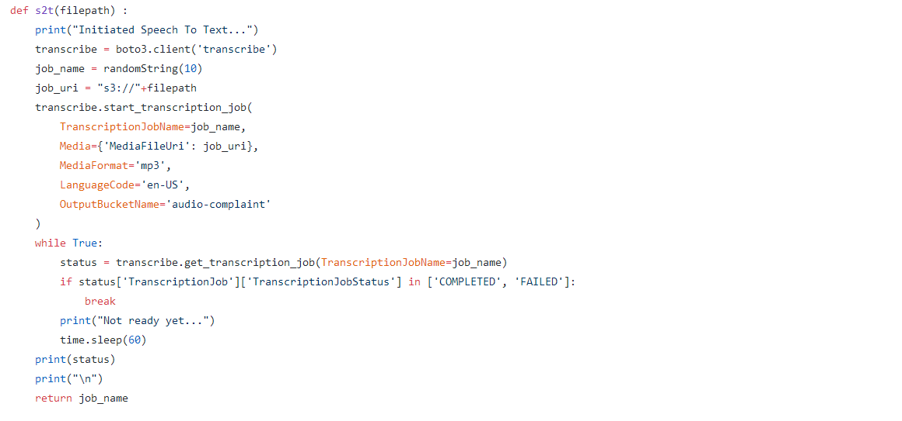
s2t.py

Slide 12
Text Summarization using TextRank algorithm

Slide 13
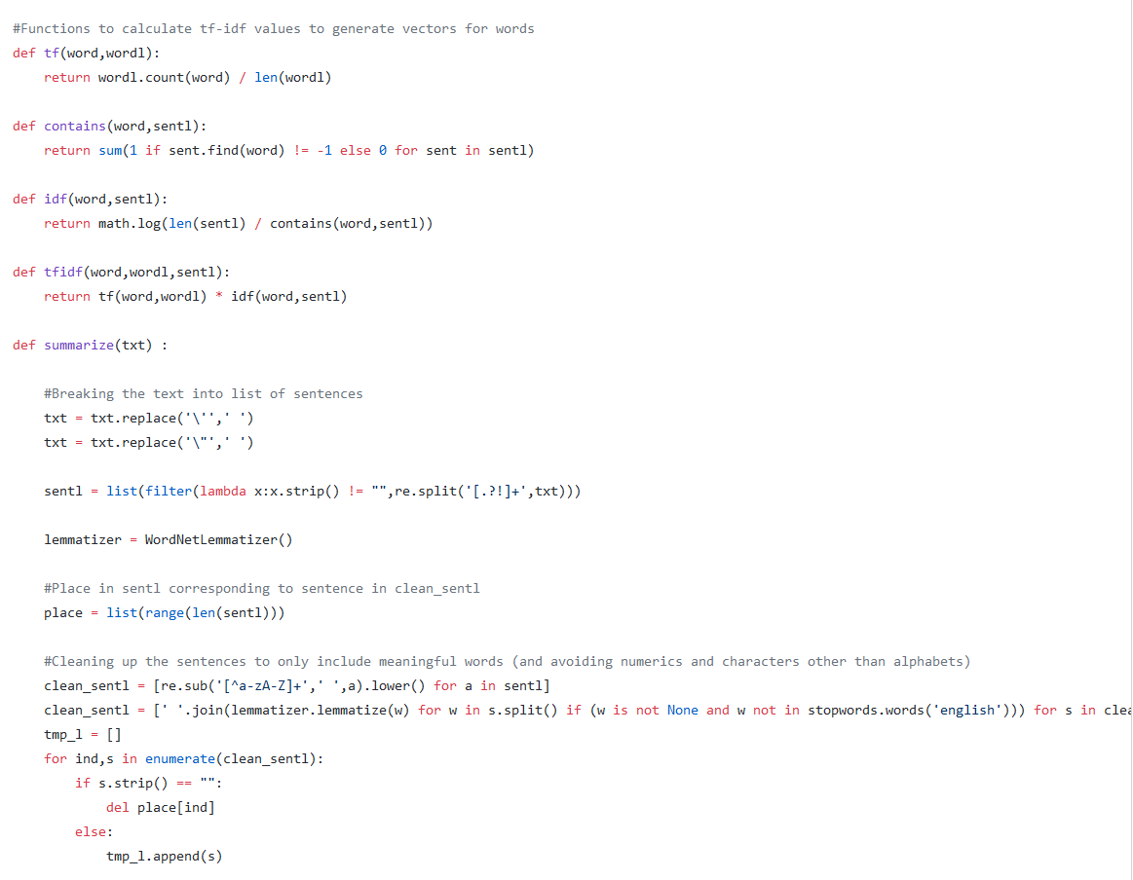
textsummarization.py

Slide 14
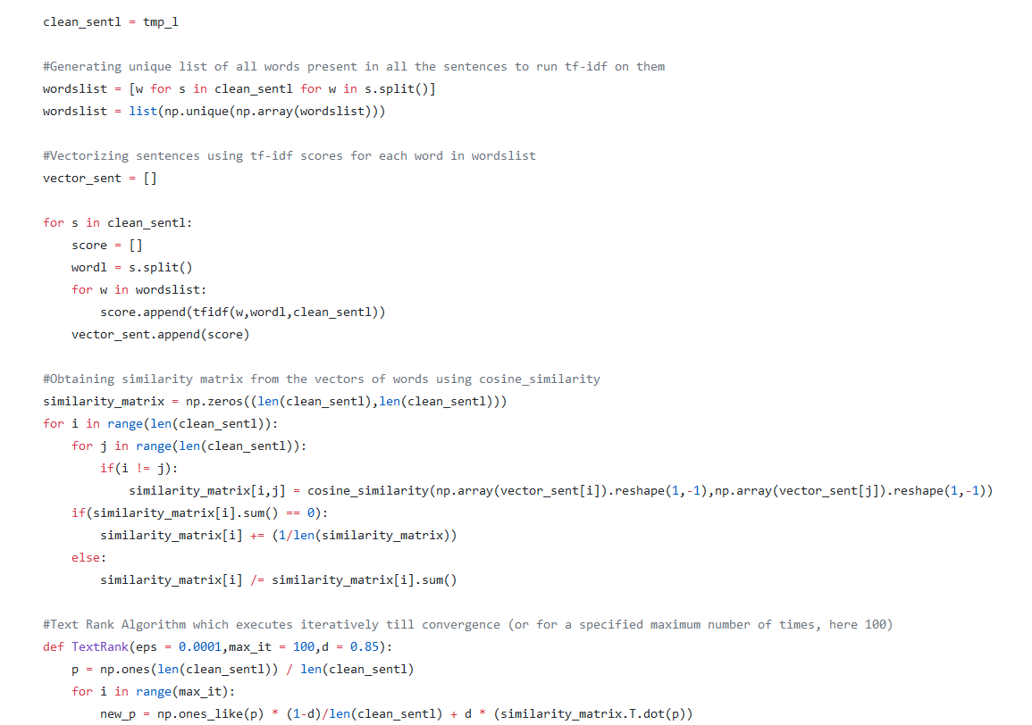
textsummarization.py

Slide 15
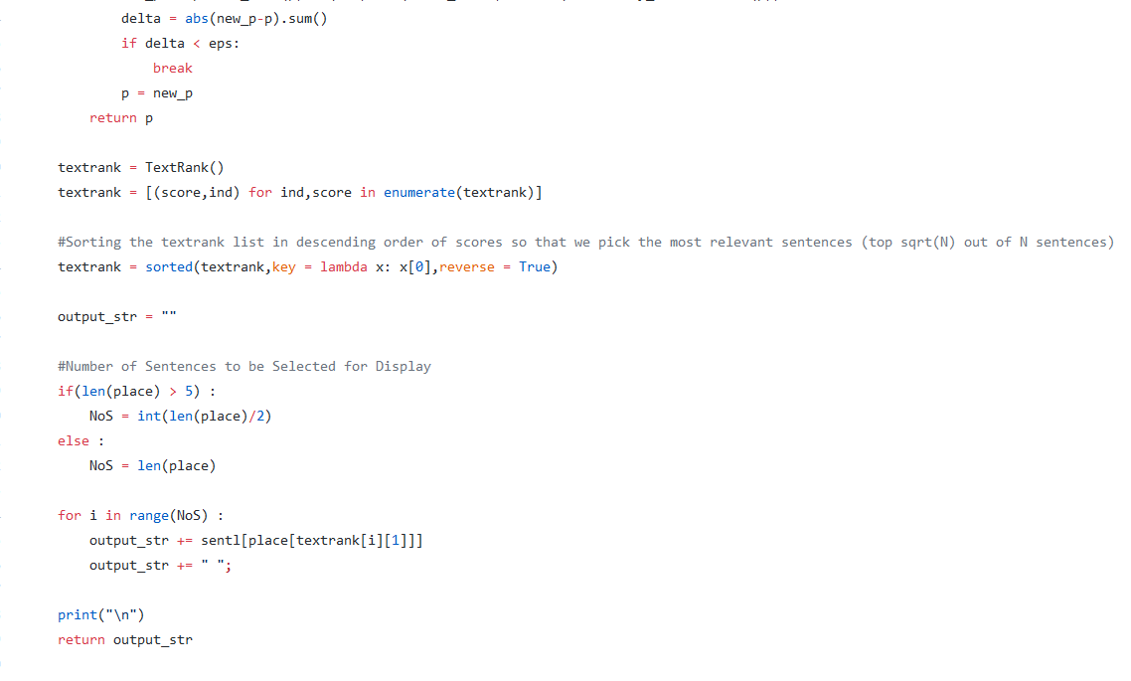
textsummarization.py

Slide 16
Using trained models from AWS Comprehend to extract labels

Slide 17
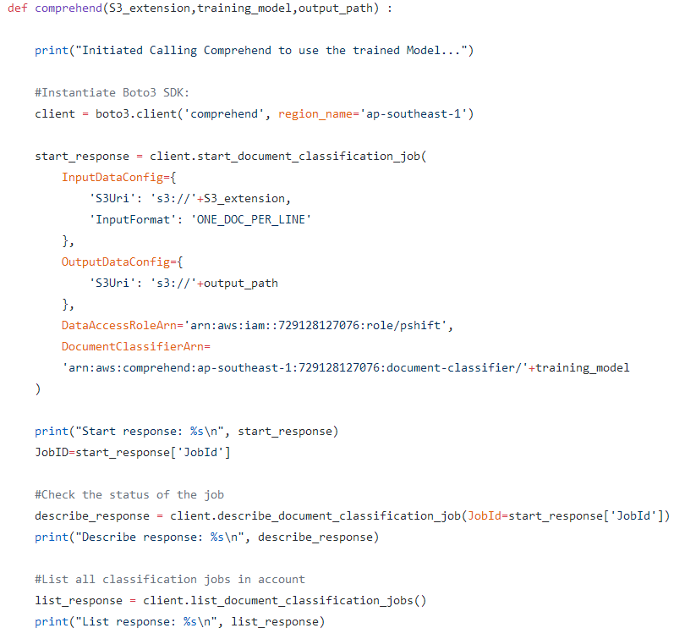
calling_comprehend.py

Slide 18
Finding Matching Account Numbers to the given phone number

Slide 19
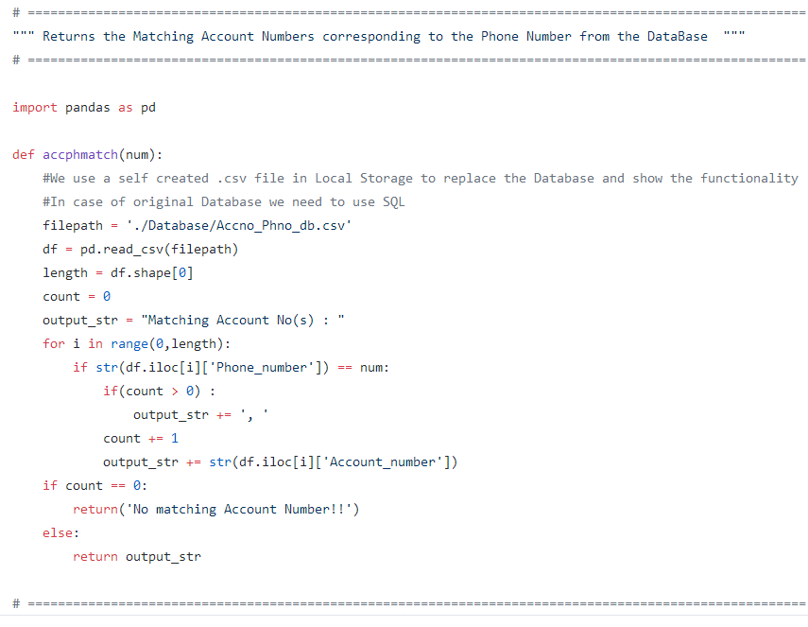
phno_to_accno.py

Slide 20
Utility Functions for uploading, downloading and text processing

Slide 21
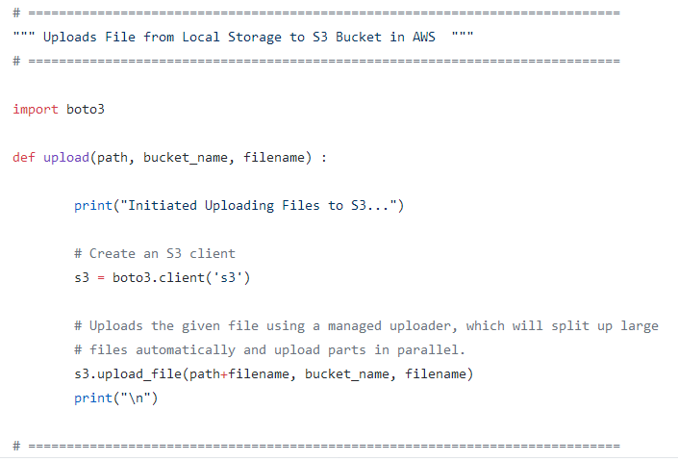
upload_s3.py

Slide 22
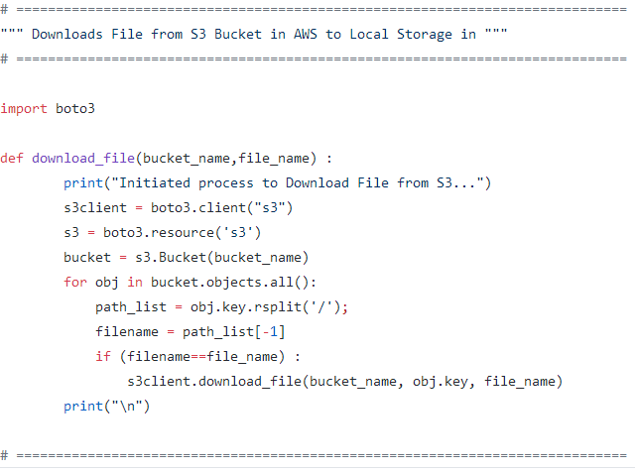
s3_filedownload.py

Slide 23
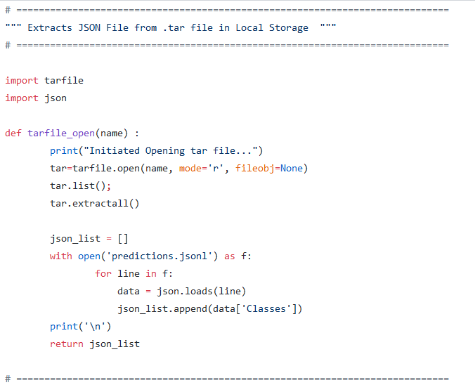
multiple_tarfile_opener.py

Slide 24
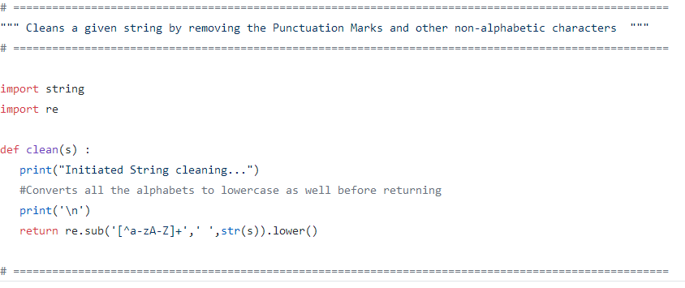
clean_string.py

Slide 25
Main Module which integrates all processes

Slide 26
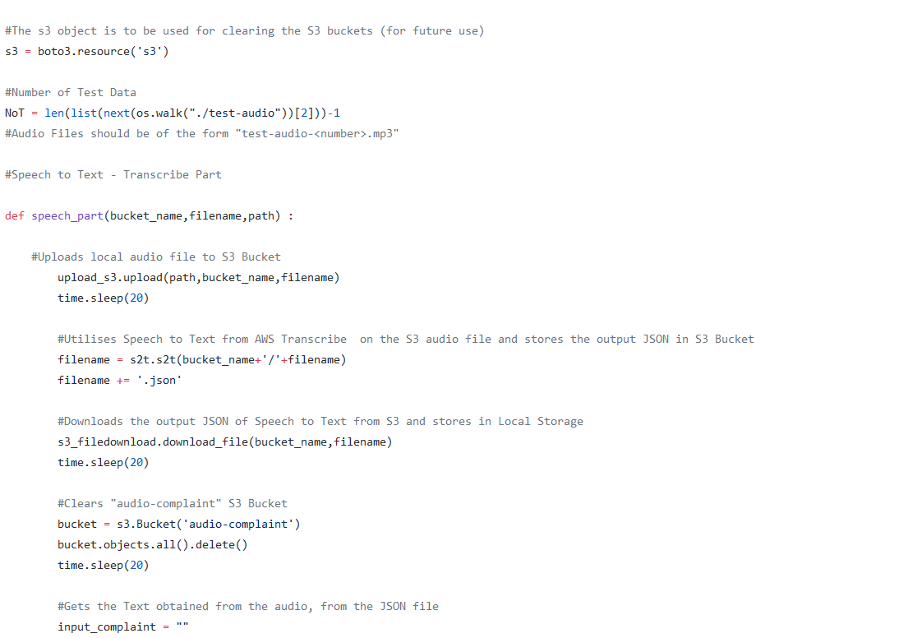
driver.py

Slide 27
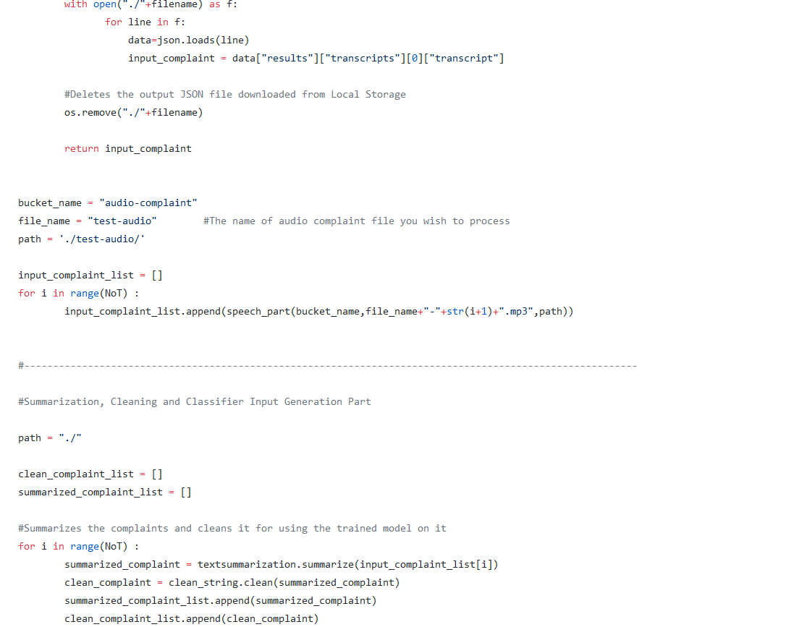
driver.py

Slide 28
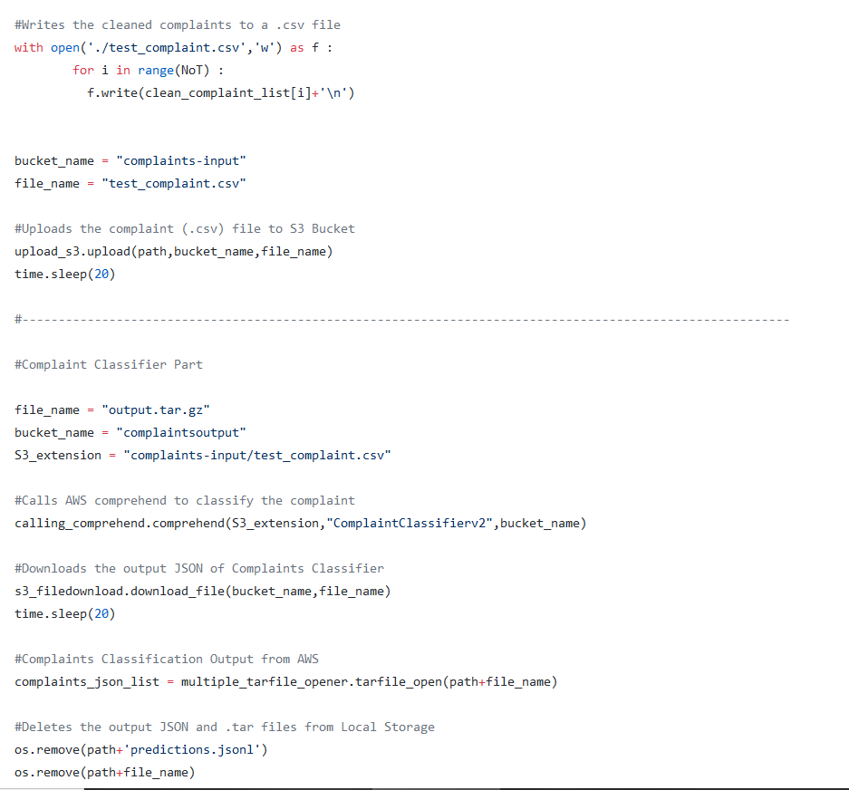
driver.py

Slide 29
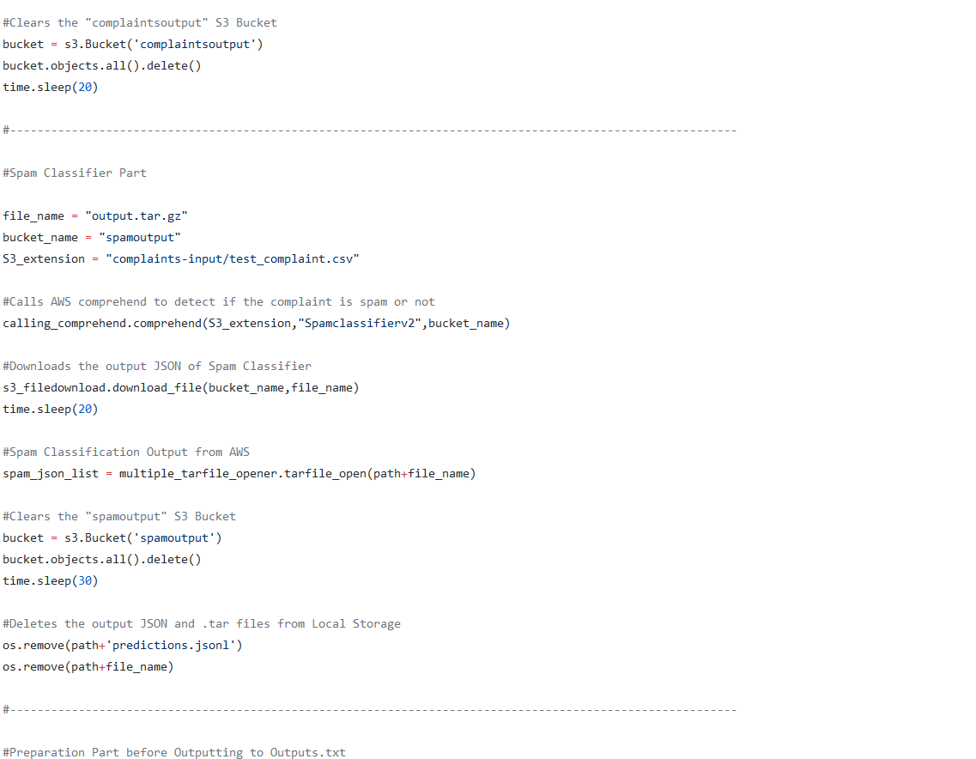
driver.py

Slide 30
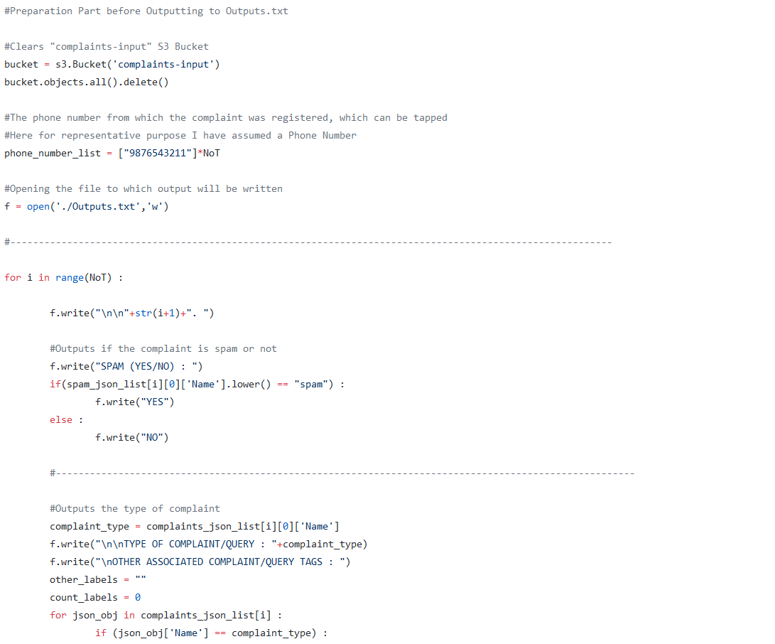
driver.py

Slide 31
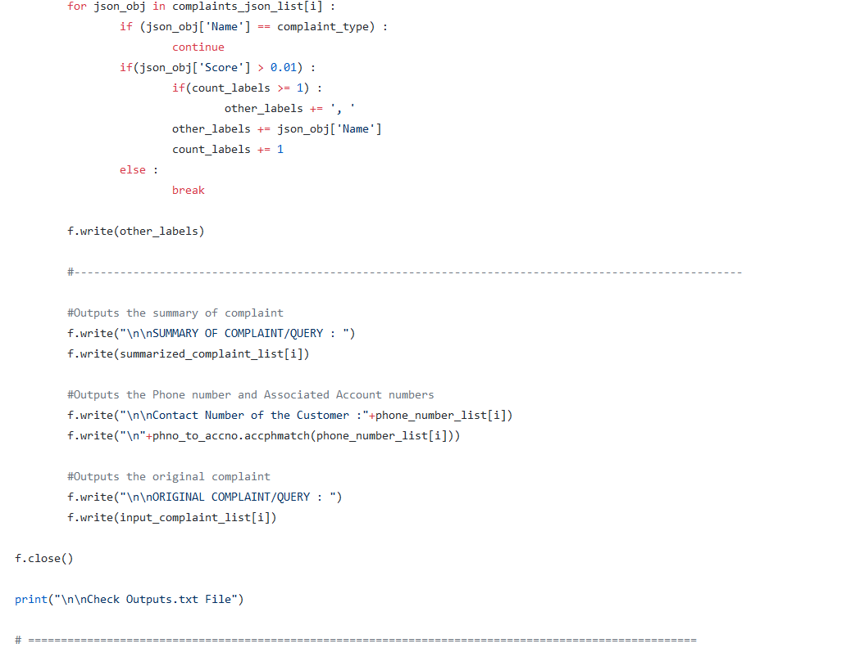
driver.py

Slide 32
Programs to Train Machine Learning Classification Models
CUSTOM CLASSIFIER – COMPLAINT TYPE CLASSIFICATION

Slide 33
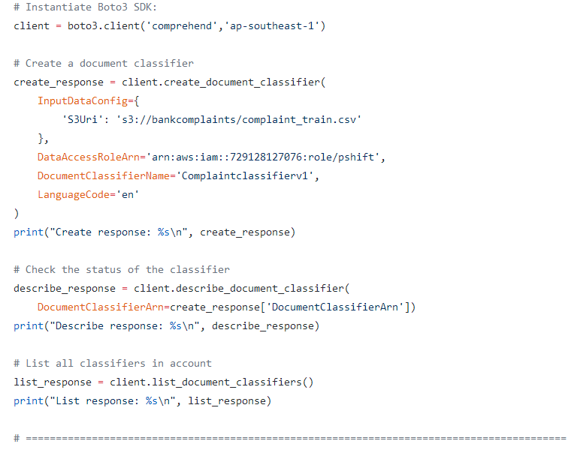
complaintclassifier_train.py

Slide 34
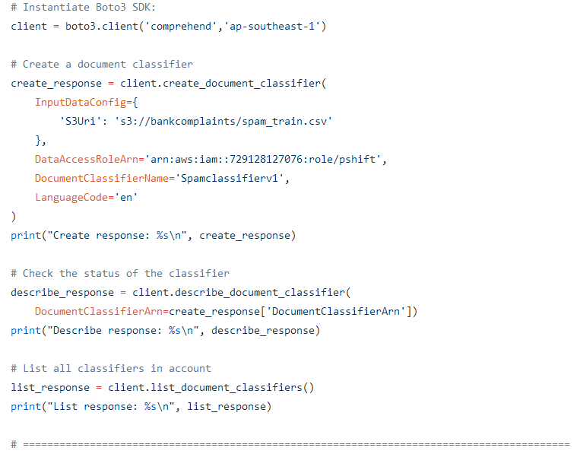
spamclassifier_train.py

Slide 35
TEAM MEMBERS :
S Vishal
Abishek S
Aniswar s krishnan

